Slide 1
Lesson Overview: Subject/phase – KS2/3
  Content
  Objective: to stimulate independent enquiry into the Aberfan disaster of 1966.
  Using VTRs
  Step Inside, Perceive, Care About
  What makes you say that?
  Think, Puzzle, Explore
  Learning behaviours – Resourcing Learning as a springboard into independent enquiry – in particular:
  Noticing and Speculating from limited information
  Sharing ideas and asking questions of others
  Revising their views
  Explaining their thinking to others
  Distilling and linking key ideas
  Undertaking internet research
Here is a dual focused introduction….a content objective alongside the learning behaviours the task will activate in pupils.
Notes:
Rough cut planning.
At this point, before you have thought hard about the outcomes and flow of the lesson, you are jotting down what the lesson will achieve....roughly what you want students to achieve and the learning behaviours they will need to use.

Slide 2

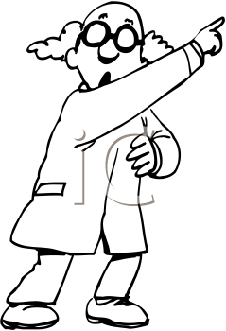

Episode 1, Overview - What might this poem be about?
Teacher talk
Could be . . . .
What else . . . ?
Any other ideas . . .?
Screen image
What might this poem be about ?
Teacher Action
Put students in fours.
Work through the various 5 phases of this Episode 1 over approx 30 mins.
Student Action
30 minutes working with various learning behaviours through the phases of the activity..
Process encourages students to use a wide range of learning behaviours to arrive at a view of what the poem might be about.
Notes:
See the notes online relating to these Episodes for detail on how you might conduct the conversations.
2

Slide 3
Episode 1, phase 1 - What might this poem be about?
Teacher talk
What might it be about?
What makes you ay that?
Screen image
What might this poem be about ?
Teacher Action
Groups of 4
Give each group a different, stanza of the poem (omit stanza #1 at this stage)..
Warn that they only have the stanza for 2 minutes before you take it back.
Student Action
2 minutes to read the stanza and to speculate what it might be about.
Process encourages students to speculate with only partial information. Requires attentive noticing and imagination.
Notes:
See the notes online relating to these Episodes for detail on how you might conduct the conversations.
3

Slide 4
Episode 1, phase 2 - What might this poem be about?
Teacher talk
Any common threads?
What are you trying to discover?
What will you tell others about your stanza?
What questions do you need to ask?
Screen image
What might this poem be about ?
Teacher Action
Give 1 minute warning you will collect the stanza, before they circulate to discuss with others.
Collect the stanzas.
Invite students to circulate around to find out about the other stanzas of the poem..
Student Action
5 minutes to ask others what they have read and what they think the poem is about.
Process encourages distillation of the key aspects of the stanza, to make links between their stanza and those of others, to ask pertinent questions, to listen carefully to answers and ,possibly, revise their views.
Notes:
See the notes online relating to these Episodes for detail on how you might conduct the conversations.
4

Slide 5
Episode 1, phase 3 - What might this poem be about?
Teacher talk
What is your best guess?
What will you be looking for?
What will you do first?
What will you do after that?
How might it start?
Finish
Screen image
What might this poem be about ?
Teacher Action
Orchestrate whole class discussion – what are they thinking the poem might be about?
Gallery ideas without comment..
Give out all stanzas of the poem,
Task is to put them into the right order, but they must first decide, together in 4s, how they intend to tackle the problem.
Student Action
1 minute to contribute speculative ideas.
1 minute to discuss in 4s how they intend to tackle the task
Process encourages students to pool what they have found out, and to think ahead to plan together how they will tackle the problem of ordering the stanzas.
Notes:
See the notes online relating to these Episodes for detail on how you might conduct the conversations.
5

Slide 6
Episode 1, phase 4 - What might this poem be about?
Teacher talk
Did your plan work?
How are you tackling this?
Do you all agree?
Now you can see all the stanzas, what do you think it is about?
Screen image
Putting the poem in the right order
Teacher Action
Give each 4 the poem, cut up in stanzas.
Challenge students to agree an order for the stanzas.
Student Action
5 minutes in 4s to discuss and agree their preferred order..
Process encourages students to make links and see connections, to speculate, to discuss their ideas and explain their thinking to others, and to revise their ideas as a consensus emerges.
Notes:
See the notes online relating to these Episodes for detail on how you might conduct the conversations.
6

Slide 7
Episode 1, phase 5 - What might this poem be about?
Teacher talk
Who got the start right?
What made you think that was the starting stanza?
Ditto finishing stanza.
Are we all agreeing that . . . . ?
Screen image
Where was God that fateful day . .
In the morning hush so cold and stark . .
Where was God the people cried . .
The silence so still like something unreal .
The utter waste of childhood dreams . .
But where was God the people cried.
Teacher Action
Give students the correct order..
Ask, now that they can see the whole poem, what they think it is about.
Compare with gallery of initial ideas from phase 3.
Help students to come to a class view about the poem’s meaning.
Student Action
1 minute to consider whether they prefer their order or the poets, and why.
1 minute to agree what they now think the poem is about.
2 minutes to share ideas across the class.
Process encourages students to share ideas, to build consensus, to explain their thinking and offer evidence to support their view.
Notes:
See the notes online relating to these Episodes for detail on how you might conduct the conversations.
7

Slide 8
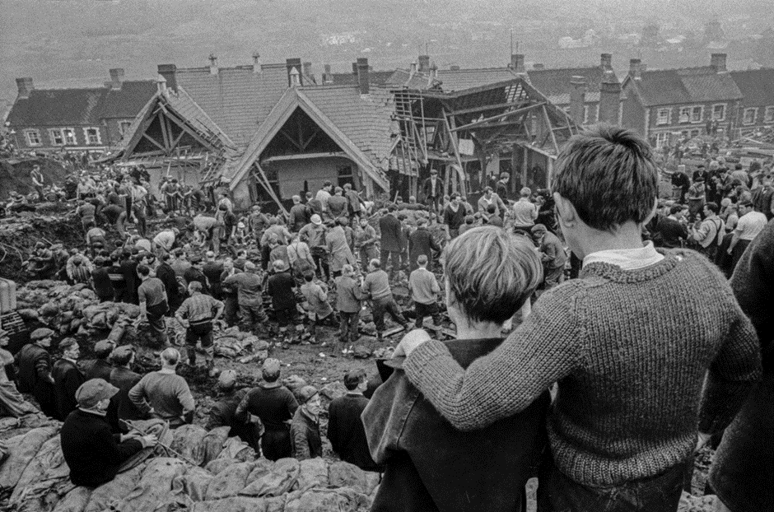
Episode 2 - What are these 2 boys thinking?
Teacher talk
What can they see?
What might they know or believe?
What might they care about?
What makes you say that?
What else might explain . . .?
Which one question would you like to ask them?
What does this remind you of?
Screen image
Teacher Action
Use the Step Inside VTR to help students to explore the image of Aberfan.
Lead discussion using the Teacher Talk box (top right) to structure the conversation.
Ask students to say what they are thinking to talk partner at various points before reverting to whole class discussion.
Student Action
Whole class and pair activity.
5 minutes to explore the image of Aberfan and link it to the poem of Episode 1.
Exploring See, Believe, Care about.
Process encourages students to respond with empathy to the image, to make links to the poem, to notice detail, to speculate and offer evidence and to distil and frame questions.
Notes:
See the notes online relating to these 5 Episodes for detail on how you might conduct the conversations.
8

Slide 9
Episode 3 - What can you find out about the Aberfan disaster?
Teacher talk
See what you can find out?
How could you search for that?
What keyword(s) might help you?
How can you refine your search?
Screen image
What can you find out about the Aberfan disaster?
Teacher Action
Enable students, in 4s, to access the internet to search for information on Aberfan.
Student Action
15 minutes to access the internet to gather information about the Aberfan disaster.
Process encourages students to use their search skills to gather information by asking appropriate questions and pursuing a line of enquiry on the internet.
Notes:
See the notes online relating to these Episodes for detail on how you might conduct the conversations.
9

Slide 10
Episode 4 - What do we know, what is puzzling us, what do we want to find out about?
Teacher talk
What do you think you know about Aberfan?
What questions to you still have?
What is still puzzling you?
How might you go about finding out?
Who will do what?
Screen image
None
Teacher Action
Using Think//Puzzle/Explore, (see teacher talk)
Challenge groups to reflect on:
What they have found out,
What they want to find out,
And how they might do it.
Student Action
5 minutes to respond to the 3 aspects of Think, Puzzle, Explore.
Process encourages students to distil what they already know,, to frame questions about what they still wish to find out, and to consider how they might best go about it.
Notes:
See the notes online relating to these 5 Episodes for detail on how you might conduct the conversations.
10

Slide 11
Episode 5 - Independent Research
Teacher talk
Are you achieving what you set out to do?
Will you complete in time?
How will you tell others about this?
Screen image
None
Teacher Action
Support groups,
Ask probing questions,
Nudge where necessary,
But otherwise lets groups get on with their enquiries..
Student Action
2 hours (?) to undertake the research and plan how they will feedback to other groups..
Process encourages students to undertake independent research, to question reliability / bias, to distil key messages and to build a credible line of argument.
Notes:
See the notes online relating to these 5 Episodes for detail on how you might conduct the conversations.
11

