Slide 1
The Faulkes Telescope:
In Search of a Planet
Planning and Revising
Notes:
Aim: To stretch students’ planning and revising skills.
Resources:
Telescope Planning cards (one set per 4 students)
Planning Format (one per 4 students)
Faulkes Skymaps (one set per 4 students)
Time: For the whole unit, 85 minutes.
This unit will help students exercise their planning skills and learn to cope with fresh challenges that make them change or revise what they set out to do at first.

Slide 2
What’s the use of planning
…and revising?
Mirror, mirror on the wall…
Planning and Revising
7 habits of effective planners
Planning to use the telescope
Revising your point of view
THINK ABOUT WHAT YOU WANT TO GET OUT OF THIS LEARNING
ASSESS WHICH RESOURCES ARE NEEDED
ESTIMATE HOW LONG IT WILL TAKE
PLAN THE STEPS YOU MIGHT TAKE
ANTICIPATE WHAT MIGHT GET IN THE WAY
REVISE PLANS AS YOU GO ALONG
FLEXIBLE IN YOUR LEARNING
MONITOR HOW THINGS ARE GOING
REVIEW YOUR PROGRESS AND CHANGE TACK IF NECESSARY
CHANGE PLANS WHEN YOU’VE A BETTER IDEA
PLANNING
REVISING
Notes:
Use Slide 2 to describe the running order of activities.
Say a little about each if appropriate.

Slide 3
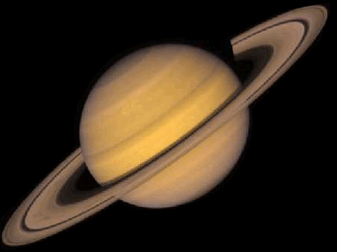

Thinks about how they are learning
Perseveres
Plans
work flexibly
Reflective learner
Asks questions
Understands how others are feeling
Makes changes along the way
Stops and assesses progress
5
Notes:
Use Slide 3 to remind students of previous work do on reflectiveness. Look again at the moon-habits that revolved around the Reflective Planet.
Lead a discussion on ‘Why is being reflective important?’ Points to look for or expect, and perhaps nudge towards (but don’t rush it!), include:
It helps learners distil what they know already,
It causes them to pose questions about what they don’t know or understand and to come up with an outline plan of what they need to do next.
Reflective learners think ahead of action, and therefore save themselves a lot of wasted time and frustration in the future.
The best plans are flexible — that means they are open to review and revision as learning progresses.

Slide 4
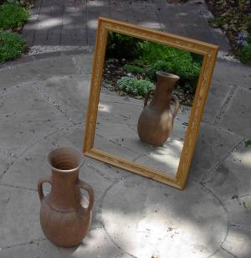
Mirror, mirror on the wall…
Stand a meter apart facing your partner
Decide who is ‘A’ and who is ‘B’
A mimes cleaning my teeth
B mirrors what A does exactly
Now you are going to mirror
Making a pre-cooked meal for an astronaut
How would you do this?
Work out a plan to make your mirroring effective Let A mirror B this time
10
Notes:
Use Slide 4 to introduce the warm-up activity.
Resources: Post-its
Time: For ‘Mirror’ warm-up, 10 minutes.
This warm-up makes students aware of what it is to be reflective and the importance of planning before starting to do something complicated.
Activity 1 (in pairs)
Stand a meter apart facing your partner
Decide who is ‘A’ and who is ‘B’
A mimes ‘cleaning my teeth’
B mirrors what A does exactly
Activity 2
Change places – B ‘mimes’, A mirrors
To make a pre-cooked meal for an astronaut.
Make a plan first – What would you do first, second, third?
– What would you need to be aware of?
– What might get in the way or hamper progress? Etc.
Put the stages of the plan onto Post-its.
Put the plan into action (demonstrate making the pre-cooked meal).
Review in pairs to discuss
What worked, and why, about the plan?
Would you do things in the same order again?
Amend the order of the Post-its if relevant.

Slide 5
7 habits of effective planners
Understand the problem or challenge
Decide what you want to achieve
Decide your success criteria (how you know you have been successful)
Think about what you will need to do
Think about the obstacles that you might meet
Decide what resources you will need
Decide how long it will take and when you will check you are on the right lines
10
Notes:
Use Slide 6 to discuss what effective planners do. What are the seven habits of an effective planner?
Don’t reveal the list at first.
Invite students to brainstorm what is involved in planning
Offer the seven habits of effective planners. Compare students’ ideas with this list:
Understand the problem or challenge.
Decide what you want to achieve.
Decide your success criteria (how you know you have been successful).
Think about what you will need to do.
Think about the obstacles that you might meet.
Decide what resources you will need.
Decide how long it will take and when you will check you are on the right lines.

Slide 6

Planning to use a telescope
You have to make a plan to use a telescope to find and photograph Mars
Resources:
  Planning cards
  Planning format
30
Notes:
Use Slide 7 to introduce the planning exercise.
Groups of four.
Resources: Telescope planning cards (one set per 4 students)
Planning formats (one per group)
Sky maps (three per group)
(The planning cards are divided into information cards, resource cards, decision cards.)
Time: For Planning activity, 30 minutes.
Task: To plan to use a telescope.
Give each group a set of Planning cards and ask them to distribute them equally amongst tem. Tell students there are information cards, resource cards and decision cards.
Group to discuss the cards and what they appear to be telling them. They will need to make several deductions about what they need to do.
Give out the planning sheet.
The group has now to arrange the relevant cards (not all) on the planning sheet (the sheet reflects the seven habits of effective planning).
NB The task is not to know how to use a telescope but to plan what they need to do and find out in order to use it.
Gallery the plans and look at similarities and differences.

Slide 7
Revising your point of view…
What might it be?
Draw the whole object
Think and draw again
10
Notes:
Use Slide 8 to introduce the idea that reflective people are adaptable and flexible, changing their plans as new ideas or information emerges.
Time: For ‘Revising your point of view’, 10 minutes.
Show image 1 and invite pairs to work out what it might be. Ask them to draw the whole object of which this is a part
Show image 2 of the same object and ask them to think and draw again. Indicate how they are revising their point of view and changing their mind.
Show the final image of the complete object.
Other examples like this can be found at:
http://www.theimage.com/closeup/15.htm#top

Slide 8
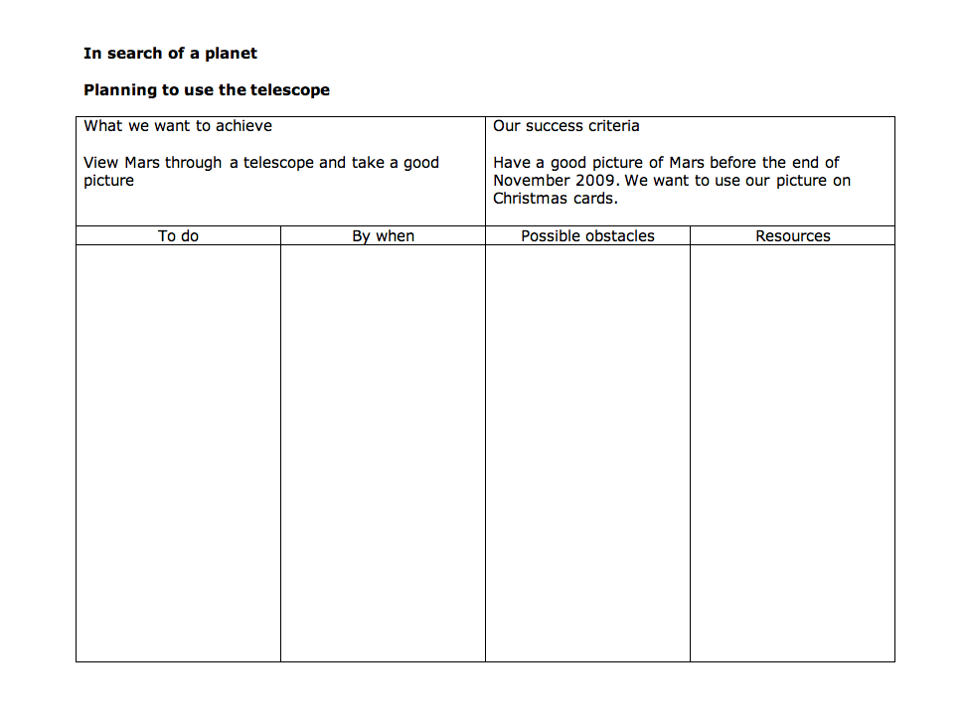
‘The best laid plans…’
No matter how good your planning might be…things change and you need to revise your plans…
What might happen?
5
Notes:
Use Slide 9 to relate revising to their own plans.
Time: For ‘The best laid plans…’, 5 minutes.
Ask students to look at their plan for ‘In Search of a Planet’.
List things that might make them need to change their plans … it pays to think ahead in case you need to revise your plans according to the circumstances at the time.
For example, cloudy night, poor visibility, a comet or asteroid appears and distracts attention, the astronomer has gone on holiday for a week, the telescope is undergoing maintenance, they have calculated the time incorrectly.
Ask how these possible distractions or obstacles would cause them to change their plan.

Slide 9
Taking stock of our learning
What was easy about planning?
Is planning important?
Why is revising a good learning habit?
What do you need to get better at?
Planning and Revising
THINK ABOUT WHAT YOU WANT TO GET OUT OF THIS LEARNING
ASSESS WHICH RESOURCES ARE NEEDED
ESTIMATE HOW LONG IT WILL TAKE
PLAN THE STEPS YOU MIGHT TAKE
ANTICIPATE WHAT MIGHT GET IN THE WAY
REVISE PLANS AS YOU GO ALONG
FLEXIBLE IN YOUR LEARNING
MONITOR HOW THINGS ARE GOING
REVIEW YOUR PROGRESS AND CHANGE TACK IF NECESSARY
CHANGE PLANS WHEN YOU’VE A BETTER IDEA
5
PLANNING
REVISING
8
Notes:
Use Slide 10 to reflect on the session and what they have found out about themselves as planners and revisers.
Time: For formative reflection, 8 minutes.
Explore the following using Think, Pair, Share
What have you found out about planning?
What was easy about planning?
What makes you say that?
What is tricky about planning?
Would you say you were a planner? (At school, at home, with friends.)
What makes you say that?
Is planning important?
What have you fund out about revising?
Would you say you are a reviser?
Why is revising a good learning habit?
Where do you need to use these learning habits?
What do you need to get better at?

