Slide 1
Lesson Overview: Subject/phase – KS2/3
  Content
  To be able to construct a plan for using a telescope
  Using VTRs
  Think Puzzle Explore
  Think Pair Share
  Resources
  Learning behaviours – The lesson engages the following learning behaviours:
  noticing
  reasoning
  collaborating
  planning
  revising
    Telescope Planning cards (one set per 4 students)
    Planning Format (one per 4 students)
    Faulkes Skymaps (one set per 4 students)
Here is a dual focused introduction….a content objective alongside the learning behaviours the task will activate in pupils.
Notes:
Rough cut planning.
At this point, before you have thought hard about the outcomes and flow of the lesson, you are jotting down what the lesson will achieve....roughly what you want students to achieve and the learning behaviours they will need to use.
Aim: To stretch students’ planning and revising skills beyond the levels used in the Induction units.
Resources:
Telescope Planning cards (one set per 4 students)
Planning Format (one per 4 students)
Faulkes Skymaps (one set per 4 students)
Time: For the whole unit, 85 minutes.
This unit will help students exercise their planning skills and learn to cope with fresh challenges that make them change or revise what they set out to do at first.

Slide 2
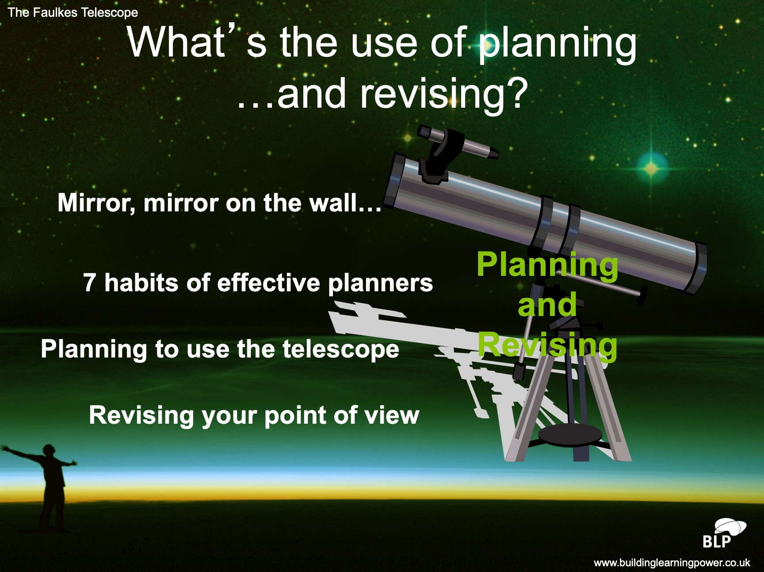

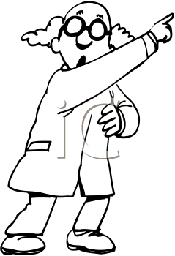

Episode 1 An outline plan for the lesson
Screen image
Teacher talk
We’ll remind ourselves about the meaning of reflection and planning
We’ll then learn how to make a plan for using a telescope.
Teacher Action
Introduce the running order of the lesson
Say a little about each
Encourage questions
Student Action
Listen for rationale
Become aware of learning behaviours to be used
Provoking and supporting the use of listening for purpose and making links with learning behaviours to be used.
Notes:
2

Slide 3
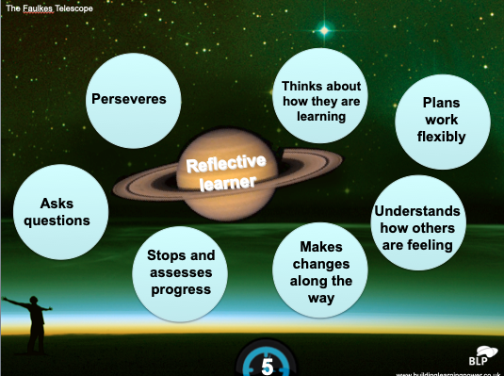
Episode 2 features of managing their own learning
Teacher talk
Why is being a self managing learner important?
What do these statements mean?
What makes you say that?
Screen image
Reflective learners:
Persevere
Think about how they are learning
Ask questions
Plan work flexibly
Stops and assesses progress
Makes changes along the way
Understands how others feel
Teacher Action
Time 5 mins
Reveal the titles on the screen one by one
For each, ask students to record on mini whiteboards what the statements mean.
Lead a discussion about being a manager of their own learning
Student Action
Each student with a whiteboard
Offer a short (no more than 5word) answer to each item shown.
Offer reasons re the importance of managing their own learning.
Provokes and supports the use of reasoning and link making to understand self regulation
Notes:
Use Episode 2 to remind students about what it means to be a strategic/reflective
learner i.e. manage their own learning
Lead a discussion on ‘Why is being strategic/reflective important?’
Points to look for or expect, and perhaps nudge towards (but don’t rush it!), include:
It helps learners distil what they know already,
It causes them to pose questions about what they don’t know or understand and to come up with an outline plan of what they need to do next.
Reflective learners think ahead of action, and therefore save themselves a lot of wasted time and frustration in the future.
The best plans are flexible — that means they are open to review and revision as learning progresses.
3

Slide 4
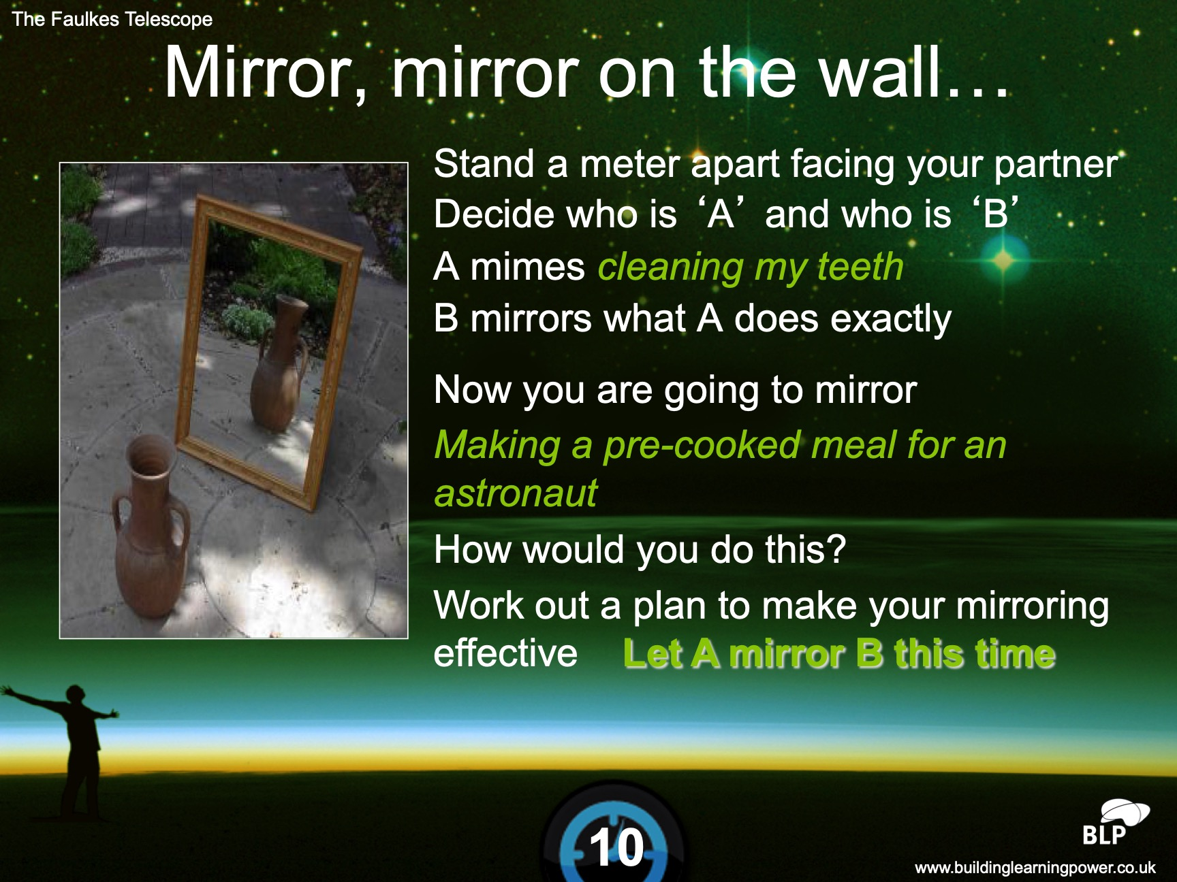
Episode 3 Warm up activity...mirroring
Screen image
Teacher talk
Review what works.
What worked and why in your plan?
Would you do things in this order again?
Amend your Post its order.
Teacher Action
Time 10 mins
Set up pairs
Task 1 Teeth cleaning mirroring
Discuss and change places
Task 2...to make a pre-cooked meal for an astronaut
Give pupils Post its to plan the order of actions needed.
Review in pairs
Student Action
Pairs. A mimes B mirrors
Reverse for 2nd task
Put stages of plan onto Post its
Pairs review their plan
Provokes the use of imitation, planning and imagination.
Notes:
Use Episode 3 to introduce the warm-up activity.
Resources: Post-its
Time: For ‘Mirror’ warm-up, 10 minutes.
This warm-up makes students aware of what it is to be reflective and the importance of planning before starting to do something complicated.
Activity 1 (in pairs)
Stand a meter apart facing your partner
Decide who is ‘A’ and who is ‘B’
A mimes ‘cleaning my teeth’
B mirrors what A does exactly
Activity 2
Change places – B ‘mimes’, A mirrors
To make a pre-cooked meal for an astronaut.
Make a plan first – What would you do first, second, third?
– What would you need to be aware of?
– What might get in the way or hamper progress? Etc.
Put the stages of the plan onto Post-its.
Put the plan into action (demonstrate making the pre-cooked meal).
Review in pairs to discuss
What worked, and why, about the plan?
Would you do things in the same order again?
Amend the order of the Post-its if relevant.
4

Slide 5
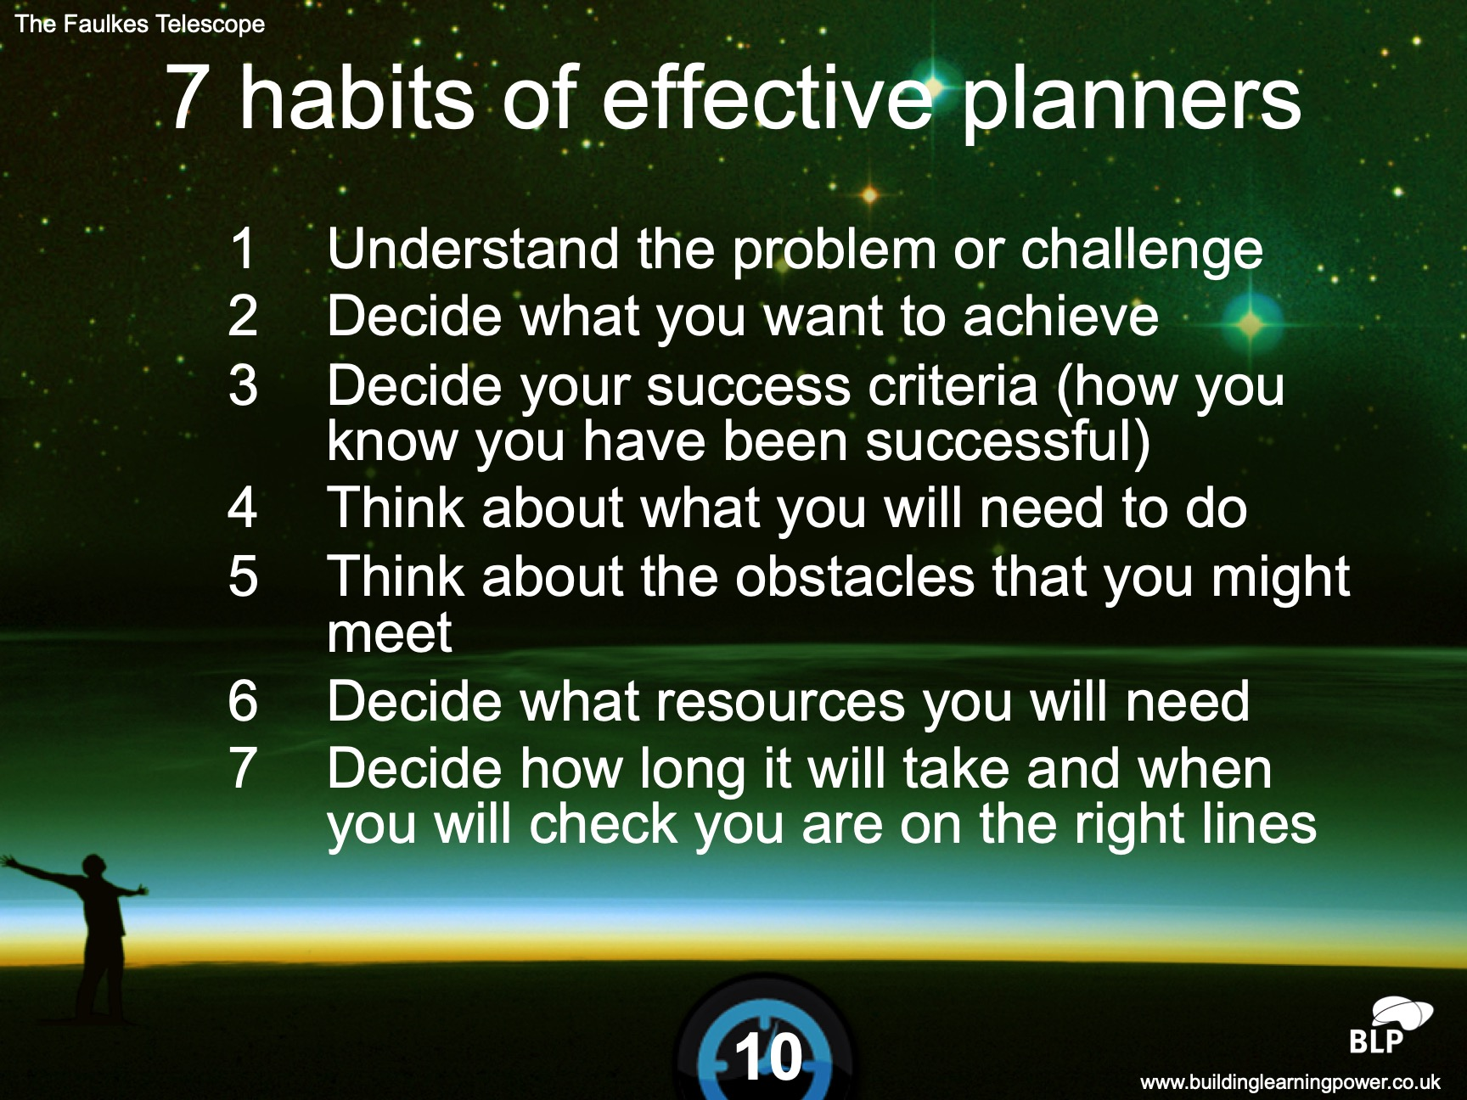
Episode 4 Seven reminders about effective planning
Teacher talk
What is involved with making a plan?
What might you need to think about first?
Is there one best order?
Screen image
Teacher Action
Time 10 mins
Brainstorm question...what is involved with planning?
Record a list of suggestions
Compare with those you now reveal on the whiteboard.
Pairs to order the lists
Student Action
Offering suggestions for the brainstorm
Pairs ordering the list to make sense for planning
Provoking and supporting the use of reasoning and link making to previous activity
Notes:
Use Episode 4 to discuss what effective planners do. What are the seven habits of an effective planner?
Don’t reveal the list at first.
Invite students to brainstorm what is involved in planning
Offer the seven habits of effective planners. Compare students’ ideas with this list:
Understand the problem or challenge.
Decide what you want to achieve.
Decide your success criteria (how you know you have been successful).
Think about what you will need to do.
Think about the obstacles that you might meet.
Decide what resources you will need.
Decide how long it will take and when you will check you are on the right lines.
5

Slide 6
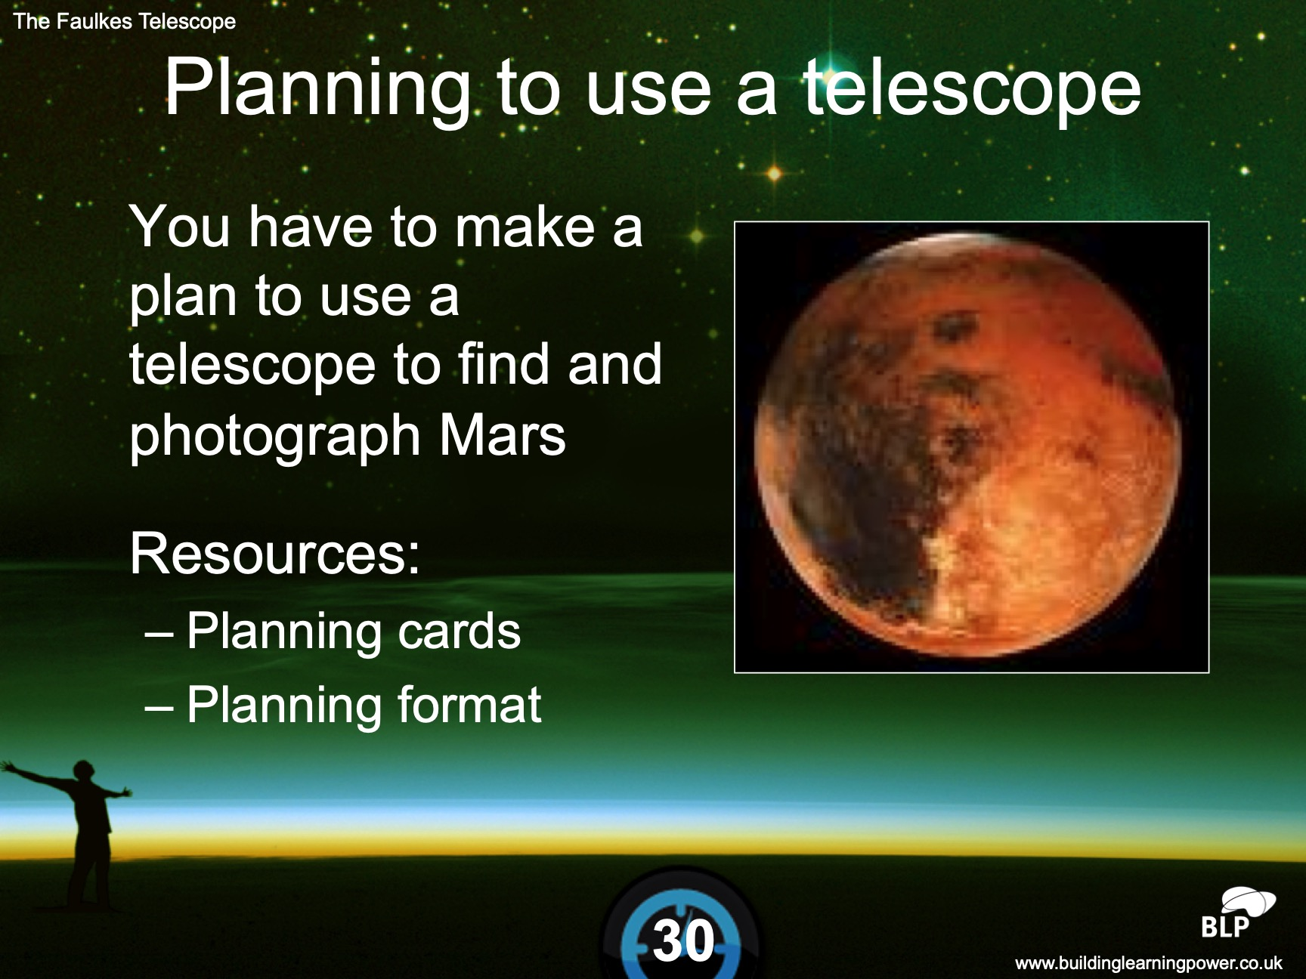
Episode 5 In search of a planet activity
Teacher talk
What do the cards appear to be telling you?
What can you deduce from this?
Where might this go on the planning sheet?
Screen image
Teacher Action
Time 30 mins
Distribute resources to groups of 4
Resources: Planning cards, formats, Sky maps
Distribute planning cards equally
Explain difference in cards
Groups to discuss cards
TASK To plan a search for Mars
Gallery plans, look for similarities and differences
Student Action
Groups of 4
Discuss cards
Sort cards onto the planning sheets
Check for accuracy
Discuss similarities and differences
Provoking a planning mindset using reasoning and linking to previous learning.
Notes:
Use Episode 5 to introduce and undertake the planning exercise.
Groups of four.
Resources: Telescope planning cards (one set per 4 students)
Planning formats (one per group)
Sky maps (three per group)
(The planning cards are divided into information cards, resource cards, decision cards.)
Time: For Planning activity, 30 minutes.
Task: To plan to use a telescope.
Give each group a set of Planning cards and ask them to distribute them equally amongst tem. Tell students there are information cards, resource cards and decision cards.
Group to discuss the cards and what they appear to be telling them. They will need to make several deductions about what they need to do.
Give out the planning sheet.
The group has now to arrange the relevant cards (not all) on the planning sheet (the sheet reflects the seven habits of effective planning).
NB The task is not to know how to use a telescope but to plan what they need to do and find out in order to use it.
Gallery the plans and look at similarities and differences.
.
6

Slide 7
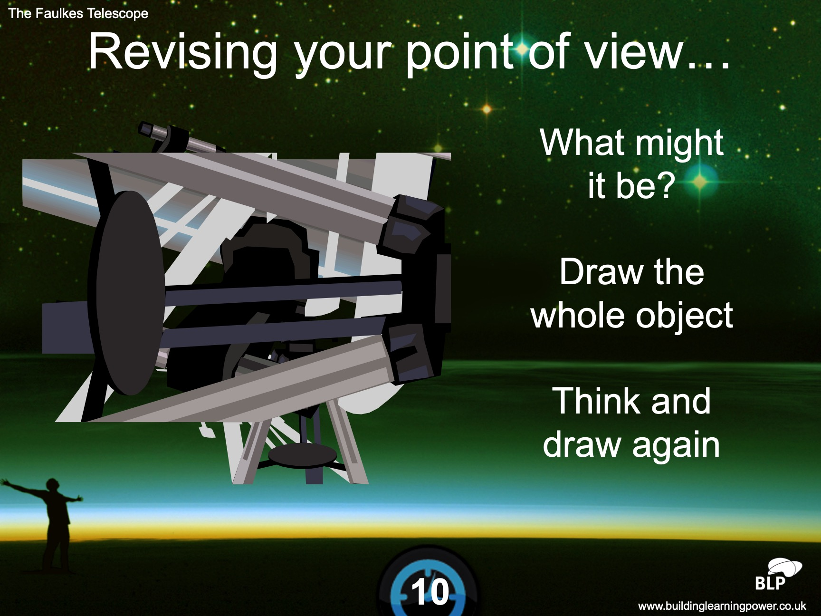
Episode 6 Being adaptable
Teacher talk
What does the image suggest?
What can you see?
What might you imagine
How is your image changing. Why have you changed your mind about that?
How have you changed your drawing?
Screen image
Teacher Action
Time 10 mins
Show image 1. Invite pairs to work out what it might be and draw the object
Show image 2 of same object and ask them to think and draw again
Show final image of complete object
Discuss how their minds are changing and how they are revising their ideas
Student Action
Pairs discuss what object might be and draw it.
Similarly with image 2
Become aware of how their drawing is changing as more of the original is revealed
Provoking the use of noticing, revising and reflective behaviours
Notes:
Use Episode 6 to introduce/reinforce the idea that reflective people are adaptable and flexible, changing their plans as new ideas or information emerges.
Time: For ‘Revising your point of view’, 10 minutes.
Show image 1 and invite pairs to work out what it might be. Ask them to draw the whole object of which this is a part
Show image 2 of the same object and ask them to think and draw again. Indicate how they are revising their point of view and changing their mind.
Show the final image of the complete object.
Other examples like this can be found at:
http://www.theimage.com/closeup/15.htm#top
.
7

Slide 8
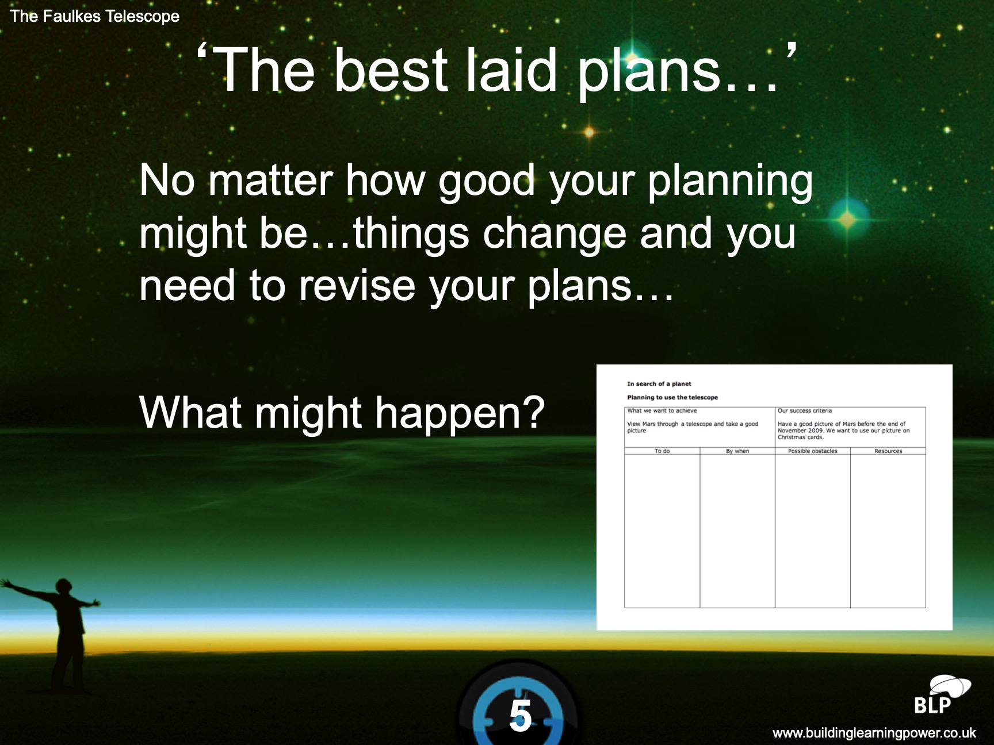
Episode 7. Revising your plans
Teacher talk
What if...it’s a cloudy night? an asteroid appears? The telescope is undergoing maintenance?
Have you calculated the time correctly?
Screen image
Teacher Action
Time 5 mins
Require pupils to re-look at their plans ‘In search of a planet
Invite them to think of things that may cause a need to change their plans
Student Action
Make lists of what might cause them to change their plans.
Make amends to the plan for the most probable suggestions
Provokes the use of reflecting and revising behaviours.
Notes:
Use Episode 7 to relate revising to their own plans.
Time: For ‘The best laid plans…’, 5 minutes.
Ask students to look at their plan for ‘In Search of a Planet’.
List things that might make them need to change their plans … it pays to think ahead in case you need to revise your plans according to the circumstances at the time.
For example, cloudy night, poor visibility, a comet or asteroid appears and distracts attention, the astronomer has gone on holiday for a week, the telescope is undergoing maintenance, they have calculated the time incorrectly.
Ask how these possible distractions or obstacles would cause them to change their plan.
.
8

Slide 9
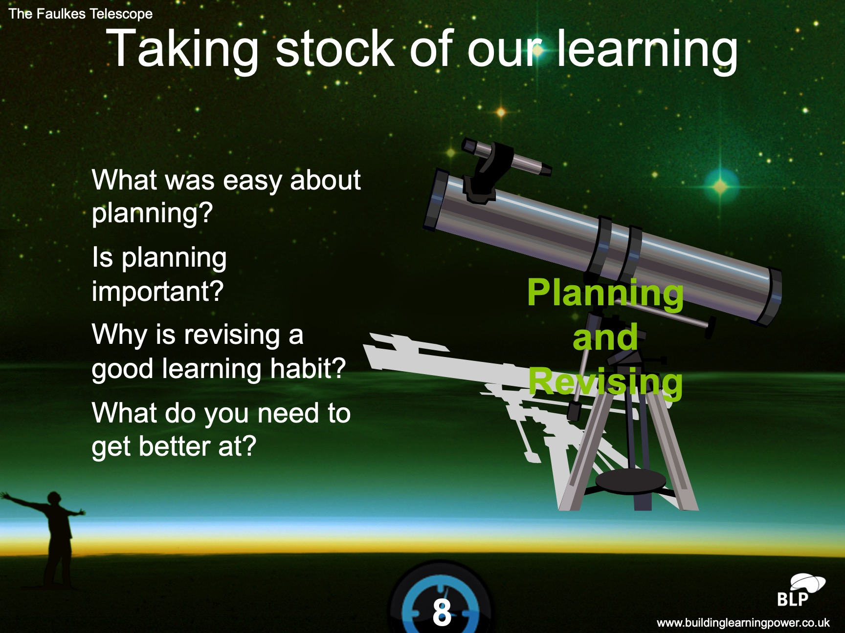
Episode 8 Reflecting on planning
Screen image
Teacher talk
What have you found out about planning?
What was easy about planning?
What makes you say that?
Why is revising important?
What might stop us revising?
Teacher Action
Time 8 mins
Use VTR Think Pair Share
Pose three or 4 key questions re planning and revising
Note down key things emerging from groups
Assist agreement of consensus
Student Action
Pairs
Consider first question alone
share and discuss each other’s answer
Share with larger group
Agree a consensus
Provokes and supports the use of reflective and evaluative behaviours.
Notes:
Use Episode 8 to reflect on the session and what they have found out about themselves as planners and revisers.
Time: For formative reflection, 8 minutes.
Explore the following using Think, Pair, Share
What have you found out about planning?
What was easy about planning?
What makes you say that?
What is tricky about planning?
Would you say you were a planner? (At school, at home, with friends.)
What makes you say that?
Is planning important?
What have you fund out about revising?
Would you say you are a reviser?
Why is revising a good learning habit?
Where do you need to use these learning habits?
What do you need to get better at?
9

