Slide 1
Chalkface. Learning Power. What and why
A learning conversation
Notes:
The threads that link these slides together:
​Learning is Learnable
Some of our beliefs about learning may not be born out by research
Some of our actions may, unintentionally, act against good learning
​
Aim of the discussion: To consider/explore what we believe about learning and what research says about learning
​
Objectives: By the end of the discussion participants will have:
Discussed and considered 6 key issues around learning;
Reflected on what research says about learning;
Considered what this means for classroom practice.
:

Slide 2
A conversation about learning
Provocations
Learning is learnable
To focus on learning might compromise standards
High achievers are generally very good learners
Spoon-feeding gets results
Students become independent learners as they move through their school careers
If we develop ‘growth mindset’ language with our students they’ll become better learners
How
6 groups
1 statement per group
Use PEE
  What’s your point of view?
  What evidence can you cite?
  How would you explain it to others?
  Oh! and what are the implications for teachers?
10 mins discussion in your group
Notes:
Key Points
“Make up your own groups”
Allocate the statements to the groups•
Allow 10 mins for group discussion
Encourage groups to look up evidence if needed
Allow 5 mins for each group answer and your subsequent input
45 mins for whole exercise
Background notes
Starter activity to engage participants, draw out from them and/or develop a shared understanding of the background to the learning agenda, and surface fears and anxieties.
You need to have 6 groups, one each to discuss the 6 statements – this could be in pairs for a small audience, in 5s for a whole school inset etc. Ask each group to discuss their statement, focusing on.
Do they agree with it?
Are there any additions they might wish to make?
Is there any evidence you would wish to cite in support (or against) it?
What are the implications for teachers?
Use responses to begin a conversation about learning.
For each statement there is at least one slide that either summarises the research or provides/provokes further insight. The point is to allay any fears that may be around about L2L and give the group confidence to proceed.

Slide 3
Point | Evidence | Explain
Sum up the main idea | Provide evidence for your point you are making | Why is the quotation significant? What effect does the quotation have on the reader? Why has the writer used this technique?
In my opinion… Arguably… The writer uses… Similarly… Both… In contrast… One of the language features used is… | For example… An example of this is… This is shown… This can be seen… This is demonstrated when… We know this because… The evidence for this is… | This shows… This suggests… This implies… This is effective because… The writer has chosen this technique because.. This would make the reader feel… This has been used because…
(In case you haven’t met it before).
Notes:
Skip slide if teachers already aware of PEE.

Slide 4

1. Evidence shows that Learning is a Learnable craft...
In cognitive science, a revolution has taken place in the way we think of ‘intelligence’. For a while, people believed that it was a fixed-sized dollop of general-purpose mental resource that God or your genes gave you when you were born, whose main effect was to set a ceiling on what you could achieve. We now know that this model is scientifically indefensible, factually incorrect, and educationally pernicious. In fact, there is enormous room for everyone to get smarter by developing their ‘learnacy’.
“I have heard about penicillin, but I have more experience with leeches, so let’s give them a try”
Prof. Guy Claxton
Notes:
Key Points
The key to what we are about
If learning isn’t learn-able BLP is barking up the wrong tree
Allow participants to read quote
click to add Prof. Guy Claxton as author
Prof. Claxton is the cognitive psychologist behind Building Learning Power.
His research through the ELLI project at Bristol University led to the frameworks that we will explore and use.
click to add a humorous throw-away:
Would you go to a GP like this ?
Are we in danger of holding on to teaching strategies that have been superseded by developments in cognitive science and neuroscience ?
Do we organise learning in C19 ways despite C21 understanding of how children learn ?
Background notes
This is key, because if learning is not learnable, BLP is barking up the wrong tree !
Quote from Guy Claxton – Learning is Learnable (and we ought to teach it)

Slide 5

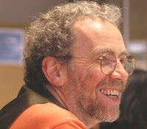
2. Evidence shows that a focus on learning enhances performance. . .
‘The evidence leads to the conclusion that learning about learning is a practically viable and educationally important strategy which also has the effect of improving performance’
‘Performance pressure does not help to improve performance’
‘A focus on learning can enhance performance, whereas a focus on performance (alone) can depress performance. The effects of performance orientation include greater helplessness, reduced help-seeking, less effective strategy use, increased use of ineffective strategies, and a greater focus on grade feedback’
Chris Watkins
Notes:
Key points
When pupils are helped to become more confident and independent as learners, and more articulate about the process of learning, their results go up.
Click to reveal each of 3 statements from research quoted by Chris Watkins - Institute of Education, University of London
Mention other pertinent snippets from this paper if time

Slide 6
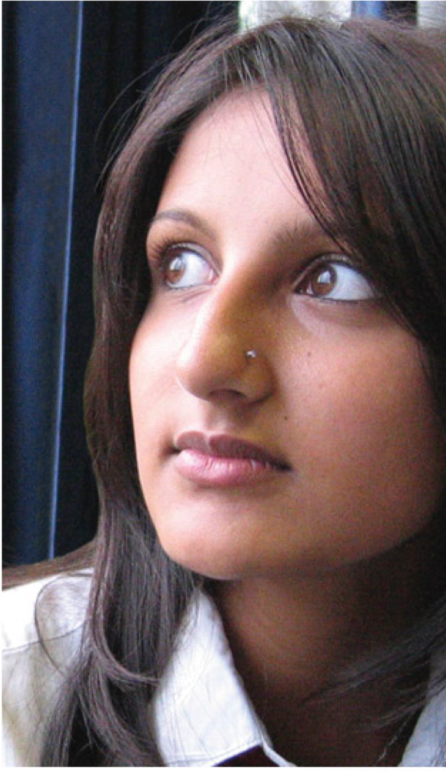
3. Evidence shows high achievers are vulnerable
‘I guess I could call myself smart. I mean I usually get good grades.
Sometimes I worry though, that I’m not equipped to achieve what I want, that I’m just a tape recorder repeating back what I’ve heard.
I worry that once I’m out of school and people don’t keep handing me information with questions...I’ll be lost.’
Emily, aged 15
Notes:
Key points
Give time for participants to read quote
Even the most seemingly assured learners can be vulnerable
Rarely stretched, unused to having to try and fail
The highly successful student who’s first taste of failure is the driving test at 18 . .
Or at University being a relatively small fish in a big pond . . .
Emily may be familiar to you
How does this description resonate with you?
Do you know some Emilys?
Were you an Emily?
Make the point about good students vs good learners
Offer research examples e.g. Dweck
•Allow time to discuss this

Slide 7
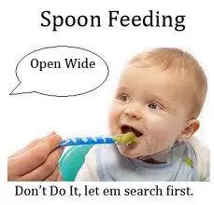
4. Spoon feeding gets results . . . . .
Pedestrian is definitely the word I would use to describe my GCSE English experience. From coursework to prepping for exams, the teachers had an affinity for spoonfeeding. Rather than engaging in class discussions where ideas are exchanged and developed, I and many of my peers passively processed the answers being given to us.
However, as painful as it is to admit, it did result in a successful outcome on results day. The teachers did what they had to do to get us over the line. What they did not do, though, is prepare me for the independence and high level thinking required at A level. Spoonfeeding may have been the answer at GCSE but it certainly isn’t at A level. Teachers must identify a limit to spoonfeeding and students must take it upon themselves to seek independence.
The writer is a Year 12 student in London
Notes:
Key points:
Spoonfeeding may work, in the short term, but is it good for us ?
This is an extract from an article in the TES written by a year 12 A level student in London in 2017.
The full text is given below:
'Being spoonfed at GCSE got me the grades, but has left me behind at A level'
This student explains that she has been left completely unprepared for the independence of study at A level because of the spoon feeding strategies at GCSE
"Does Shakespeare present Othello’s fatal flaw of jealousy as the cause of Desdemona’s death? Or is Desdemona’s naivety a tragic trap that leads to her fatality?" We sit bewildered. So this is A-level English. This wasn't how it was at GCSE. Not at all.
Pedestrian is definitely the word I would use to describe my GCSE English experience. From coursework to prepping for exams, the teachers had an affinity for spoonfeeding. Rather than engaging in class discussions where ideas are exchanged and developed, I and many of my peers passively processed the answers being given to us. This was truly disappointing when the likes of Shakespeare and Andrew Marvell were the topic of discussion – or rather the topic of passive learning.
However, as painful as it is to admit, it did result in a successful outcome on results day. The teachers did what they had to do to get us over the line.
Limited approach
What they did not do, though, is prepare me for the independence and high level thinking required at A level.
I think it’s safe to say that there is a dramatic jump in learning from GCSE to A level – almost as dramatic as one of Shakespeare’s tragedies. As a current A-level English student, I can tell you that the passion and inquisitiveness required to tackle the texts at A level is not something that can be learned over-night.
From the very beginning I was at the bottom of a learning pit, thanks to my lack of confidence and the missing independent thinking I should have been helped to adopt at GCSE. Delving deep and exploring authorial methods from different perspectives in comparative texts such as The Great Gatsby and The Awakening is something that still leaves me frazzled. If that isn’t enough, teacher expectations on homework and reading outside of class are unrealistically high. Spoonfeeding may have been the answer at GCSE but it certainly isn’t at A level.
I fear the next step. What will happen when I reach higher education? University is the epitome of independence. Studying English at university makes it absolutely necessary to hold your own firm view as well as considering counter-arguments. Writing two-thousand word essays will not exactly be a walk in the park if you aren’t completely confident in your own opinion.
Collaborative effort
So how do we solve this long –term problem that seems to be affecting students’ achievement across the country?
Well, we take two-steps back to GCSE and change the style of learning that currently dominates classrooms. The quality of learning can be enhanced by having more engaging discussions, student presentations, group projects and an increase in independent tasks. Personally, I think it is mandatory for a change in teaching and learning to take place immediately. Teachers must identify a limit to spoonfeeding and students must take it upon themselves to seek independence. Meeting in the middle and creating a balance is the only way forward.”
The writer is a Year 12 student in London

Slide 8
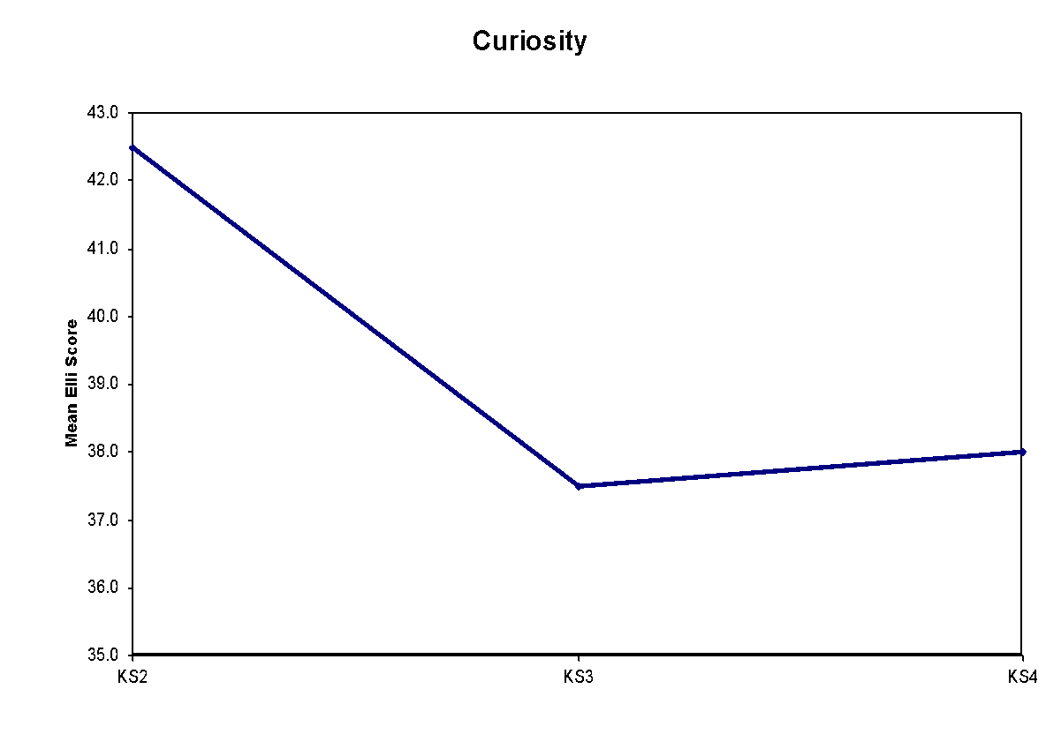
5. Research shows the Learning Power of critical curiosity declines through school
Curiosity drops significantly from KS2 to KS3, and makes a marginal but not significant recovery at KS4.
Notes:
See the notes on ELLI under slide 14

Slide 9
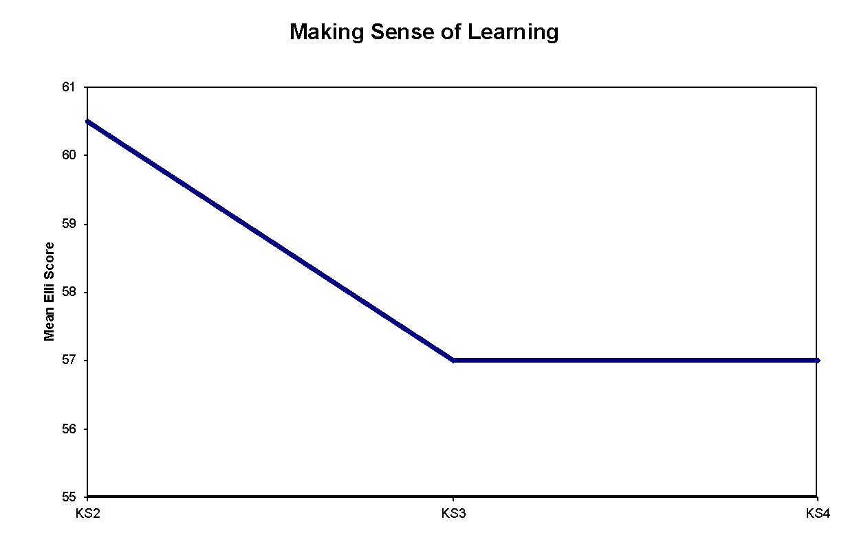
5. Research shows the learning power making meaning declines
The ability to make sense of new learning, to understand how it fits with prior learning, and to transfer new learning into other contexts drops significantly from KS2 to KS3, then stabilises.
Notes:
See the notes on ELLI under slide 14

Slide 10
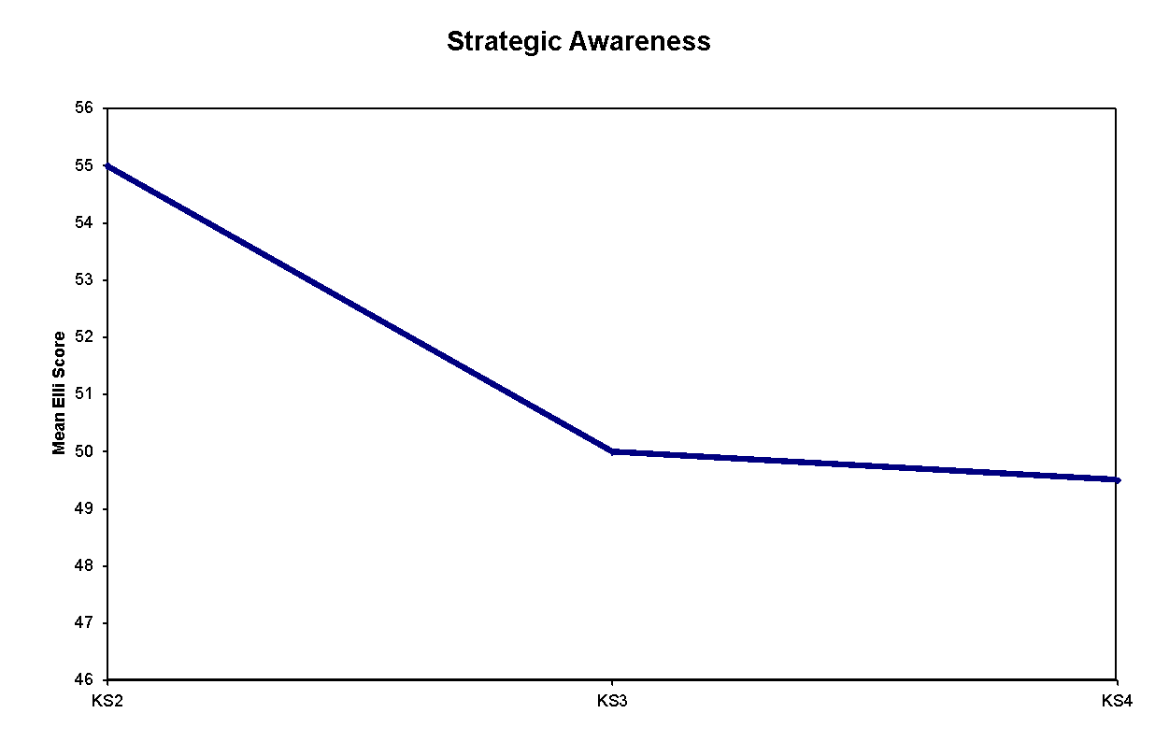
5. Research shows the learning power of strategic awareness declines
Reflectiveness and the ability to be strategically aware of learning drops significantly from KS2 to KS3, and makes a marginal but not significant drop at KS4.
Notes:
See the notes on ELLI under slide 14

Slide 11
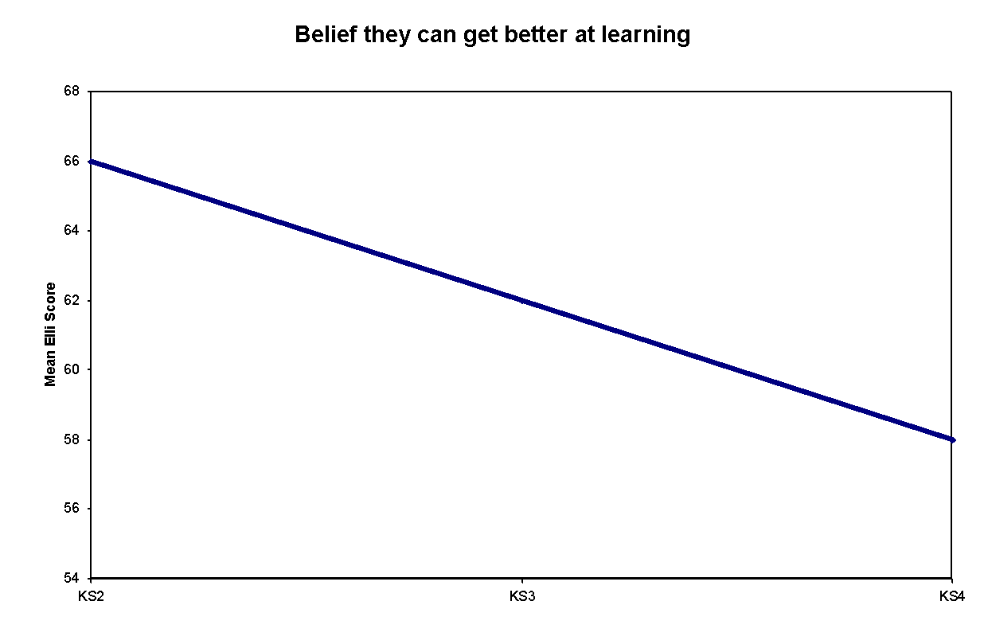
5. Research shows positive beliefs about learning decline
Optimism about their ability to improve as learners drops significantly from KS2 to KS3, and continues to drop significantly from KS3 to KS4.
Notes:
See the notes on ELLI under slide 14

Slide 12
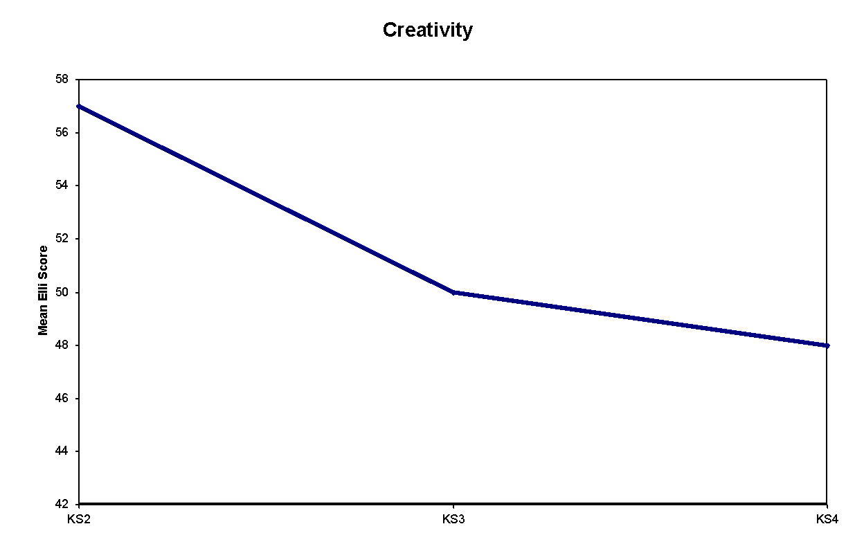
5. Research shows the learning power of creativity drops too
Levels of creativity drop significantly from KS2 to KS3, and continue to drop significantly from KS3 to KS4.
Notes:
See the notes on ELLI under slide 14

Slide 13
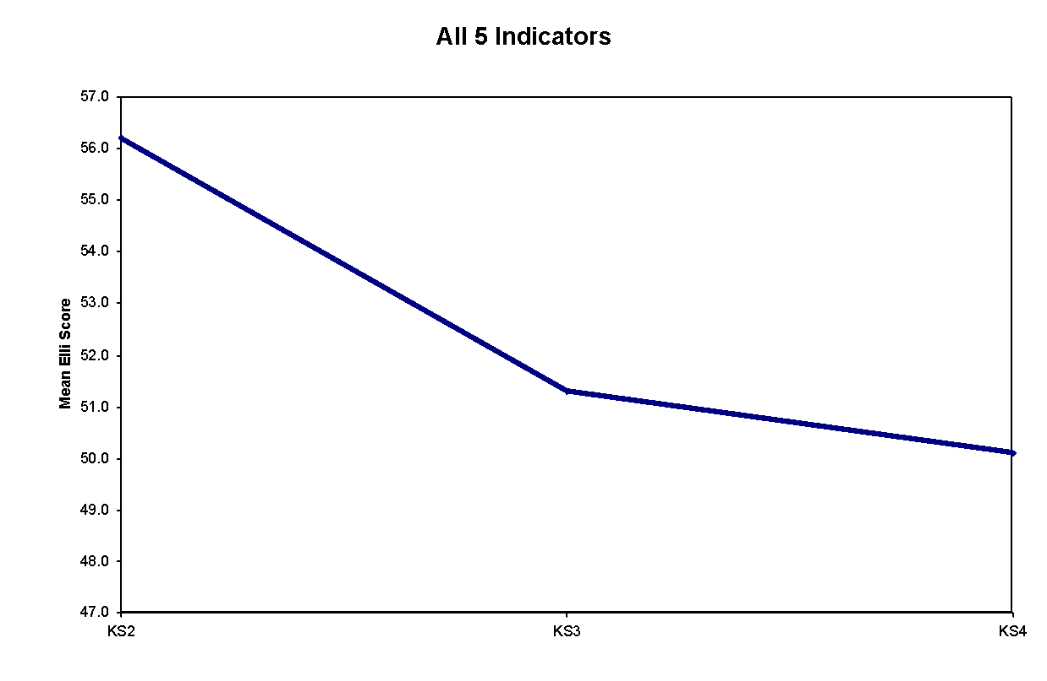
5. Research shows the learning power of resilience falls, and dependency rises
Elli research shows that Fragility and Dependency are the statistical inverse of these five indicators taken together.
Notes:
See the notes on ELLI under slide 14

Slide 14
5. Conclusion: The longer students stay in school the more dependent they become
Hence as these indicators fall, so Fragility and Dependency rises.
Notes:
Key points
• Explain graphs
• ELLI project Uni. Bristol 2004
• Basis of Prof Claxton’s BLP frameworks
• Show many learning capacities falling in use the longer pupils were in school
• Students were becoming more dependent more spoonfed
Background notes
Recent research is broadly showing that the longer students stay in school, the more dependent they become (on self-report, ELLI research)
• Significant drop even though KS2 starting point not very high
• Explain more of research findings of appropriate
Final graph is a composite of several results in the Bristol University ELLI project. The research found that all the key learning dispositions (ELLI have 7 rather than BLP18) were found to be dropping in use from KS2 to KS3 and beyond, the worst casualty being creativity.
The research is based on students’ self-reports.
Guy Claxton was instrumental in starting the ELLI project and much of it was based on his previous thinking. However, the (7 dimensions which are not unpacked further) following a narrower route than BLP.

Slide 15
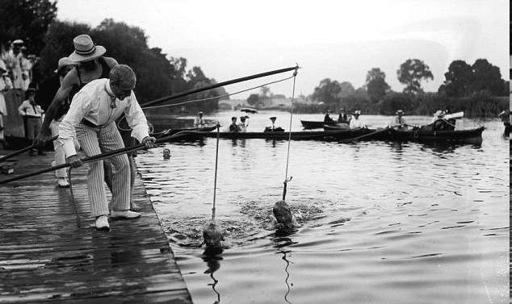
5. Students gain independence
Notes:
Key points
To what extent does this picture evoke ‘schooling today ?
Period? (Edwardian )
Place? (Serpentine, London.)
Children being ‘taught’ to swim.
Presumably at some stage the instructors progressively remove the life jackets and supports and let the children ‘swim free’
How well do we release the learning ‘supports’?
or do we actually tighten them as the exam system bites ?

Slide 16

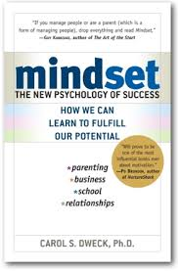

6. Fixed mindset
Born smart or dumb
I prove/believe it
Conservative learning
Hate or expect mistakes or failure
Don’t see point of making an effort
Prepared to blame, cheat to maintain that view
Competitive
Carol Dweck
Notes:
Key points
A quick dip into mindsets thinking
Explain bucket and balloon mindsets
Ask whether they recognise any of these behaviours in their children
Background notes
There is an interesting example of training mindsets on page xx The Learning Powered School
Tell the story if time. Emphasise that these changes began to take place after 3 weeks into the experiment.
The experiment had to be halted. Both groups were treated as growing learners

Slide 17

6 Growth mindset...expandable ability
Get smarter
Can improve
Adventurous
Failure/mistakes useful
Effort pleasurable
Try, open, commit
Collaborative, generous
Carol Dweck
Notes:
How we would like all learners to be.

Slide 18
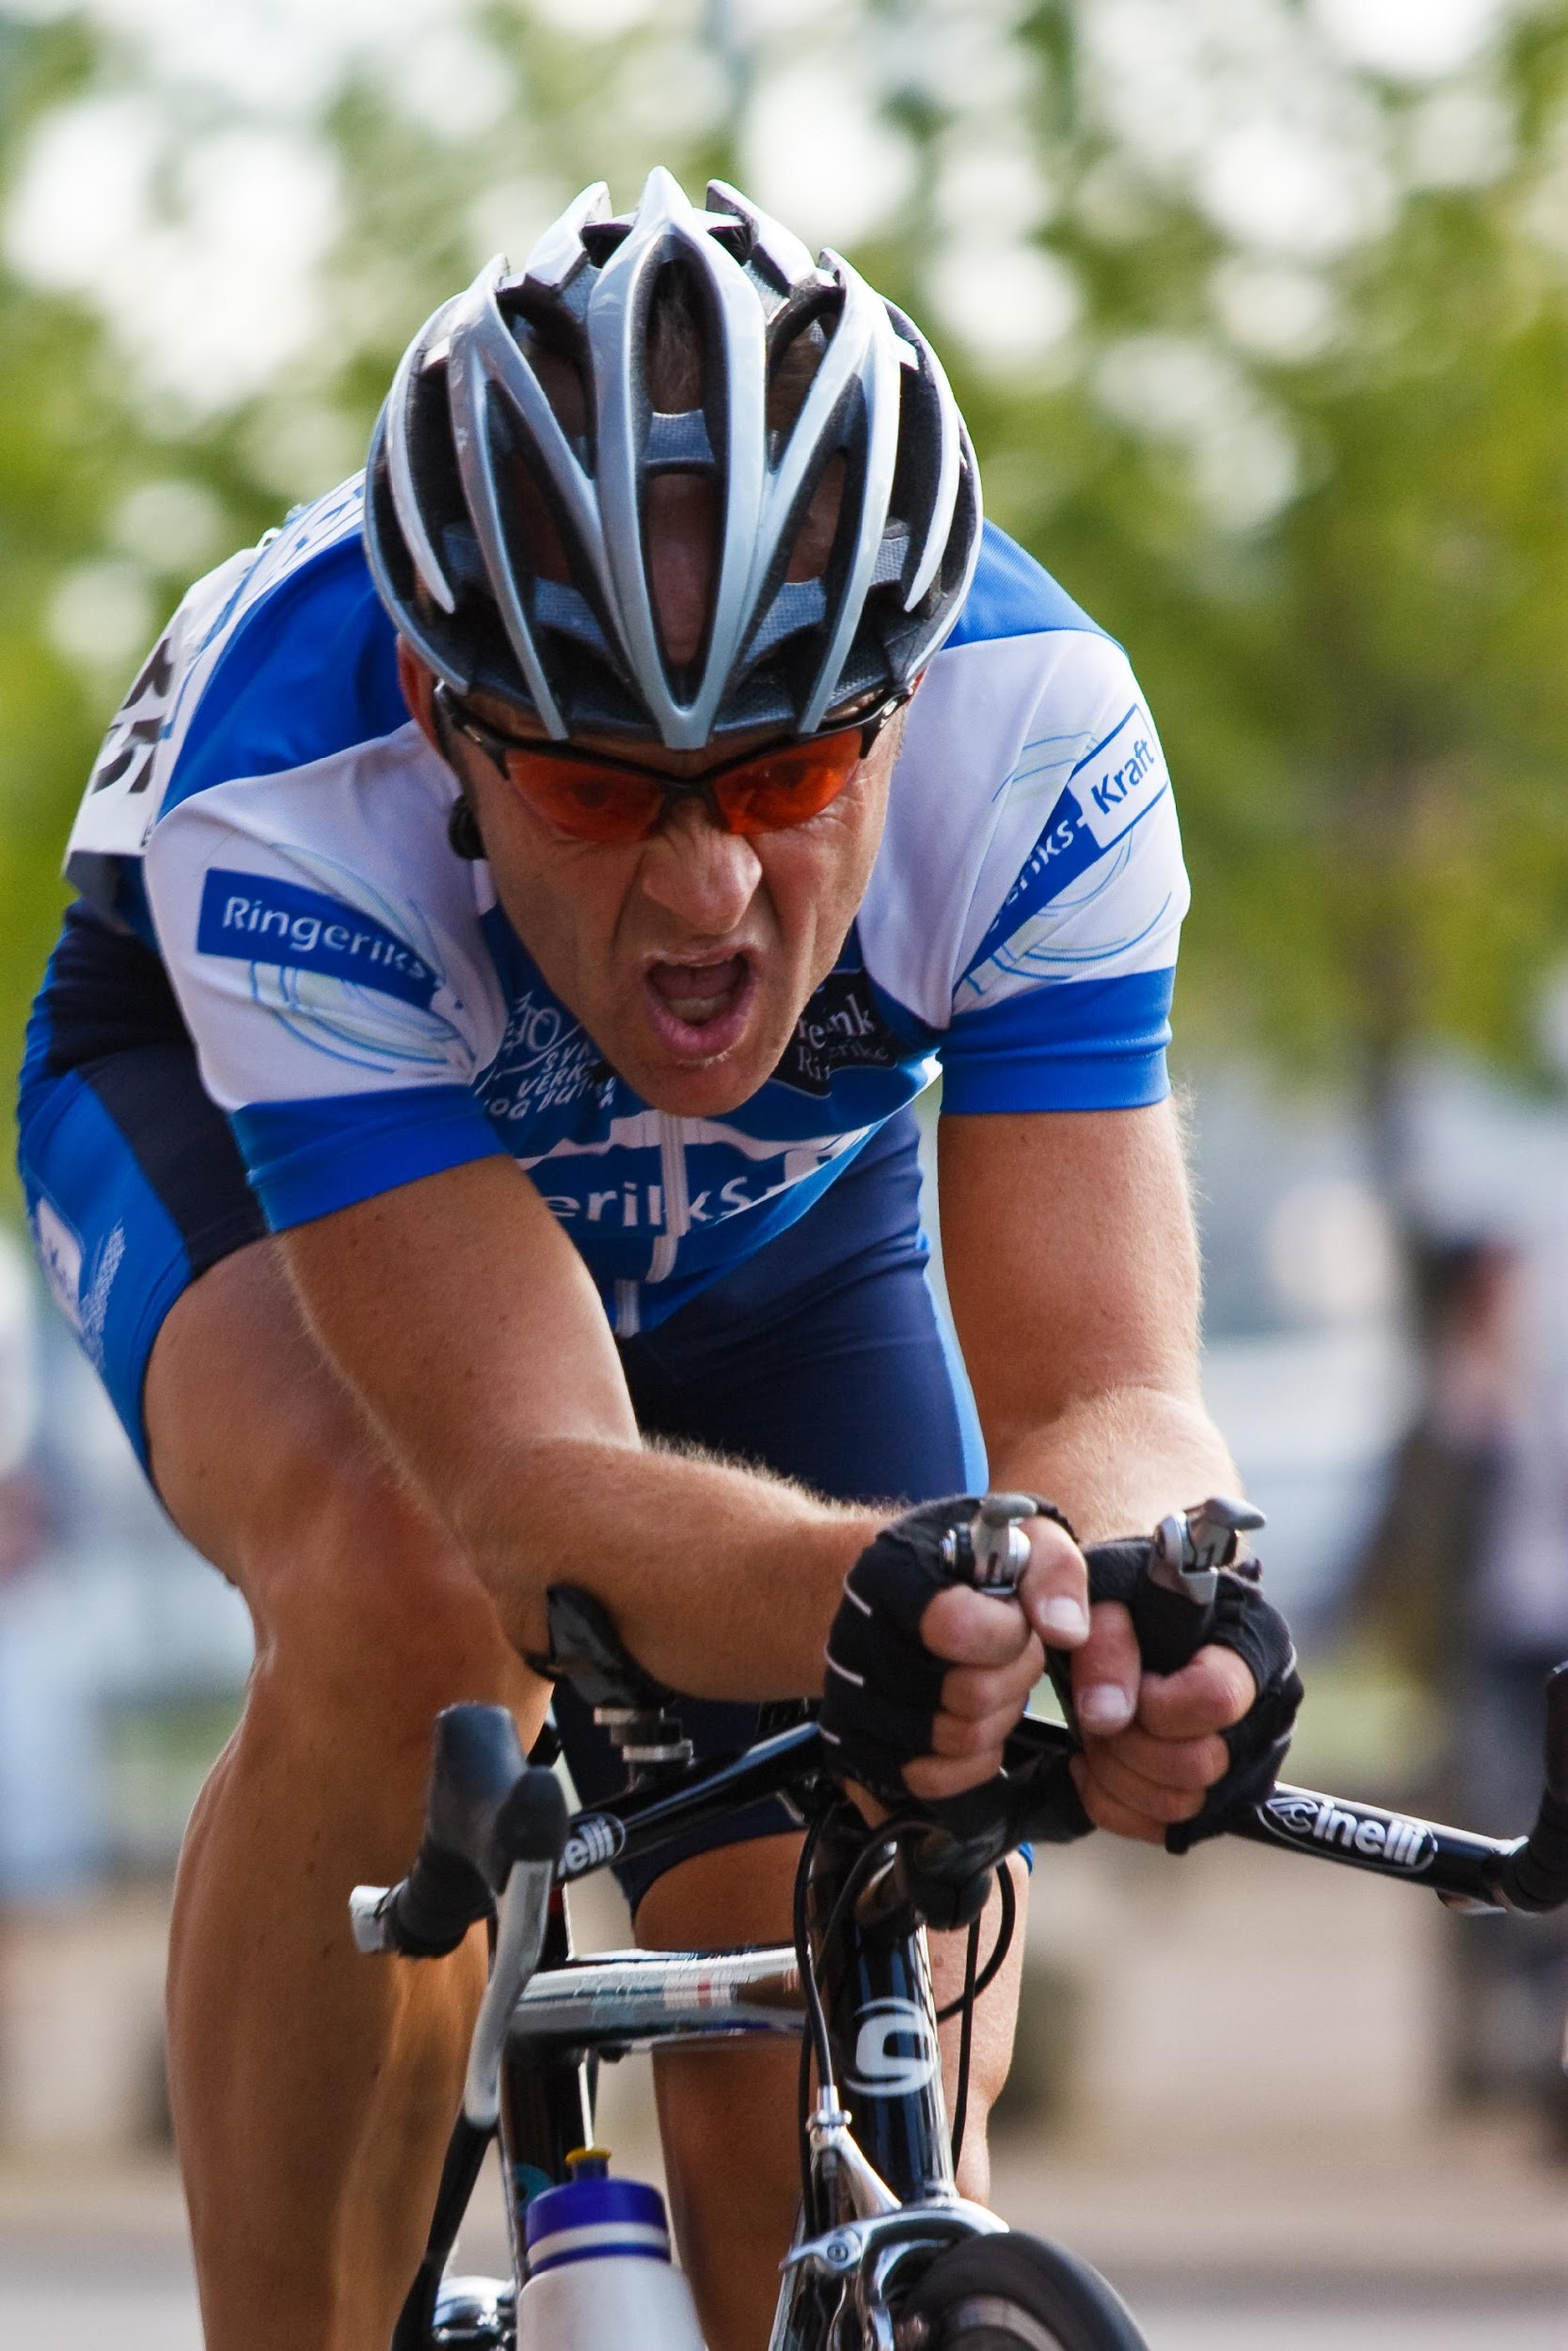
Focus on effort
Born smart
I prove it
Conservative learning
Hate mistakes or failure
Don’t like making an effort
Prepared to blame cheat
Competitive
Get smarter
Can improve
Adventurous
Failure/mistakes useful
Effort pleasurable
Try, open, commit
Collaborative, generous
? %
? %
Notes:
Key points
Ask participants whether they can estimate the sort of % of pupils in each category in their class.
Interesting to see if this changes as the children go through the school. Are there generally more buckets in year 6 than 5 and so on? Why might this be?
Dweck now concerned that her work has been misinterpreted. Not just about having a belief that you can get better. Believing you can get better is an essential first step, but the belief in itself is not enough - you have to be prepared to act on the belief.You need the strategies to do it. Dweck sees BLP as building on her work offering a real way to ‘do it’.

Slide 19
Growth mindset: moving attitudes and beliefs
From
Not good at this
I’m awesome at this
I give up
I can’t get this any better
I just can’t do maths
I made a mistake
I’ll never be smart
It’s good enough
Plan ‘A’ didn’t work
To
What am I missing?
I’m on the right track
I’ll use another strategy
I can improve so I’ll keep going
I can train my brain in maths
Mistakes help me to learn better
I’ll figure out how to do it
Is it really my best try?
There are more I can try.
Notes:
The beliefs that we need to counteract on the left, and the ones we want to encourage on the right.

Slide 20
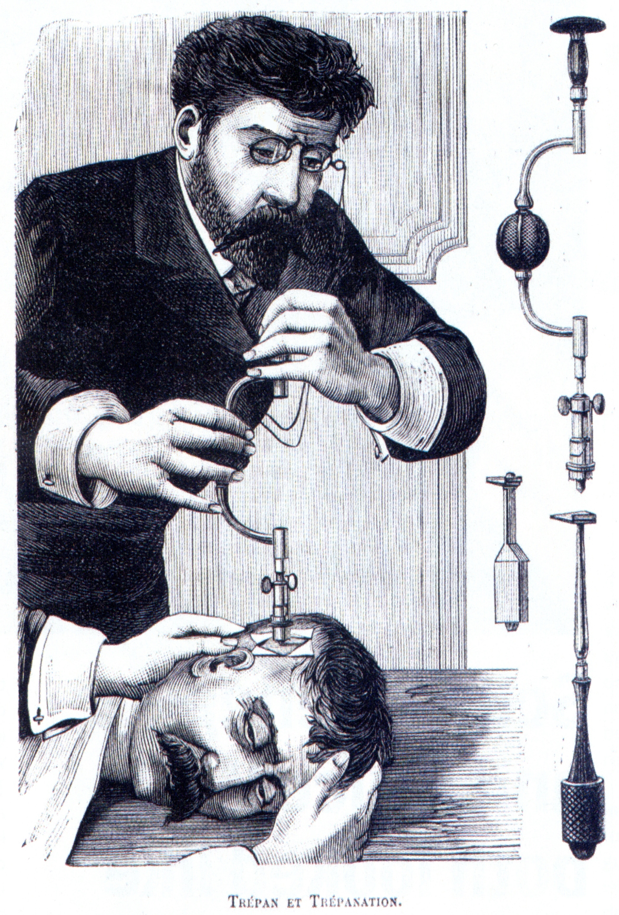
Ideas about learning and your brain
Is Learning Learnable?
Old idea
  intelligence is fixed
Research into the brain
  mind is improvable
Intelligence is
  ‘the sum total of habits of mind’
  Resnick
Habits can be changed and developed
Intelligence is
  ‘knowing what to do when you don’t know what to do’
  Piaget
Getting stuck is the liberating point, when learning begins
Notes:
Key points
Important scene for explaining the research background to BLP.
We now know L2L is possible
New ideas on nature of intelligence
Profession has duty to use these new ideas in teaching
Currently students are spoon fed
Students needs to be prepared for a fast changing world
Background notes
This scene draws together a range of arguments that together make up a convincing case for BLP. It is about shifting the focus from teaching to learning and developing the habits of lifelong learners.
The flow of the argument goes like this:
• Ideas about intelligence have moved on as research into the brain continues at a great pace.
• We know that learning is itself learnable and ideas about intelligence (Resnick/Piaget) confirm this.
• As professionals in the learning business we need to use these ideas (even have a duty to).
• Research into what has been happening in schools suggest that the longer students stay in school the more dependent they are becoming (spoon feeding).
• Students need to be prepared for a lifetime of learning and the skills to deal confidently with whatever life throws at them.

