Slide 1
Chalkface. Learning friendly cultures
What are they?
What do they look,sound and feel like?

Slide 2
How can we build powerful learners?
Connect
Extend
Challenge
VTR
Notes:
The threads that link these 10 slides together:
​Classroom culture is a key aspect in developing effective learning behaviours
Classroom culture has 4 dimensions - the relationships; what is talked about; how learning is constructed; what is celebrated.
‘Good’ teaching does not necessarily foster effective learning habits
​
Aim of the discussion: To consider/explore the importance of classroom culture in creating the conditions within which learning can flourish.
Objectives: By the end of the discussion participants will have:
Considered their existing classroom culture using Culture Tool 1;
Explored the second key model of Building Learning Power - the Teachers’ Palette;
Explored the nature of a Learning Focused classroom culture using Culture Tool 2;
Discussed the teacher’s contribution to creating learning focused classrooms.

Slide 3


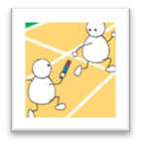

Teaching: poles apart
Subject content explained plus hints and tips for exams. |  |  |  |  |  |  |  | Learning capacities explained discussed and trained. Become a learning coach
|_____________|_____________|_____________|_____________| Relating
Busy activities. Learning content driven. Display best products. Spoon feeding. Heavy scaffolding. |  |  |  |  |  |  | Activities and environment arranged to surface and develop learning habits. Less scaffolding.
|_____________|_____________|_____________|_____________| Constructing
Mark regularly with supportive comments about subject. |  |  |  |  | Continual comment (talk and written) to nudge progression in learning power. Learning language developed.
|_____________|_____________|_____________|_____________| Talking
Secure in curriculum knowledge. Try not to show vulnerability. |  |  |  |  |  | Model being a learner too – trying things out, making mistakes, getting stuck.
|_____________|_____________|_____________|_____________| Celebrating
Notes:
The Key message(s): ​
​
How teachers behave impacts on how students are as learners​
​
Detail:​
Another Poles apart diagram, this time looking at teaching behaviours. In the left hand column, competent teaching behaviours that focus on the efficient delivery of curriculum content, and in the right hand column the teaching behaviours of the teacher who is delivering curriculum content and, at the same time, building better learners.​
​
Key Points​
This slide suggests the change teachers need to make.​
The left side depicts a perfectly good enough teacher but there is still a gap between how a good teacher works, where their emphasis lies, and the learning coach type teacher that developing learning power demands​
Use this slide to orchestrate a discussion about the shift needed.​
​
Note that the 4 dimensions are Relating, Constructing, Talking and Celebrating. These are the dimensions that are picked up later in the Teachers’ Palette and the culture diagram.​

Slide 4
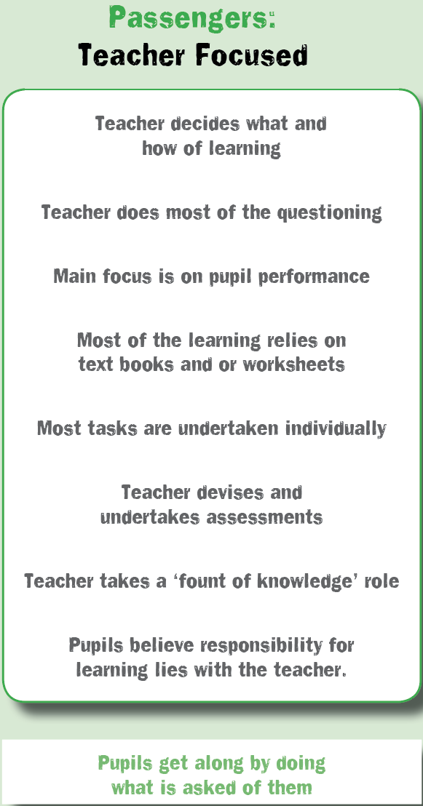
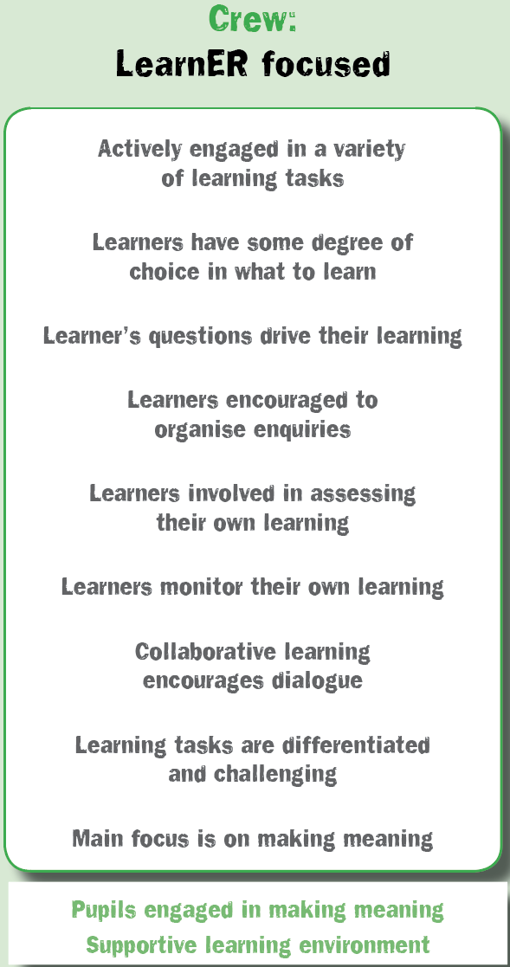
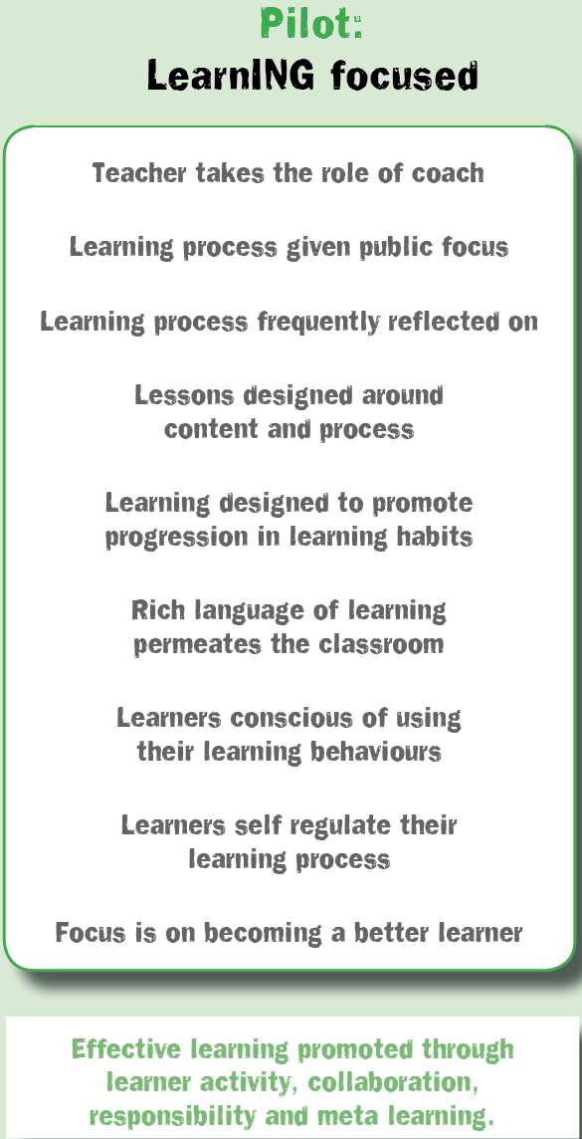
Classroom cultures
What is your’s like?
Notes:
The Key message(s): ​
​
There are three different types of classroom culture.
​
Detail:​
This is the first of two Culture tools.
​
Key Points​
Classrooms tend to be either teacher focused, learner focused or learning focused.
.

Slide 5
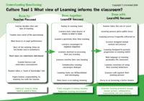
The journey of classroom cultures
Time to reflect on the culture of your classrooms ….
Highlight all aspects of culture that are a regular feature in your classroom.
Chat to your neighbour
What is this telling you?
Notes:
The Key message(s): ​
​
There are three different types of classroom culture.
​
Detail:​
Self reflection activity - where is your classroom culture now?
​
Key Points​
Tick/highlight all aspects that you consider to be a regular feature in your classroom.
Try to avoid suggesting that teacher focused is bad and learning focused is good. Surely there are some aspects of teacher focused that will be present in all classrooms, to a greater or lesser extent, no matter how learner/learning focused?
This model, the Culture Tool 1, is rooted in the work of Chris Watkins of the London Institute. He argues that it is not possible for a classroom to become learning focused unless there are a good number of learner focused features already in place. In other words, classroom culture cannot jump from ‘panel 1’ to ‘panel 3’ without first developing ‘panel 2’ characteristics. The key differences, he argues, between panels 1 and 2 are that in panel 2 learners are more active participators, learning becomes an increasingly shared responsibility, and collaborative learning is in greater evidence.
Experience tells us that classroom culture frequently becomes more like panel 1 as examinations loom into view. Early years practitioners frequently describe a learning focused culture to us, but worryingly this seems to evaporate in the face of ‘schooling’..

Slide 6
The journey of classroom cultures
Share your highlighting with others
Similarities / differences?
Identify at least one thing you might fancy building into your classroom cultures
How might you do this?
Notes:
The Key message(s): ​
​
There are already examples of learner focused and learning focused practice in school that I could emulate
​
Detail:​
What does your colleague already do in panel 2 or panel 3 that you might like to try?
[​If your culture is predominantly panel 1, look for panel 2 ideas. If it is mostly panel 2, look for panel 3 ideas.]
​
Key Points​
We already have examples of learner and learning focused activities in our school;
How can we share best practice more widely?

Slide 7
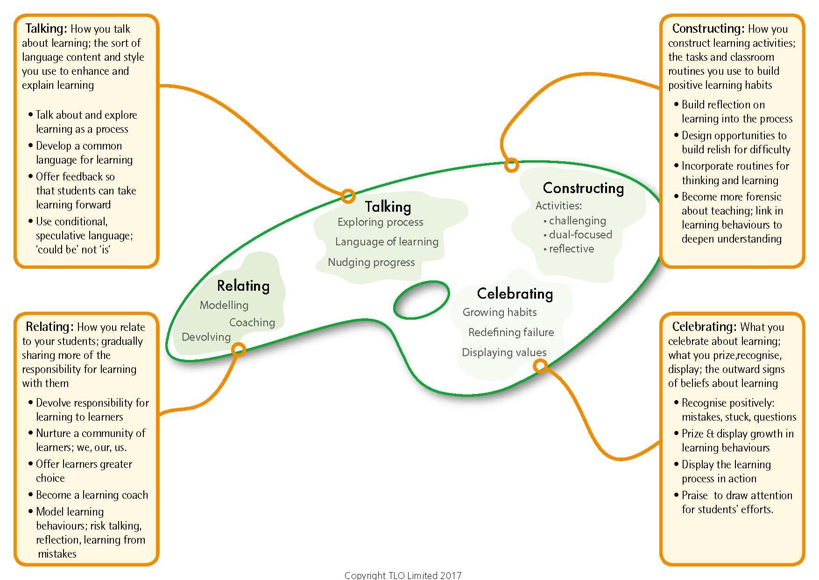

The teaching framework to make it work
Notes:
The Key message(s) on this slide:
The 4 aspects of classroom culture - Relating; Talking; Constructing; Celebrating - in the form of the second Building Learning Power model – the Teachers’ Palette
Detail:
Along with The Supple Learning Mind, it is the other key model in Building Better Learners.
There are 4 dimensions of classroom culture that need to be addressed:
1) Relating for learning – making learning a shared responsibility: the changing roles and responsibilities of teachers and learners, where learning becomes a shared responsibility. Students are given more responsibility for their own learning, the role of the teacher changes from ‘the sage on the stage’ to ‘the guide by your side’; the role of the student moves from ‘passenger’ to ‘crew’ and ultimately ‘pilots of their own learning’;
2) Talking for learning – making learning the object of conversation: the sort of language content and style to enhance learning, making learning the object of conversation. The way we express ourselves in the classroom creates a powerful linguistic environment that teaches young people the best of what we know about learning. The language of learning helps students to discuss, understand, and become conscious of using their learning behaviours;
3) Constructing learning – making learning the object of learning: activities and classroom routines feed learning habits and learning becomes the object of learning. Learning challenging activities are designed to enable students to understand both the content and the process of learning. They do this by having a dual focus – to explore content and stretch students’ use of their learning behaviours. There is a strong underpinning of not just ‘doing’ learning but reviewing and reflecting on the process in order to make meaning and apply it elsewhere;
4) Celebrating learning – making learning the object of attention: the outward signs of the values that underpin the culture, making learning the object of attention. In this dimension common notions of classroom learning are flipped or re-defined - being stuck is seen as interesting and mistakes valuable. Effort, questioning and taking risks are recognised, attended to, acknowledged and praised. These and the recognition of the development of learning habits serve to make visible and public the underlying values of the learning friendly environment.

Slide 8

A teacher’s job becomes one of…
Introducing learning behaviours
  making pupils aware of the tools they command as learners
Developing a language for learning
Infusing learning behaviours into lessons
Becoming a learning power coach
Celebrating the use and growth of learning behaviours
Notes:
The Key message(s) on this slide: ​
​
The role of teachers has to change​
​
​
Key Points​
How do teachers build pupils learning power?​
Key - making pupils aware of the learning tools THEY command​
Developing language, designing tasks, structuring the environment.​
Turning themselves into a learning coach ​
​
Background notes​
This slide gives a broad rundown on the change in role/job in hand.​
It concentrates on the role of the teacher who is charged with creating a learning environment where children understand their learning capacities and are enabled to stretch them. (Remember this includes emotional, social, cognitive and strategic capacities.) ​
The teacher becomes a learning power coach: orchestrating the language, the activities including assessment, and the set-up of the classroom to ensure children have continuing opportunities to develop the learning habits that underpin all the subject disciplines.​

Slide 9
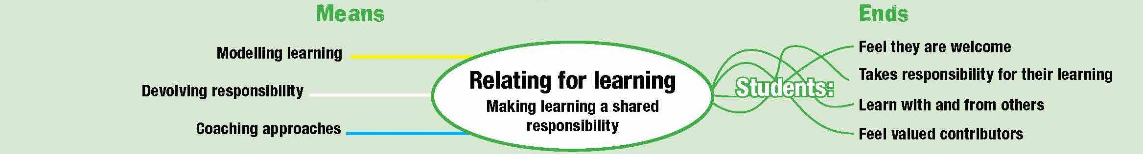
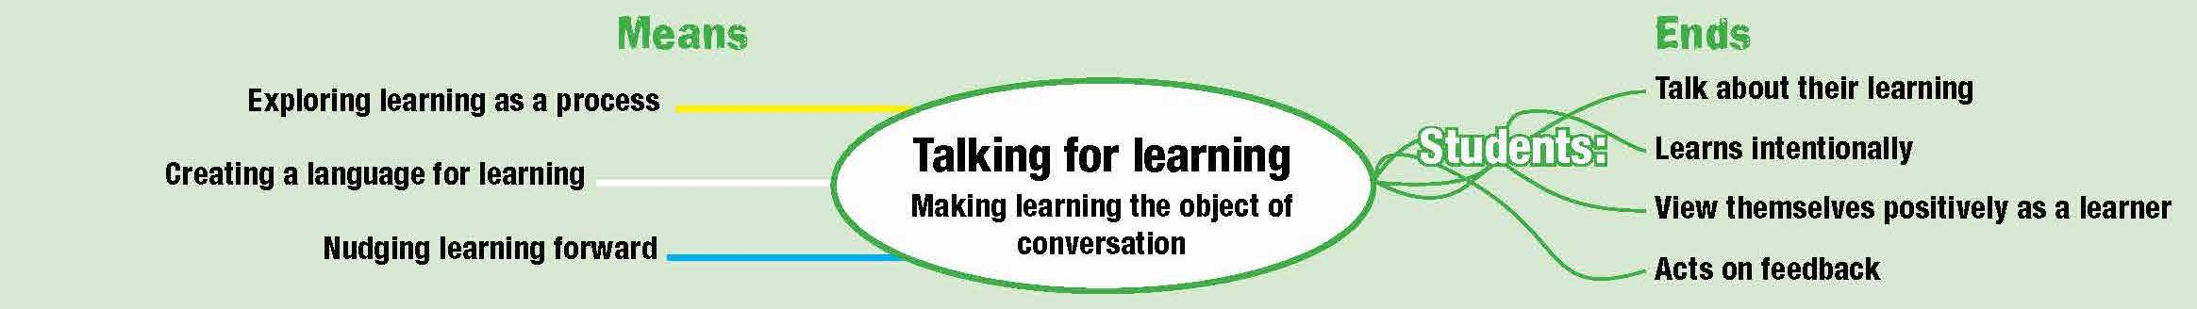
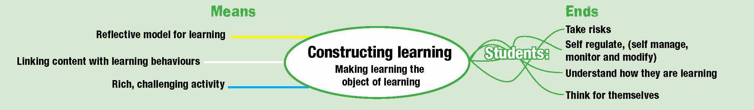
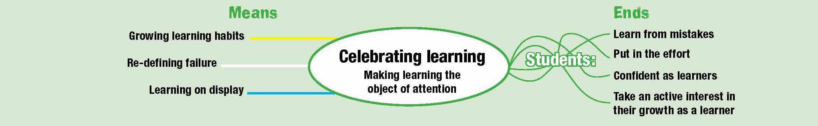
Notes:
The Key message(s) on this slide: ​
​
Putting some flesh on the bones of the previous slide​
​
Detail:​
​
Talk through the central ovals only​
​
The 4 shifts in making a learning friendly culture​
​
The roles people play...Relating​
The learning talk....language of learning​
The process of learning...constructing learning ​
The values of the classroom, what is celebrated, recognised, attended to.​
Detail:
Talk through the central ovals
The 4 shifts in making a learning friendly culture
The roles people play...Relating
The learning talk....language of learning
The process of learning...constructing learning
The values of the classroom, what is celebrated, recognised, attended to.

Slide 10
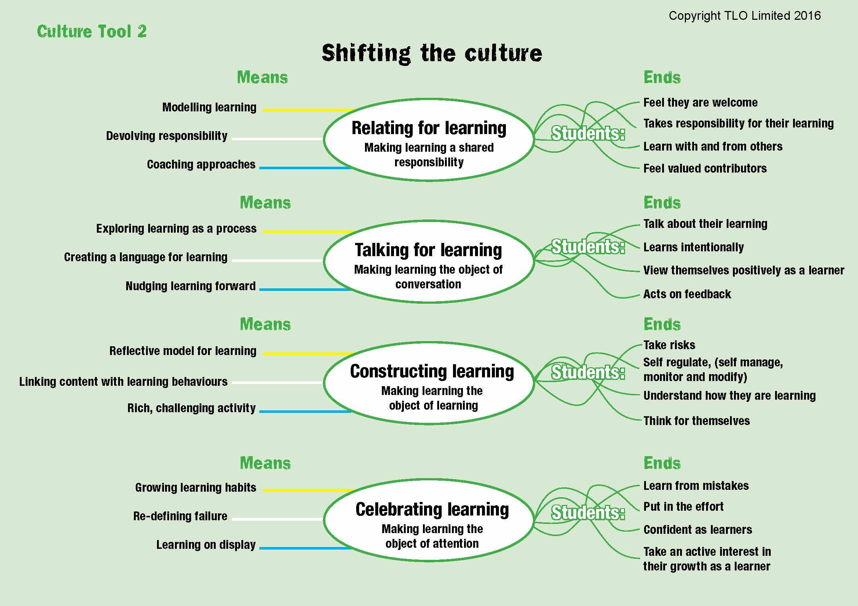
A learning focused culture
Notes:
The Key message(s) on this slide: ​
​
Teachers change the means in order to achieve the desired outcomes for learners​
​
Detail:​
​
The shift in culture that needs to be achieved ​
​
Talk through the outputs/ends for learners...which of these would you not want?​
Which of these are NOT important in the modern world?​
​

Slide 11
A learning focused culture
Notes:
The Key message(s) on this slide: ​
​
This is how teachers behave to create a learning focused culture​
​
Detail:​
​
Talk through briefly the inputs from teachers.​
​
RELATING​
Modelling learning – walking the talk, being a learner yourself. If teachers can’t be bothered to do it, why should students?​
Devolving responsibility – shifting the emphasis towards learners taking increasing responsibility for their own development​
Coaching approaches – moving away from ‘teacher telling’ mode whenever possible​
​
TALKING​
Exploring learning as a process – finding time to talk about learning and how it works​
Developing a language for learning – teacher talk uses the school’s learning language, nuanced by the school’s understanding of progression.​
Nudging learning forward – catching students employing positive learning behaviours and commenting on them, orally and in writing​
​
CONSTRUCTING​
Reflective model for learning – reflection on content and reflection on learning behaviours is routinely built into lessons​
Linking content with learning behaviours – lessons are designed intentionally to deliver content and to exercise learning behaviours, and students are made aware of both​
Rich, challenging activities – increasingly open-ended activities are designed to engage, to stretch and to challenge ​
​
CELEBRATING​
Growing learning habits – finding ways to track, record and celebrate learning behaviour growth,​
Redefining failure – turning the lens around: mistakes become learning opportunities; difficulty is when learning happens; asking questions shows curiosity, not a lack of intelligence. ​
Learning on display – the process of learning (as opposed to the finished outcomes of learning) are on display. Annotated work in progress, first attempts, revisions, failed lines of enquiry, leading, of course, to the finished article.​

Slide 12

And in case you thought it just happens.....
“Dispositions to learning should be key performance indicators of the outcomes of schooling.
Many teachers believe that, if achievement is enhanced, there is a ripple effect to these dispositions. However, such a belief is not defensible. Such dispositions need planned interventions.”
It won’t happen by itself!
John Hattie
Notes:
The Key message(s) on this slide:
There is evidence that high quality teaching alone does nothing in terms of improving learning dispositions,
Detail:
This is a key slide. There are many teachers who believe that because their teaching is effective in enabling their students to do well in examinations, then they are also effective in building better learners, that somehow examination success implies that learning behaviours must be improving.
It is a seductive line of reasoning, often used as an excuse for not engaging with Building Better Learners.
Hattie indicates that research does not support this. Just because achievement is high, learning behaviours are not necessarily improving. Learning behaviours improve because teachers intervene in order to improve them – they will not necessarily improve if left to chance.

Slide 13
Ideas for making a start on the 4 shifts
Listen Think Choose
Notes:
The threads that link the remainder of these slides together:
Teaching ideas to develop the 4 dimensions of the culture shift;
The slides address the question - So, what might I do differently in my classroom?
​
Aim of the discussion: To consider/explore teaching ideas that support the 4 culture shifts.
Objectives: By the end of the discussion participants will have:
Considered a range of ideas for classroom practice in relation to the 4 aspects of the Culture Tool 2

Slide 14
Readying your classroom for learning
Relating for learning: making learning a shared responsibility
  create opportunities for pupils to ask more questions
  move responsibility for monitoring learning towards pupils
  train pupils in ‘getting themselves unstuck’. Plan to get learners stuck.
Notes:
The Key message(s) on this slide:
Unhooking
Detail:
Now putting the concepts into practice in the classroom.
Some suggestions about how teachers can make a start on putting learning first in the classroom.
The key here is UNHOOKING the dependence of the learner from the teacher.

Slide 15
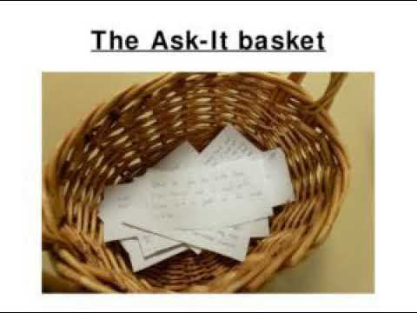
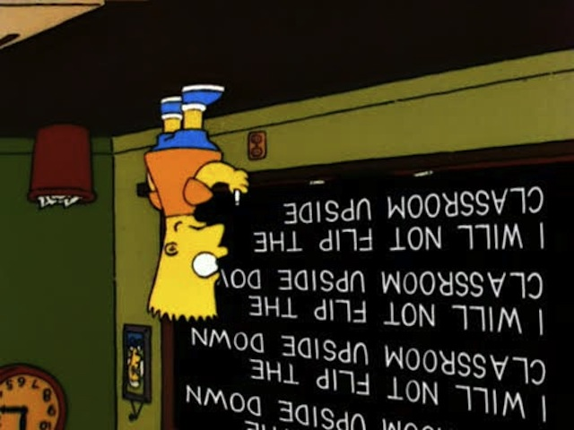
The Ask-it Basket, or Flipped Classroom
Notes:
The Key message(s) on this slide:
A structured way of encouraging students to ask questions and build the curriculum around those questions
Detail:
Students do some research / reading in advance of exploring a topic in class.
Their job is to pre-digest the material and to arrive with one question they wish to ask.
It might be about something that is puzzling them, something that they want to find out . . . . .
The class now has 25 or so questions
Remove any duplicates
Add a couple of your own if they have missed a key idea out
Ask yourself -
Which questions would have been answered anyway by the upcoming curriculum?
Which could be included with a slight tweak?
Which questions do you not know the answer to? (This is the extension task!)
Start your teaching
A week or so later open up the basket. Which have we answered ? Have any new questions emerged?
Early completers get given the extension task to research
Towards the end of the topic, get the questions out and add the answers - it is now a revision pack of FAQ’s for the topic.

Slide 16

A Visible Thinking Routine:
Notes:
The Key message(s) on this slide:
See, Think Wonder is a visible thinking routine. The intention is that it is used routinely to explore a situation. The routine requires students to notice, to think and frame a question about what they have noticed.
Detail:
Invite students to make an observation (see) about an object (artwork, image, artifact) or topic.
Follow up with what they think might be going on. Encourage backing up their interpretation with reasons.
Ask students to think about what this makes them wonder about the object or topic.
The routine works best when a student responds by using the three stems together at the same time, i.e., “I see…, I think…, I wonder…”. If not you need to scaffold each response with a follow up question for the next stem.
This routine encourages careful observations and thoughtful interpretations. It helps stimulate curiosity and sets the stage for inquiry. Use it at the beginning of a new unit to motivate student interest. Try it with an object that connects to a topic during the unit of study. Use the routine with an interesting object near the end of a unit to encourage students to further apply their new knowledge and ideas. Go to visiblethinkingpz.org for more examples and information about think routines

Slide 17

Students self-monitoring their own learning
Notes:
The Key message(s) on this slide:
Students can monitor different aspects of their own learning
Detail:
Many schools have red/yellow/green pages in their planners - a hangover from AfL.
Students display the colour that reflects where they are in terms of what is being monitored.
They could monitor how hard they are finding it -
Red = too hard, Yellow = tricky but do-able, Green = too easy.
Teacher supports the Reds, challenges the Greens, and leaves the Yellows alone.
The ideal classroom is full of yellow students.
Red students could seek help from Yellow or Green students.

Slide 18
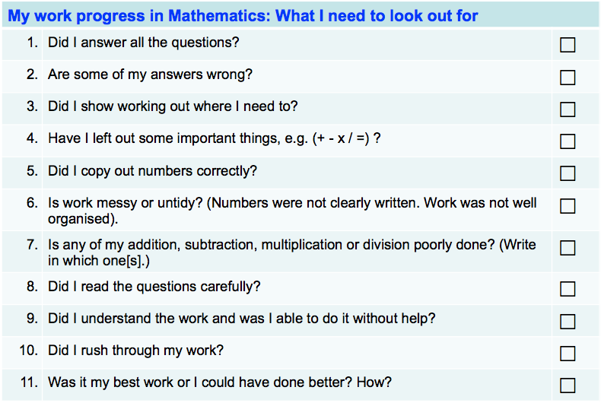
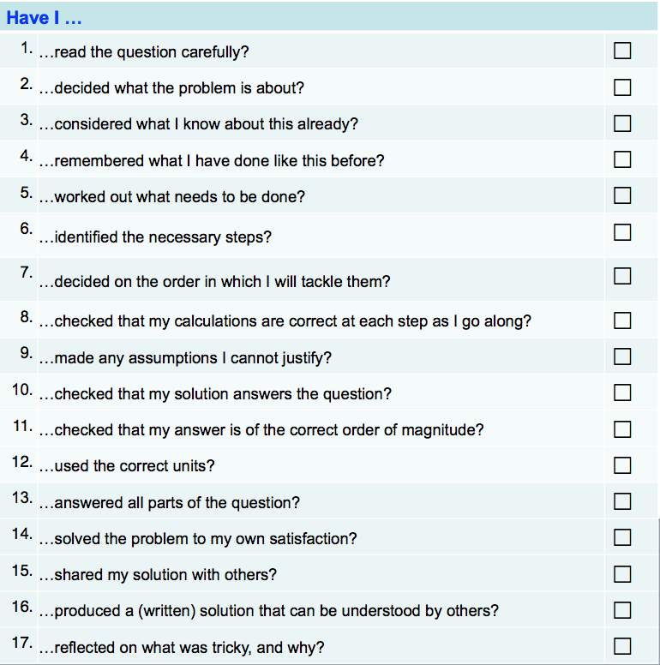
Examples of a couple of monitoring checklists
Notes:
The Key message(s) on this slide:
Provide checklists to help students to structure the monitoring of their own learning.
Detail:
Help students to monitor and check their own work
Construct checklists with students itemising the important things to check before they consider something is finished.
Use such checklists as they work through something, and use it again as a final check before they submit work for assessment.
How we relate to standards of excellence, quality, and correctness is key. It is about developing a sense of standards; a view of what’s good, bad or indifferent. Initially students accept what they are told by teachers about what something needs to look like, be like, feel like. But with support and encouragement students are able to begin to think for themselves about what makes something good and eventually determine their own standards.ecklists as they work through something, and use it again as a final check before they submit work for assessment.

Slide 19
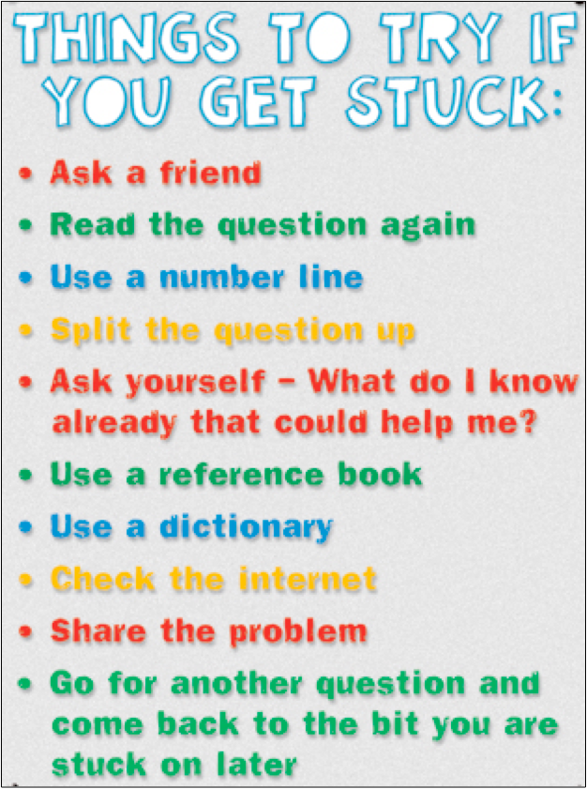
Train students to get themselves unstuck.
Notes:
The Key message(s) on this slide:
Devise strategies for getting themselves unstuck so that they can try something before turn to you for help
Detail:
First quick win
Stuck poster - what to do when stuck
Collect students’ ideas
Builds engagement and makes students more self-reliant

Slide 20
Re-fresh being stuck
Getting unstuck; a natural part of learning. Celebrate as a site of interest not shame
Have learners identify the obstacle to their progress. I’m stuck because..
Model and talk through the ‘getting unstuck’ process.
Use the VTR. What do I know? What do I need to know? What techniques do I have to bridge the gap?
If pupils freeze offer supportive questions NOT answers. ‘What do you do next?’ and ditto. You are encouraging pupils to take over the job for themselves.
Tell pupils you are planning to get them stuck.
Notes:
The Key message(s) on this slide:
Stuck is ok. It is the point when learning really begins, not when it finishes.
Detail:
The big idea here is ‘I’m stuck because’.
Once students’ can say why they are stuck, the ‘why’ often suggests a course of action.
I’m stuck because I don’t know what this word means - get a dictionary
I’m stuck because I don’t know what to do next - what might you do next?
I’m stuck because it is not working - what else could you try?

Slide 21
Readying your classroom for learning
Talking for learning; making learning the object of conversation
  give pupils physical ‘hooks’ on which to hang talking about learning;
  broaden your feedback to develop both content and learning behaviours
Notes:
The second cultural shift - making learning the object of conversation.
Developing the learning language.
Teacher talk and written feedback important here.

Slide 22
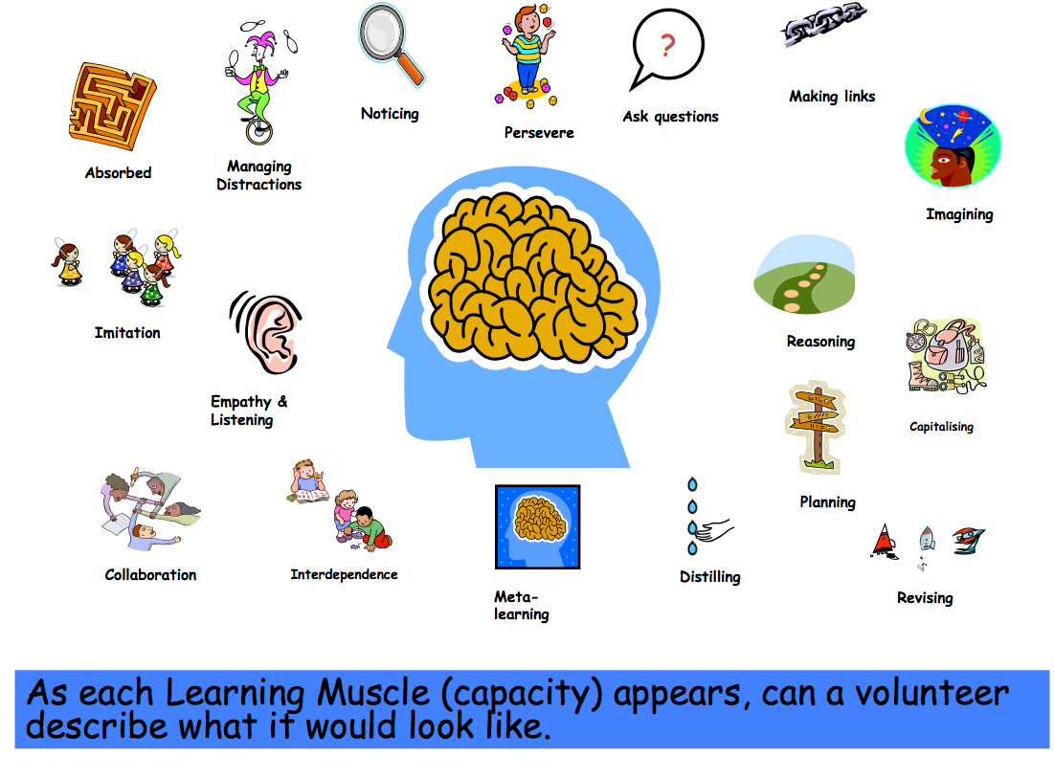
Hooks; Using icons
Notes:
The Key message(s) on this slide:
Students find it helpful to have visual ‘hooks’ to support their thinking/understanding
Detail:
An example from a school in Milton Keynes of icons for each capacity
Pictures are from Clip Art
Some schools use animals. e.g Emperor penguin to illustrate interdependence - spider for perseverance etc

Slide 23

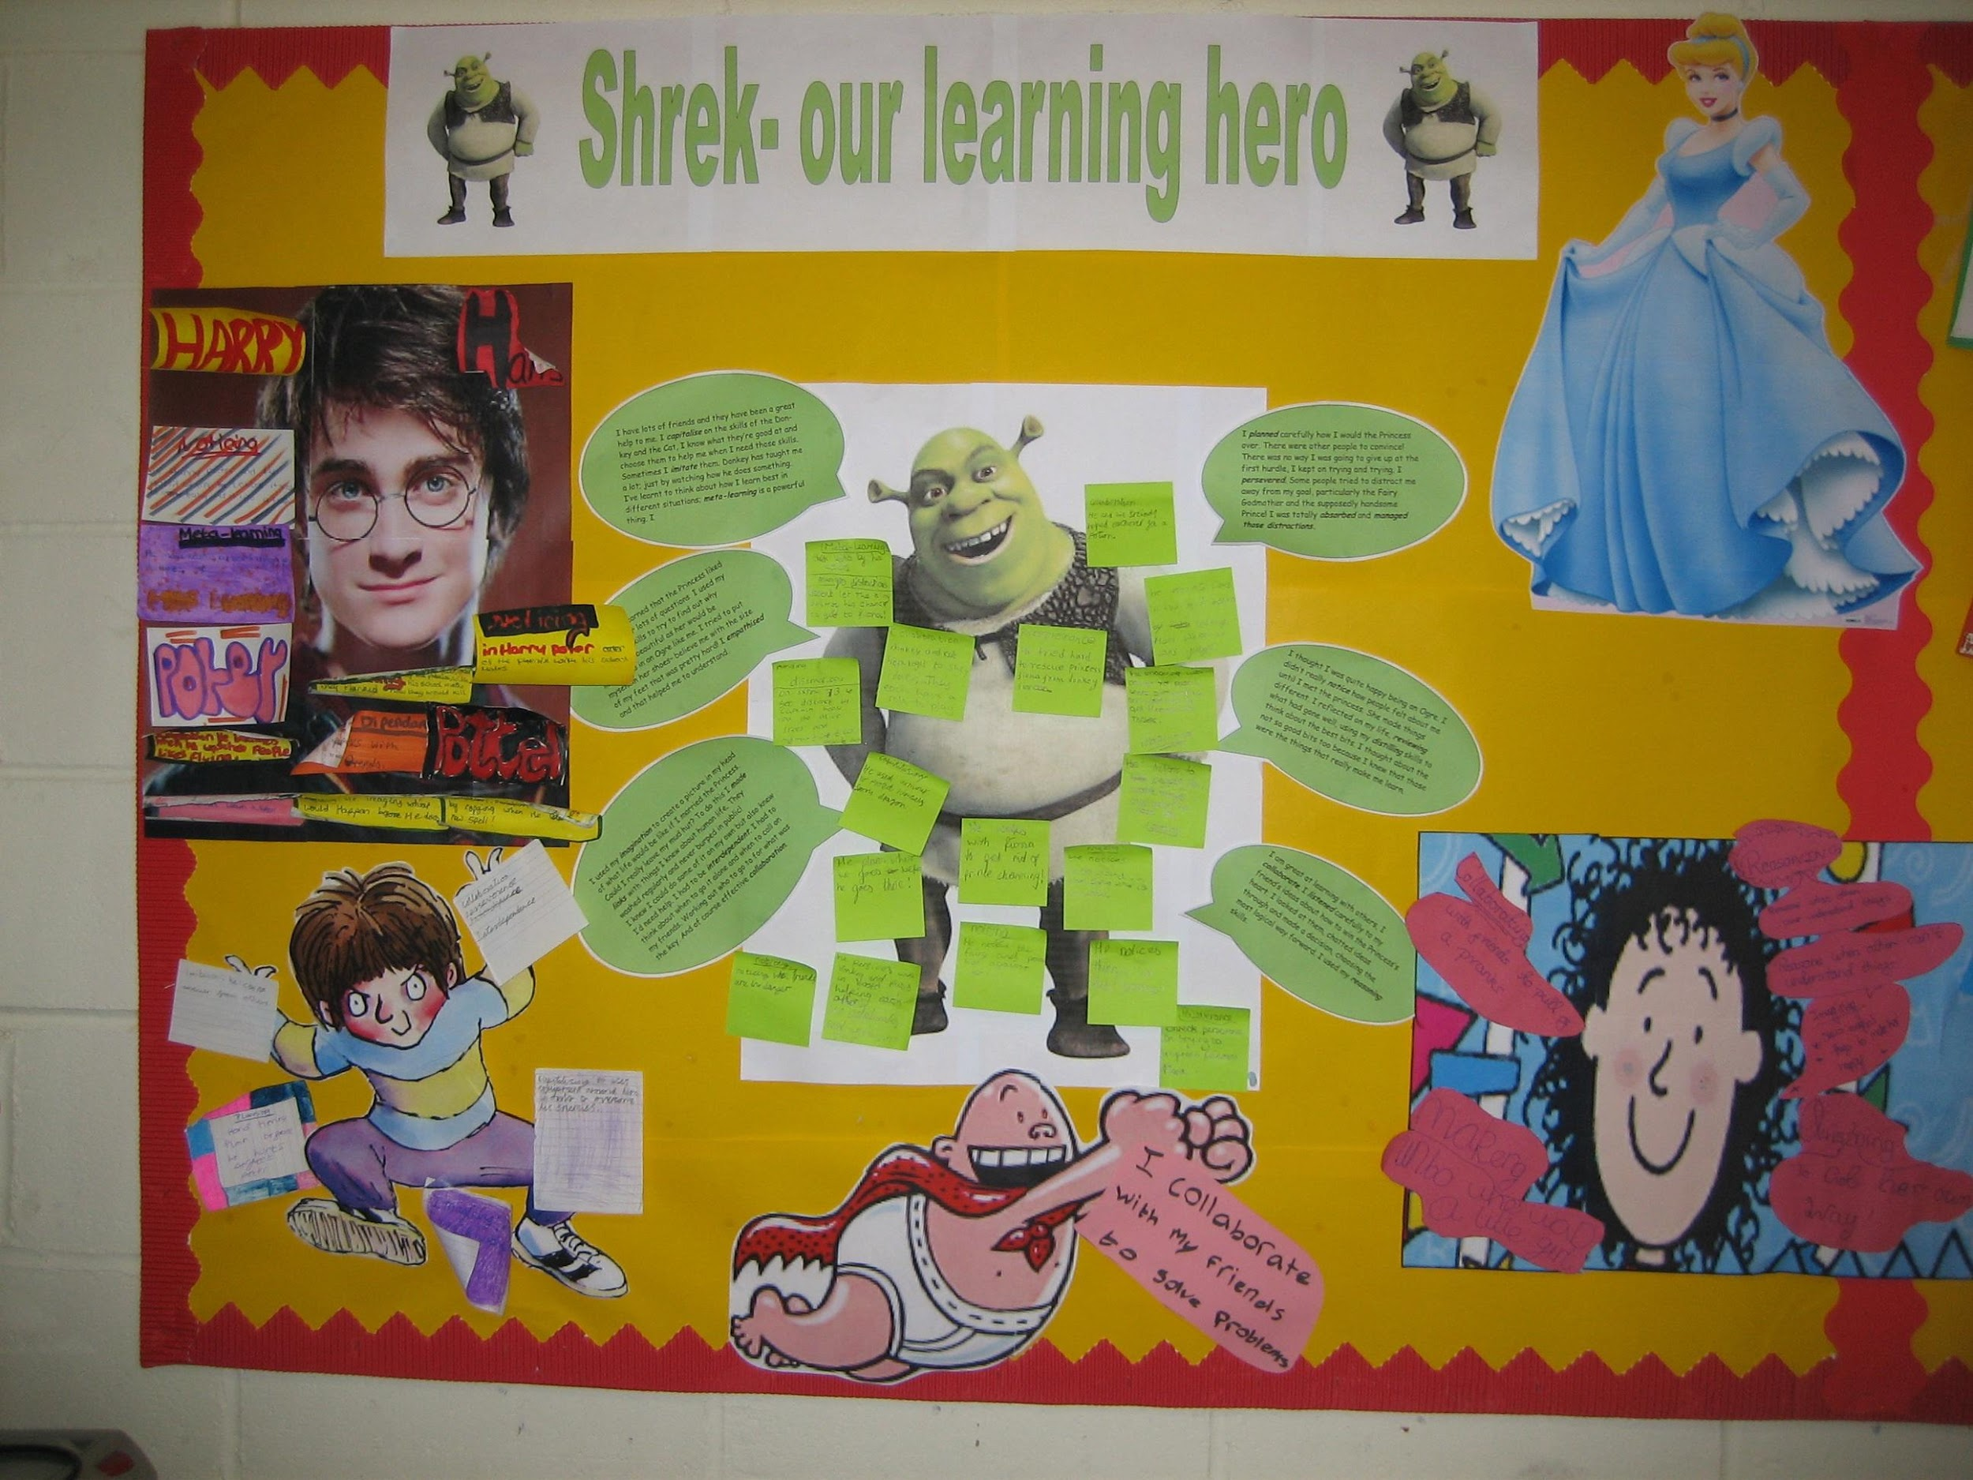
Notes:
The Key message(s) on this slide:
Explore the learning behaviours of characters that the students know
Detail:
The ‘character’ could be real or fictional, known to them or simply a ‘personality’.
Consider David Beckham. How did he achieve success?
Talented, yes, but also very perseverant in practising his skills;
Team player with high levels of interdependence;
Strategic, thinks ahead;
Prepared to change tack if strategy is not working.
And so on . . .
But the ‘character’ could just as easily have been Shrek, the Queen, . . . .

Slide 24

The balance of teacher talk . . . .
Notes:
The Key message(s) on this slide:
What is talked about in classrooms gives a strong message about what the teacher believes is important.
Detail:
Reflect on your own classroom:
If you could replay what you say during a typical lesson, what would you hear?
How much of your talk concerns what students are learning?
How much of your talk concerns how they are learning?
What message are you giving your students about the relative importance of content acquisition and of understanding the process of learning?

Slide 25


Using ‘Could be’ language
Notes:
The Key message(s) on this slide:
How teachers talk impacts on how students think
Detail:
Teachers who talk the language of certainty, who use ‘is’ language, reduce students to being memorisers of their wisdom.
Whereas teachers who use ‘could be’ language, who say things like ‘it might be’ or ‘how else . . ‘ or ‘what if’ open up possibilities for exploration and enquiry.
Research shows that the former leads to short-term retention of ‘facts’, while the latter leads to deeper understanding and longer term retention of ‘facts’.

Slide 26
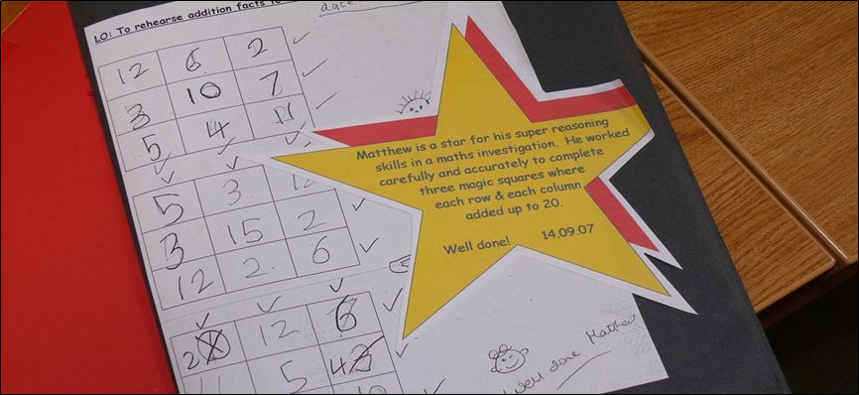
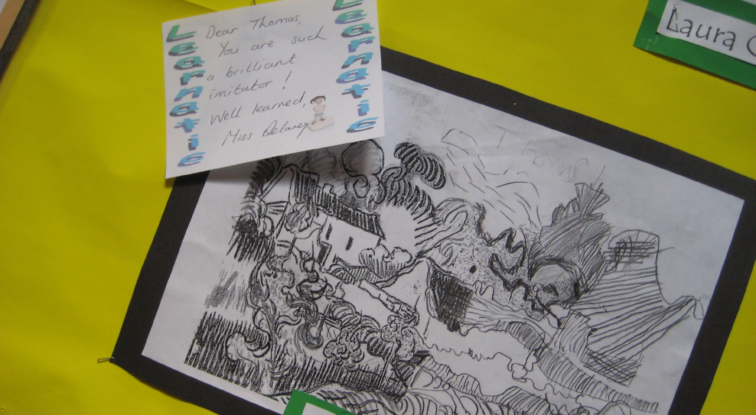
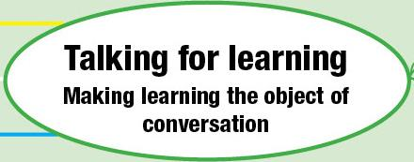
Feedback on process: written
A ‘brilliant imitator’
‹#›
Notes:
The Key message(s) on this slide:
Written feedback should include feedback on learning behaviours
Detail:
Moving on to written feedback now.
The first example:
Comments differentiating the capacity being used.
Moving from simply ‘good’ or ‘well done’ to the type of learning being used.
RE-enforces use of capacities and when they have been particularly successful
BUT - comment tells Thomas he is a brilliant imitator without giving him any idea of what that means
The second example
Is better because Matthew is praised for his super reasoning skills and there follows a brief explanation of what he did to be a super reasoner.

Slide 27
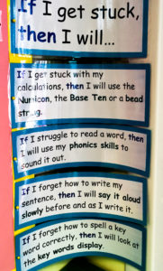

If / Then targets
Notes:
The Key message(s) on this slide:
Many targets are little more than a wish list that has little hope of becoming a reality. If/Then targets are different.
Detail:
Put ‘If-then’ planning into action in your classroom to make stuck solutions more specific and personal
If we want students to change their behaviour we need to help them to think much more closely about the 'hows' and the 'whats'.
Motivation research proposes an effective solution to this called ‘if-then’ planning.
‘Ifs’ are the situations you want to remind yourself about. In the case getting unstuck it's useful to list all the sorts of places this tends happen
'Thens’ are what you will do about something; the action you will take. Brainstorm a list of the ‘what we might do in response to the Ifs'.

Slide 28
Constructing learning;
Making learning the object of learning
  Build reflection on learning into lessons.
  Blend content and process; what learning/how learning.
  Build understanding using rich, challenging and authentic activities.
Notes:
The Key message(s) on this slide:
The third cultural shift - making learning the object of learning. Learning about learning. Constructing lessons that both build content understanding and build positive learning behaviours.
Detail:
Now moving on to constructing learning.
Emphasis here is on weaving content and process together. So lessons are designed to link content and learning capacities and thinking about how to go about learning.....plan it, do it, review it. Metacognition comes to the fore here.

Slide 29

Notes:
The Key message(s) on this slide:
Reflection needs to not only be about what has been learned, but also about how it has been learned.
Detail:
A simple end of lesson activity.
Tell me:
Three things we have learned today;
Three ways we have learned today;
Three things you still need to find out.
Or change ‘today’ to ‘yesterday’ and use it as a lesson starter to reconnect students with yesterday’s learning.

Slide 30
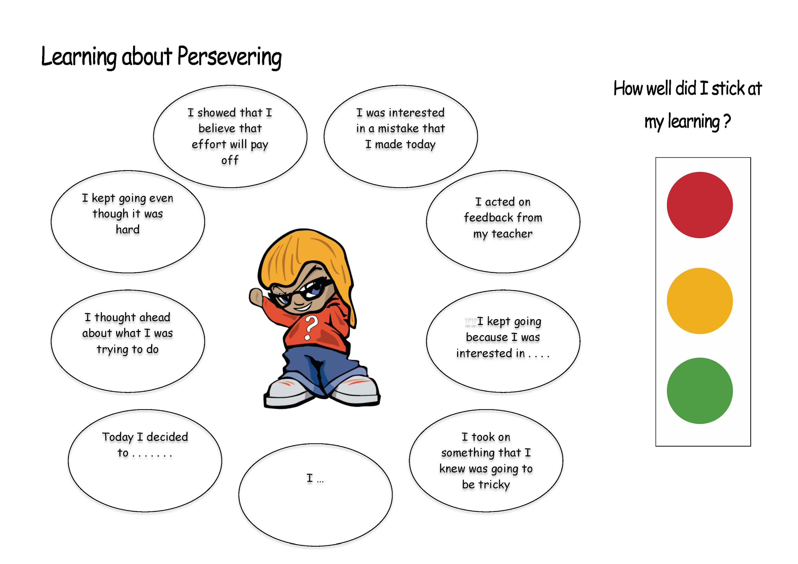
Notes:
The Key message(s) on this slide:
Students reflecting on their own perseverant behaviours
Detail:
Learning mats are tools to encourage students to become more self-aware of how they are using a learning habit. Basically, they are A3 or A4 laminated sheets that show various aspects of a learning habit - in this case Perseverance. They are kept on tables or used as part of wall display. Students refer to them during lessons, using them as prompts about the finer aspects of a learning habit that is being stretched. They help students to be able to join in meta-cognitive talk.

Slide 31

Plan to get them stuck
Notes:
The Key message(s) on this slide:
Challenge and difficulty need to be engineered.
Detail:
Many students, particularly able ones, expect learning to be easy. Many prefer it this way - quick and effort-free success usually trumps hard-won persistence. They may believe that effort is what less able students use to compensate for a lack of talent!
All learners need to be working at the edge of their intellectual comfort zone, where learning is hard but do-able.
Rather than making it easy enough to understand, teachers need to be making it hard enough to stretch them.

Slide 32

Let students 'get on with it' - so that they can wrestle with it for themselves
Notes:
The Key message(s) on this slide:
Experiment with intervening only when absolutely necessary – stand back, listen and watch, and let the learning happen.
Detail:
Teachers are constantly walking a tightrope – when/whether/how to intervene, how much support to offer, how much challenge to inject etc. It is in these ways that teachers scaffold the learning for their students, offering just the right balance of challenge and support to keep students working towards the edge of their comfort zone. But if teachers always scaffold learning in this way, when will students develop the skills required to manage their own learning for themselves?

Slide 33
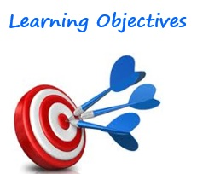

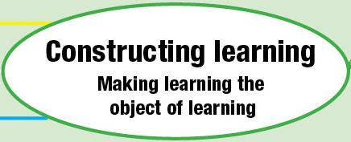
Blend learning behaviours with content.
Learning objective:
  ... able to use the language of chance or likelihood to describe and predict possiblities
  Success Criteria:
  I can think logically (saying because..) and in clear steps to determine the probability of rolling certain numbers on a dice. reasoning
  I can decide if I can learn this on my own, or learn this with others. interdependence
Constructing activities:
  signaling learning behaviours to be used in a maths activity
Notes:
The Key message(s) on this slide:
Building mention of learning behaviours into learning objectives
Detail:
Key points
Learning intention – content...but putting the ‘how’ first
Success criteria - learning capacity to be used
These together drive the design and implementation of the lesson
Background notes
This slide shows the learning intention of a split screen or dual focused lesson. Point out the content and the learning habits to be employed ( woven into the success criteria). these are sometimes shown to/shared with pupils. Sometimes pupils discern the objectives and the learning habits being used as the lesson progressed and discuss at the end.

Slide 34
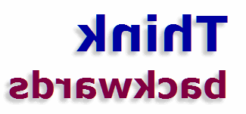
To identify which learning behaviour(s) to link to your lesson . . . .
Notes:
The Key message(s) on this slide:
It is not always easy to identify the key learning habits that should be linked to the content
Detail:
In any lesson, a wide range of learning behaviours will be triggered, some fleetingly, some extensively. Some will arise because of the content of the lesson, some will arise because of the planned activities. In the best of situations, the behaviours that are required by the content are also the behaviours triggered by the activities.
So - how do you know which behaviour(s) will link to an upcoming lesson, especially as there will be so many to choose from?
Many teachers find it easiest to turn the question around:
Which learning behaviour, if missing, would make it impossible to achieve the objectives?
The answer to that question is the learning behaviour that needs to be woven into the lesson objectives and success criteria.

Slide 35
Celebrating learning: let your values come through.
Making learning the object of attention
  Put learning ‘in your face’; making the learning process... how it feels, what it means obvious
  Celebrate growth in learning behaviours
  Redefine failure....celebrate stuck, mistakes managing distraction, striving for goals, asking questions....
Notes:
The Key message(s) on this slide:
The fourth cultural shift - making learning the object of attention
Detail:
3 aspects - making it obvious; celebrating growth in learning; and redefining failure

Slide 36
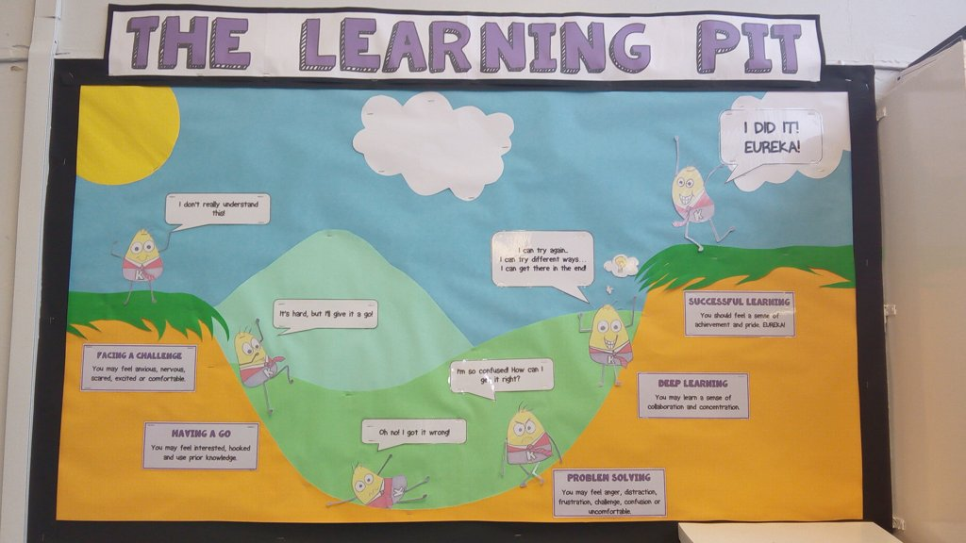
Notes:
The Key message(s) on this slide:
Learning is about moving from clarity, through confusion, and back into clarity.
Detail:
Use the 'Learning Pit' as a means of opening up a conversation around the feelings involved with being stuck, and the journey towards getting unstuck - the struggle. It is essential that students know:
that the 'pit' is only one staging post on the learning journey
they can get out by using 'stuck strategies' and tools
It is also worth noting that the pit is not necessarily inevitable for all students in all learning - some will fly over the pit in some topics or curriculum areas.
The ability to cope with and overcome difficulty and challenge is a key aspect to becoming a successful learner.
James Nottingham introduced the idea of the Learning Pit as a way to explain that struggling is part of learning and that if we are to understand something we need to struggle with it first. Students move from unconsciously incompetent (an emotionally 'safe' area before learning), to consciously incompetent (the emotionally tricky "pit"), to consciously competent (the far side, after the learning has happened).
Find out more by visiting:
http://www.jamesnottingham.co.uk/learning-pit/

Slide 37
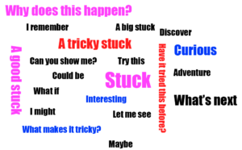
Build positive associations with facing up to challenges and being stuck
Notes:
The Key message(s) on this slide:
Turning the lens from challenge and stuck being where learning ends, to where it begins.
Detail:
Discuss places where students may get stuck because it gives 'being stuck' a status. Through such discussions make sure you signal to students that being stuck is a good thing; it probably means they are at an interesting place in learning, or on the brink of discovering or learning something new.
Try creating a wordle with your students, using the words they associate with being stuck. If it is negative introduce a new 'stuck positive' language

Slide 38
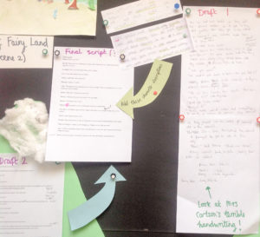
Display ‘work in progress’ . . .
Notes:
The Key message(s) on this slide:
If we truly value the process of learning, display will include both work in progress as well as the finished article
Detail:
Ensure that your display walls include early drafts of work which show where students got stuck and how they ‘edged’ towards the finished article. Encourage students to write on a separate note how they got unstuck, and display the note with the work.
It’s important that students understand learning as a process rather than an event, and that stuckness is a prominent part of that process. From scribbled notes to final copy can be a long and eventful journey. Learning routines along the way include capturing rough ideas, adding to them, trying again, trying another way, re-thinking, refining and completing. Such routines lead students to see that it's not about everything being perfect or easy from the start.

Slide 39





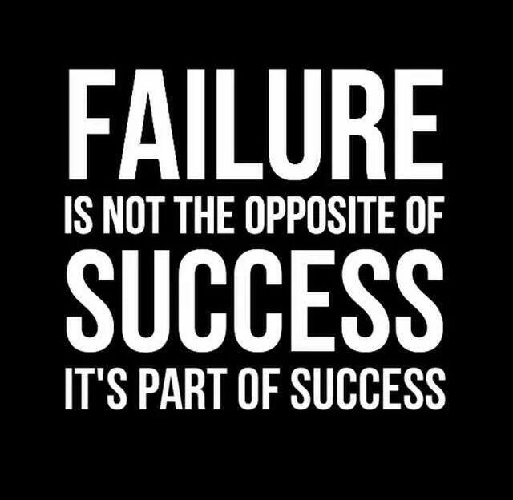
Positive messages in environment
Notes:
The Key message(s) on this slide:
Display conveys messages about we really believe about learning, effort, motivation.
Detail:
Take a hard look around your own classroom, and around the school in general.
What does display reveal about what the school believes about learning?
Are there learning positive messages?
Do walls show the commitment to learning?
Are there any displays that convey, even unintentionally, less positive, messages relating to the importance of attainment over progress?

Slide 40
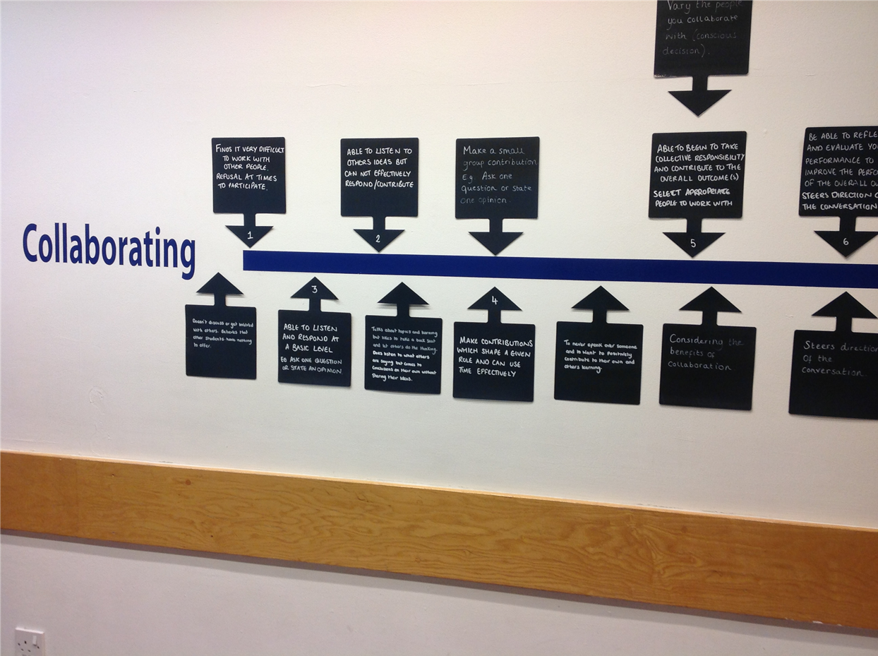
Display of learning lines
Notes:
The Key message(s) on this slide:
Displaying progression in learning lines
Detail:
This school has taken a progression chart for a particular learning habit - in this case Collaboration - and has converted the cells of the chart into what they call ‘a learning line’. This is the beginning bit of their Collaboration Learning Line.
The learning lines of these key learning behaviours are displayed in public circulation areas around the school.
The effect is to: reinforce the school’s commitment to and interest in growing learning behaviours; remind learners of the various facets of different learning habits; enhance the learning language; enable learners to monitor progress.

Slide 41
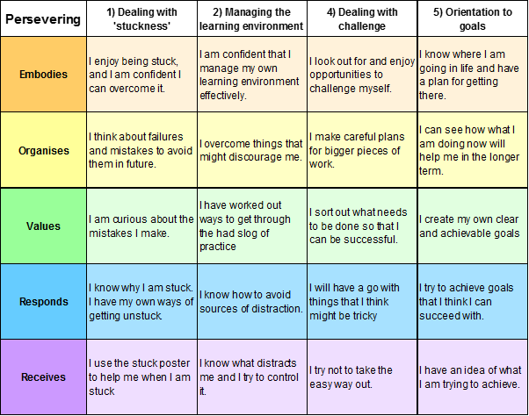
Notes:
The Key message(s) on this slide:
Learners can monitor and record their own growth as a learner
Detail:
The example given is the progression chart for perseverance, but this time written in child-speak.
This could form a page in the student planner, or a laminated sheet to be used in class.
Students keep an eye on how effectively they persevere against the chart.
They should, of course, become secure at an increasing range of positive perseverance behaviours over time.
How might they evidence this ? Who will verify ?

Slide 42
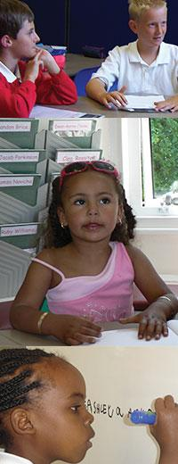
Why learning powered learners are different...
because they begin to see how to take control of their learning behaviours..
  have a learning language
  they talk about how they do it, how it feels, learning together, getting better at it
  develop self-awareness as a learner across each domain...thinking, feeling, managing, relating
  can take control of their learning...if you let them
  Consciously develop their learning behaviours...they become better learners
Notes:
Key points
What pupils need in order to become learning powered learners.
Here again the emphasis is on:
A language for learning
Being self aware of what they are doing as a learner
Taking control of their learning and consciously developing their capacities
The last of these means getting better at them (more skilled) and using these skills more often and across many contexts – at school, at home, in clubs, in different subjects; i.e. transferring the skills.

