Slide 1
Chalkface. Growing learning habits.
See, think, wonder
Notes:
The threads that link these slides together:
Understanding progression is key to building better learners;
Progression enhances and deepens the school’s learning language.
Teachers can intervene in order to build perseverance
Aim of the discussion: To consider/explore the nature of progression in relation to perseverance.
Objectives: By the end of the discussion participants will have explored:
The progression chart for perseverance
Where their students are secure in relation to the chart
Whether students are becoming increasingly perseverant as they move through the school;
Ideas to use in the classroom that build student perseverance.

Slide 2

It’s the building that matters.
Building perseverance
with a different sort of scaffolding
Notes:
The Key message(s) on this slide:
It’s not enough to get them ‘doing it’, whether the ‘it’ is persevering, asking questions, thinking ahead or whatever.
We need to get them ‘doing it better’ over time.
But first, we need to understand what ‘getting better’ really means.
Detail:
We are going to focus on perseverance here because it is the leaning behaviour that teachers tell us is most in need of improvement.
We could, of course, chosen any other learning behaviour and treated it in the same way, but that is for the future - it is the focus of the phase 2 online modules in both Stepping Stones and Nutshells.

Slide 3
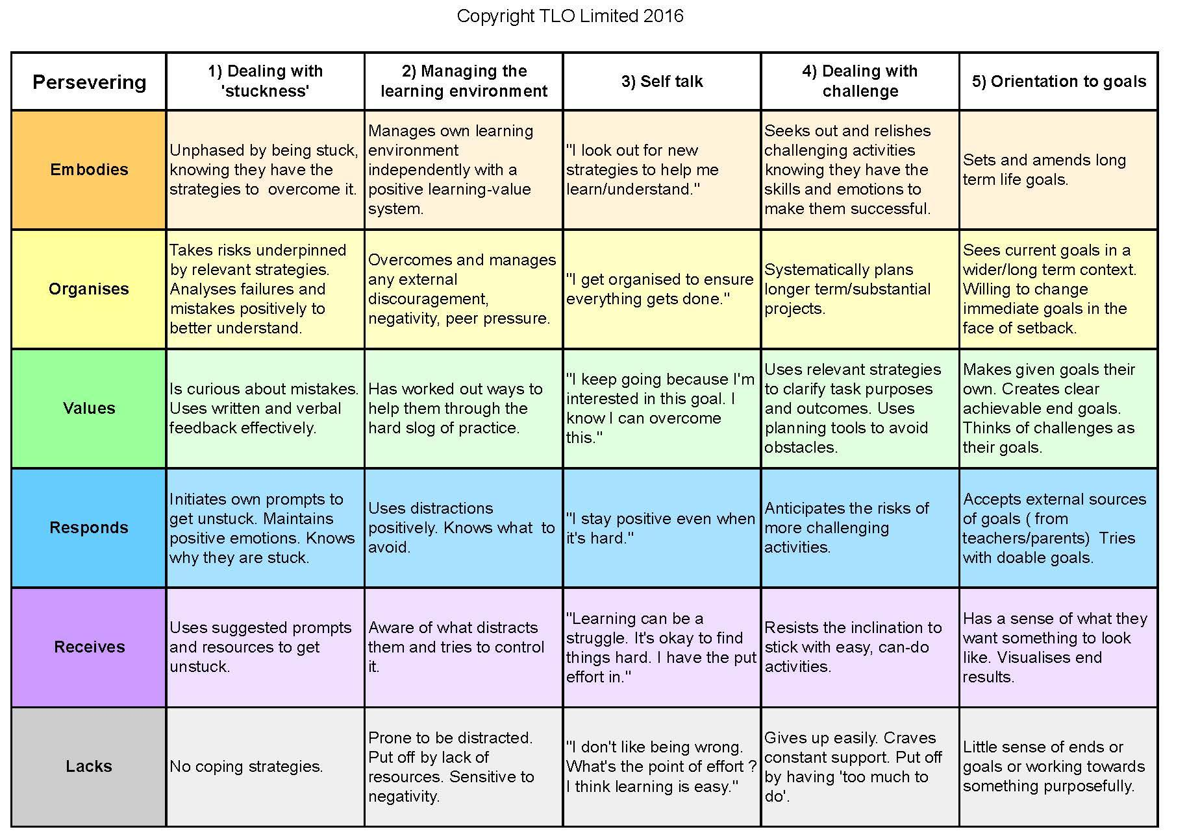
Perseverance What it consists of:
How it grows
Reacting to stuckness
Dealing with ‘stuckness’
Notes:
The Key message(s) on this slide and the next 4 slides
Perseverance is a complex blend of a number of factors
Detail:
How we deal with being stuck, the way in which we react when stuck, the strategies we have for overcoming it, our curiosity about the mistakes we make and how we can learn from them.

Slide 4
Perseverance
What it consists of:
How it grows
Maintaining focus.
Managing distraction
Managing the learning environment
Managing the
learning environment
Notes:
Detail:
How adept we are at maintaining focus, the extent to which we can manage our own learning climate, ignore or manage distractions, regain focus if lost.

Slide 5
Perseverance
How it grows
.
What we think of, or say to ourselves as a learner.
Self talk
Notes:
Detail:
How we talk to ourselves. How emotionally tough we are, whether we really believe that learning is learnable, that effort will pay off in time, that learning ought to be taxing, and how we retain optimism when doing the hard yards.

Slide 6
Perseverance
How it grows
Excited or afraid, embrace or give up.
Dealing with challenge
Notes:
Detail:
The relationship we have with challenge, are we more excited by the prospect of triumphing over challenge, or more afraid of failing when faced with difficulty ?

Slide 7
Perseverance
How it grows
Why bother with something in the first place?
Pursuing our own goals
Orientation to goals
Notes:
Detail:
The extent to which we are goal orientated how we design and pursue our own challenging goals with tenacity and independence

Slide 8
Perseverance
How it grows
Negative behaviours. Things to turn around
I can’t.
I won’t
Notes:
The Key message(s) on this slide and the next 5 slides:
There are 5 stages in the growth of perseverance
Detail:
How do these aspects of perseverance GROW?
[NB THE SCALE IS DERIVED FROM BLOOM’S TAXONOMY OF THE AFFECTIVE DOMAIN.]
The grey row:
LACKS Minded to seek to stay in their comfort zone In this phase pupils have made a big leap from having a negative mindset to a neutral one. Here they are inclined to play it safe, staying within their own comfort zone to ensure success and avoid perceived failure. They still need adult support to maintain focus and optimism when tackling tasks they perceive as difficult, but beginning to show willing to take more responsibility.

Slide 9
Perseverance
How it grows
Do it because I’m told to.
Show me
Tell me
Receives
Notes:
Detail:
The purple row
RECEIVES. Minded to seek to stay in their comfort zone In this phase pupils have made a big leap from having a negative mindset to a neutral one. Here they are inclined to play it safe, staying within their own comfort zone to ensure success and avoid perceived failure. They still need adult support to maintain focus and optimism when tackling tasks they perceive as difficult, but beginning to show willing to take more responsibility.

Slide 10
Perseverance
How it grows
Do it willingly
I’ll try
Responds
Notes:
Detail:
The blue row
RESPONDS. Minded to be willing to believe that effort will pay off. In this phase pupils develop greater independence and are motivated by trying to reach achievable goals. They are realising that fear, the need for adult support and distractiveness can be overcome by having/using more coping strategies and practical ideas to get them unstuck.

Slide 11
Perseverance
How it grows
I see the point. I value it. I win by doing it
I see why.
Values
Notes:
Detail:
The green row
VALUES. Minded to value persevering on learning In this phase the pupil has developed a strong belief that they can get better at learning. They become curious about mistakes and care about the goals they are trying to reach. They develop and use many practical strategies to assist them in dealing with challenge, stuckness and the learning environment.
NB This is a breakthrough point. In the purple and blue rows learners are heavily dependent their teachers to make it happen. In the green row, learners come to believe that behaving in this way has pay-off for them. Increasingly from here onwards, they become less reliant on teacher support and more willing and able to do it for themselves.

Slide 12
Perseverance
How it grows
Organises
Organised to do it.
I make sure I do
Notes:
Detail:
The Yellow Row
ORGANISES. Minded to relish open ended challenge In this phase the pupil organises themselves to get the job/task problem done. Risk taking is underpinned by sound strategies. Failures are analysed for greater understanding. They have accepted responsibility for their behaviour.

Slide 13
Perseverance
How it grows
Embodies
Characterised by it. Part of them.
I can’t not do it
Notes:
Detail:
The orange row
Embodies. Minded to internalise the value of perseverance. In this phase pupils’ behaviour is pervasive and consistent, predictable and importantly characteristic of the learner. Perseverance is part of their character.

Slide 14
The complete perseverance chart
Notes:
The Key message(s) on this slide:
Putting it all together produces a progression chart for Perseverance like this.
Detail:
Give time to look at this chart - it is a lot to take in !
Movement upwards is not inevitable
Many adults do not reach the top of this chart
A lifetime of growth is detailed here
The chart is a ‘professional document’ written in professional language - do not be tempted to use it with students - they will have no idea what it is talking about !!!
However, re-drafting the purple and blue cells in pupil-speak would be an interesting activity.
Remember - there are two breakthrough points:
Going from Grey to Purple requires changing a negative outlook (Grey) into a neutral outlook (Purple)
Going from Blue to Green is where students start to do it for themselves, when teachers can step back, intervene less, and allow learners to do it for themselves.

Slide 15



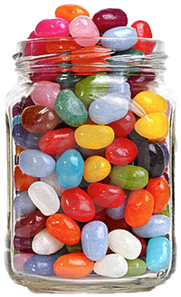
Have a think...
Where do you estimate most of your students to be secure on the perseverance chart?
Notes:
The Key message(s) on this slide:
We can use the chart as a lens through which we can view our students as perseverers.
Detail:
There are exceptional perseverers who are well towards the top of the chart.
And there are others who barely get onto the bottom rung.
Ignore these outliers for a moment - think about the vast majority of learners in your class.
Which colour best describes them ?
In terms of running this reflective activity, it is best done in phase teams (in the primary school).
Give time for teams to agree an answer. Typically they will say things like ‘Purple with a bit of Blue’.
Collect answers, starting with your youngest learners and moving up through the school.
What generally emerges is that everybody says largely the same.
Or, put another way, our learners are not growing significantly in perseverance as they move through the school. And that is despite all of the good advice about ‘not giving up’ and ‘trying hard’ that they are given.
Sometimes levels of perseverance weaken as students get older - that is the basis for an interesting conversation !
If students appear to be moving ‘up’ the chart as they move through the school, is that happening because of the planned interventions that teachers are making, or is it almost accidental ?
Whatever the picture - explore why this is happening.

Slide 16
Implementing the ideas in your classroom
Creative
questions.
Ask yourself
what if ?
Notes:
The threads that link these slides together:
There are small changes that teachers can adopt to ‘nudge’ students to move up the chart
The changes need to be appropriate the their starting points
Aim of the discussion: To consider/explore teaching ideas that could help students to become better at persevering
Objectives: By the end of the discussion participants will have explored:
A range of possible perseverance related strategies
Which strategies might work with their students at this phase of their development
Decided to adopt a strategy or two to trial in their classroom.

Slide 17
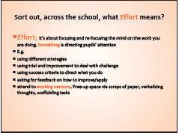
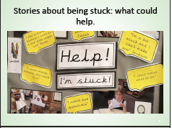
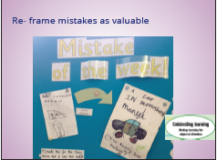
Implementing the ideas
VTR Creative questions. How would it be different if...?
Look at the ideas about improving perseverance on the set of cards (also in your resource book).
Work together to decide...
If I do XXX will it... improve/develop/enhance/ help move... my pupils from xxx to yyy on the perseverance chart......
Notes:
The Key message(s) on this slide:
This slide sets up the card sort activity
Detail:
Download and print sufficient sets of the cards.
In small groups, invite teachers to talk through them one by one
Some ideas will immediately appeal and be well-matched to where their learners are
Some will appeal, but students are not yet ready for it
Some will appeal, but teachers are uncertain how they might do it
And some will not appeal or seem relevant.
You might want to use the following slide to support the sorting exercise:
Imagine three baskets
Place the cards, one by one, into the 3 baskets.
Basket 1 is ‘I like the idea and I fancy trying it with my students’
Basket 2 is ‘It is an interesting idea that I might try at some point’
Basket 3 is ‘not in my classroom!’

Slide 18
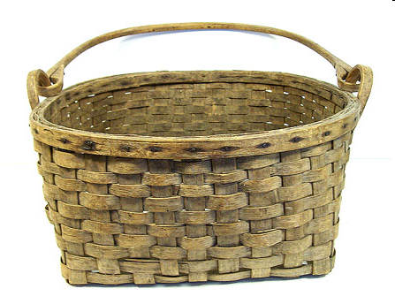



Activity: Imagine three baskets . . . .
Notes:
See notes on the previous slide
Allow plenty of time for this
Listen to the conversations
You may want to get groups to share particularly interesting discussions
(The slides towards the end of this presentation show the cards they have been sorting. No need to talk through these slides, they are just here so that you can put one up on the screen while it is discussed)
You might consider getting some people to visit other groups to hear which cards have ended up in which basket and why.

Slide 19
Implementing the ideas
VTR Creative questions. How would it be different if...?
Look now at the cards that you have placed in your ‘I fancy doing this with my students’ basket . . . .
Where, between the lines of the progression chart, would it fit?
Put the ideas you want to use on the between the lines chart.
Notes:
The Key message(s) on this slide:
The ideas we are going to try must match the development phase of our students
Detail:
Refer to the ‘between the lines’ chart (it is in the downloadable resource, and also shown on the next slide)
Using just the cards in the ‘I fancy doing this’ pile, invite teachers to place the ideas on the ‘between the lines’ chart.
After a while, ask the question:
Is where you are putting the cards consistent with where you guesstimated your learners to be?
[For example, if you think that you students are mostly purple, are the ideas you are considering falling in the Purple to Blue gap?]
[Look at the other cards in a similar way if time permits]

Slide 20
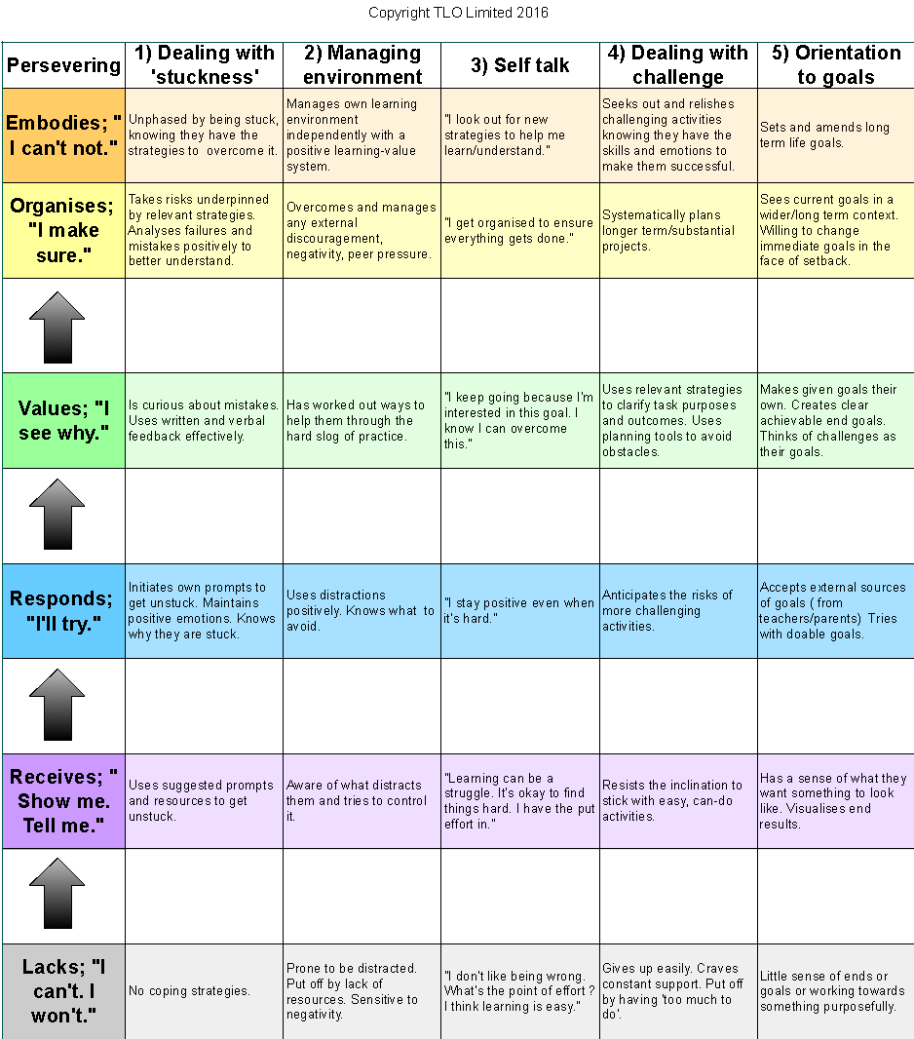
Between the lines.
Notes:
The Key message(s) on this slide:
See notes for previous slide

Slide 21
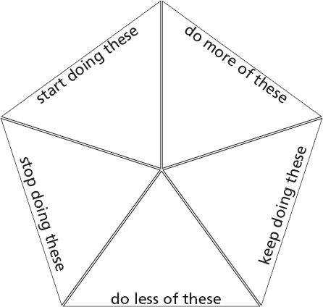
Committing to action
Notes:
The Key message(s) on this slide:
Committing to action
Detail:
In light of the session, what will you do, do more of, do less of, keep doing . . . .
This could initially be an individual reflection activity
It could be followed by teachers putting their key changes on to a large version of the pentagon as a public expression of what they are all seeking to do.

Slide 22
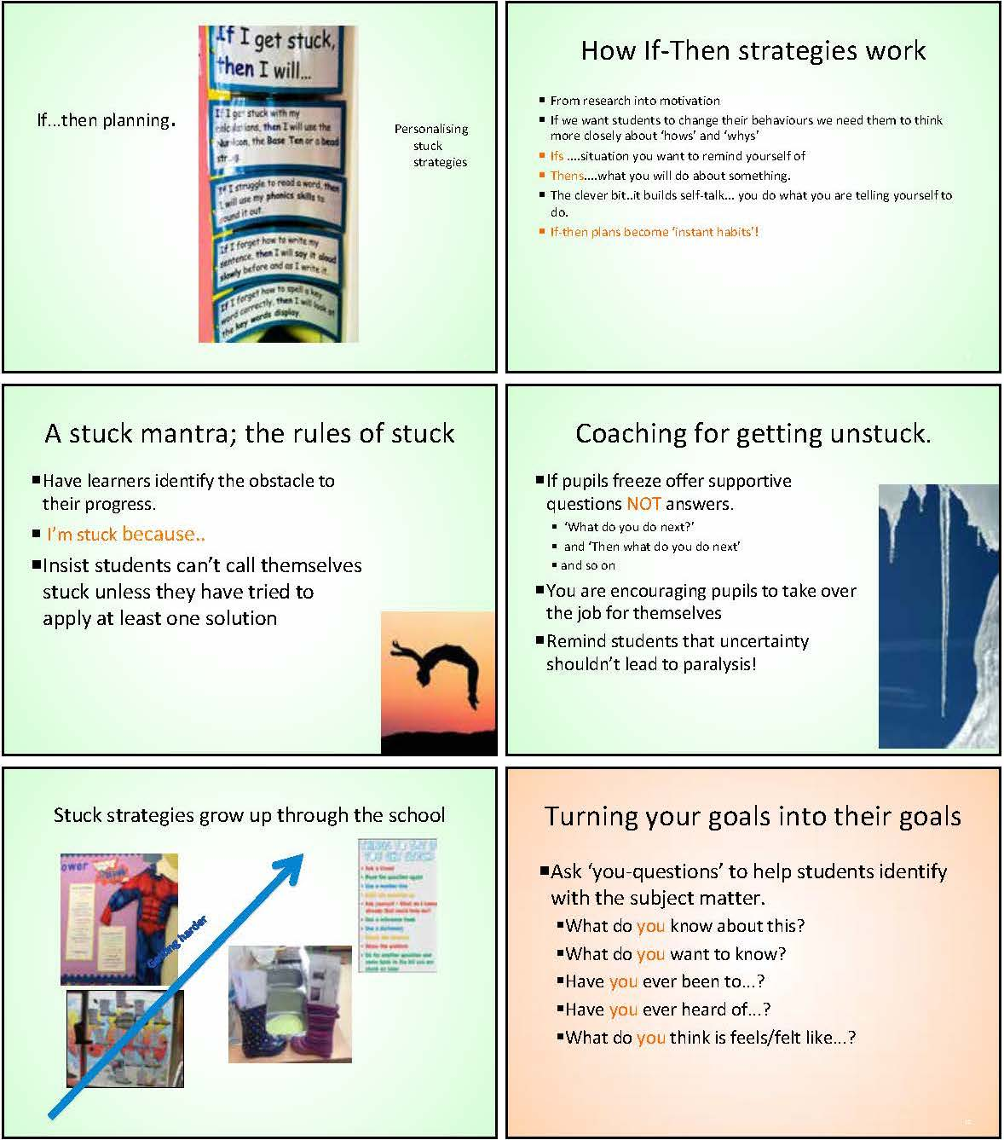
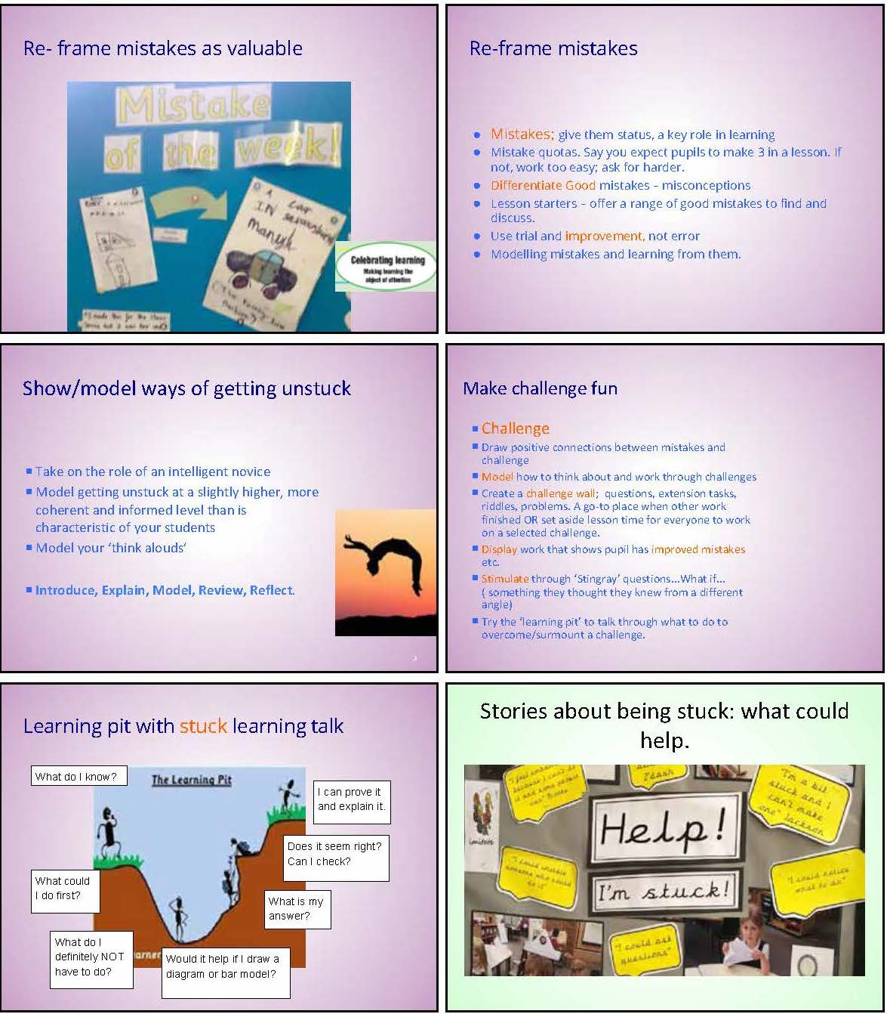
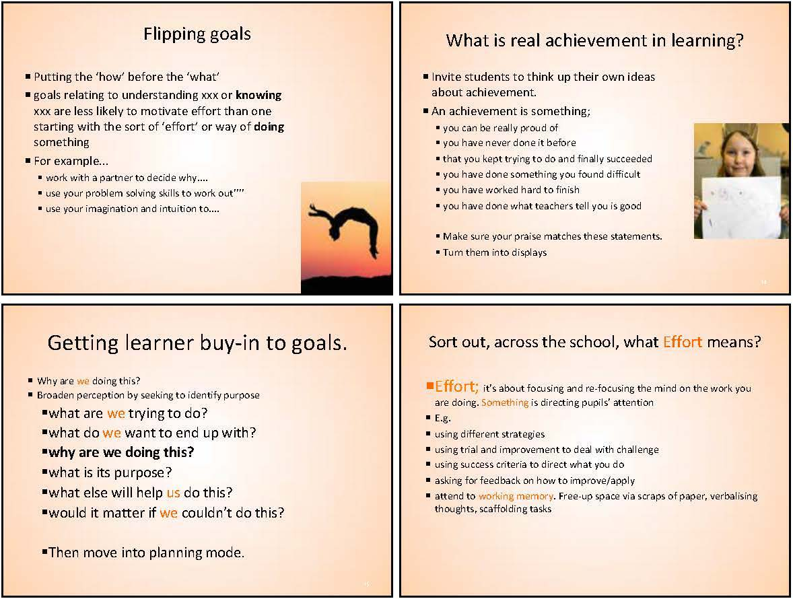
Card sort activity
Notes:
The Key message(s) on this slide:
These are the 15 cards in the card sort activity on slide 17
Detail:
This is not included as a slide to be shown, unless the discussion arising from the card sort means that you want to illustrate which card you or they are talking about.

