Slide 1
Managing. The supple learning mind
A guided conversation for managers of Learning Power

Slide 2
Line of argument through the slides
What does the learning journey look like? Not a quick fix.
Plan ahead, be prepared.
Achieve the change by developing staff; culture of enquiry
Manage the essentials of professional enquiry
Sort out what online content is available + when to tackle
Find out about the ‘how’ of team learning sessions/agendas
Keep in touch with the developments as they go along
Make a plan for use of the online units across the year
Take a look at what might be achieved over 3 years
Notes:
The threads that link these slides together:
The Building Better Learners 'journey'
The blended learning programme and teacher learning communities
How the story unfolds over time
Aim of the discussion: To consider/explore the different aspects of using the online modules in Nutshells 1 to support developments.
Objectives: By the end of the discussion participants will have explored:
What the journey might look like
The possible barriers/obstacles
How Teacher Learning Communities work
The development of a detailed plan of implementation

Slide 3
The learning journey: how long it takes
Focusing Year 1
Understanding the concepts
  reviewing current practice
  planning a route
Establishing Year 2-3
Increasing the variety of learning behaviours
  develop twin focused lessons
  infusing throughout the curriculum
  tracking progression
Developing Year 1
Build learning friendly cultures
  devolve greater responsibility to students
  develop learning talk
  incorporate reflection into learning
  celebrate the learning process
Enhancing Year 3-4
Increasingly build the use of learning behaviours into:
  the curriculum
  lessons plans....3 levels of inclusion
  task design...choice and challenge
  continually improving and deepening practice
Notes:
The Key message(s) on this slide:
The school's journey will take time, it is not a quick fix.
Detail:
This slide emphasises that developing children’s learning habits is a long-term (but rewarding) process which will take several years to become fully established in the school. However, research suggests that real improvements in pupils’ motivation, achievement and behaviour will become apparent within weeks of beginning the journey.
It is important that the approach is taken up in all classrooms – learning power is an entitlement for all children.
The focusing and developing stages are supported through materials in this pack.
Copyright © TLO Limited 2009
Building Better Learners | CPD Unit 1
Page ‹#›

Slide 4
Anticipating needs and difficulties
Think about a realistic and transparent framework for understanding what is being asked of teachers,
  what difficulties and demands will it involve
  what support will be available
  what is and what is not negotiable
  what timescales are envisaged.
  openness and clarity about understanding the change will remove any resistance by staff or parents.
Notes:
The Key message(s) on this slide:
We are asking a lot of teachers, what support structures will we need to provide?
Detail:
what difficulties and demands will it involve: The vast majority of teachers find it easy to buy into the vision of helping their students to become better learners - much like raising standards, what is not to like? Some may be less keen to make the necessary changes in their teaching habits / classroom culture; some may believe that because their teaching is ‘good’ they are already building these learning habits and hence it does not apply to them; some will want to do it, but need help to know what to do differently; some may be ‘initiative weary’ and reluctant to engage; a few may argue that they are paid to teach a subject and that this is not their responsibility; and some may just need time to think through the implications for themselves, to see the impact of the others’ experiments, before fully committing. Consider these your critical friends, the ones who will ask the awkward questions, who will want to see evidence of impact, who will in time become your most thoughtful advocates.
what support will be available: There is online support for the learning journey ahead, and colleagues will gain support from learning within a Teacher Learning Community. But the question goes beyond what we will give teachers to read, think about and do. It begs the question ‘how will we, as leaders/managers support individual teachers to navigate these changes.
Ask yourself: What help and support would you like if you were a main scale classroom teacher working through this programme? Then consider how you provide it!
what is and what is not negotiable: This is a tension that needs to be aired and resolved. Within a culture of small-scale action research and individual teachers experimenting, there are still some things that are not negotiable or open to experimentation. For example, a common language for learning will no longer be common if teachers are free to experiment with changing it as they wish.
Ask yourself: As we progress through the online modules, which decisions need to be taken at whole school level and the outcomes applied by everyone, and which decisions can safely be left to teams and/or individuals?
what timescales are envisaged: Habit change is hard, and takes time, and the school still has ‘the day job’ to attend to. Both suggest the need to go slowly and not rush the process. And yet if you go too slowly the impetus of initial enthusiasm might evaporate. The message is ‘gentle pressure, relentlessly applied’. Many schools try to get all the way through Stepping Stones 1 in an academic year. This is probably on the optimistic side, but taking more than 18 months is likewise probably too slow. You know your school and the scale of the journey, and how you have (already?) carved up the directed time budget. These local constraints will determine the timescales you envisage.
Ask yourself: What is the least time we can possibly do this in? What is the maximum time we dare allow without risking loss of impetus?

Slide 5



Achieve the change through blended learning programmes
Individual learning
Online learning sessions
Read, think, prepare
Team session
Tight, focused agenda
Monthly meetings
Share, discuss, plan
Developing practice
Planned gradual changes
Monitor impact
Share with coach
Notes:
The Key message(s) on this slide:
This an overview of the blended learning programme of online support, individual and team reflection, and small scale action research.
Detail:
.
Now to the blended learning programme.
Talk through the learning process diagram
Content about learning and learning behaviours are fed to teachers, working at their own pace, each month. these are absorbed and thought about.
Teachers then meet as groups to discuss the ideas, firm up understanding and plan how to use the ideas and change their practice.
In later sessions they bring accounts of their classroom experiments to the group. These are probed and extended by the group
After the team session teachers put their plans into action and monitor the effects.
possibly discussing with a coach if coaching is part of the school’s CPD support system.

Slide 6
Professional development and community of enquiry
encourage teachers’ openness about and enthusiasm for their own learning
strengthen a whole school ethos of non-defensive, supportive and collaborative enquiry
Without the development of professional intelligence, teachers are unlikely to ‘practise what they preach’, and the process of culture change is slowed.
Notes:
The Key message(s) on this slide:
Creating a community of enquiry is an essential cornerstone of professional development through a Teacher Learning Community
Detail:
Changing or developing one's working practices is hard and delicate work. It works best when you can meet in a safe professional environment in which to explore and plan how you could change and then share and probe the triumphs, tribulations and outcomes of your classroom experiments. Research into teacher learning communities by Dylan Wiliam, of Assessment for Learning (AfL) fame, describes such teams as:
a small group of teachers who meet together regularly
to deepen their understanding of an approach,
to commit to trying out new things,
to reflect on and share their experiments with each other.
Teacher learning communities are the engines of teacher development, but safety is the key.
We want our students to experiment and explore, to 'fail in safety', to learn in an environment where it is ok to have a go, to make mistakes and to learn from them.
“In the same way, teachers themselves need to be in a safe environment to learn about the success or otherwise of their teaching from others.”
( John Hattie, Visible Learning for Teachers.)
Ask yourself: What do we currently do to ensure that teachers can 'fail in safety'? What more could we do?

Slide 7
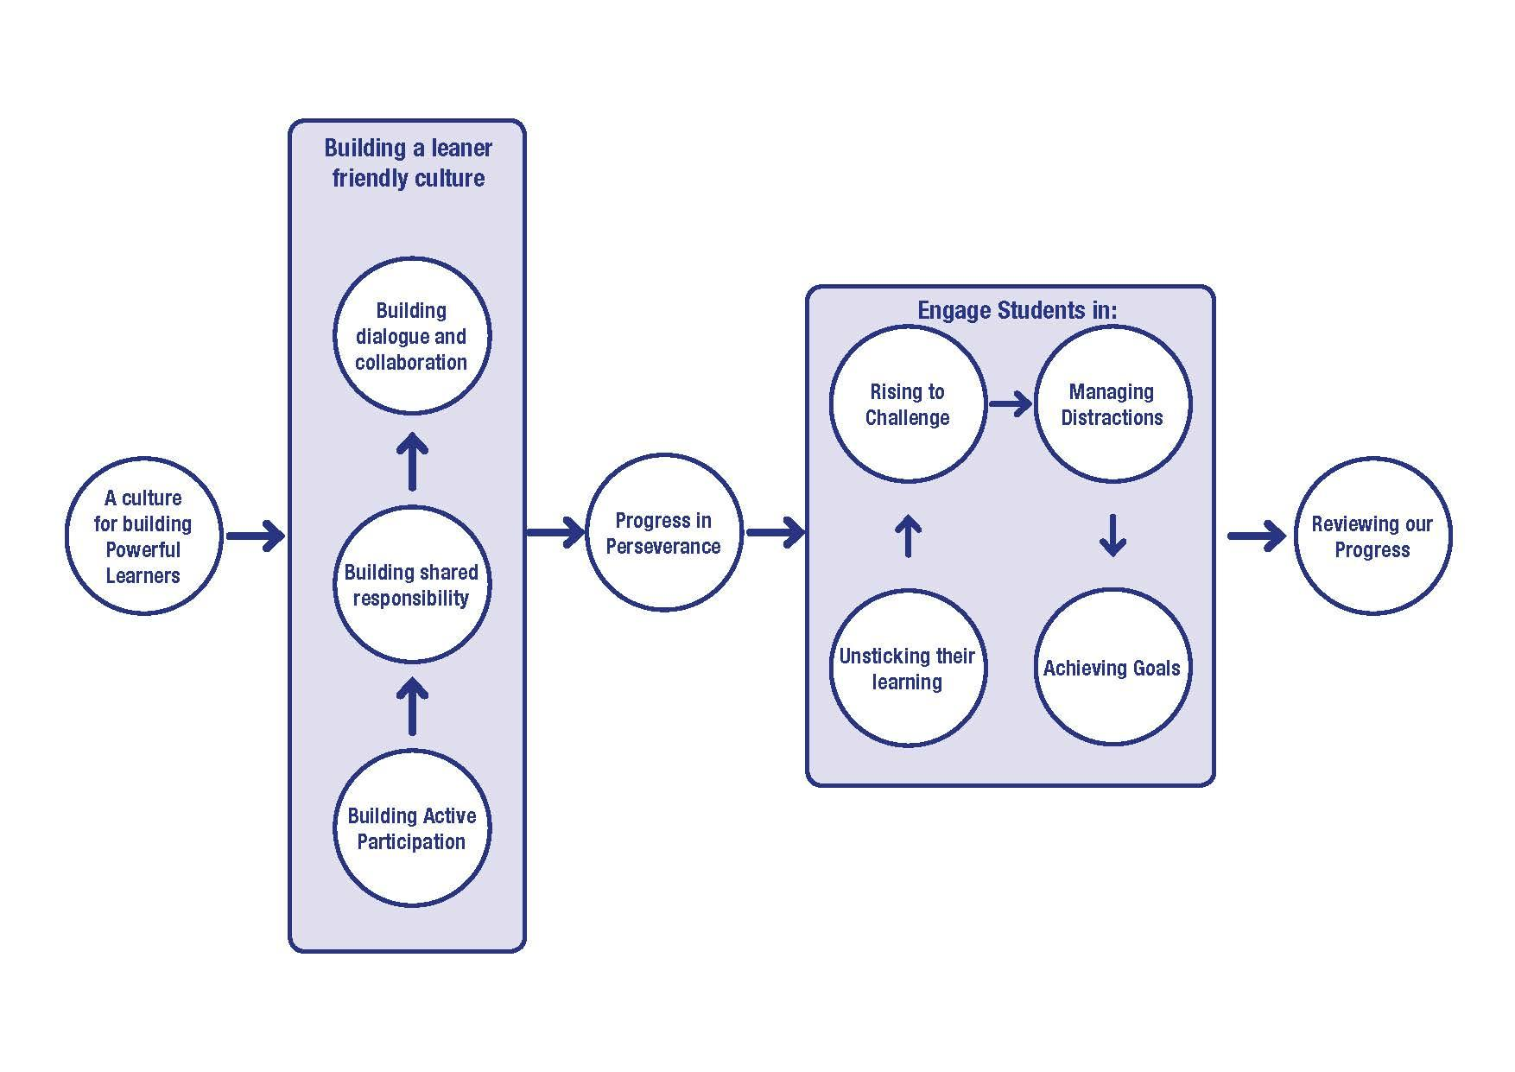
Online units in Nutshells Phase 1
Notes:
The Key message(s) on this slide:
These are the 10 online modules in Nutshells 1
Detail:
There is an implied order in these modules:
We strongly recommend that teachers start with the culture module – it sets the scene for the others that follow.
Followed by the three modules that are designed to move classroom culture to being less teacher-focused:
Building Active Participation;
Building Shared Responsibility;
Building Dialogue and Collaboration;
Progress in Progression is an information module that tees up the 4 modules on aspects of Perseverance - Unsticking your Learning; Rising to Challenge, Managing Distractions; and Achieving Goals.
The final module, Reviewing our Progress is a leadership/management module that supports reflection on what has been achieved over the lifetime of Nutshells Phase 1. Although it is scheduled last, leaders/managers should take a look at it very early on as it will suggest ways in which they might conduct baseline measures against which to subsequently evaluate progress.
Additionally there is a senior leaders only support module called “Strategic issues and coaching notes”, which covers in greater depth many of the aspects unpicked in these management sections.

Slide 8
Making the most of the online units
Set up Professional Learning Teams
  monthly?
  use the discipline of the tight team agenda in the online units
  take an interest in staff learning enquiry plans
  be aware of feedback from learning enquiry results
  discuss and agree which ideas (from the online material) should become policy across the school
Notes:
The Key message(s) on this slide:
To make the most of the online units, we need to be careful in how we establish, support and respond to professional learning teams.
Detail:
Timings: These will be dictated by the pace you choose to proceed at.
Ask yourself: Do we risk losing momentum if they are too widely spaced? How will we reconcile directed time with this?
The discipline of the tight team agenda in online units: The online modules contain a tight agenda for team meetings. This need for this has been extensively researched and should not deviated from.
Take an interest in staff learning enquiry plans: At each meeting, teachers will develop small scale enquiry plans. An example might be: ‘If we create together a range of strategies that they can use when they are stuck, will their inclination to ask for help without first trying it for themselves diminish?’
Ask yourself: How will you keep abreast of what these plans are? How will you demonstrate your interest? How will you offer support?
Be aware of feedback from learning enquiry results: At the next meeting, they feedback on the progress or otherwise that they have made.
Ask yourself: How will you discover the outcomes of these enquiries?
Discuss and agree which ideas (from the online material) should become policy: Leaders/Managers need to be aware of the outcomes of these learning enquiries and spot the ones that appear so important that they should be adopted in all classrooms. It is the point at which the negotiable becomes the non-negotiable.
Ask yourself: What will the mechanisms be for this? How much consultation will be involved? How will we ensure that we are sufficiently responsive that the moment is not lost?

Slide 9
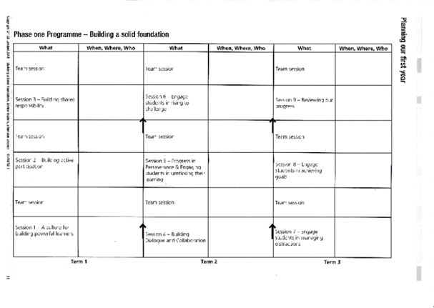
Plan the use of the online learning units
Notes:
The Key message(s) on this slide:
How will we tackle the online units, in what order, when?
Detail:
The group now needs to work together to talk through some of the administrative decisions they need to make.
The table scaffolds this discussion.
When will we start?
Will we expect staff to do the individual work in their own time or will they be given time to do it?
What teams will we have? subject teams, mixed subject teams. how big is a team,?
When will the teams meet, when in the month, how long after the individual sessions?
Who will be leading which team?
And so on......
WHAT PHASE 1 DEVELOPMENT LOOKS LIKE IN DETAIL
This is a planning tool. When will the online learning happen....in which month. When will the relevant team meeting take place?
Often staff are encouraged to look at an online unit in .say week 3 of the month and the team meeting is arranged for week 4.

Slide 10
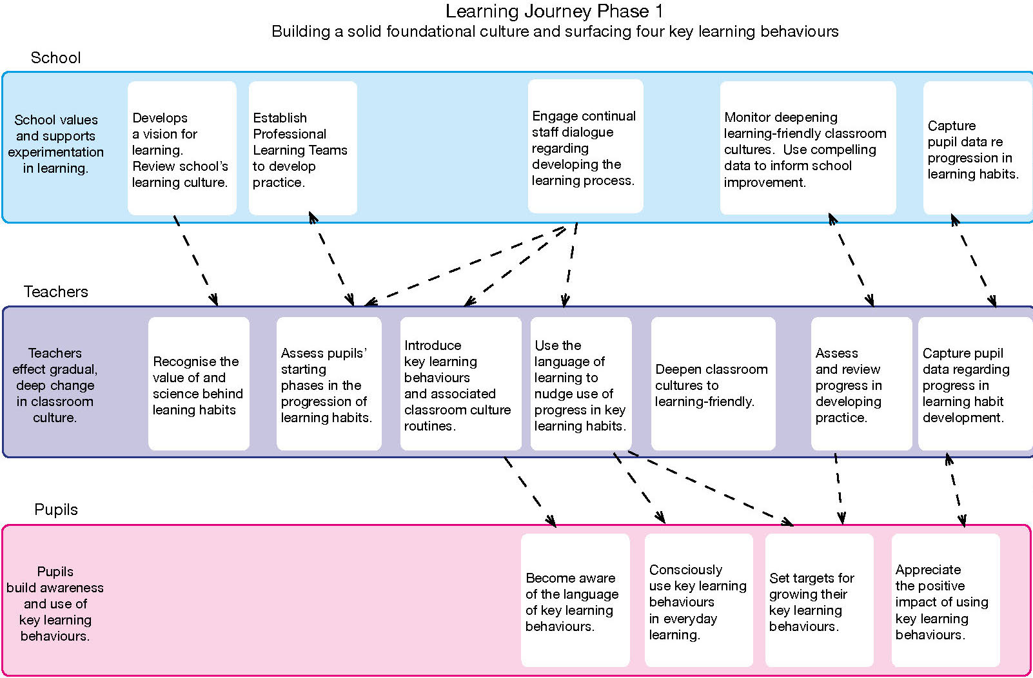
Learning Journey Phase 1.
Notes:
The Key message(s) on this slide:
Changes in leadership and teaching drive changes in student learning
Detail:
Phase 1 is supported by Nutshells 1.
Phase 1 in detail.
Building a solid foundation for understanding classroom culture and developing a focus on progression in perseverance.
This phase may take a year to 18 months to complete.
There are 3 levels of development;
what the school leadership needs to do
how this underpins and enables teachers to develop
and how teacher development similarly underpins the what and how of pupil development as learners

Slide 11
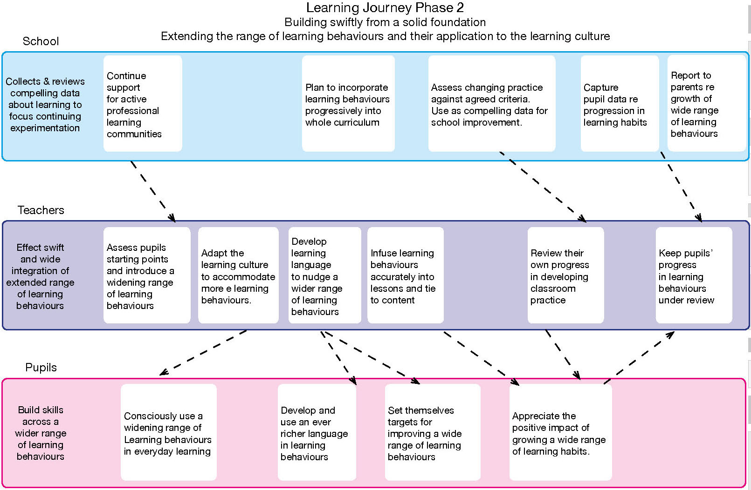
Learning Journey Phase 2.
Notes:
The Key message(s) on this slide:
Phase 2 goes deeper and expands the range of learning behaviours.
Detail:
Phase 2 is supported by Nutshells 2
Phase 2 Building swiftly from a solid foundation
Extending the range of learning behaviours and their application to content
The different sorts of development that happen in phase 2.
Again the changes in the teaching line happen approximately monthly because the phase 2 online course will introduce a new behaviour each month or so.
The school could start with any of the learning habits and move on in any order OR it could group them; starting with three that cover, for example, attentiveness....revising, noticing and listening/empathy.
[The modules in Nutshells 2 are : Questioning; Making Links; Reasoning; Imagining; Capitalising; Noticing; Listening; Collaborating; Planning; Revising; and Meta Learning.]
Note too the inclusion of parents being kept informed of their child’s progress in learning behaviours.
Emphasise the importance of monitoring the developing practice and changes in student behaviour.

Slide 12
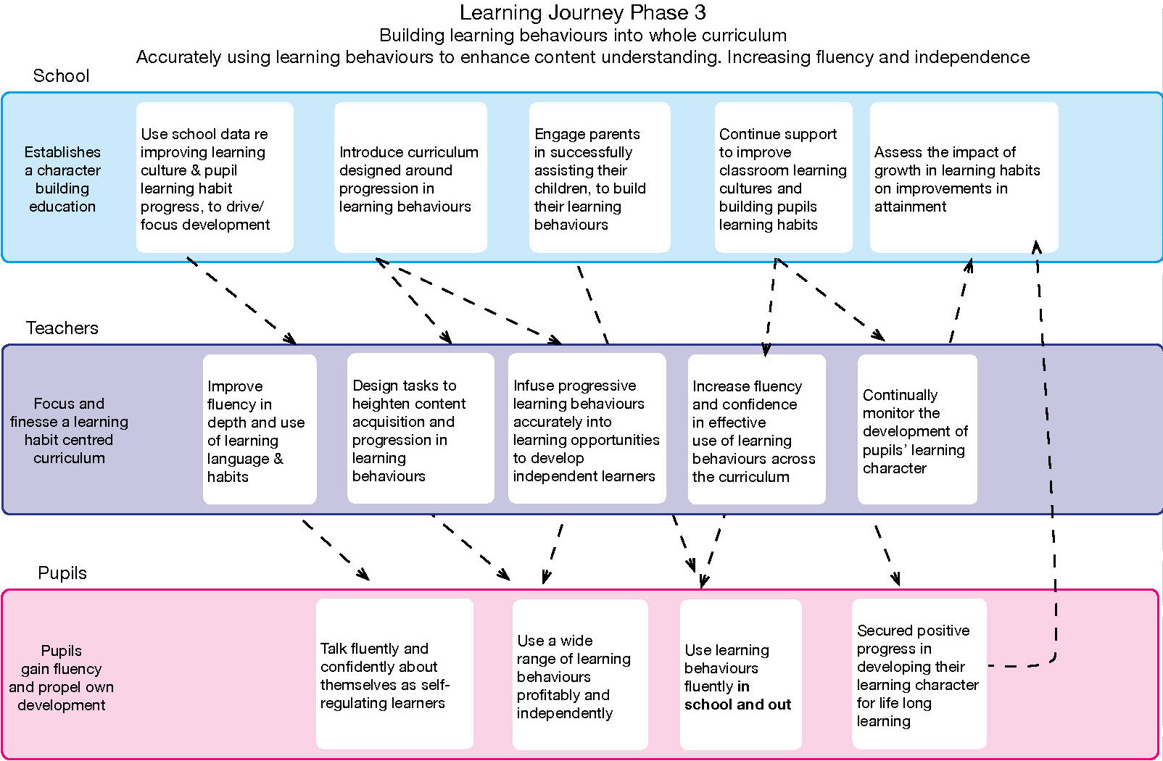
Learning Journey Phase 3.
Notes:
The Key message(s) on this slide:
Phase 3 builds on phase 2 to Build Better Learners
Detail:
Building learning behaviours into whole curriculum.
Accurately using learning behaviours to enhance content understanding. Increasing fluency and independence.
Phase 3 is about infusing all the learning behaviours across the curriculum at the level needed, the greater fluency of use, more accurately linking content and learning behaviours and pupils being able to transfer the habits to life elsewhere
AT PRESENT WE DO NOT HAVE ANY ONLINE PRODUCTS TO SERVE THIS PHASE 3 BUT WE ARE WORKING ON IT.

