Slide 1
Managing. Growing learning habits
A learning conversation

Slide 2
Line of argument through the slides
Become aware of the sort of progression in learning behaviours that might be possible
Think about ways of tracking behaviours across the school.
Think... how to monitor enquiry projects relating to the ‘between the lines’ tool on slide 5
Consider using the Perseverance Monitoring tool as on slide 6
Consider all the other progression related issues (slide 6)
and plan when/how to monitor them.
Notes:
The threads that link these slides together:
Progression puts the building into Building Learning Power;
Tracking progression is a key measure of impact.
Aim of the discussion: To consider/explore how the school will keep a close eye on developments and generate evidence to show that learners are becoming increasingly more effective learners.
Objectives: By the end of the discussion participants will have:explored:
The progression chart for Perseverance, and considered where learners are at this point;
Where students might be as they leave the school;
How progression might be tracked;
How leaders might maintain an overview of how classroom experiments are affecting perseverance levels;
How they might undertake some longitudinal evaluations to monitor developments.

Slide 3
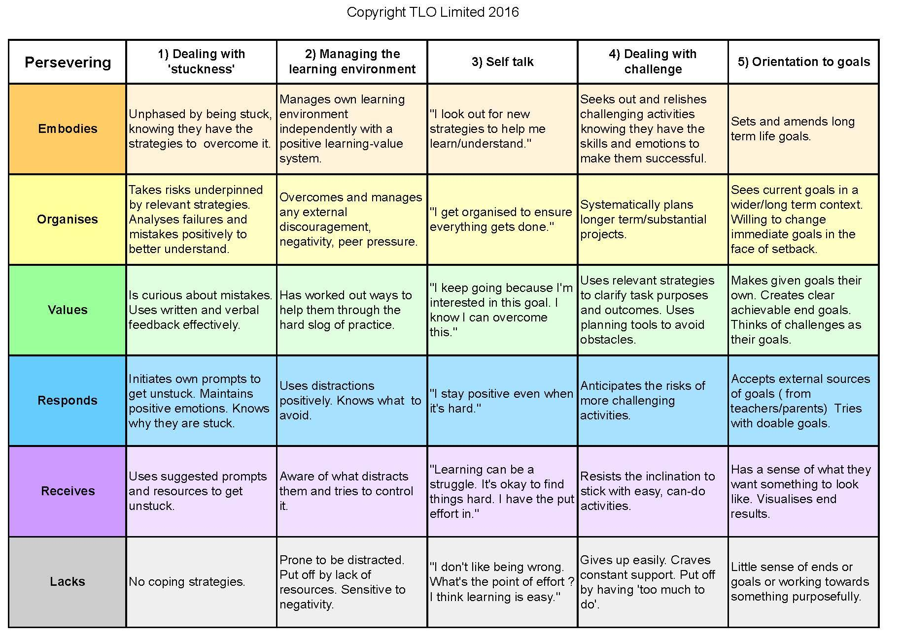
The complete perseverance chart
Where are students now?
Where do you want them to be by the time they leave the school?
Notes:
The Key message(s) on this slide:
​
This is one example of progression in a learning behaviour, in this case Perseverance. Read it from the bottom upwards, from unskilled in the bottom, grey row to highly skilled in the top, orange row.
Detail:
Consider your youngest learners. Ignoring the highly tenacious and the insufferably ready giver-uppers, where are the majority of your youngest learners? Which ‘colour’ best describes them?
Repeat for your oldest learners.
Do you have a sense that learners become increasingly perseverant as they pass through your care?
Whether they do or not, why does this happen – by accident or design?
Be pragmatic – the majority of students will not reach the top of the grid before they leave you. But where would you hope that the majority would be by the time they leave?
The gap between where they are and where you hope they will be defines what needs doing. The question becomes ‘how do we teach in order to secure the skills between what they can do on entry and what we hope they will be able to do on exit.’
Note - a similar discussion, with different prompts obviously, could be held around any of the other progression charts that you use in the future (in the Questioning/Collaboration/Revising modules, for example).

Slide 4
Keeping growth under review
Design explicit ways of tracking students’ growth as confident and independent learners, and of evaluating what appears to stimulate that growth.
Without some creative thought, commitment and honesty about this, traditional forms of student assessment and certification will continue to determine what counts as ‘high stakes’ learning and ‘bottom line’ success in school.
See links in the notes to early tracking instruments.
Notes:
The Key message(s) on this slide:
​
Tracking progression is both important and possible
Detail:
There are 2 key monitoring tools in this section:
The ‘between the rows’ tool (slide 5) - keeping an eye on the action research that teachers are undertaking
The ‘Monitoring Changes in Perseverance’ tool (slide 6) - monitoring shifts in the perceptions of teachers in relation to learner perseverance
Leaders / Managers would do well to read, as a minimum, the Online Unit - ‘Tracking learners progress as learners’
And for a further read, the Book Chapter - ‘A deeper read exploration’.

Slide 5
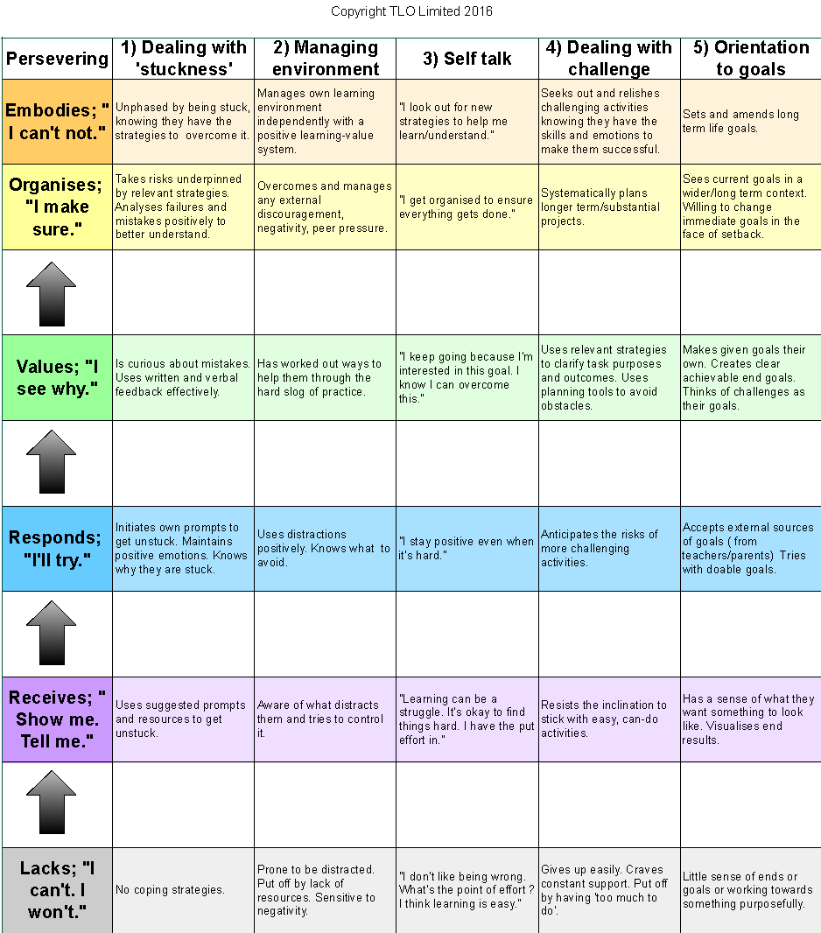
Working between the lines
Notes:
The Key message(s) on this slide:
​
Keeping an eye on teachers’ classroom experiments
Detail:
As teachers work through the 4 modules relating to perseverance they will be working ‘between the lines’, trying to nudge learners upwards on the progression chart.
Team leaders / managers could ask teachers to identify which ‘gap’ their proposed intervention is looking to bridge.
For example
the teacher who is introducing a stuck poster is aiming to bridge the gap from grey to purple in the ‘stuck’ column;
the teacher who is focusing on ‘I’m stuck because’ is going from purple to blue.
This would have 2 effects:
It would give a good indication of where teachers feel that their students are in terms of the skills that they do and do not have;
It would encourage teachers to think carefully about whether their proposed intervention is well-matched to the stage of development of their students.

Slide 6
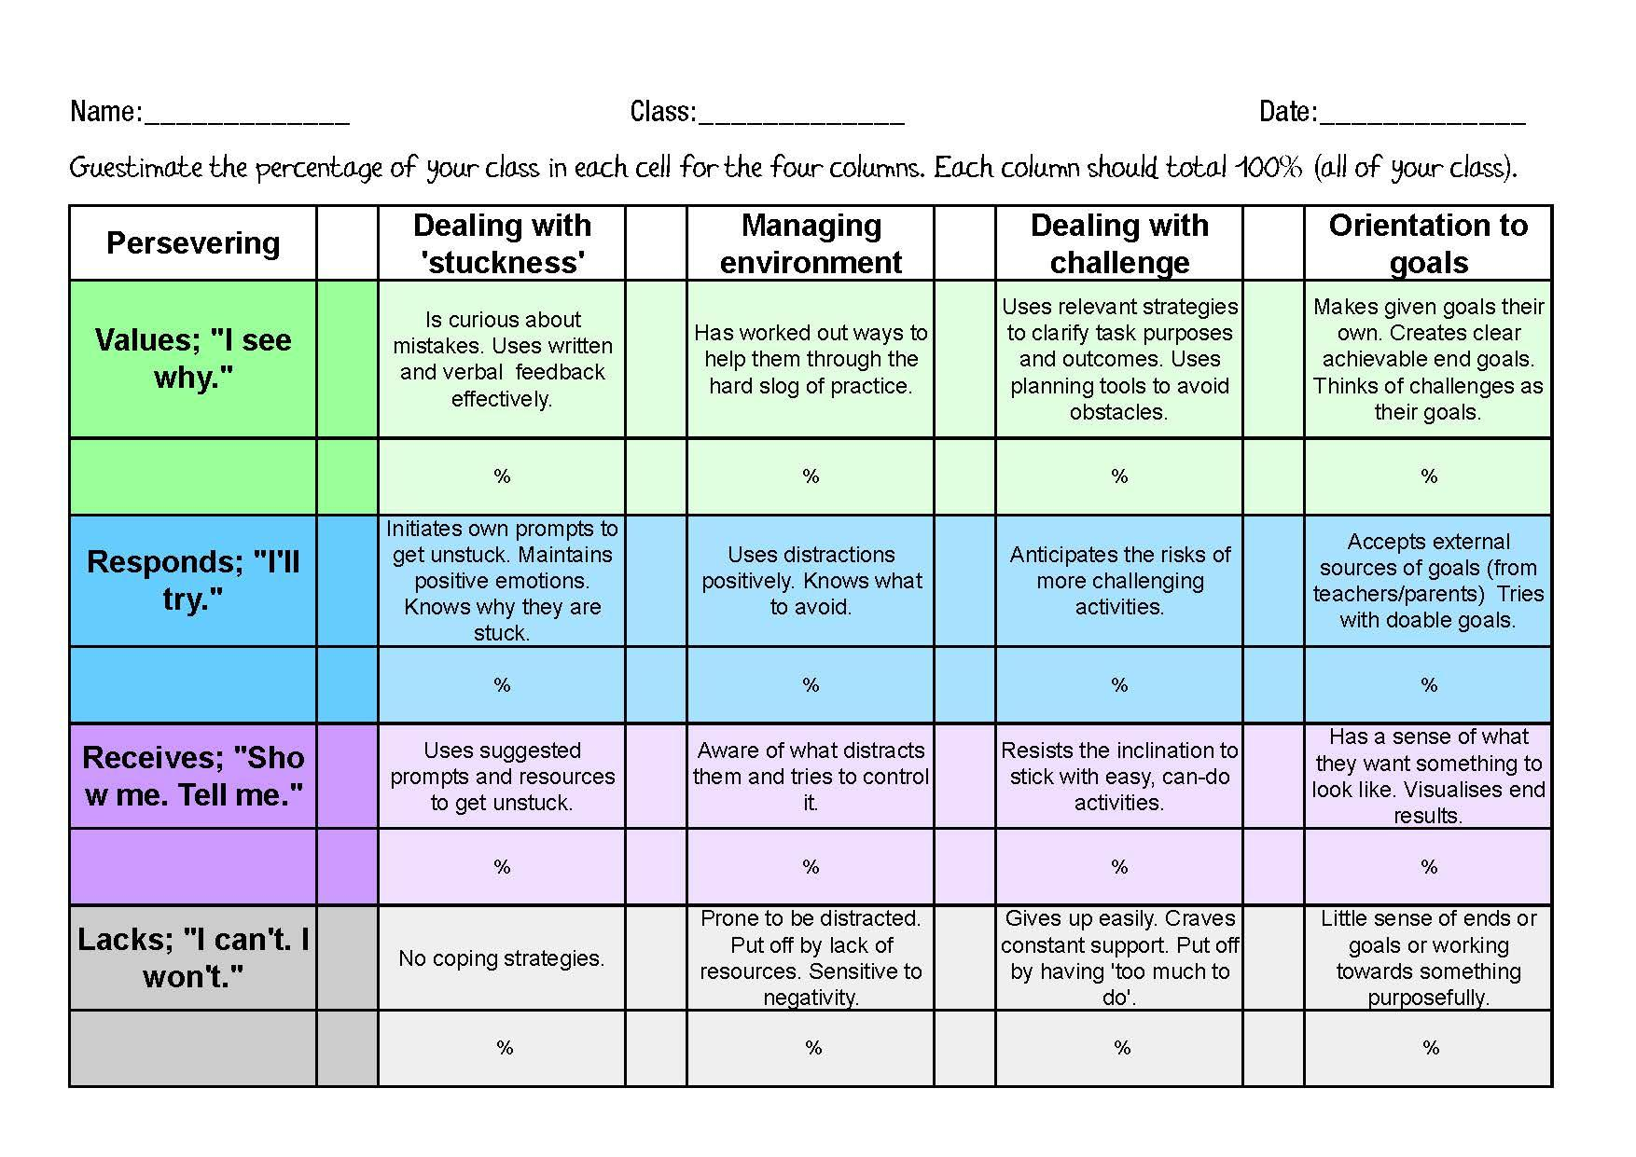
Monitor changes in students’ perseverance
Notes:
The Key message(s) on this slide:
A suggestion for before and after monitoring
Detail:
Download and print copies of the ‘Growth in Perseverance tool’.
Before they undertake the 4 online modules on Perseverance in Nutshells, ask teachers to Guesstimate the % of their class currently in each cell of the four columns.
For example, a teacher with students who are weak in reacting to being stuck might respond 50%, 40%, 10%, 0% (going up from the bottom of the stuck column), whereas a teacher with learners who are better able to deal with being stuck might respond 20%, 30%, 30% ,20%.
No need for great accuracy, a gut instinct will suffice.
Consider how you might collect, collate and share their responses.
After they have completed the 4 modules and undertaken classroom experiments in relation to all of them (this could well be two or more terms after the start of their work on perseverance), ask them to complete the same sheet without reference to what they thought previously.
Collect, compare and contrast. The difference indicates the learning gains achieved through the interventions.
Ask yourself:
Which column appears to have seen the greatest improvement?
Which the least?

Slide 7
Other progression related things to keep an eye on in year 1
Learning language becoming more sophisticated
Students understanding of learning deepening
Design of tasks being linked to progression
Students setting their own LP targets
Inclusion of statements from progression charts being included in reports for parents
Plan when to look out for other progression related issues.
Notes:
The Key message(s) on this slide:
There are aspects beyond Perseverance that need to be monitored
Detail:
Consider how leaders might keep an eye on:
The learning language and understanding of learning. How will you collect evidence that:
Teachers are using the school’s agreed learning language?
They are becoming increasingly fluent?
Learners are becoming aware of the language?
Learners are better able to use the language to discuss/understand learning?
[Think teacher and learner interviews]
Design tasks linked to progression. How will you assure yourself that teacher experiments are well-linked to learner skills. [Think how you might use slide 5 for this.]
Students setting their own learning power targets. How / when will you ask learners the questions:
How do you want to improve as a learner?
What are you doing to achieve this?
Impact on Reports. How do expect reports to parents to change? How will you ensure that teachers’ advice uses the language of the progression chart(s)?

