Slide 1
Strategic. Learning Power What and why.
A guided conversation
for strategic leaders

Slide 2
Line of argument through the slides
Education as a preparation for the future
What does the future look like? How is work changing?
There's one essential skill...learning how to learn
Research shows that learning is a learnable craft
So how do we want our learners to be?
Research highlights four essential learning dispositions
Building powerful learners involves changing how we function in the classroom, in developing staff and in evaluating change
The outcomes for students go beyond exam success
A student explains how she is a powerful learner
To achieve this requires a long term professional learning programme
Notes:
The threads that link these slides together:
In times of change, students need to be equipped to deal with an uncertain future
There is more to Education than examination success
Education is not the same as ‘Schooling’
Aim of the discussion: To consider/explore the school’s policy and direction in developing students’ learning habits through the use of Learning Power.
Objectives: By the end of the discussion participants will have explored:
The implications of the changing economy of the 21st Century;
How you want students at your school to be as learners;
Whether learning is itself a learnable craft;
The 4 dimensions or domains of learning and what they might mean for learners, for teachers, and for the school;
How a blended learning programme for teachers might support the changes.

Slide 3
Education is a preparation for the future.
That means: helping to give all young people the knowledge, skills, dispositions, and values they need to thrive and contribute to society, in the face of the challenges and opportunities they will meet. The curriculum and means of assessment must support that preparation. (Claxton 2008)
The job of a school is to give young people the knowledge, skill and character that will enable them to flourish in the face of uncertainty: ‘strong minds for tricky times’. (Claxton June 2010)
Is this what we are doing now?
Notes:
The Key message(s):
While we may, on the surface, be doing ok in terms of attainment/achievement measures, are we also preparing our students to live well in the 21st Century?
Detail:
In 2008 Claxton was saying there is more to education than knowledge and skills… dispositions (habits), values and attitudes…
In 2010, in preparing for his next book, signalling how important this preparation is… because society is handing them some very tough times.
But we may have lost sight of this. . What has happened, and happening, in many schools is a focus on the knowledge and skills… the agenda to raise test scores.
What this has done has narrowed the curriculum, narrowed children’s experiences, failing to equip them with the character to thrive in the real world.

Slide 4
The changing nature of work
Which of the following categories of skill is disappearing from the work-place most rapidly?
  Routine manual
  Non-routine manual
  Routine cognitive
  Complex communication
  Expert thinking/problem-solving
Notes:
The Key message(s):
A challenge to what we think we know about changes in the workplace.
Detail:
A short discussion. Most will, correctly, go for the manual ones.
But how many will see that routine cognitive is also on the downward slide?

Slide 5
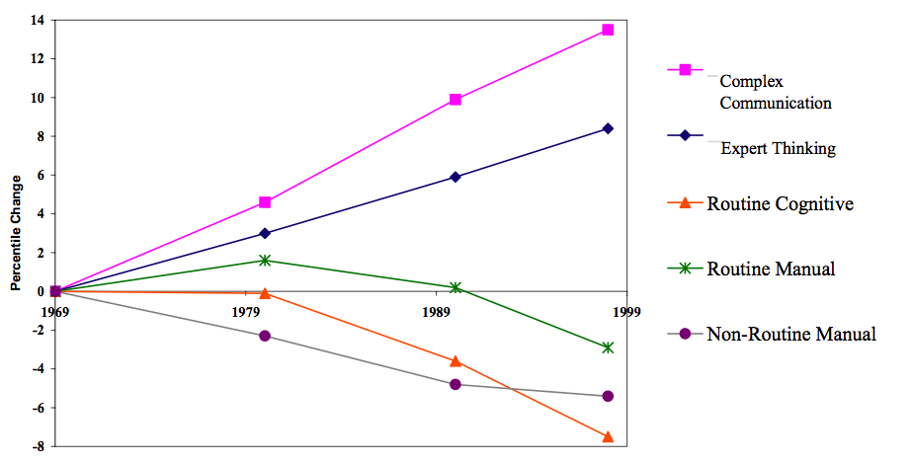
... need to prepare students for an unknown future
Autor, Levy & Murnane, 2003
Notes:
The Key message(s):
Routine cognitive is also in decline, Only Expert Thinking and Complex Communication are rising.
Detail:
Routine Manual – repetitive assembly type roles, construction, production, repair roles
Non-Routine Manual – service occupations, janitorial roles, car/lorry driving roles, assisting and caring roles
Routine Cognitive – sales, office roles,
Although this graph is several years old now we are increasingly actually experiencing this reduction.
Expert Thinking – non routine cognitive roles that require problem solving skills
Complex Communication – management and leadership type roles

Slide 6
Learning for the future
The skills that you can learn when at school will be obsolete by the time you get into the workplace, except for one skill.
The one really competitive skill is the skill of being able to learn ... not to give the right answer to questions about what you were taught in school, but to make the right response to situations that are outside the scope of what you were taught in school.
Pepart 1998
Notes:
The Key message(s):
The ability to ‘learn’ underpins the non-routine cognitive roles that are on the increase
Detail:
So the model that says learn while you’re at school, while you’re young, the skills that you will apply during your lifetime is no longer tenable. The skills that you can learn when you’re at school will not be applicable. They will be obsolete by the time you get into the workplace and need them, except for one skill.
The one really competitive skill is the skill of being able to learn. It is the skill of being able not to give the right answer to questions about what you were taught in school, but to make the right response to situations that are outside the scope of what you were taught in school. We need to produce people who know how to act when they’re faced with situations for which they were not specifically prepared.
(Pepart, 1998)

Slide 7
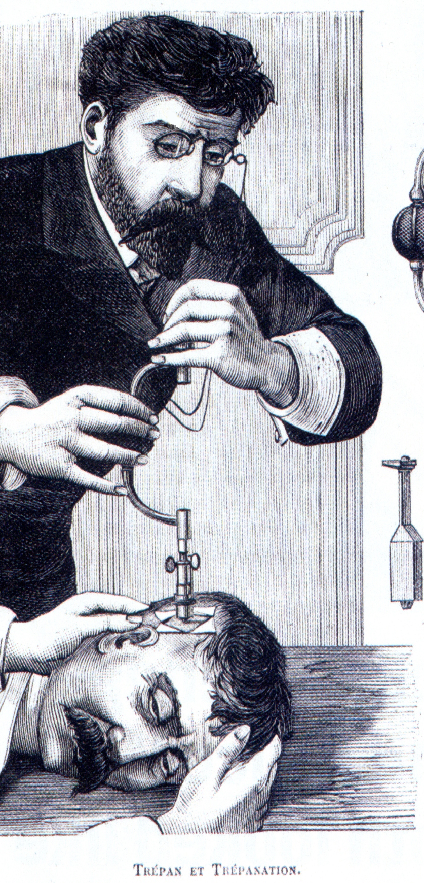
An overview of learning and your brain
Is Learning Learnable?
Old idea
  intelligence is fixed
Research into the brain
  mind is improvable
Intelligence is
  ‘the sum total of habits of mind’
  Resnick
Habits can be changed and developed
Intelligence is
  ‘knowing what to do when you don’t know what to do’
  Piaget
Getting stuck is the liberating point, when learning begins
Notes:
The Key message(s):
Learning is a learnable craft at which everyone can get better
Detail:
Key points
explain the research background to BLP.
We now know L2L is possible
New ideas on nature of intelligence
Profession has duty to use these new ideas in teaching
Currently students are too spoon fed
Students needs to be prepared for a fast changing world
Background notes
This slide draws together a range of arguments that together make up a convincing case for BLP. It is about shifting the focus from teaching to learning and developing the habits of lifelong learners.
The flow of the argument goes as follows:
• Ideas about intelligence have moved on as research into the brain continues at a great pace.
• We know that learning is itself learnable and ideas about intelligence (Resnick/Piaget) confirm this.
• As professionals in the learning business we need to use these ideas (even have a duty to).
• Research into what has been happening in schools suggest that the longer students stay in school the more dependent they are becoming (spoon feeding).
• Students need to be prepared for a lifetime of learning and the skills to deal confidently with whatever life throws at them.

Slide 8
What’s the point of education in our school?
How do we want our students to be as learners?
Leading on to considerations of . . .
How will they become this?
How can our teaching build their learning capacity?
Where are we now? What will it take?
How should we lead our school with learning in mind?
Notes:
The Key message(s) on this slide:
There is more to Education than just getting good exam results
Detail:
To stimulate a discussion about how we want our school to be.
The first question is the important one - How do we want our students to be as learners?
Use it as a prompt to explore things like problem solving, critical curiosity, creativity, self-regulation etc.
Questions 2/3/4/5 follow on from Question 1 and are addressed in the upcoming slides.

Slide 9

Research suggests successful learners are disposed to…
What do we want our students to be as learners?
…be emotionally engaged. Resilient disposition
…use a wide cognitive range. Resourceful disposition
…engage socially. Reciprocal disposition
…take strategic responsibility. Reflective disposition
Notes:
The Key message(s) on this slide:
Learning has 4 key dimensions or domains of learning
Detail:
Slide goes back to the foundations of learning. It introduces the notion of learning dispositions.
Dispositions are deeper than skills. They describe what people have a tendency to do. They underpin people’s whole approach to learning – being ready and willing as well as able.
NB The dispositions cover the emotional, social and cognitive domains of learning together with how we take personal responsibility for learning.
Dispositions can be improved and deepened when students become aware of them and are encouraged to use them positively..

Slide 10
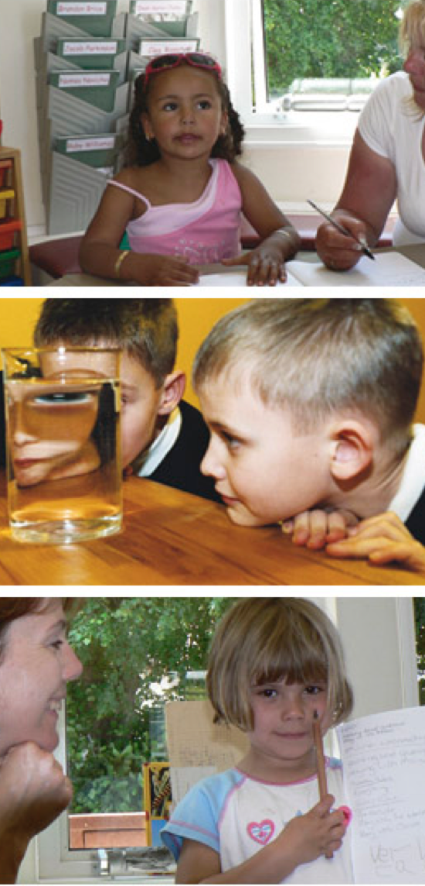
Building Powerful Learners is about:
students developing long term learning habits to stand them in good stead for a complex world
a way of educating that has learning at its heart
classroom cultures becoming learning-friendly
teachers using a forensic, more precise understanding of learning
schools playing a bigger educational game . . .
Notes:
The Key message(s) on this slide:
Developing students’ learning power means there will be changes in student learning behaviours and classroom practice and culture
Detail:
Students will only develop these skills if teachers and classroom practice change first.
This will not happen unless the school also ‘plays’ what has been referred to as a ‘bigger educational game’

Slide 11
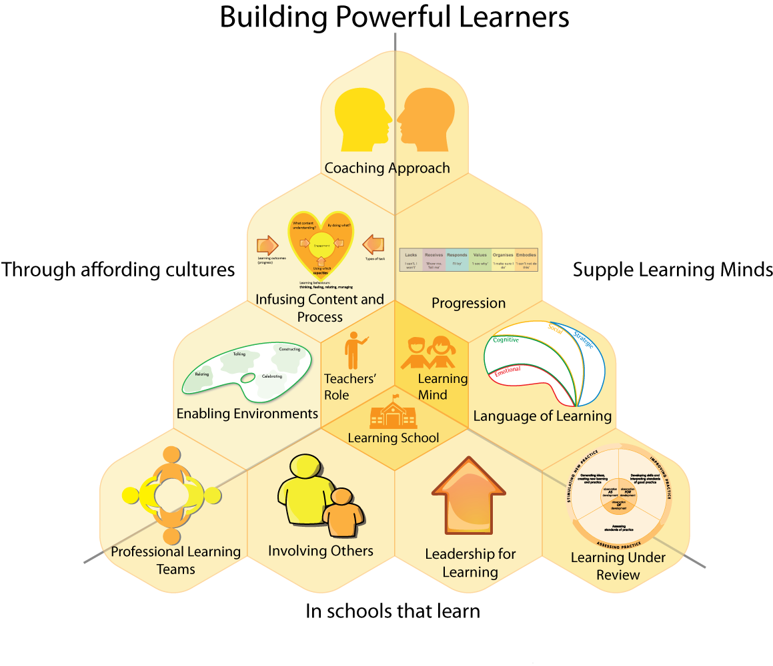
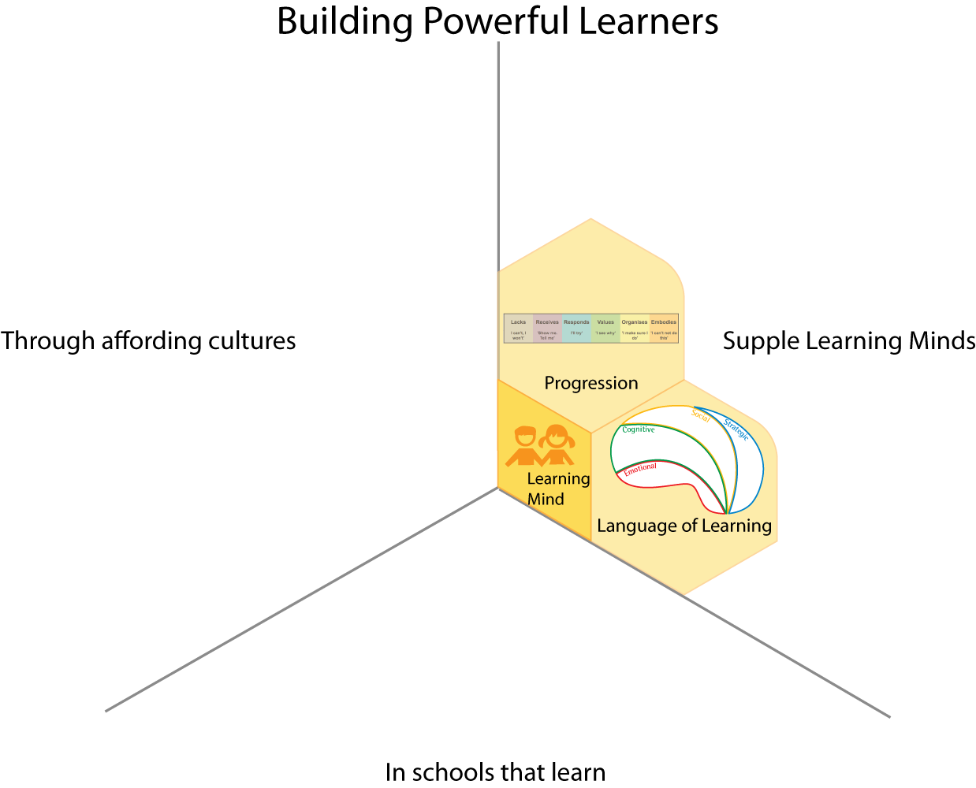
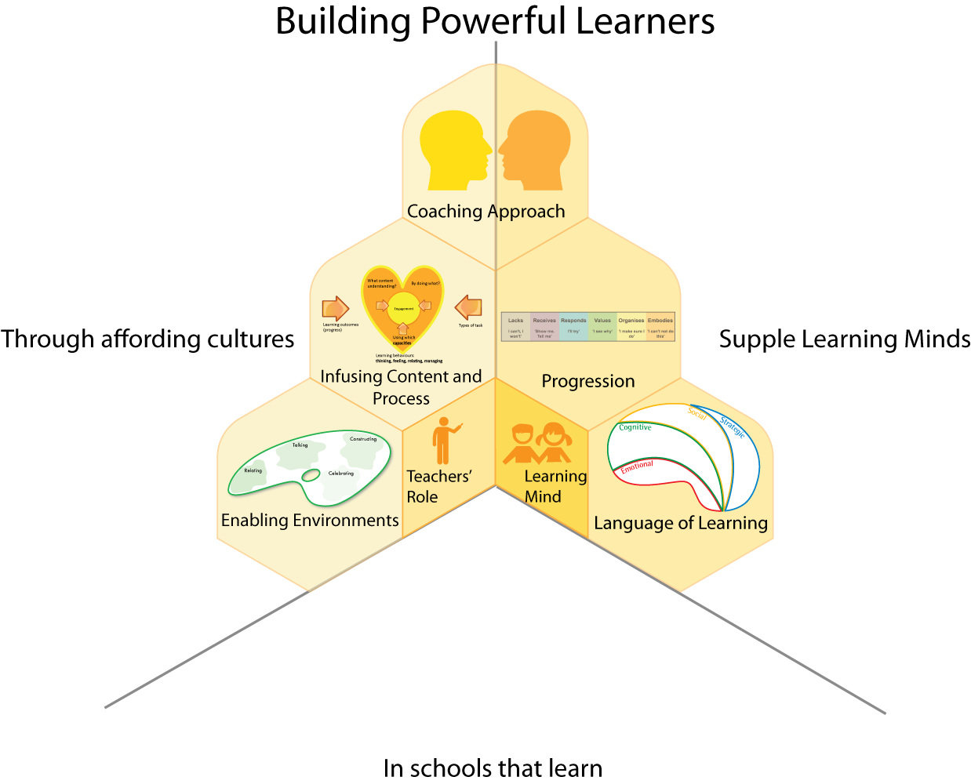
Breadth of change
Notes:
The Key message(s) on this slide:
The changes will impact on all areas of school life
Detail:
The three areas:
1 Building students supple learning minds (the learning behaviours we are seeking to develop)
2 the classroom cultures and teaching practices that will enable these behaviours to grow
3 the aspects of a learning school necessary to support the other 2 aspects.
See notes in Downloads below
.

Slide 12
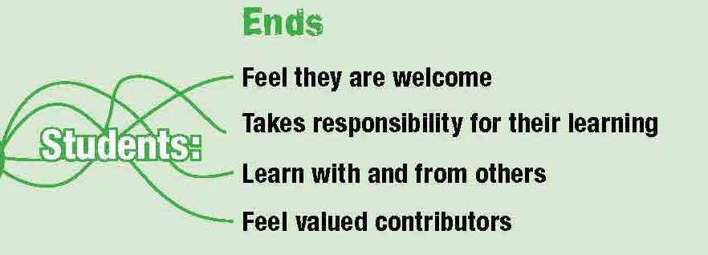
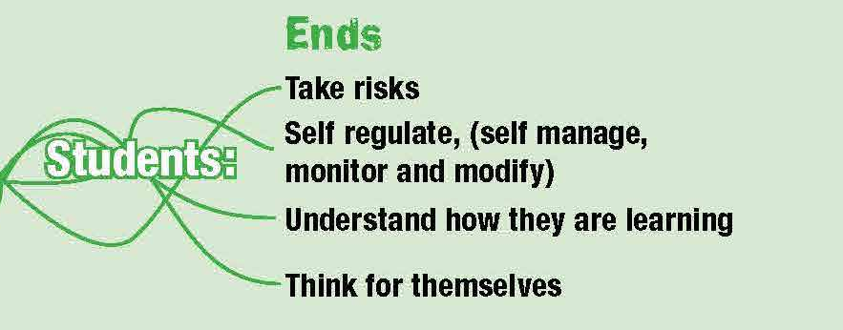
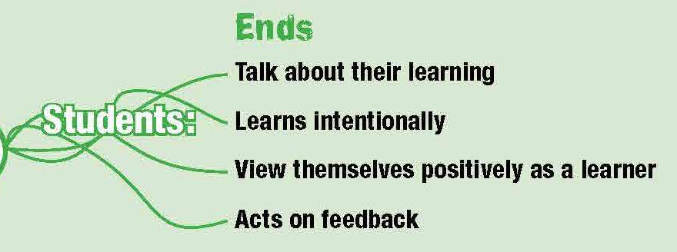
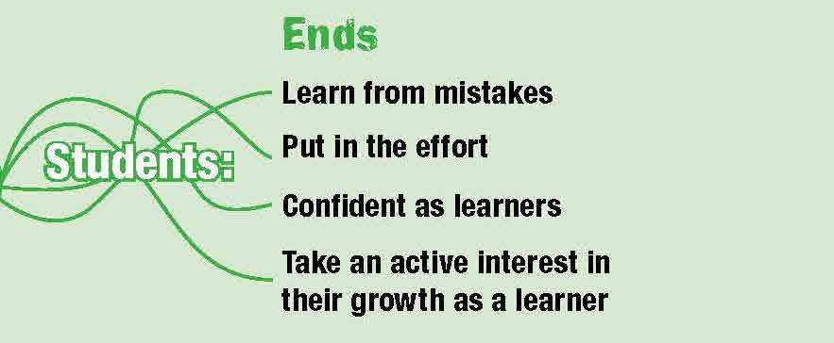
The type of outcomes we want to achieve...
1
3
2
4
Notes:
The Key message(s) on this slide:
How we want our students to be different . . .
Detail:
Box 1 – to participate in and take an increasing responsibility for their own learning
Box 2 – to have a fluent language with which to discuss learning
Box 3 – to manage themselves as developing learners, to be ‘meta cognitively’ aware
Box 4 – to understand that learning is a slow, uncertain yet satisfying process

Slide 13
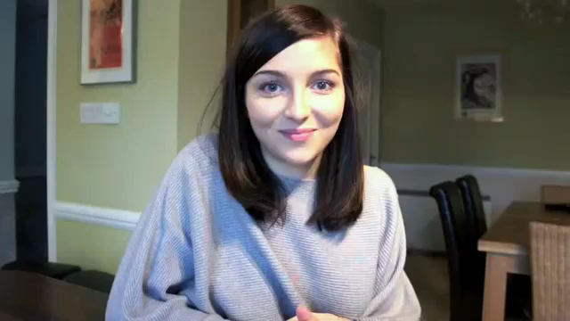
What school leavers say about learning power
Notes:
The Key message(s) on this slide:
Would you employ this young lady ?
Detail:
Could our most able students talk like this (at an age-appropriate level)?
This is the sort of learner we could produce with the help of a learning power programme

Slide 14



Achieve the change through blended learning programmes
Individual learning
Online learning sessions
Read, think, prepare
Team session
Tight, focused agenda
Monthly meetings
Share, discuss, plan
Developing practice
Planned gradual changes
Monitor impact
Share with coach
Notes:
The Key message(s) on this slide:
Making these numerous shifts will take some serious development effort.
This is an overview of the blended learning programme of online support, individual and team reflection, and small scale action research that the school hopes to take on
Detail:
Describe the learning process diagram
Content about learning and learning behaviours are available to individual teachers online. Teachers work at their own pace through an agreed content unit. Content is absorbed and thought about.
Teachers then meet as groups ( Professional Learning Teams) to discuss the ideas, firm up understanding and plan how to use the ideas and change their practice.
In later sessions they share accounts of their classroom experiments to the group. These are probed and extended by the group
After the team session teachers put their plans into action and monitor the effects. possibly discussing with a coach if coaching is part of the school’s CPD support system.

