Slide 1
Strategic.
The supple learning mind.
A guided conversation
for strategic leaders
Notes:
The threads that link these slides together:
The 4 domains of learning – Emotional; Cognitive; Social ; Strategic.
The 17 learning capacities of effective learners
Using the capacities to create a language for learning
Aim of the discussion: To consider/explore what effective learners really do, the ‘capacities’ that research tells us comprise effective learning.
Objectives: By the end of the discussion participants will have explored:
The 4 domains of learning
The 17 learning ‘capacities’ that sit beneath them
How ‘schooling’ can inadvertently hinder the development of these capacities if learners are not supported to understand, talk about, and use them
What might need to change in classrooms

Slide 2
A line of argument through the slides
The four learning dispositions unpacked
The learning power model often known as the supple learning mind
The opposite ends of learning. Moving learners from left to right
Part of the job of building the habits is to counteract the negative behaviours
Learning powered students talking about using the behaviours

Slide 3

A framework for helping students to understand how they learn
Their feelings
Their ways of thinking
How they learn together
How they manage the process
Managing the process
Feelings about learning
Relating to others
Thinking in different ways
Notes:
The Key message(s) on this slide:
There are 4 domains of learning –
the emotional domain, how we feel about learning;
the cognitive domain, the ways in which we think;
the social domain, how we relate to others, and
the strategic domain, how we manage the process of learning.
Detail:
Learning is our brain at work. Making it work better at learning it's a good idea to understand a bit about how it works.
To understand that learning is most affected by how we feel, and how we feel controls how we attend.
To learn well we need to think in different ways,
We need to relate to others with and from whom we can learn
We need to be able to manage the process of our learning.
It all goes on in our brain. The problem is we cant see the learning happening.
A student’s Performance enables teachers/learners to see some of what may have happened in the learning process. Developing students’ learning power aims to make the process of learning more visible to the learner and teacher

Slide 4
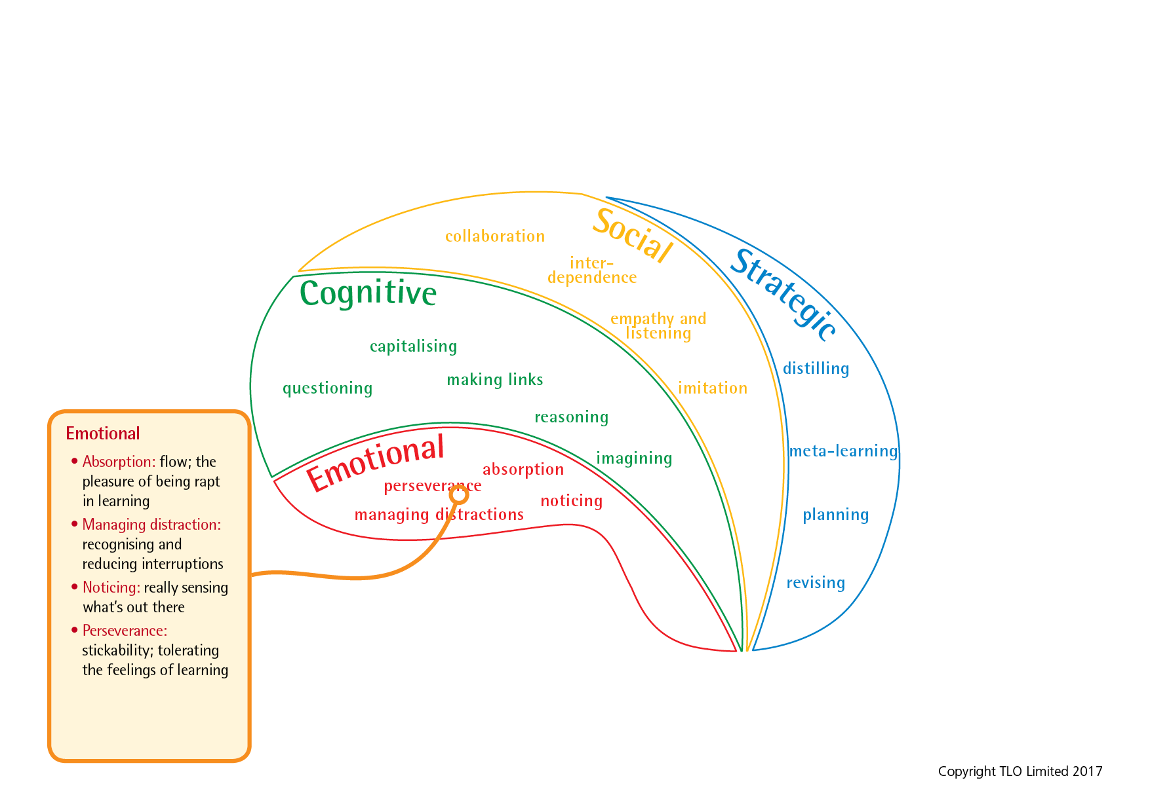
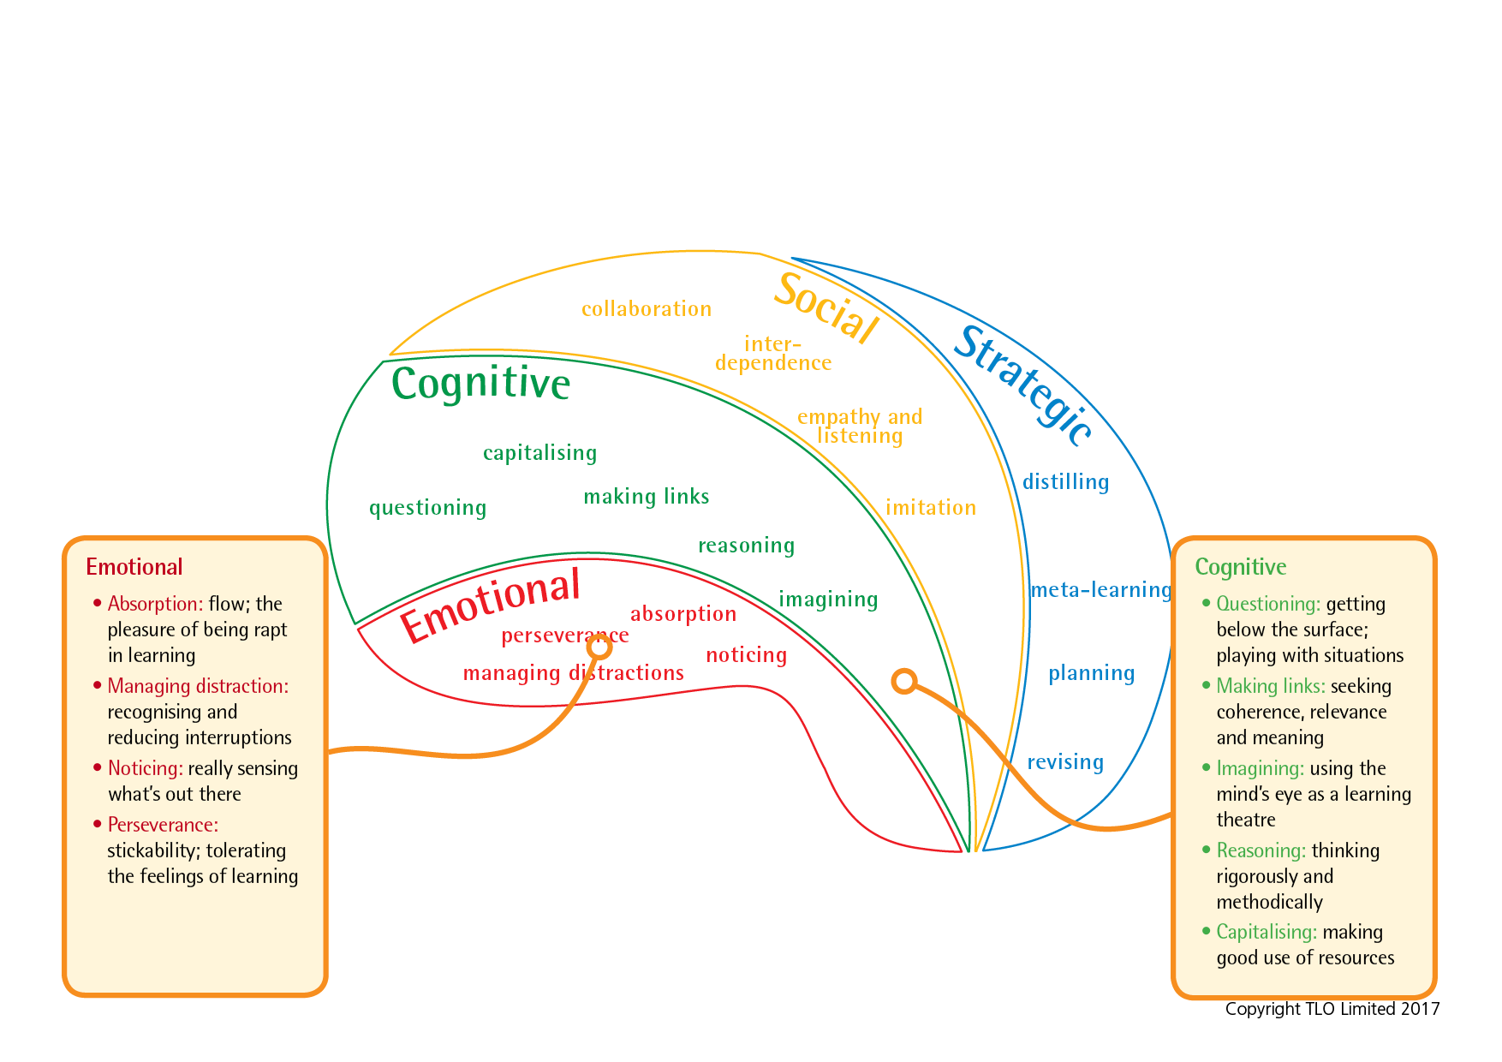
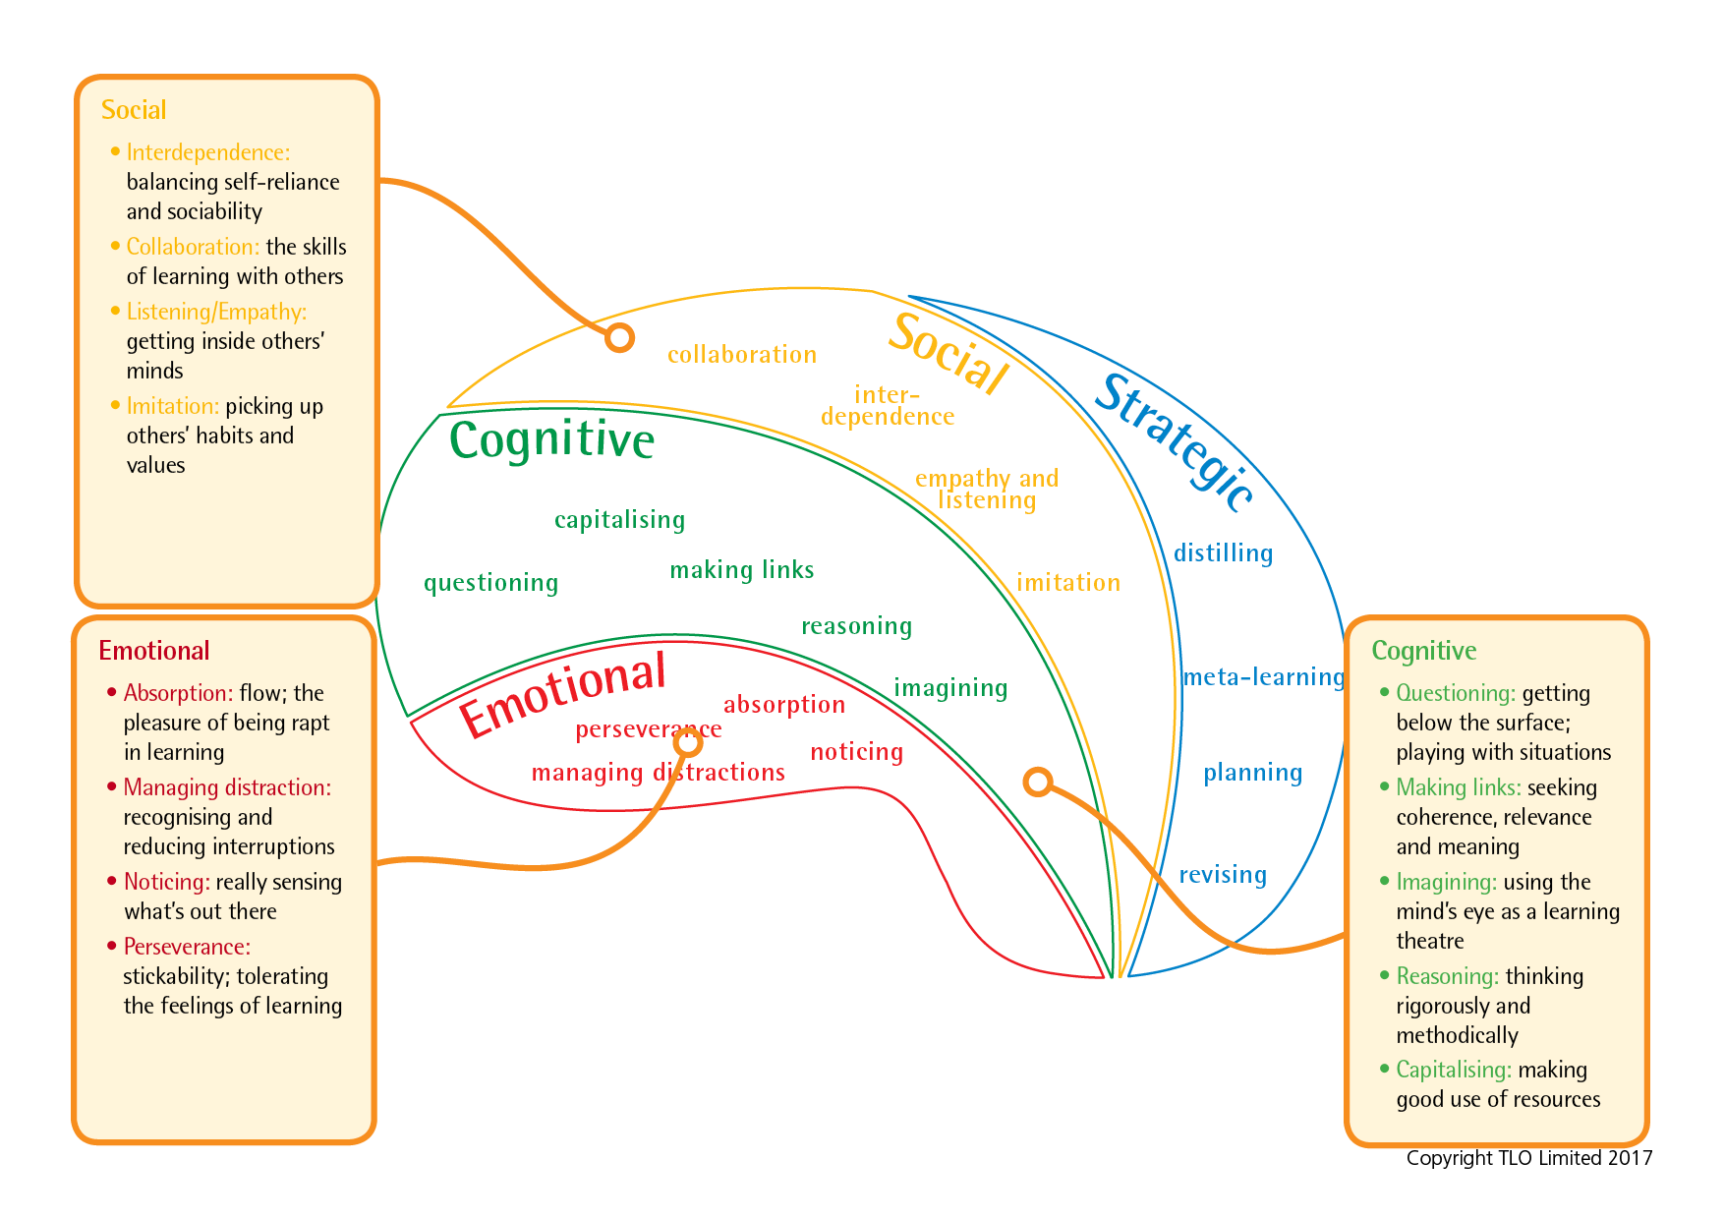
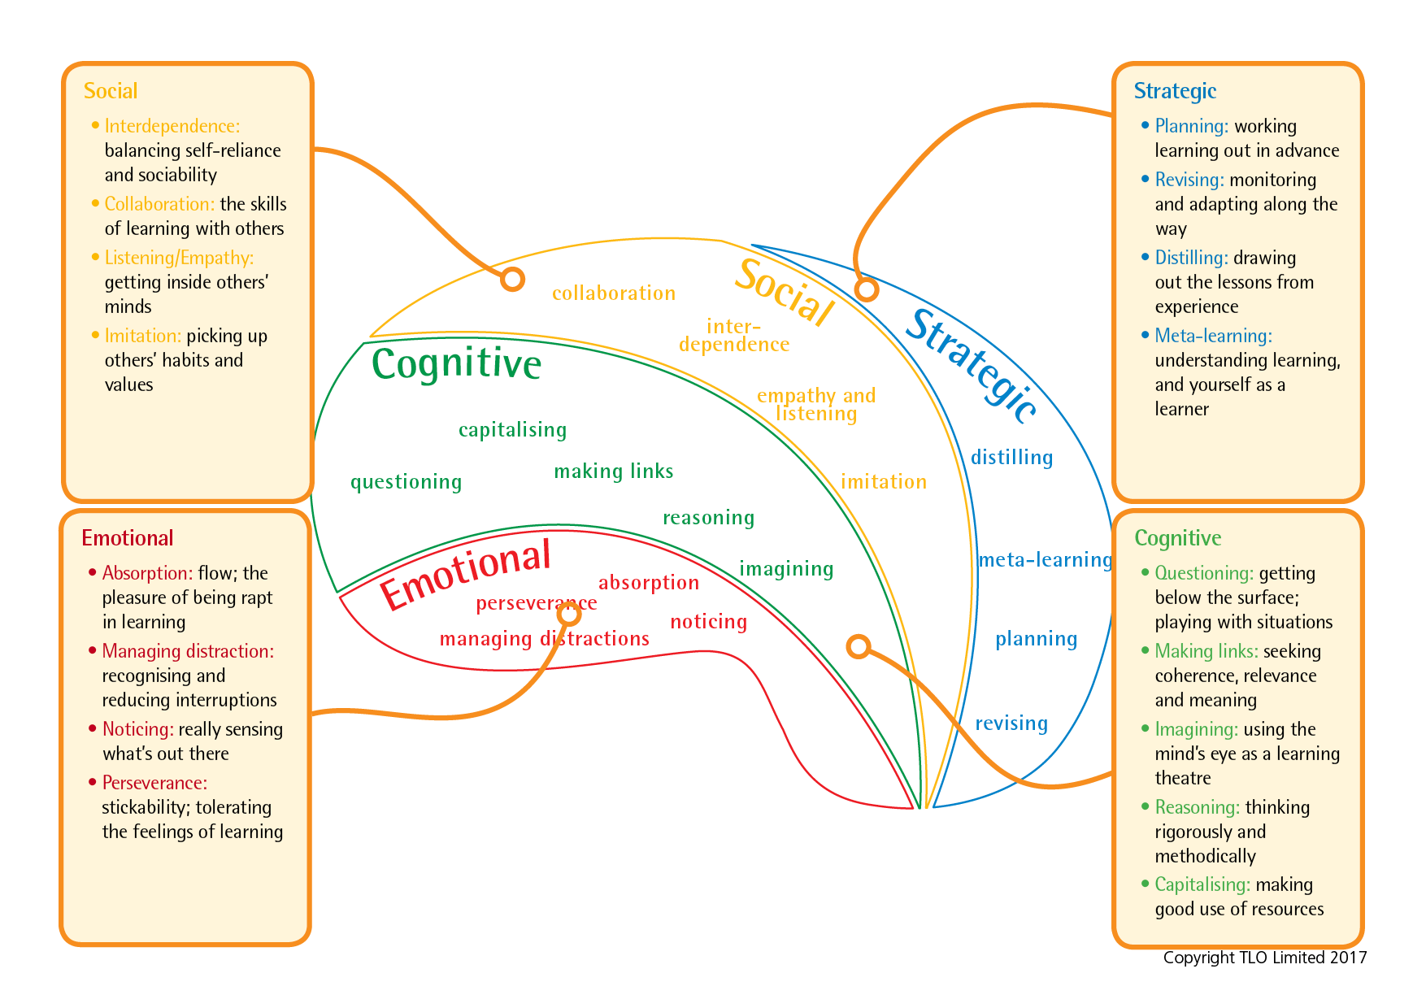
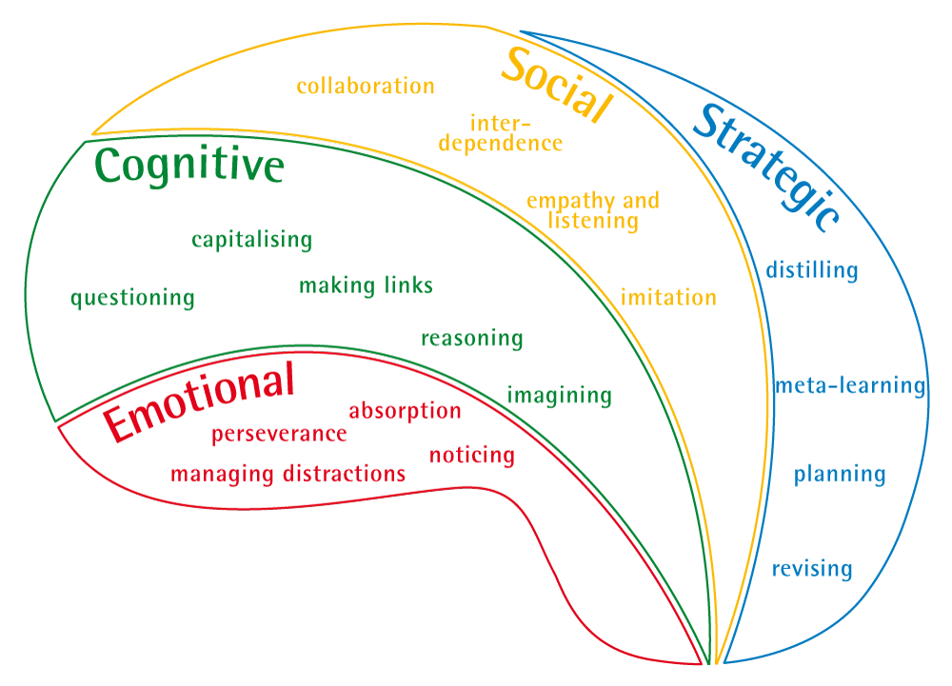
The Learning Power framework
Notes:
The Key message(s) on this slide:
The 4 domains of learning are made up of 17 learning ‘capacities’
Detail:
Key points
These slides build up the key capacities that make up each domain of learning
The names of the capacities form just the start/ beginnings of a language of learning
Each capacity develops or atrophies over time
Background notes
This is what it takes to be a good learner
International research suggests key capacities for better learning
BLP is about building these capacities into HABITS
These capacities give us a start on a language for learning
Resilience: attentional engagement — emotional aspect — feeling
Resourcefulness: range of tools and skills — cognitive aspect - thinking
Reciprocity: learning with and from others — social aspect – relating
Reflectiveness: good manager of own learning — strategic awareness — managing
How do we optimally build these capacities?
Hence BLP is an all-embracing framework, based on the psychology of learning. The Rs, (the Domains) are clustering devices for the capacities. The capacities are what successful learners do. The point of BLP is to develop capacities into HABITS.

Slide 5


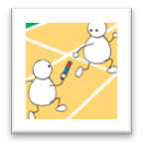
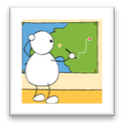
Learning: poles apart
Fragile, dependent, risk averse, weak perseverance |  |  | Absorbed, attentive, hang in there despite toughness, give it a go
|_____________|_____________|_____________|_____________| Emotional engagement
Rule bound, like only tried and tested, fragmented info, passive, uncritical |  |  | Curious, rich understandings, imaginative, logical
|_____________|_____________|_____________|_____________| Cognitive range
Isolated and dependent, lack of engagement with others. |  |  | Collaborative, listen empathise, Learn with and from others
|_____________|_____________|_____________|_____________| Social interaction
Little self awareness, robotic, can’t explain reasons for what/why they do things |  |  | Plan, revise, know themselves as learners. Like to take responsibility for own learning
|_____________|_____________|_____________|_____________| Strategic responsibility
Notes:
The Key message(s) on this slide:
‘Schooling’ often leaves many students towards the left hand side. How can we help them move towards the right ?
Detail:
What might happen if pupils are not supported in their learning behaviours?
What might happen if we spoon-feed learners ?
Here are the alternatives - we want learners to be at or near the right hand side
•tough, alternative, curious, imaginative, rational, collaborative, empathetic, revisionist, and meta-cognitive
•Rather than fragile, risk averse, rule-bound, fragmented understanding, passive, dependent, robotic.
If we left learners to it they would probably be like the right hand side – they certainly appear to be before they go to school !
But schooling, too often works, against these natural, innate learning behaviours.
It hot houses learners through, and in so doing moves them towards the left.
Important
Left side does NOT mean low achievers. Many high achieving girls are fragile learners who ‘fall apart’ when they come up against something they cannot do. They are not used to having to struggle. They have not learned how to make mistakes profitably
NB Definition - Robotic learners. - unwilling to try other ways of doing things. Keep to the teachers instructions in order to pass the exam.

Slide 6
Forming the habits of good learners involves counteracting negative learning behaviours, such as...
Becoming distressed when mistakes are made;
Giving up when it is ‘difficult’;
Answering rather than ask questions;
Rushing to complete rather than allow time for quality to emerge;
Acting impulsively rather than take stock and developing a plan of action;
Sticking with known strategies rather than breaking new ground.
Notes:
The Key message(s) on this slide:
We not only have to build positive learning behaviours, we also need to counteract unhelpful learning behaviours. Which unhelpful behaviours do your students exhibit?
Detail:
There may be negative approaches to learning that need to be eradicated before we can begin to build positive ones. Discuss – which negative learning approaches do we need to counteract in our students?

Slide 7
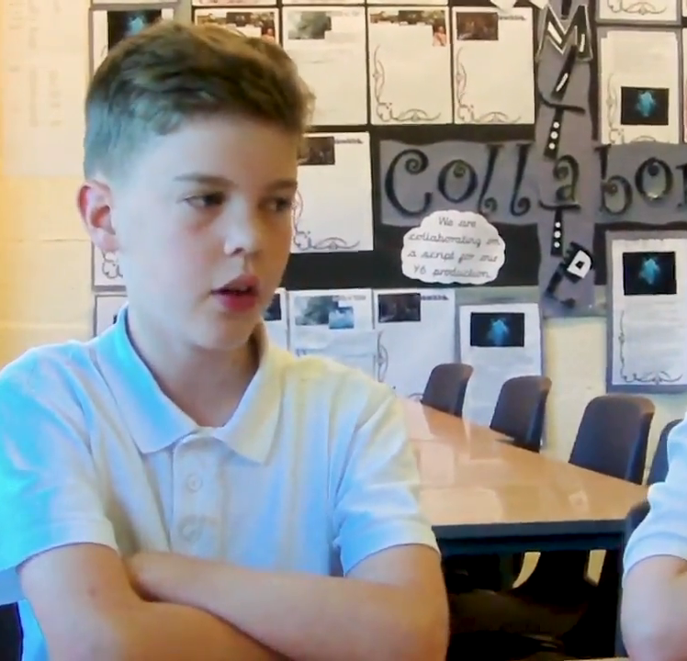
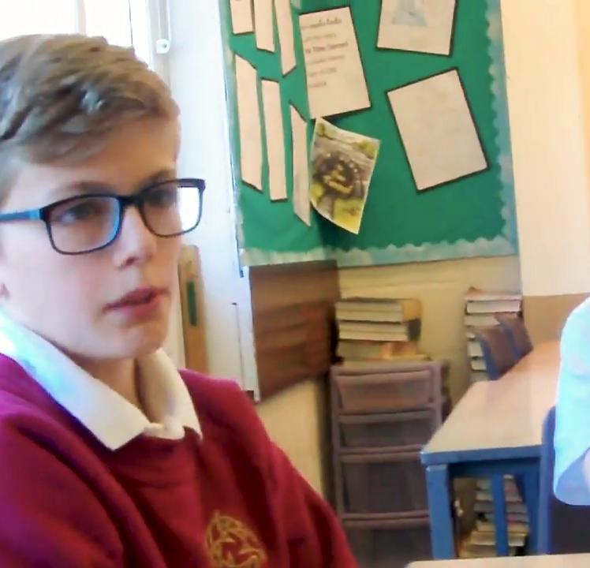
Students talk about their learning power
Notes:
The Key message(s) on this slide:
Give learners a language of learning so that they can understand the concept of learning
Detail:
Listen to these young learners. Could your students speak with similar fluency about the learning process ?

