Slide 1
Strategic.
Learning friendly cultures
What does it mean?
Where are we now?
How far is there to travel
Notes:
The threads that link these slides together:
The importance of classroom culture in creating the conditions within which positive learning behaviours can flourish
Different types of classroom culture
The second model of Building Better Learners – The Teachers’ Palette.
Aim of the discussion: To consider/explore different types of classroom culture and how classroom culture might need to change to become more learning focused.
Objectives: By the end of the discussion participants will have explored:
The three types of classroom culture and reflected on where classroom culture is at present;
The four shifts necessary in classroom culture in terms of relationships, talking learning, constructing learning and celebrating learning;
How teachers, teaching and classroom culture might need to change;
The benefits for learners;
The Teachers’ Palette, the second model of Building Learning Power, that underpins these cultural changes.

Slide 2
Line of argument through the slides
How teachers teach affects the culture of the classroom. A need to move teaching from ‘good’ to learning powered
Three types of Classroom culture. Teacher, Learner, Learning focused. Need to move left to right.
Four early shifts needed in making the move in classroom practice
Relationships, Talking, Constructing activities, Celebrating learning.
What teachers will do differently. How learners benefit.
The teaching framework to make it all work
The teachers job becomes...
Where are we now on the basics?

Slide 3


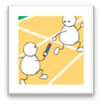

Teaching: poles apart
Subject content explained plus hints and tips for exams. |  |  |  |  |  |  |  | Learning capacities explained discussed and trained. Become a learning coach
|_____________|_____________|_____________|_____________| Relating
Busy activities. Learning content driven. Display best products. Spoon feeding. Heavy scaffolding. |  |  |  |  |  |  | Activities and environment arranged to surface and develop learning habits. Less scaffolding.
|_____________|_____________|_____________|_____________| Constructing
Mark regularly with supportive comments about subject. |  |  |  |  | Continual comment (talk and written) to nudge progression in learning power. Learning language developed.
|_____________|_____________|_____________|_____________| Talking
Secure in curriculum knowledge. Try not to show vulnerability. |  |  |  |  |  | Model being a learner too – trying things out, making mistakes, getting stuck.
|_____________|_____________|_____________|_____________| Celebrating
Notes:
The Key message(s) on this slide:
How teachers behave impacts on how students are as learners
Detail:
Poles apart diagram, now related to teaching behaviours.
In LH, competent teaching behaviours that focus on the efficient delivery of curriculum content,
RH column teaching behaviours of the teacher who is delivering curriculum content and, at the same time, building better learners.
Key Points
This slide suggests the change teachers need to make.
The LH depicts a perfectly good enough teacher but there is still a gap between how a good teacher works, where their emphasis lies, and the learning coach type teacher that developing learning power demands
Use this slide to orchestrate a discussion about the shift needed.
Note that the 4 dimensions are Relating, Constructing, Talking and Celebrating. These are the dimensions that are picked up later in the Teachers’ Palette and the culture diagram.

Slide 4
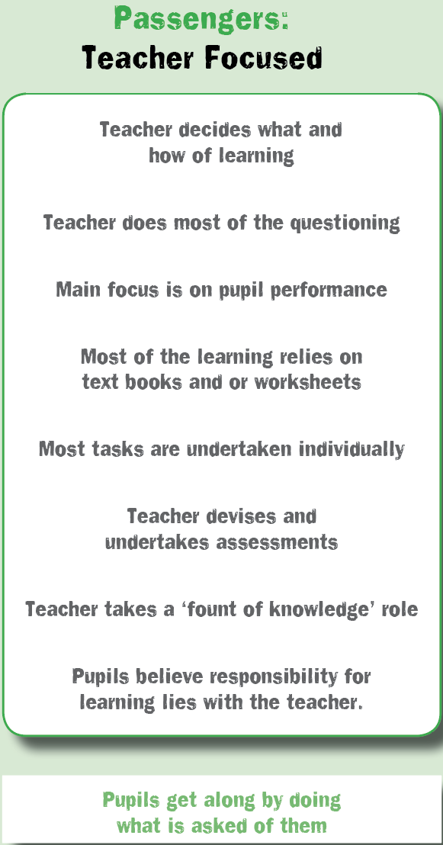
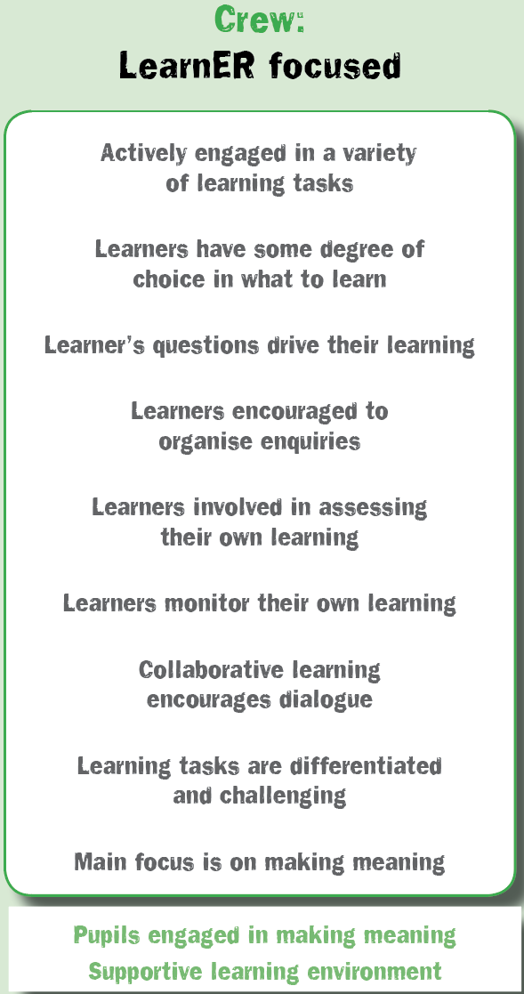
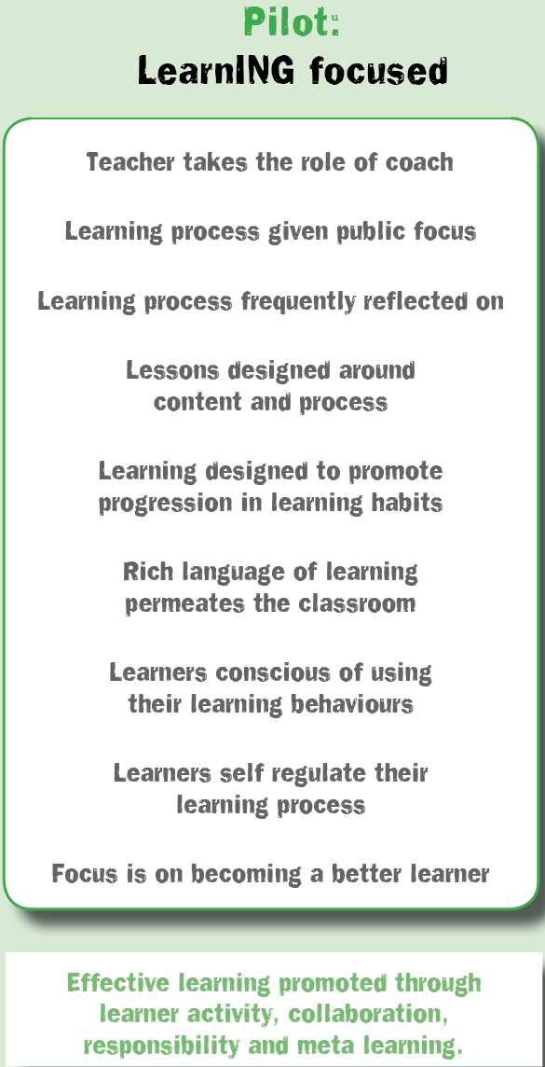
Classroom cultures
What is your’s like?
Notes:
The Key message(s) on this slide:
There are three distinct types of classroom culture – Teacher focused, Learner focused, and Learning focused.
Detail:
[Based on research by Chris Watkins of The London Institute]
Classrooms can broadly be categorised as predominantly one of 3 types.
The teacher focused classroom is highly unlikely to be learning friendly. It is designed for the efficient transmission of curriculum content. Learners’ roles are predominantly passive, responsibility for learning resides with the teacher, dialogue is largely teacher generated.
The learner focused classroom is a step in the right direction. Learning is increasingly active; students are beginning to take more responsibility for their own learning; and students have more opportunities to talk and explore their ideas for themselves. Students are beginning to create their own understandings rather than memorizing teacher delivered information.
The learning focused classroom develops effective learning behaviours through learner activity, collaborative endeavour, devolved responsibility and high levels of meta learning.
Where are most classrooms in your school?
Watkins argues that it is impossible to achieve a learning focused classroom without first securing a goodly range of aspects in panel 2. Put another way, the teacher focused classroom cannot become learning focused without first adopting a learner focus.
This is not to say that all aspects of a teacher focused classroom are bad. Indeed, some may well still be evident on occasion in the learning focused classrooms.

Slide 5
Becoming more learning centred means...
(1) Lessening scaffolding of the learning and using a coaching approach
(3) Re-designing learning opportunities to include routines that blend content and process
(4) Celebrating the growth of learning habits
(2) Adopting a common language for learning throughout the school
Notes:
The Key message(s) on this slide:
The learning focused classroom has 4 key aspects
Detail:
Lessen scaffolding – the teacher is becoming increasingly skilful at knowing when they have to intervene, and when they can nudge and coach because the learner(s) can find it out for themselves.
Adopt a common language – the classroom is alive with a sophisticated language of learning which is used fluently by both teachers and learners to discuss, critique and reflect on the learning process.
Redesign learning activities – the classroom attends simultaneously to two dimensions: the acquisition of content and the growth of learning behaviours. The content provides a workout for the learning behaviours. The learning behaviours accelerate the content acquisition.
Celebrate the growth – the classroom attends to the growth of learning behaviours. Doing it is not enough. Doing it better is the key. A language rooted in the progression of learning behaviours is evident.
These are four suggested implications of pursuing the learning friendly approach..
Invite colleagues to consider these briefly. Is there agreement with the suggestions?
Are there more that could be added?

Slide 6
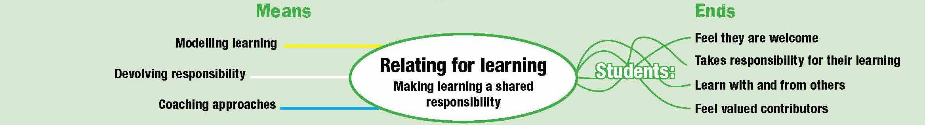
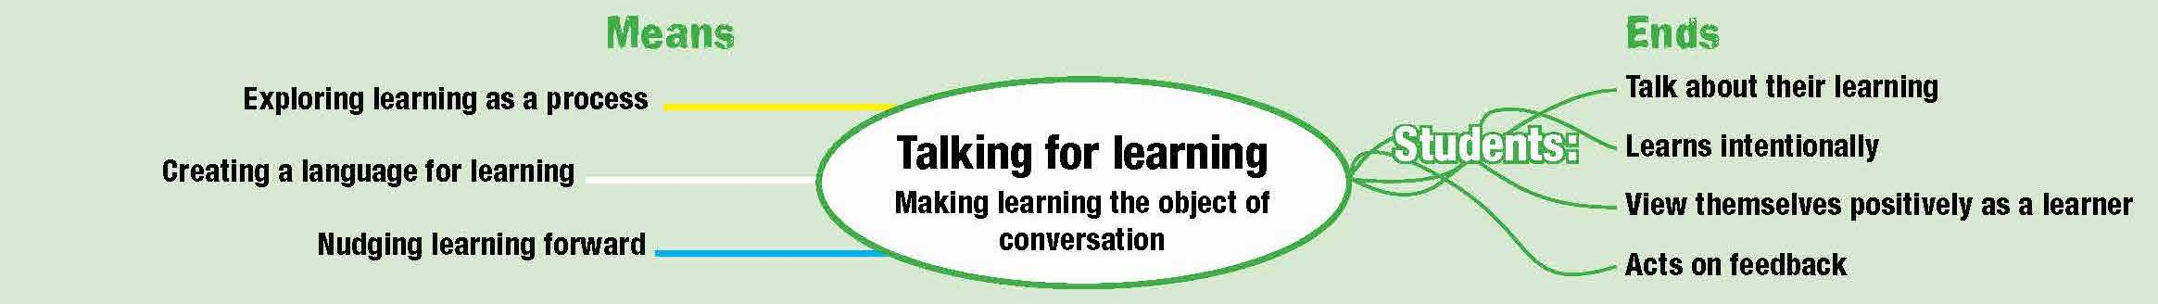
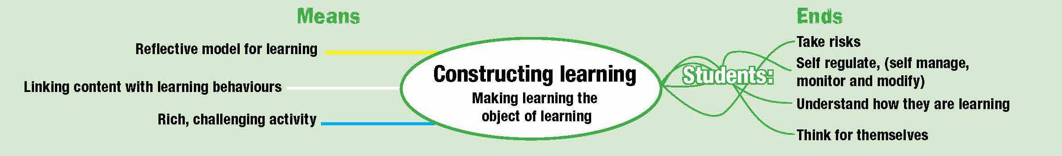
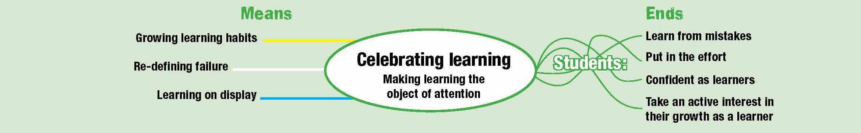
Four shifts in classroom culture
Notes:
The Key message(s) on this slide:
Putting some flesh on the bones of the previous slide
Detail:
Talk through the central ovals only
The 4 shifts in making a learning friendly culture
The roles people play...Relating sharing responsibility for learning
The learning talk....language of learning...talk about the how of learning
The process of learning...constructing learning. Make students aware of how...metacognitive
The values of the classroom, what is celebrated, recognised, attended to.praised.

Slide 7
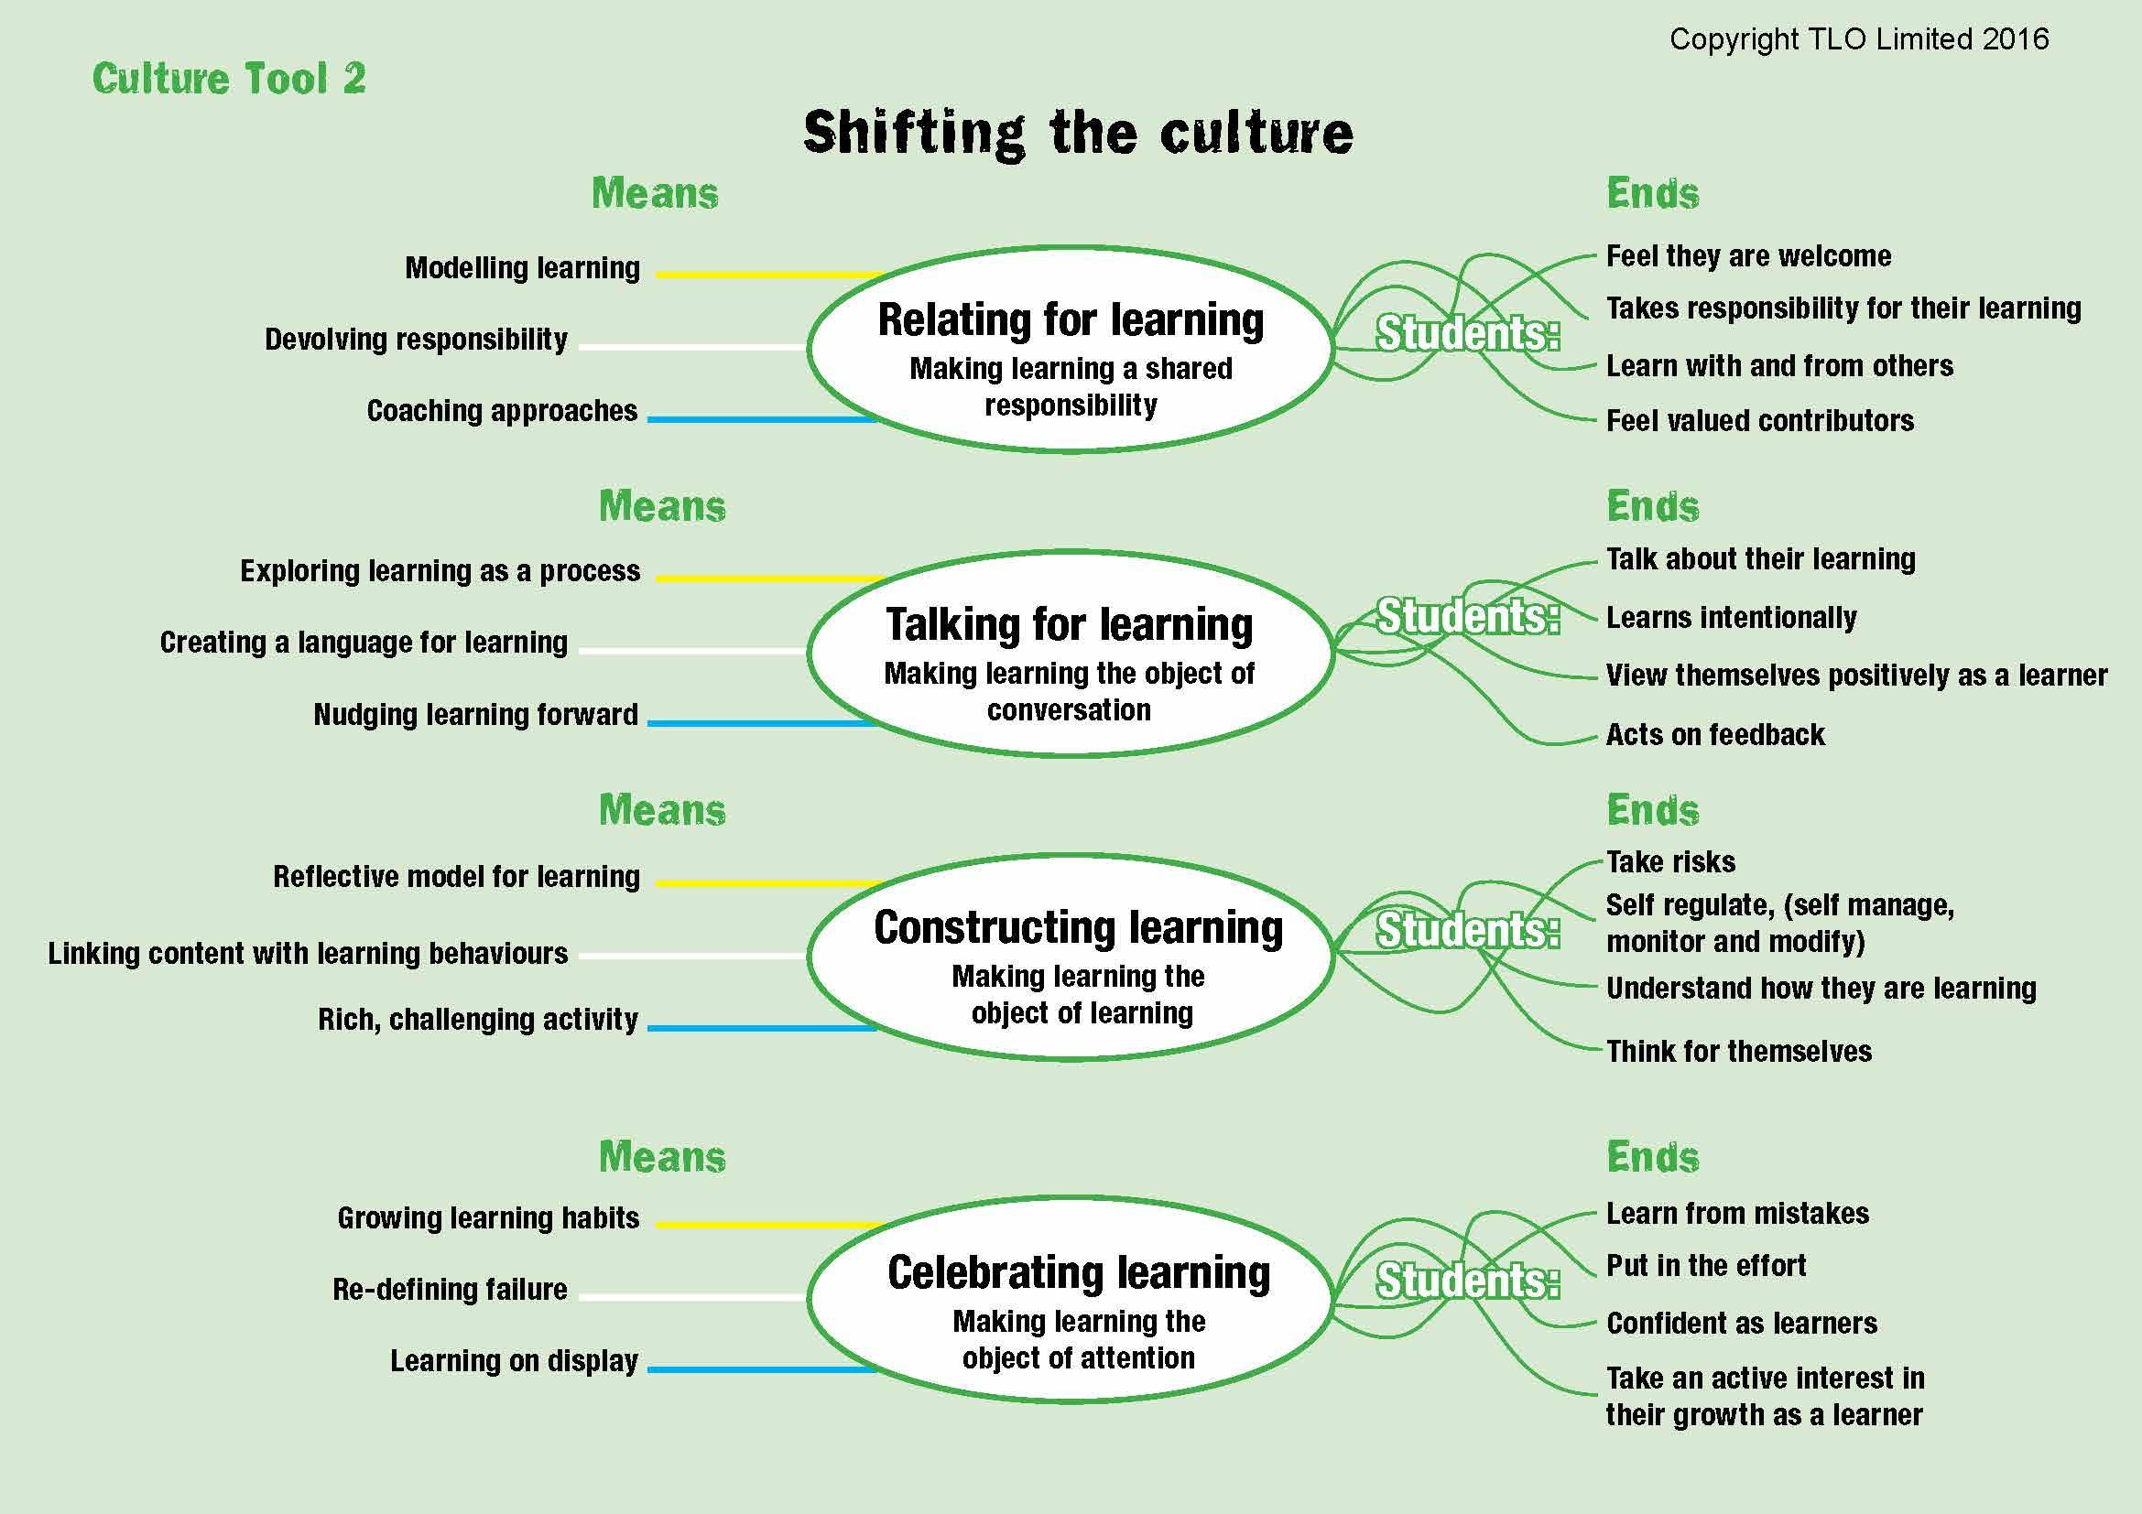
A learning focused culture
Teachers’ contribution
Notes:
The Key message(s) on this slide:
This is how teachers behave to create a learning focused culture
Detail:
Talk through briefly the inputs from teachers.
RELATING
Modelling learning – walking the talk, being a learner yourself. If teachers can’t be bothered to do it, why should students?
Devolving responsibility – shifting the emphasis towards learners taking increasing responsibility for their own development
Coaching approaches – moving away from ‘teacher telling’ mode whenever possible
TALKING
Exploring learning as a process – finding time to talk about learning and how it works
Developing a language for learning – teacher talk uses the school’s learning language, nuanced by the school’s understanding of progression.
Nudging learning forward – catching students employing positive learning behaviours and commenting on them, orally and in writing
CONSTRUCTING
Reflective model for learning – reflection on content and reflection on learning behaviours is routinely built into lessons
Linking content with learning behaviours – lessons are designed intentionally to deliver content and to exercise learning behaviours, and students are made aware of both
Rich, challenging activities – increasingly open-ended activities are designed to engage, to stretch and to challenge
CELEBRATING
Growing learning habits – finding ways to track, record and celebrate learning behaviour growth,
Redefining failure – turning the lens around: mistakes become learning opportunities; difficulty is when learning happens; asking questions shows curiosity, not a lack of intelligence.
Learning on display – the process of learning (as opposed to the finished outcomes of learning) are on display. Annotated work in progress, first attempts, revisions, failed lines of enquiry, leading, of course, to the finished article.

Slide 8
A learning focused culture
Outcomes for learners
Notes:
The Key message(s) on this slide:
Teachers change the means in order to achieve the desired outcomes for learners
Detail:
The shift in culture that needs to be achieved
Talk through the outputs/ends for learners...which of these would you not want?
Which of these are NOT important in the modern world?

Slide 9

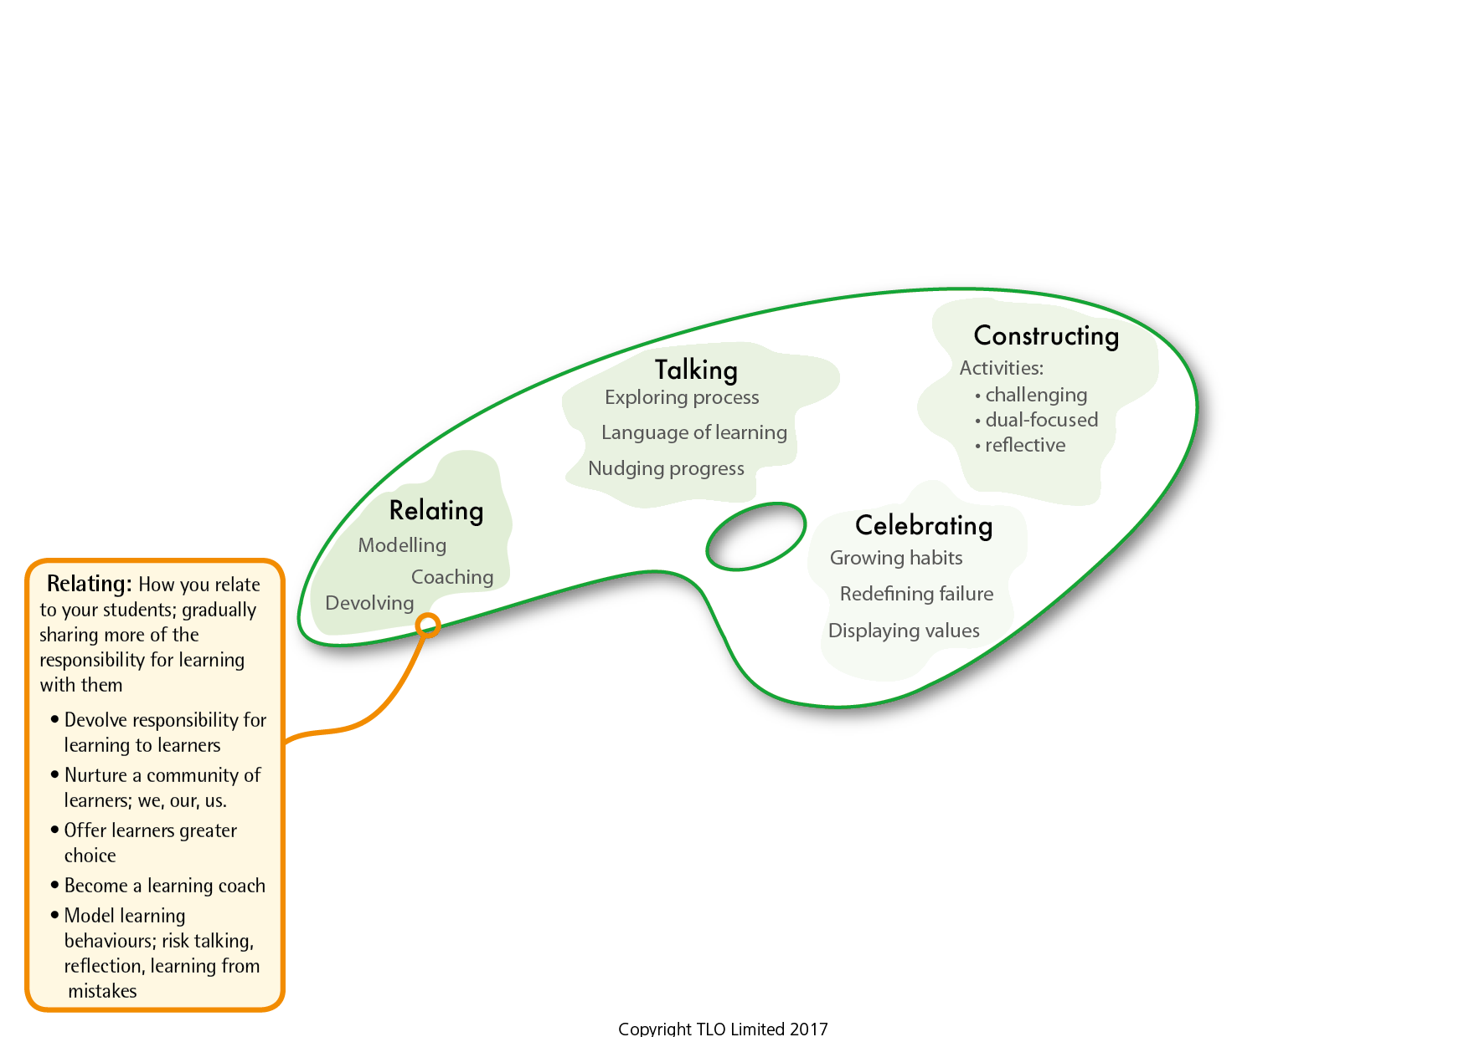
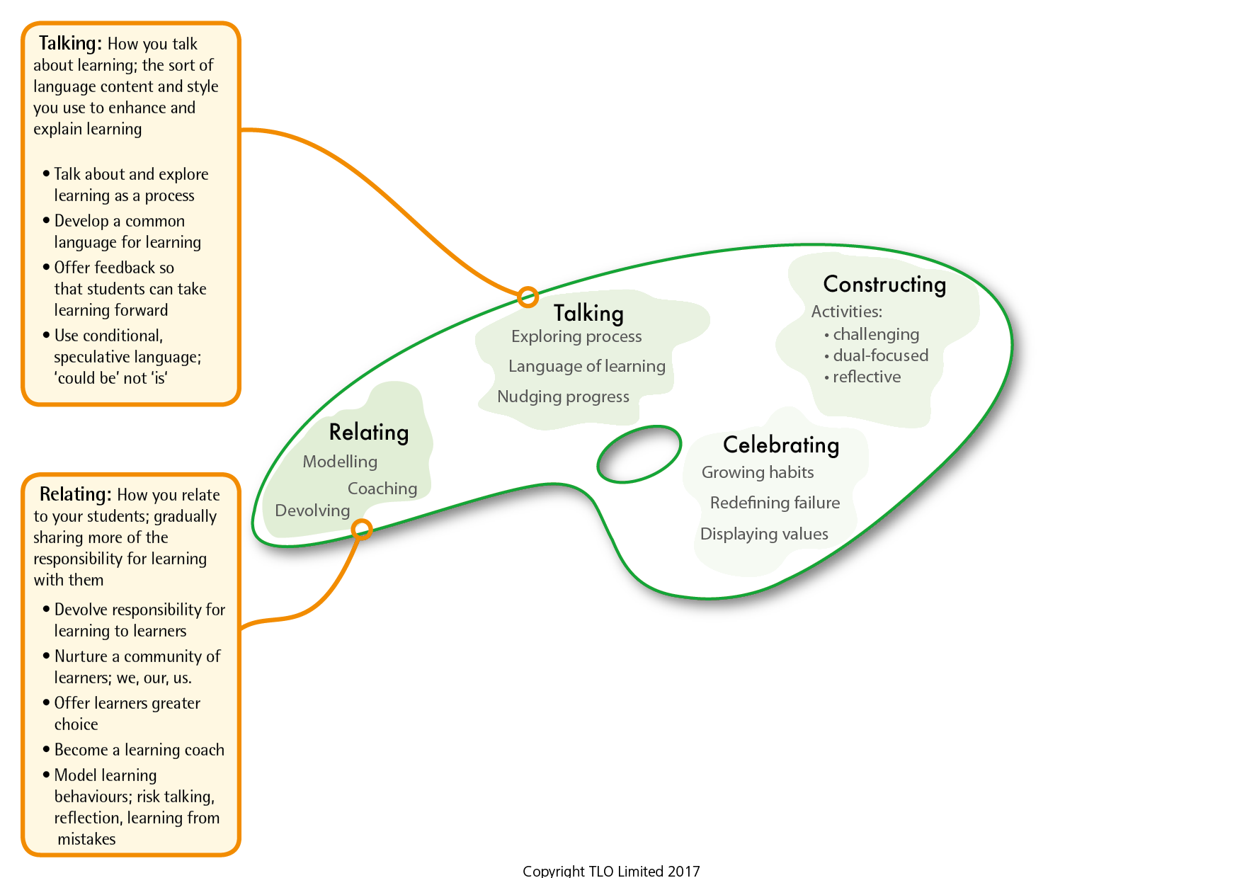
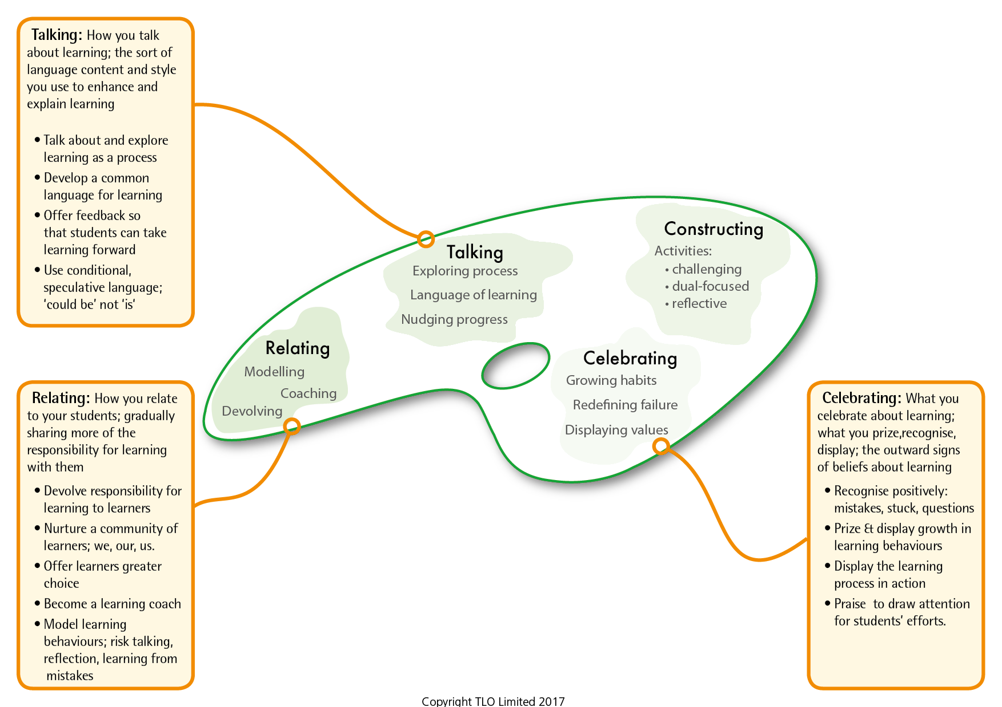
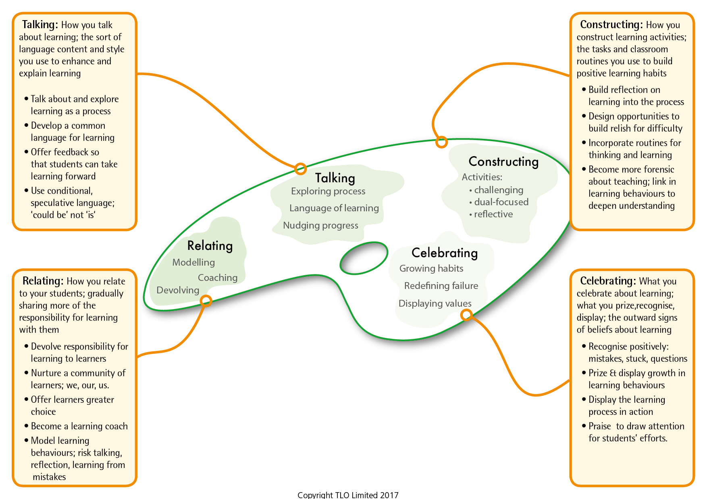
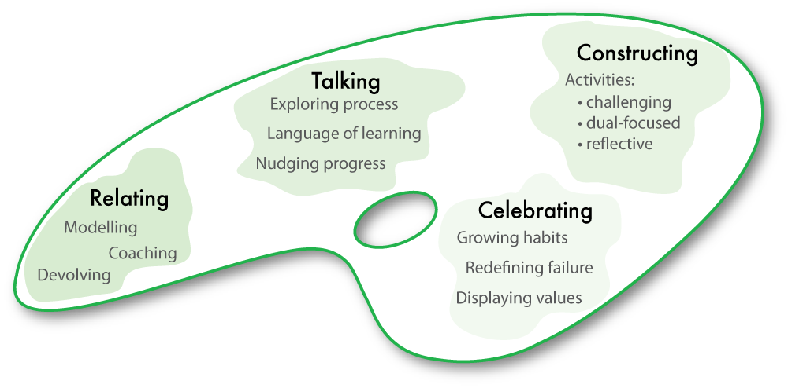
The teaching framework to make it work
Notes:
The Key message(s) on this slide:
The 4 aspects of the previous culture tool in the form of the second Building Learning Power model – the Teachers’ Palette
Detail:
The learning focused culture tool translated into a NEW palette.
NB this is NOT the same palette as described in Building Learning Power. It has been updated to take account of current circumstances.
Along with The Supple Learning Mind, it is the other key model in Building Better Learners.

Slide 10

A teacher’s job becomes one of…
Introducing learning behaviours
  making students aware of the tools they command as learners
Developing a language for learning
Infusing learning behaviours into lessons
Becoming a learning power coach
Celebrating the use and growth of learning behaviours
Notes:
The Key message(s) on this slide:
The role of teachers needs to change
Key Points
How do teachers build pupils learning power?
Key - making pupils aware of the learning tools THEY command
Developing language, designing tasks, structuring the environment.
Turning themselves into a learning coach
Background notes
This slide gives a broad rundown on the change in role/job in hand.
It concentrates on the role of the teacher who is charged with creating a learning environment where children understand their learning capacities and are enabled to stretch them. (Remember this includes emotional, social, cognitive and strategic capacities.)
The teacher becomes a learning power coach: orchestrating the language, the activities including assessment, and the set-up of the classroom to ensure children have continuing opportunities to develop the learning habits that underpin all the subject disciplines.

Slide 11
Forming the habits of good learners: Where are we now? What needs to change?
What learning habits do we model in our classrooms?
What learning habits do we talk about in our classrooms?
What are the old habits about learning we want to break?
What are the learning habits we want to form?
How can classroom routines build rather than stifle habits of learning?
How can teaching styles build rather than deny learning habits?
Notes:
The Key message(s) on this slide:
Many aspects of classroom practice will need to change
Detail:
For example:
The learning habits we model in our classrooms – learners will not become adventurous in the hands of teachers who play safe
The way we talk about learning in our classrooms – learners will not become fluent in talking about ‘learning’ unless their teachers also become fluent.
The old habits of learning we want to break – learners will remain dependent if teachers always help too readily.
Our understanding of learning habits we want to form – learners will remain unaware of their learning behaviours if teachers remain likewise unaware.
The classroom routines that stifle habits of learning – learners will not grow as learners in a classroom that focuses overly on ‘getting it right’, ‘passing the test’.
The teaching styles that deny learning habits – teachers who ask all the questions create learners who answer rather than ask.
Encourage a discussion – where are we now on this journey? The worthiness of the journey.

