Slide 1
Strategic. Progression in learning power
A guided conversation for strategic leaders

Slide 2
Line of argument through the slides
Three types of progression, frequency, scope, skill.
How work on progression deepens the impact of learning power
The learning power progression grid for perseverance; its dimensions and phases of growth
The online PD units cluster the suggested teaching activities by progression phase
An overview of what we are trying to achieve
Notes:
The threads that link these slides together:
Having ‘learning power’ is not enough – the task is to build learning power
The 3 aspects of progression – Frequency, how often /Scope, in different places /Skill, how well.
Progression in one aspect of learning - Perseverance
Aim of the discussion: To consider/explore the importance of progression and to view oneself (and people you know) through the lens of progression in Perseverance.
Objectives: By the end of the discussion participants will have explored:
The different aspects of progression and consider the importance of progression;
The areas of the school that can be impacted on by an understanding of in learning behaviours progression;
The nature of progression in Perseverance;
How well they and others they know persevere.

Slide 3
Three types of progression in building Learning Power
Frequency
Aim to develop the skill into a habit that the student employs frequently, without support, as and when the need arises
The message is ‘spot students using the behaviour and point it out’
Scope
Aim to help students to recognise and exploit opportunities to utilise their learning behaviours in new and uncharted territory
The message is to look out for and comment on the use of the behaviour, however tenuously
Skill
Aim to support students in becoming more skilled, sophisticated, nuanced in the behaviour.
The message is to build skillfulness progressively and intentionally through the learning tasks and activities in the classroom.
Notes:
The Key message(s) on this slide:
There are three aspects to progression – frequency, scope and skill
Detail:
Frequency – developing skills into habits through repeated opportunities to exercise the skill. The teacher’s role is to spot it happening and make students aware. The more students understand and are given the chance to use the capacity, the quicker they will turn using it into a habit.
Scope – the holy grail of transfer. Using skills that you have developed in one setting and applying it in another, unrelated area. For example, recognising that the perseverance, attention to detail and repeated practice necessary for solving a problem on the xbox is the same skill necessary for success in the numeracy lesson. The teacher’s role is to catch students doing it and pointing it out.
Skill – much the most complex of the three. It is not enough to get students doing it frequently, nor even in a wider range of settings. Over time we want them to be doing both of those things and, critically, doing it increasingly skilfully. The teacher’s role is to provide learning experiences/activities/tasks that progressively exercise more sophisticated learning skills. For example in the early stages a teacher might be providing opportunities for students to work together, to take turns and generally cooperate with their teammates, whereas later the teacher might be creating activities that call for the more sophisticated skills of consensus building and conflict resolution.

Slide 4
Progression in learning habits is key because..
It extends the language of learning
  from broad and vague to focused and precise
It deepens understanding of learning behaviours
  their features and scope
It focuses task design/lesson planning
  tasks that emphasise/enable specific feature of the progression
It enables students to set targets for improving learning behaviours
It feeds into report writing for parents and mentoring
It serves to help teachers take a more forensic approach to teaching for learning
Notes:
The Key message(s) on this slide:
Progression is key to helping students to improve as learners
Detail:
For example:,
It extends the language of learning – taking learners (and teachers) beyond the ability to say ‘I didn’t give up’ to talking about the strategies they could employ when learning is tricky
It deepens understanding of learning behaviours – putting more flesh on the bare bones of the learning capacities, understanding that, for example, using cause and effect or seeking similarities and differences are link making activities.
It focuses task design/lesson planning – it enables teachers to plan activities that exercise particular aspects of a learning behaviour rather than simply operating at the level of the 17 learning capacities
It enables students to set targets for improving learning behaviours – vague targets like ‘ask more questions in class’ can be sharpened into a useful target that is both memorable and achievable: ’If my question does not tell me everything I need to know, then I'll ask another question to seek more detail’.
It feeds into report writing for parents and mentoring – what is written to parents and how learners are mentored are enhanced by the language of progression. Once we know what ‘getting better at Reasoning’ looks like, the comments we give, the targets we set, the advice we offer all become better focused
It serves to help teachers take a more forensic approach to teaching for learning – teachers are highly skilled at teaching, but less so at understanding learning. Progression gives teachers the precise information they need to help students to grow as learners.

Slide 5
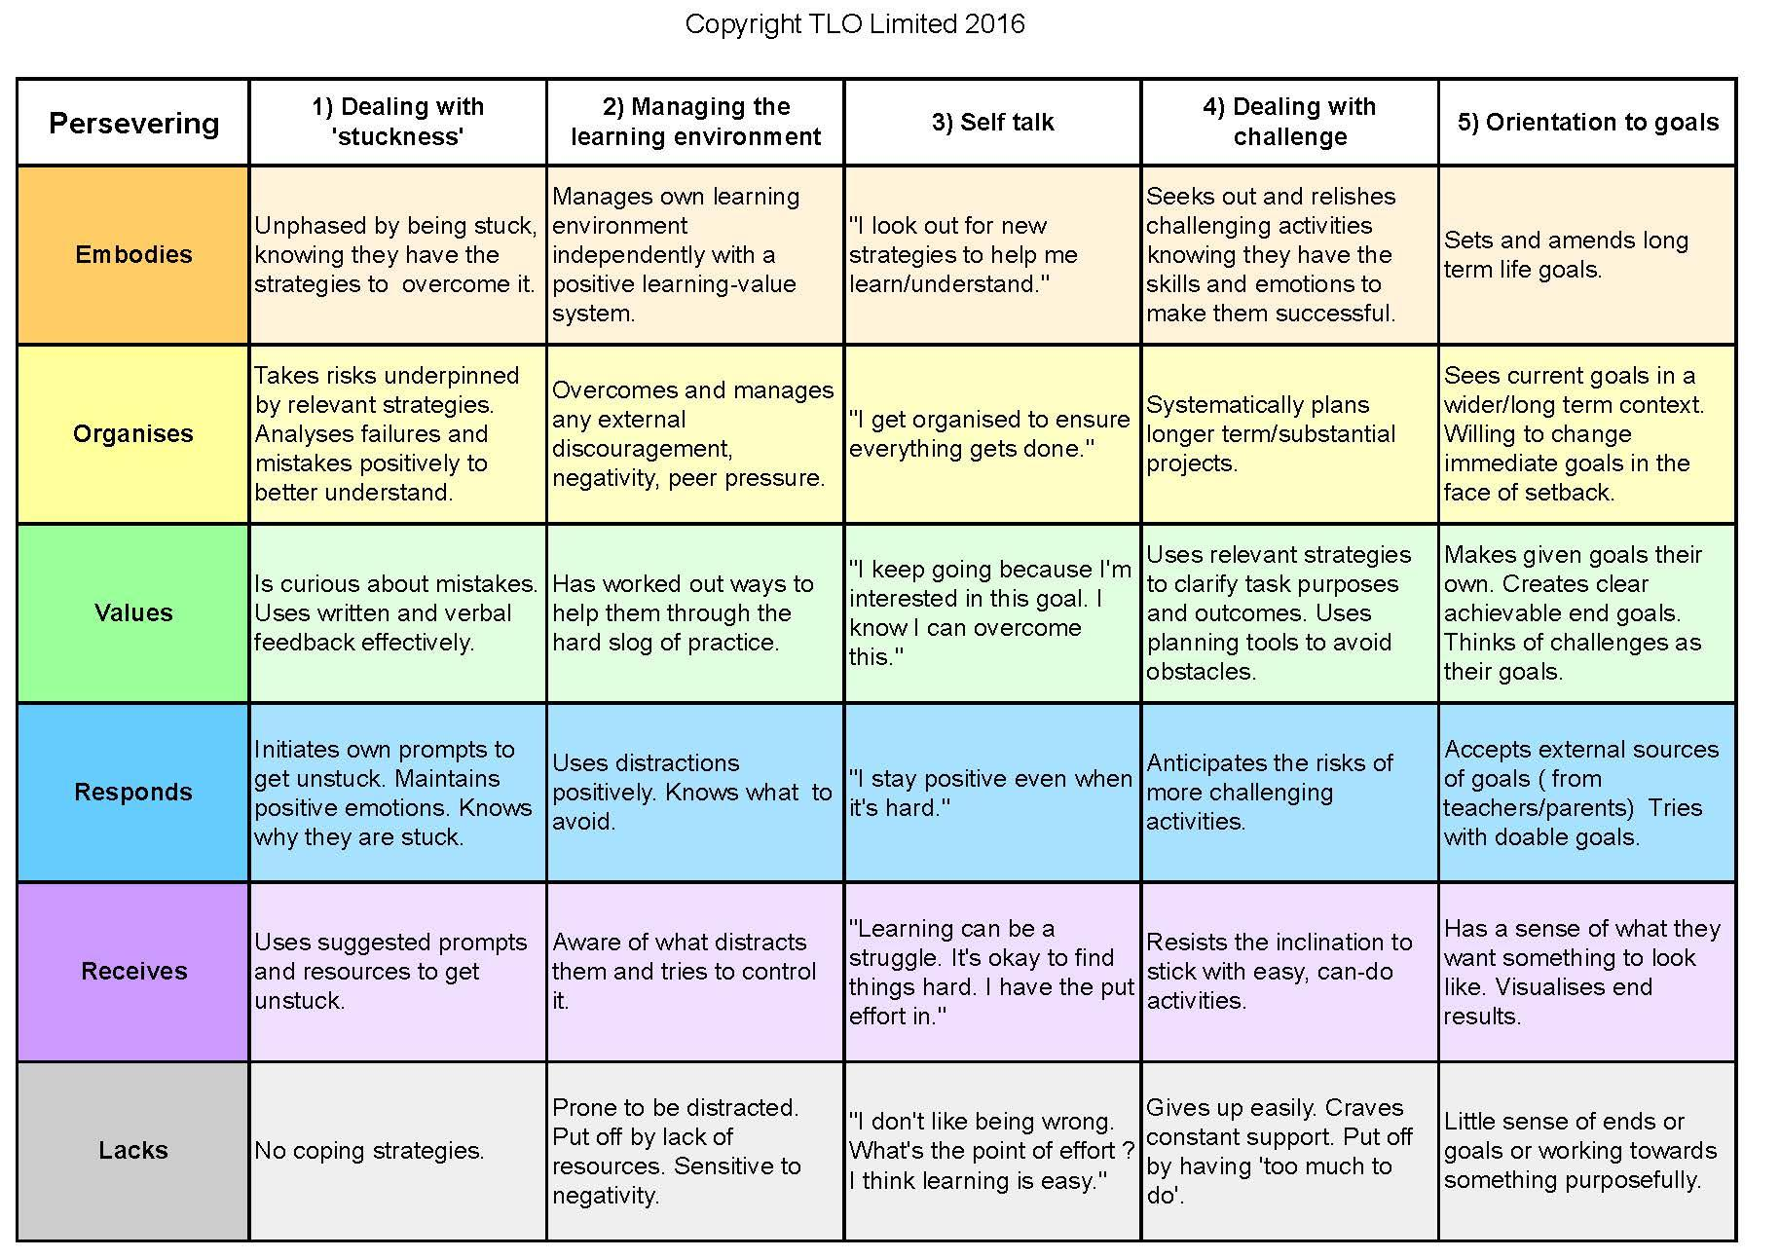
What does progression in Perseverance look like?
Ask yourself:
Where are you now?
Where is your child?
Are they ‘getting better’ at it?
Why are they?
How do you know?
Notes:
The Key message(s) on this slide:
This is one example of progression in a learning behaviour, in this case Perseverance. Read it from the bottom upwards, from unskilled in the bottom, grey row to highly skilled in the top, orange row.
Detail:
Consider:
Where are you now? – Think about yourself. How effective are you at Managing distractions? Dealing with Being Stuck? Etc. Are there some aspects of your lives where you are better than others?
Where is your child? Do the same for your own child. Look at their perseverance behaviours through the lens of this map of progression.
Are they ‘getting better’ at it? Do your instincts suggest that your child is slowly becoming more skilful over time ?
Why are they? Have you any idea why they are getting better (or not)? Is it simply because they are getting older? Is it because of the learning experiences they are experiencing? Is it a ‘natural’ development, or does it need intervention?
How do you know? A tough question, because at this stage you probably have no idea ! But at least with the map, we can begin to ask the question.
Finally – think of a successful person that you know well. Where are they on the map? To what extent do you think their success can be attributed to their perseverance skills?
There are, of course, progression maps for all of the key learning behaviours.

Slide 6
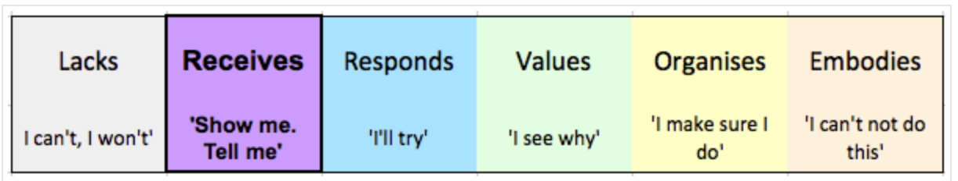
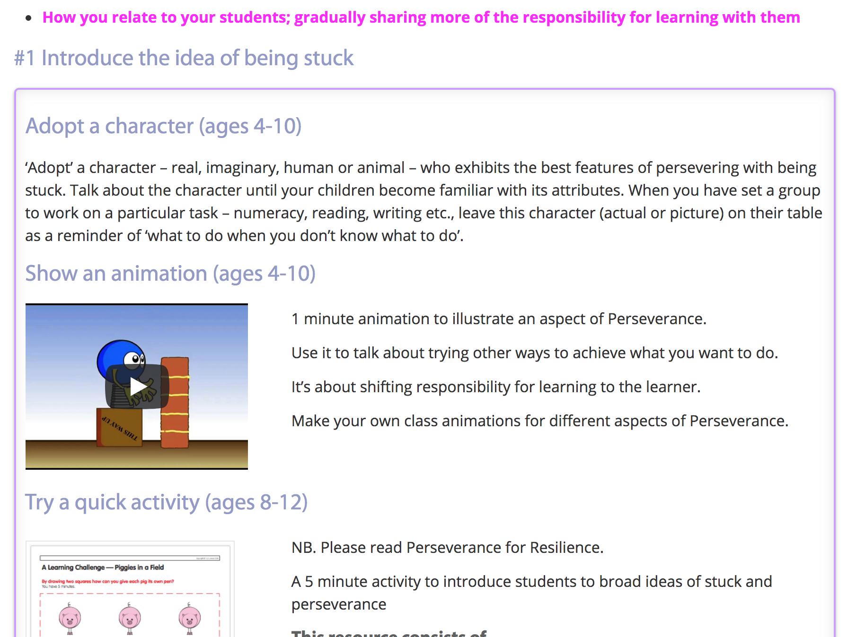
Teaching activities are structured to help the up-skilling of learning behaviours
Notes:
The Key message(s) on this slide:
Teachers need to intervene in order to help students to become more skilful at Perseverance. The online materials help them to do this.
Detail:
The online aspects of the blended learning programme have lots of teaching ideas, carefully differentiated so that teachers can target the development of particular aspects of Perseverance. In this case, the image shows the first 3 of 10 teaching ideas to use with students who are in the grey, ‘lacks’ phase to help them to move into the ‘purple’ phase.

Slide 7
By growing students’ learning power we will be working to…
build students’ learning characters
turn their learning capacities into learning habits
turn dependent into interdependent learners
develop lifelong learners
Notes:
The Key message(s) on this slide:
Summarises the importance of considering progression
Detail:
Progression puts the Building into Building Better Learners.
Copyright © TLO Limited 2009

