Slide 1
Chalkface.
The supple learning mind.
What is it?
What does it consist of?
How does it work.

Slide 2
What you and your learners think about learning: exploring differences in beliefs.
Compare and contrast
Notes:
The threads that link these slides together:
Effective learners have a wide range of effective learning behaviours at their command
The Supple Learning Mind captures these high tariff behaviours and begins to provide a language for discussing and understanding the learning process.
Aim of the discussion: To consider/explore The Supple Learning Mind - the first key model in Building Better Learners. (The second is the Teachers’ Palette - see Topic C)
Objectives: By the end of the discussion participants will have explored:
How their view of effective learning may be at variance with what students believe about it;
The supple learning mind and its 17 high value learning behaviours, and reflected on students who exhibit, and do exhibit, these key learning behaviours;
How they learn when faced with a challenge;
Used a tool for observing learning behaviours and considered how they might use it in the classroom;
Reflected on how powerful learners are different;
Heard from some students about how they view learning.

Slide 3

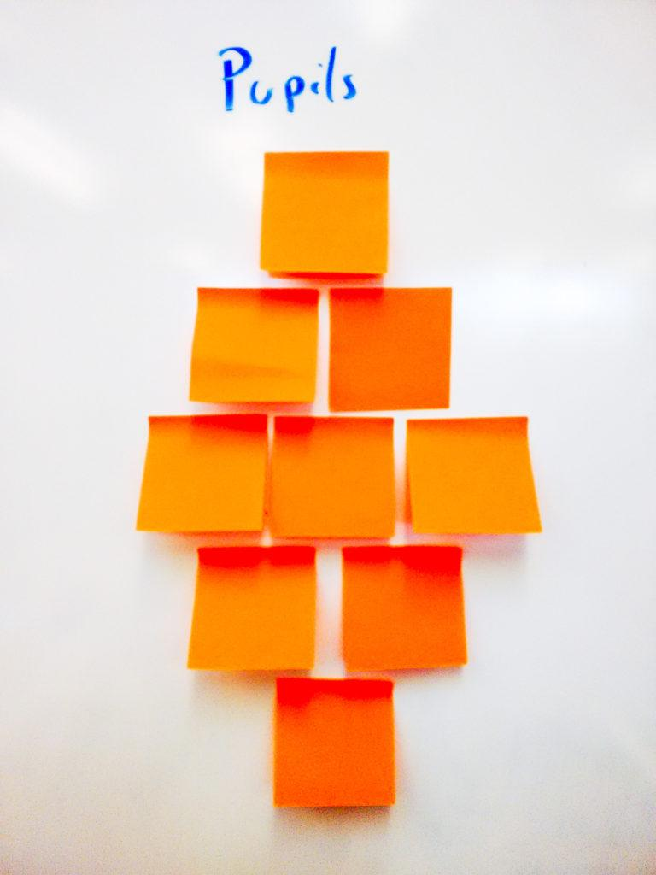


What do good learners do?
Diamond 9
Notes:
The Key message(s):
Give out sets of different coloured post-its
Allow about 10 mins
Visit each group and listen to their discussion
Take feedback about their ideas
Pose questions about how the two diamonds differ
Why do children have these ideas?
Why are they different to yours
Like it or not teachers are in the habit forming business
What you do/say/recognise/praise etc will translate into children's’ beliefs about learning
Background notes
Encourage groups to photograph their diamonds
Set a challenge…. To ask their children the same question (what do good learners do?) next week and again in 6 months time
Hopefully their answers in 6 months will be closer to the professional ideas diamond!

Slide 4
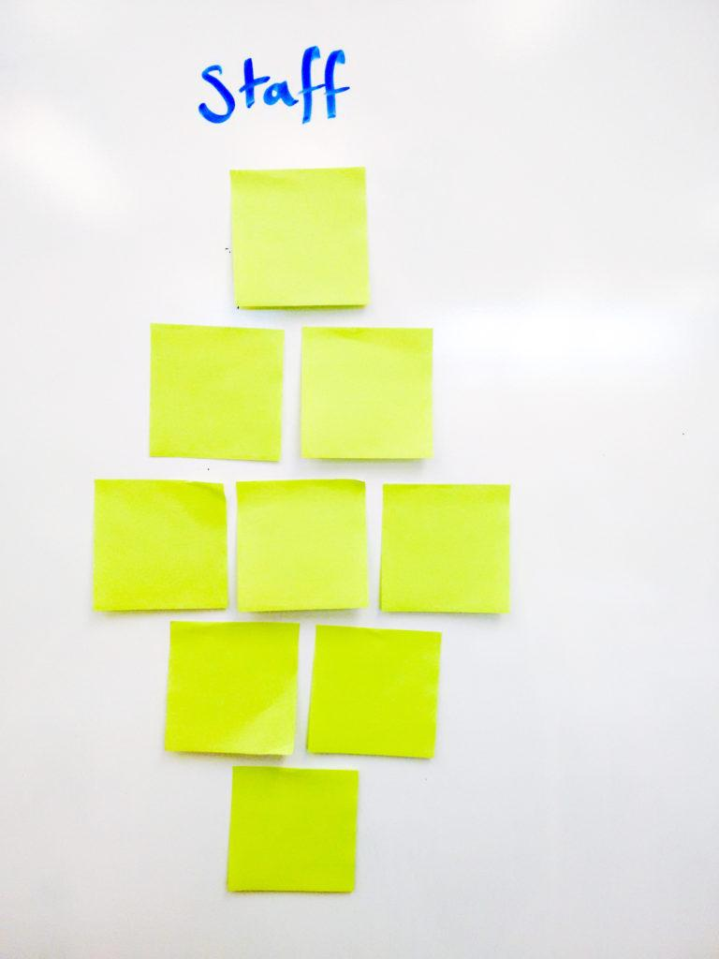

What do good learners do?
Diamond 9
Notes:
The Key message(s):
Key points
Same exercise but now using professional judgement to consider the same issue
Give out sets of different coloured post-its
Allow about 10 mins
Visit each group and listen to their discussion
Take feedback about their ideas
Pose questions about how the two diamonds differ
Why do children have these ideas?
Why are they different to yours
Like it or not teachers are in the habit forming business
What you do/say/recognise/praise etc will translate into children's’ beliefs about learning
Background notes
Encourage groups to photograph their diamonds
Set a challenge…. To ask their children the same question (what do good learners do?) next week and again in 6 months time
Hopefully their answers in 6 months will be closer to the professional ideas diamond!
[Doubtless ‘Good listening’ will come up as one of the top answers in both of the diamond 9’s - an apparent similarity. Do not let this go unchallenged. Is what students call ‘good listening’ the same thing that teachers mean? Do students really mean ‘be quiet when the adult is talking’? ]

Slide 5
Moving students’ views of learning
What they tend to say now
listening at the top
sitting straight is key
working fast is best
being stuck is bad
mistakes make you look stupid
you can do it or you can’t
working with others isn’t really learning
What we want them to say
learning is a struggle
struggling is good
good learners are curious
good learners keep at it
good learners are adventurous
good learners collaborate
learners understand themselves as learners
Notes:
The Key message(s) on this slide:
The less overlap on the two diamond 9’s, the bigger the journey for learners
Detail:
On the left, behaviours/outlooks that we need to counteract, on the right those of effective learners.
What would you add to / subtract from these lists?
Reflect on how big the journey will be for learners as they lose some of their unhelpful outlooks and move closer to the teachers’ diamond 9.
And sitting behind all of this is the somewhat awkward questions - how did students come to acquire their (mistaken) view of what good learners do? Are there hidden, or even unhidden, messages in our classrooms and in the way that teachers go about their business that leads to the misunderstanding?

Slide 6

BLP is about helping students to understand how they learn
Their feelings
Their ways of thinking
How they learn together
How they manage the process
Managing the process
Feelings about learning
Relating to others
Thinking in different ways
Notes:
The Key message(s) on this slide: ​
​
There are 4 domains of learning –
the emotional domain, how we feel about learning; ​
the cognitive domain, the ways in which we think;​
the social domain, how we relate to others, and​
the strategic domain, how we manage the process of learning.​
​
Detail:​
​
Learning is our brain at work. Making it work better at learning it's a good idea to understand a bit about how it works.​
To understand that learning is most affected by how we feel, and how we feel controls how we attend.​
To learn well we need to think in different ways,​
We need to relate to others with and from whom we can learn​
We need to be able to manage the process of our learning.​
It all goes on in our brain. The problem is we cant see the learning happening.​
A student’s Performance enables teachers/learners to see some of what may have happened in the learning process. Developing students learning power aims to make the process of learning more visible to the learner and teacher

Slide 7
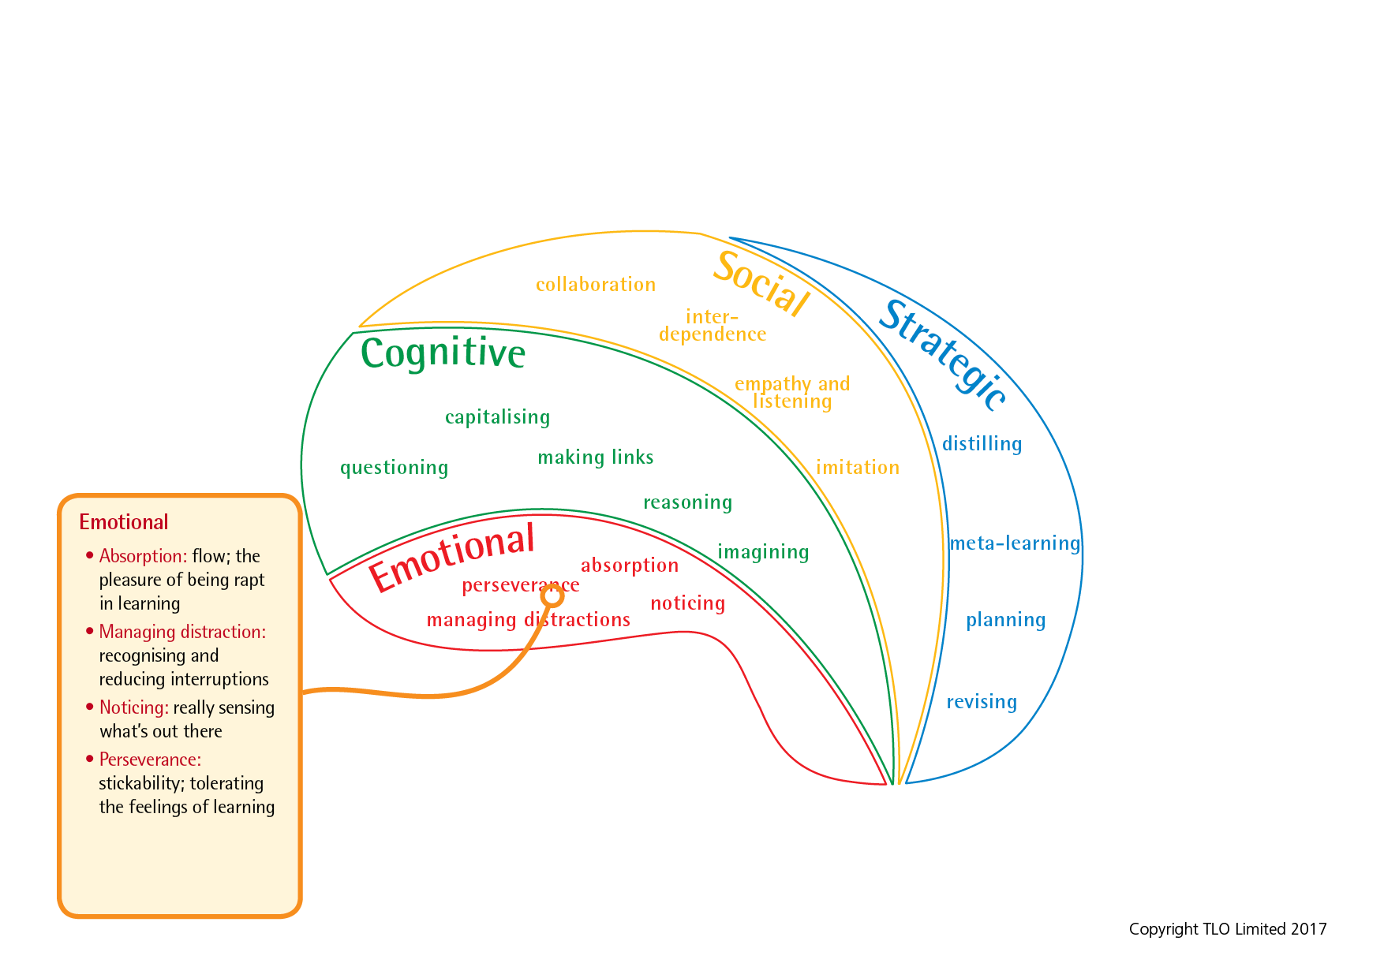
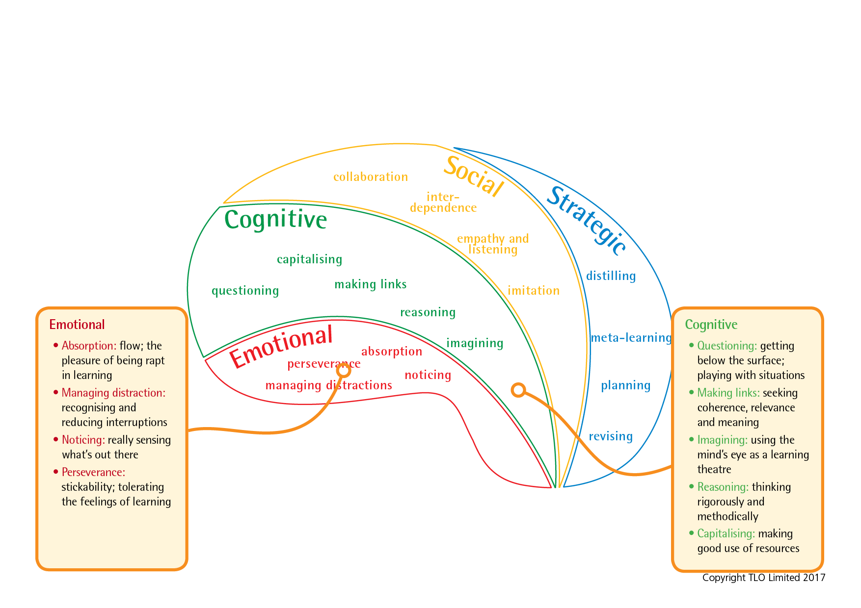
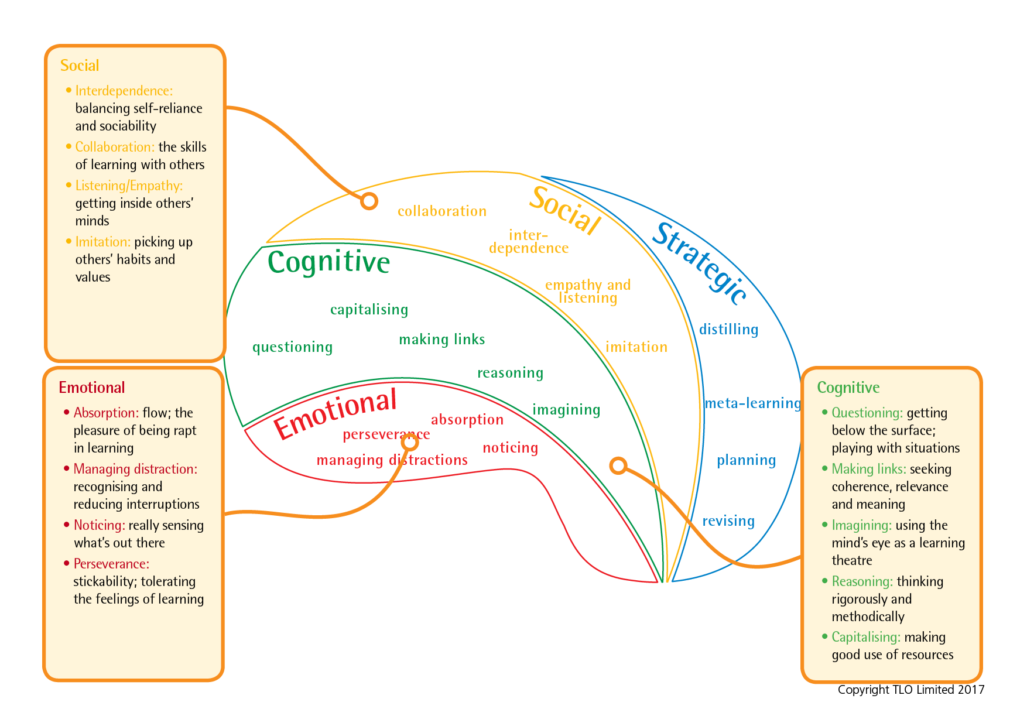
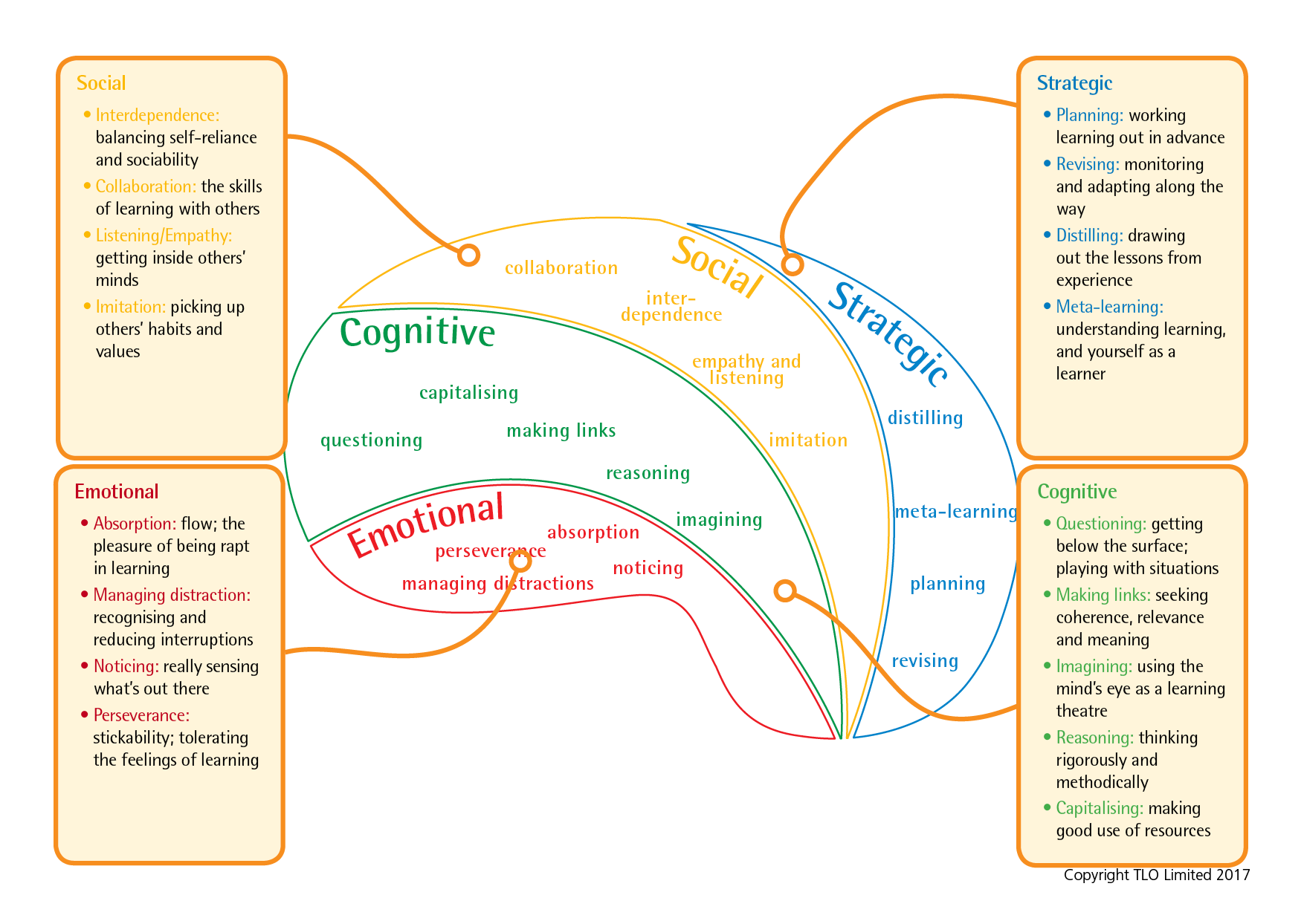
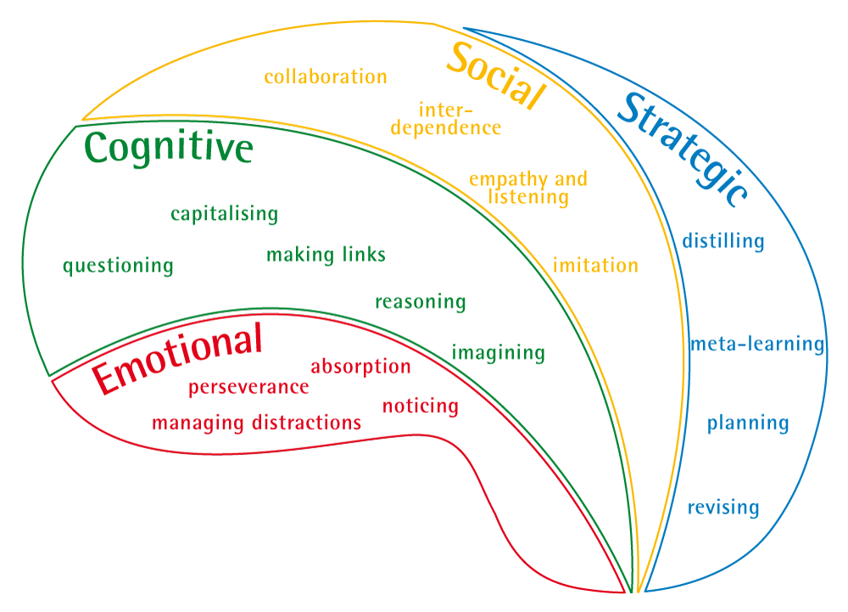
The Learning Power framework
Notes:
The Key message(s) on this slide: ​
​
The 4 domains of learning are made up of 17 learning ‘capacities’​
​
Detail:​
Key points​
These slides build up the key capacities that make up each domain of learning​
​
The names of the capacities form just the start/ beginnings of a language of learning​
Each capacity develops or atrophies over time​
​
Background notes​
This is what it takes to be a good learner​
International research suggests key capacities for better learning​
BLP is about building these capacities into HABITS​
These capacities give us a start on a language for learning​
Resilience: attentional engagement — emotional aspect — feeling​
Resourcefulness: range of tools and skills — cognitive aspect - thinking​
Reciprocity: learning with and from others — social aspect – relating​
Reflectiveness: good manager of own learning — strategic awareness — managing​
​
​
How do we optimally build these capacities?​
Hence BLP is an all-embracing framework, based on the psychology of learning. The Rs, (the Domains) are clustering devices for the capacities. The capacities are what successful learners do. The point of BLP is to develop capacities into HABITS.​

Slide 8
Getting to know your students as learners
Think, puzzle, explore
Think about the learning behaviours
Puzzle over what it means to be without these learning behaviours
Explore and record the names of students who appear to possess or are missing each behaviour.
Notes:
The Key message(s) on this slide:
Just a reminder of another visible thinking routine
Detail:
Skip slide if teachers already familiar with it.

Slide 9

The BIG one: Emotional Engagement
Become absorbed
  Being rapt and attentive
Overcome distraction
  Creating your own best learning environment
Notice attentively
  Perceiving subtle nuances and patterns
Persevere:
  Keep going despite difficulty; tolerate feeling of learning
Notes:
The Key message(s) on this slide and the following 11 slides:
Each of the 4 domains of learning contains a range of key learning capacities. The language associated with these capacities will form the basis of the school’s language for learning.
Use this slide to open discussion about how children are emotionally engaged in learning. There are four capacities that contribute to having a resilient disposition. The capacities are what lies within the secret garden of learning. Building Learning Power is about making these capacities transparent / public / overt to pupils. Giving them a language about learning, drawing attention to when they are using these capacities, designing activities to stretch and develop these capacities.
Being ready and willing are the dispositional qualities i.e. there is a tendency to act in these ways. The ‘able to’ relates to the skill. Having the skill isn’t enough: skills are not always used.
For more detail and some hints on how you might talk about / introduce these learning behaviours, download, read and digest ‘Notes relating to slides 9, 12, 15, 18 (Supple Learning Mind, Learning Behaviours)’.
It is not a script, but outlines the key points that you might make about each behaviour.

Slide 10
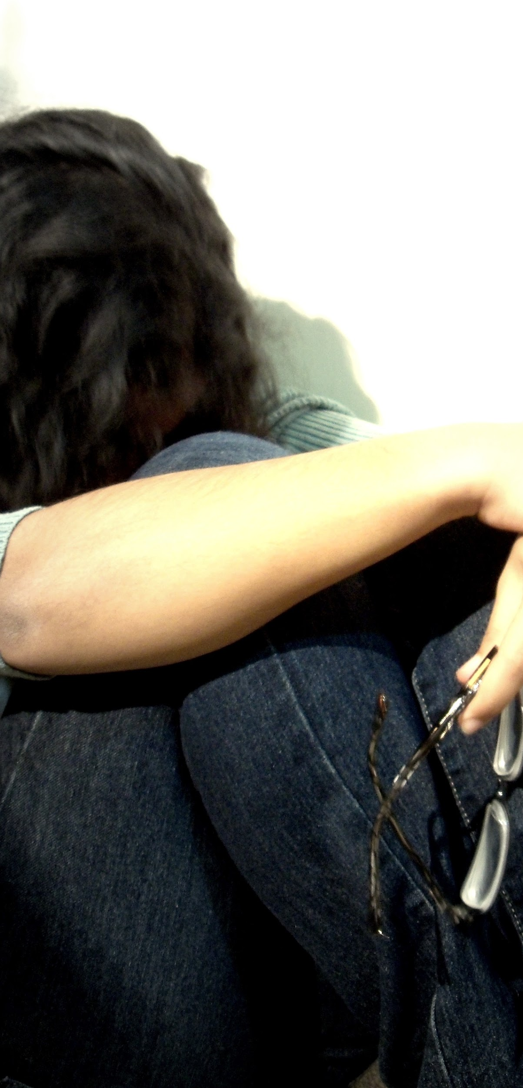
When emotional engagement is missing
Despair when an answer is not immediately clear
Hatred of getting things wrong
Want to do things quickly – to get rid of it
Easily distracted
Unaware of different strategies to try
Expect learning to be easy
Gravitate to non-challenging tasks
Notes:
The Key message(s) on this slide:
It is frequently easier to spot students with little or no emotional engagement than those with it.
Detail:
These are the behaviours of non-resilient (not emotionally engaged) pupils
Which of these behaviours do you recognise in your pupils?
How might we as teachers combat such behaviours?

Slide 11
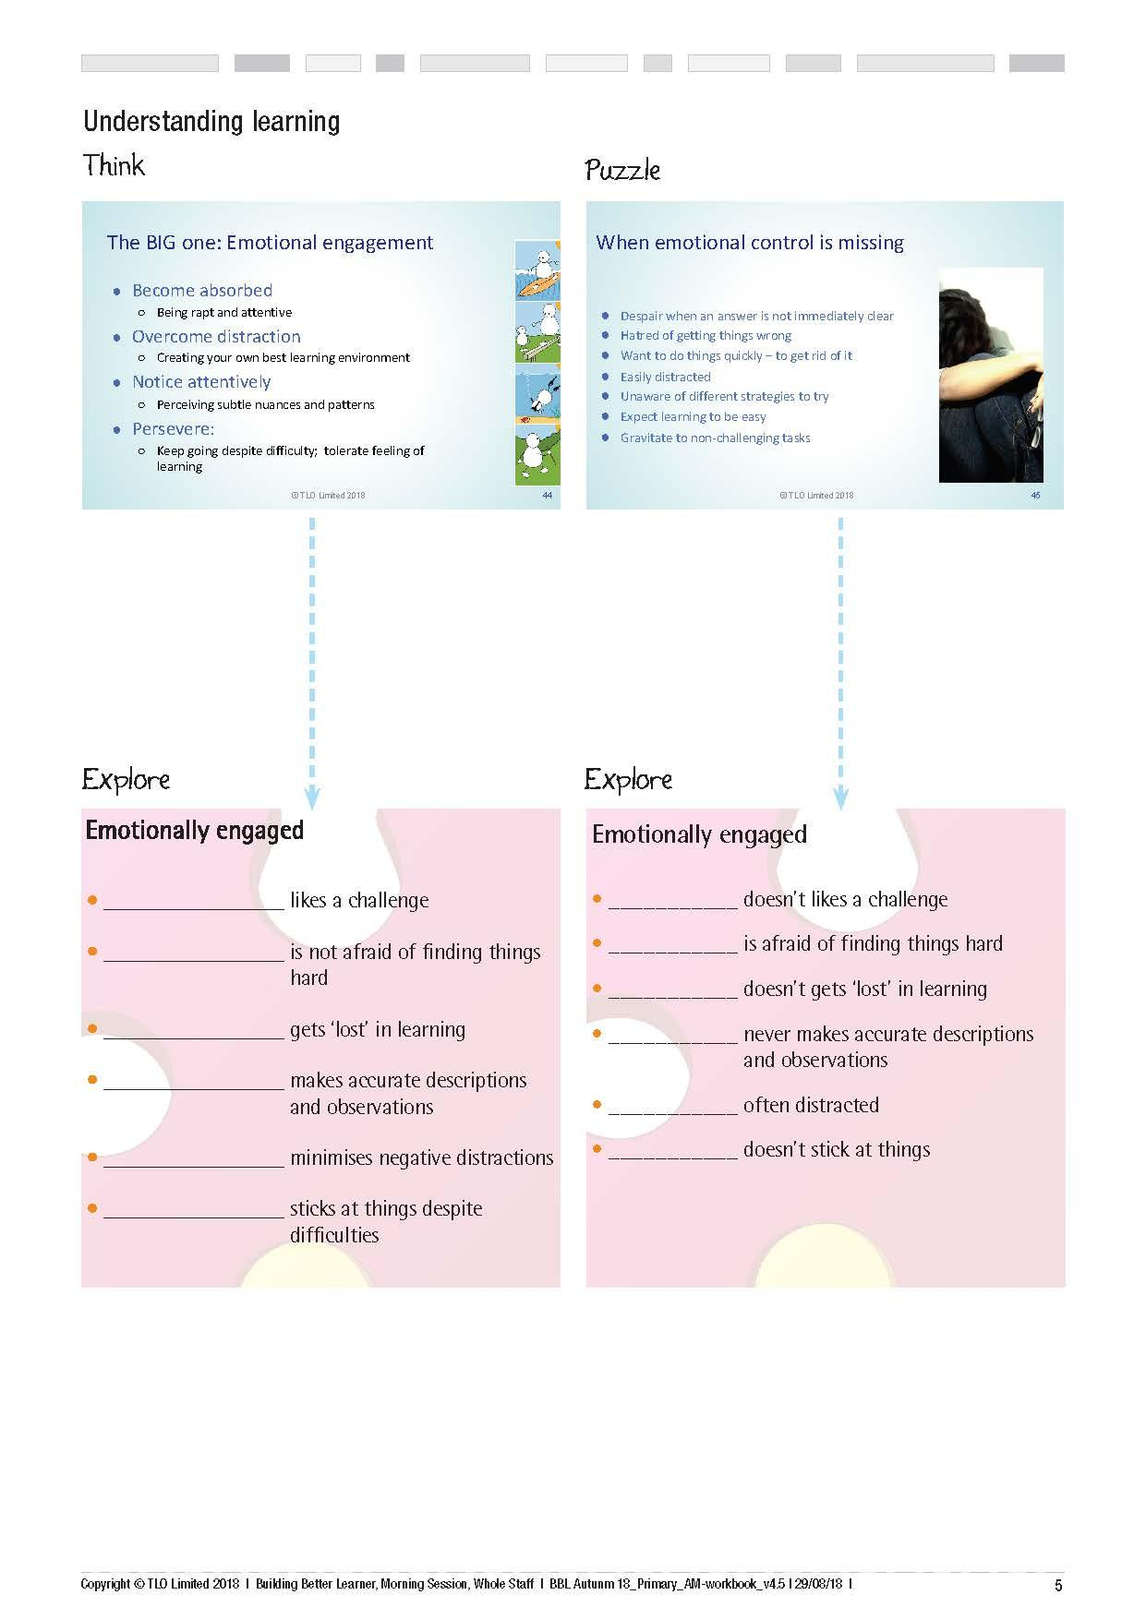
Can you think of a student for each descriptor?
Is it easier to think of names for the positive or the ‘missing’ descriptors?
Notes:
Give time to participants to write in names of students they know who use or are failing to use these behaviours
Detail:
This seemingly simple activity turns out to be quite taxing.
It is virtually impossible to do for a class you do not know well, or a class that you see infrequently
There are always a couple of students who stand out from the pack – on the one hand the accomplished learner(s) who appear to possess and use the positive learning behaviours on the left hand side of the page as and when necessary, and on the other hand those who have almost never exhibited any of them and reside firmly on the right hand side.
But these are the exceptions. Most learners, the ‘invisible majority’, are harder to place.
Force the issue if necessary – insist that they do not keep on using the same child.
Ask the questions –
Can you name a student for each positive and each ‘missing’ behaviour?
And after a while . .
Is it easier to place learners on the left hand side or on the right hand side?
Is this because there are more/fewer of them, or maybe because the ones on the RHS are the ones that demand your support/attention?

Slide 12
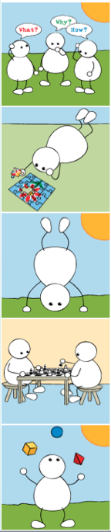
The one we concentrate on: Cognitive Range
Curious:
  question, dig deep for answers
Make links:
  relationships between things
Imagine:
  look at things in different ways playing with ideas
Reason:
  construct logical arguments
Capitalise:
  on learning resources to help
Notes:
The Key message(s) on this slide:
The second of the 4 domains of learning contains a range of key learning capacities. The language associated with these capacities will form the basis of the school’s language for learning.
Detail:
Use this slide to unpack the disposition of being cognitively resourceful; of naturally using a wide range of cognitive approaches. There are five capacities which make up the cognitive range. These capacities need to be nurtured, stretched, grown, and made visible so that pupils use them consciously and can seek to improve them.

Slide 13
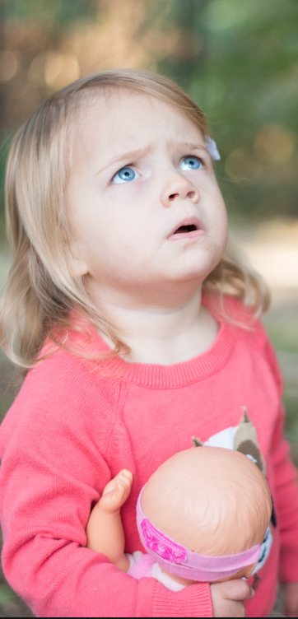
When cognitive range is missing
Unaware of purpose of questions
Afraid of asking questions
Happy with first answer
Perceive thinking as ‘hard work’ & pull back from it
Doesn’t look for or see patterns
Keeps information in silos –
Likes to keep rules; unadventurous, robotic
Lacks spontaneity
Bound by inhibitions
Impulsive; jumps to conclusions
Notes:
Detail:
How learners behave when cognitive range is missing?
Poor/simplistic questioning is an important feature of lack of cognitive range
Lack of free thinking, adopting creative ideas is another feature of limited cognitive range

Slide 14
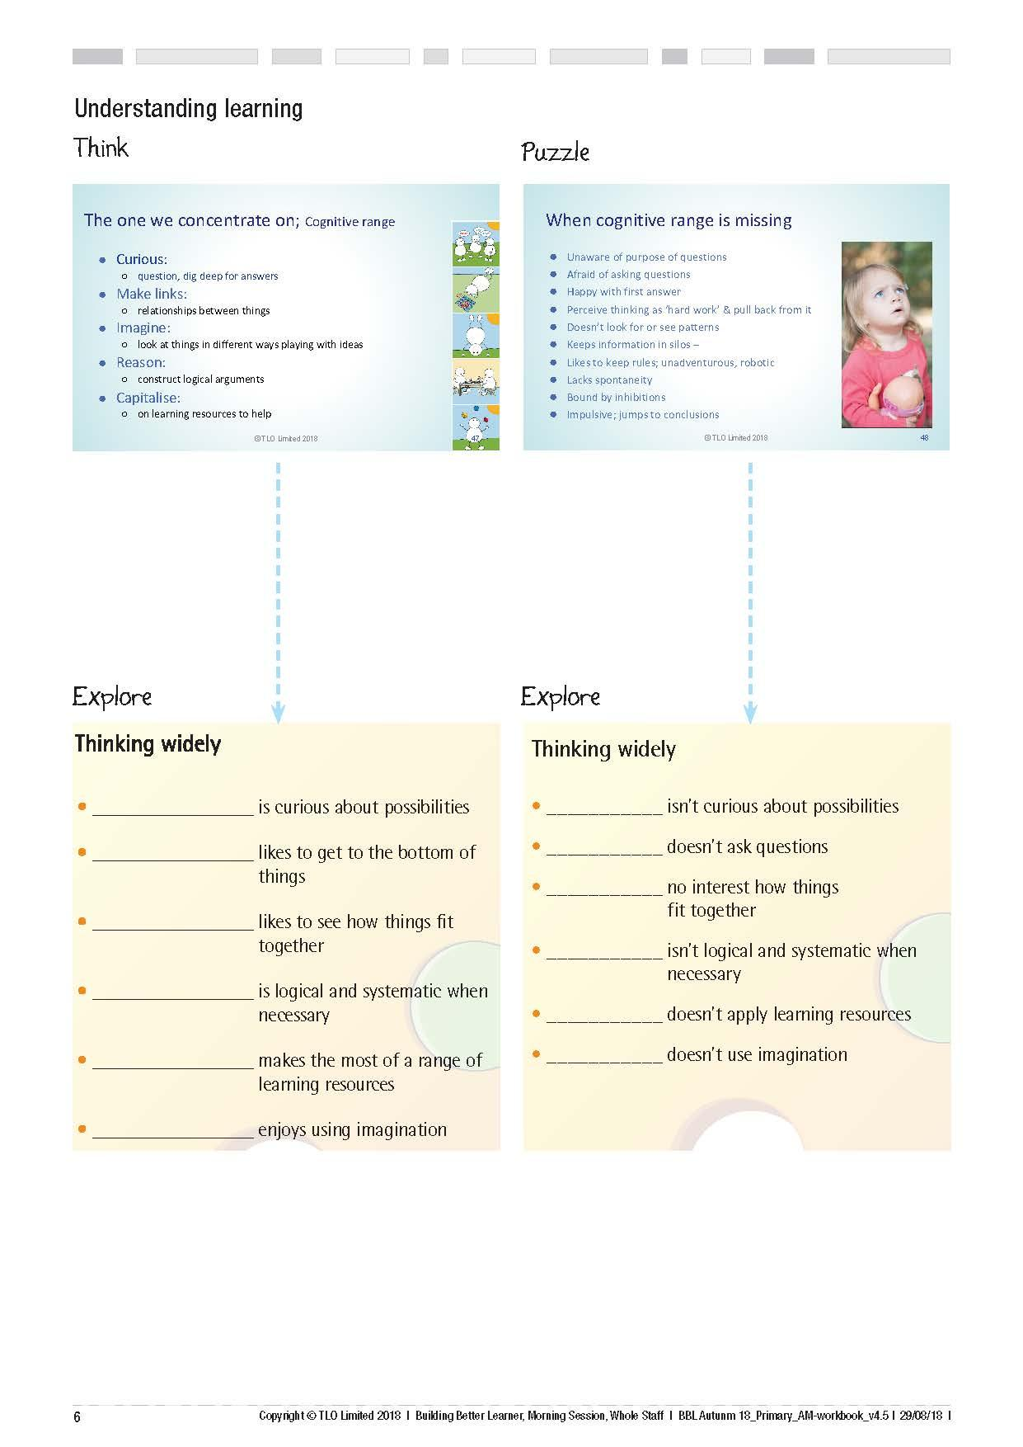
Can you think of a student for each descriptor?
Do you keep thinking of the same names?
Notes:
Ask the questions:
Can you name a student for each positive and each ‘missing’ behaviour?
And after a while
Do you find that you keep thinking of the same names?
What about the ‘invisible majority’?

Slide 15
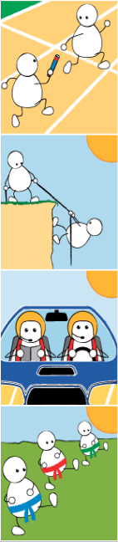
The one we think just happens: Social Interaction
Interdependent:
  Balances learning alone and with others
Collaborate:
  Know how to learn with others
Empathise and Listen:
  Get inside others’ minds
Imitate:
  Pick up others’ thinking and ideas
Notes:
The Key message(s) on this slide:
The third of the 4 domains of learning contains a range of key learning capacities. The language associated with these capacities will form the basis of the school’s language for learning.
Use this slide to unpack the disposition of being socially interactive, or being interpersonally involved as a learner. There are four capacities that make up this socially based disposition.
Again, the capacities, over time, should be introduced, made public, talked about, form the basis of learning activities, stretched, developed into habits.

Slide 16

When the social dimension is missing
Socially underdeveloped
Unaware of others
Social loafers or job hogs
Inattentive to others
Their way is the only way
Feel isolated
Feel unloved
Notes:
Detail:
Evidence of a lack of social involvement
Many children lack the basic social skills of working well with others
The skills of collaboration reach beyond social conventions for teams to be successful
Both job hogs and social loafers need to be combated

Slide 17
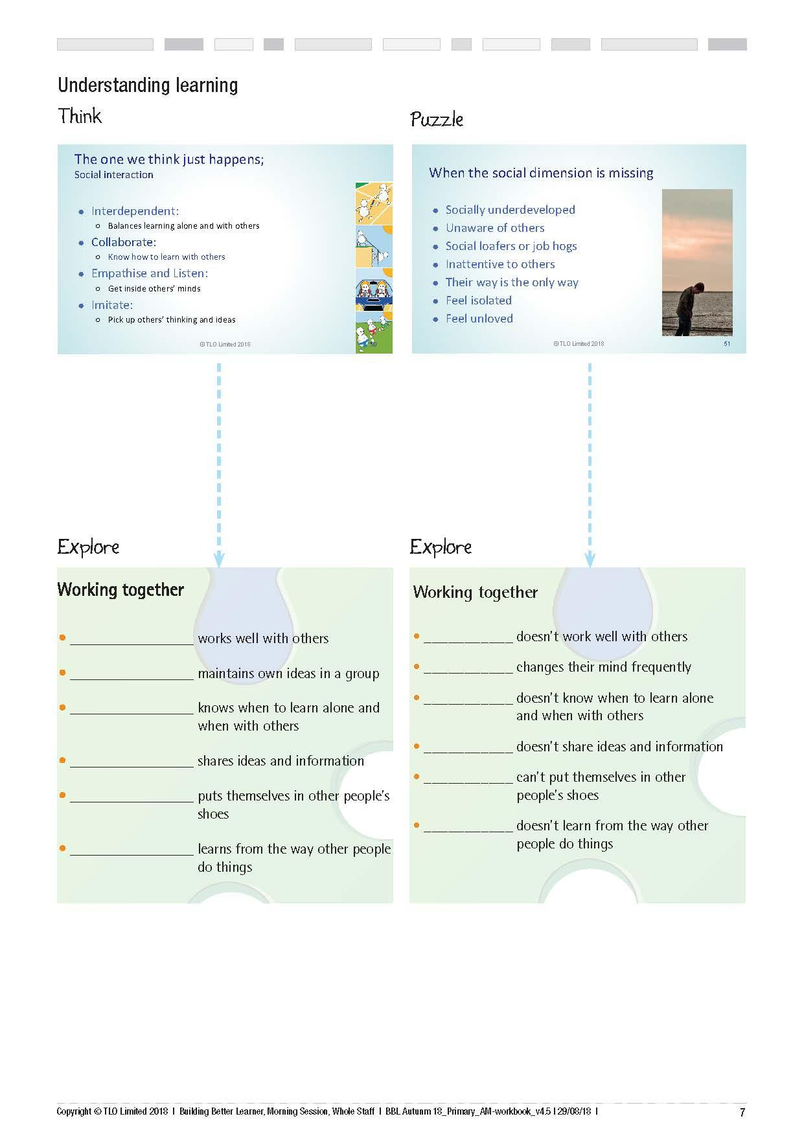
Can you think of a student for each descriptor.
Can you use names that you have not used previously?
Notes:
Detail:
Ask the questions –
Can you name a student for each positive and each ‘missing’ behaviour?
This time - Can you use names you have not previously used?
And after a while
There are some students who stand out as highly effective learners who appear regularly on the left hand side, and others who seem to exhibit many of the right hand side behaviours. But what of those students who fall into neither category? The ‘average’ learner? How well do you know them as ‘learners’?
Where are your higher attainers – LHS or RHS?

Slide 18
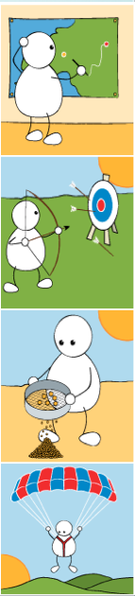
The one we tend to forget about altogether: Strategic Responsibility
Plan:
  Work learning out in advance
Revise:
  Monitor and adapt along the way
Distil:
  Draw out the lessons from experience
Learn about how they learn (Meta-learn):
  Know themselves as a learner
Notes:
The Key message(s) :
The fourth of the 4 domains of learning contains a range of key learning capacities. The language associated with these capacities will form the basis of the school’s language for learning.
Use this slide to unpack the disposition of being reflective, or taking strategic responsibility for learning.
The capacities that make up a reflective learner are a willingness and ability to plan learning, revise plans, to monitor how things are going, to distil out what went well in learning for use in learning elsewhere, to understanding yourself as a learner – to become a meta-learner.
Stress that staff do not need to concern themselves, at this stage, with remembering all the capacities. The on-line course for year 1 deals with 3...perseverance, collaboration and questioning at a deep level.

Slide 19

When strategic responsibility is missing
Blurts out first things that come to mind
Unaware of themselves as a learner
Thinks learning just happens
Rarely plans anything
Doesn’t think about how they have done something
Little sense of ‘doing their best’
Rarely changes tack – sticks to familiar
Makes nothing of feedback
Lack of interest in improving
Notes:
Detail:
Lack of planning skills
Not caring about end results
Not looking for alternative ways of working
Wanting to finish things quickly without care and attention, and with minimum effort
What percentage of your pupils are like this?

Slide 20
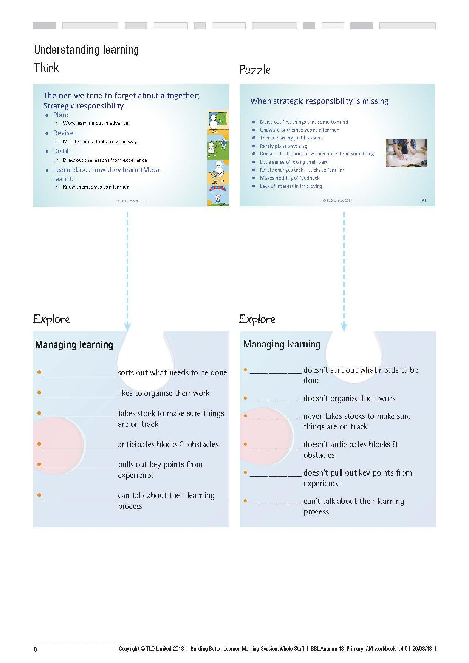
Can you think of a student for each descriptor?
Where are you high attainers tending to appear - left hand side or right hand side?
Notes:
Detail:
Ask the questions –
Can you name a student for each positive and each ‘missing’ behaviour?
And after a while
Are your high attainers on the LHS simply because they are high attainers, or are they high attainers because they are on the LHS?
What might this mean for raising attainment?
This is an important point:
High attainers tend to exhibit LHS behaviours, low attainers RHS behaviours. If we can eliminate RHS behaviours and replace them with LHS behaviours, will we also see attainment rise?
The evidence is yes, that effective learners are also effective attainers.

Slide 21
Using your learning power
A making meaning activity
Notes:
The next 5 slides guide teachers through the Tin Tin Activity.

Slide 22
Let’s experiment… How do you learn?
What’s happening here?
What learning skills are you using?
Notes:
The Key message(s) on this slide:
Introduces the Tin Tin activity
Detail:
Some participants will take part in the activity itself.
Others will observe the activity and feedback to participants afterwards.
It will take about 10 minutes

Slide 23
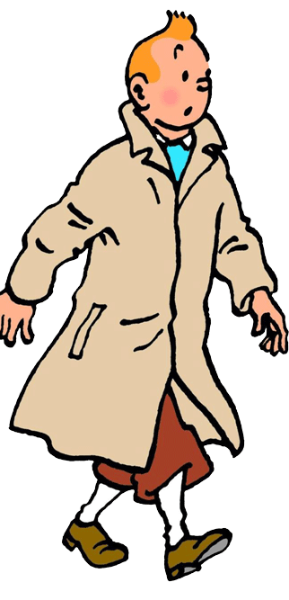
What do we do when we learn?
Groups of 4 or 5,
3 people to tackle the challenge, others to observe
Challenge – Can you sort the cartoon into a credible storyline?
Observers – which learning skills are being used to solve the challenge?
Notes:
The Key message(s) :
This activity puts teachers in the unusual position of being learners. It helps them to reflect on the learning behaviours that they command, even if they are unaware of them.
Detail:
In advance –
Download, print and cut up enough copies of the Tin Tin cartoon so that you have one pack for every 4/5 participants.
Download and print sufficient copies of the Rating Wheel for the observers.
Form groups of 4/5
Explain the task, which is two fold:
3 people undertake the challenge of sorting the cartoon into a credible storyline. Give no further advice or amplification. Most will interpret this as ‘can you put all of the cards it in the right order’ and ignore the much simpler task of creating a credible story line. It is a good lesson in answering the question that you have been asked, not the one that you think you have been asked!
Others observe the activity and the learning behaviours that are employed. Observers should not participate in the activity or comment until the activity, which takes around 10/15 minutes, is completed. Use the next slide to help observers to complete the Rating Wheel.
Once the task is set up, let it run for around 15 minutes, and resist the temptation to interfere. Use the time to wander the room, supporting observers if and when necessary.

Slide 24
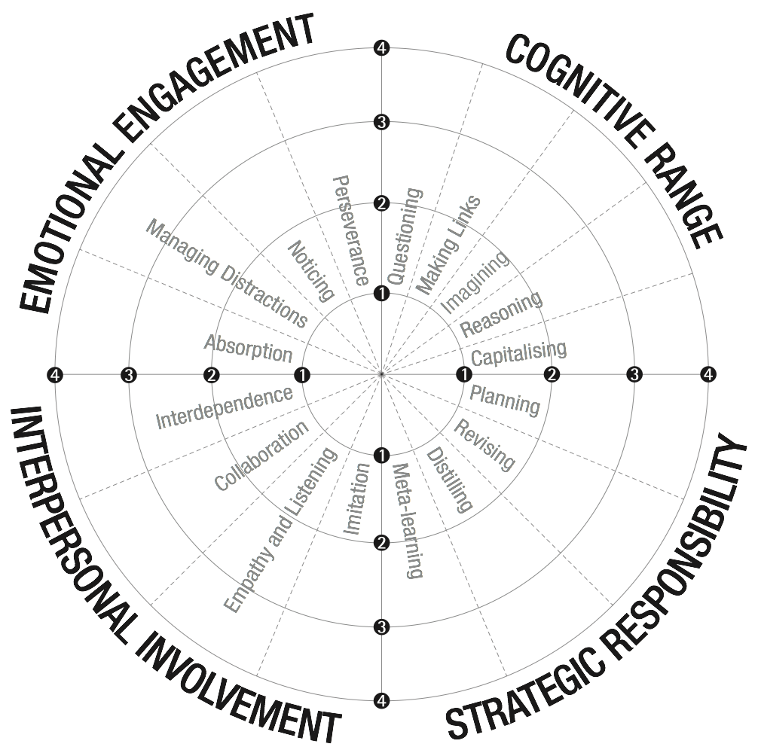
Learning power rating wheel
Observe and record the extent to which learning behaviours are being used.
Notes:
The Key message(s):
Here is way of capturing the range of learning behaviours that are being exercised
Detail:
Briefly talk observers through the process:
Watch how participants tackle the task
Whenever you spot a learning behaviour being used, put a tick on the outside edge of the Wheel
Repeat throughout the activity
At the end of the task, the number of ticks indicate how frequently each behaviour was used
Colour in the ‘spokes’ of the wheel to illustrate the relative frequencies – if the behaviour was frequently exercised, colour in most of the spoke, rarely exercised colour in little.
Feedback to participants when asked.

Slide 25
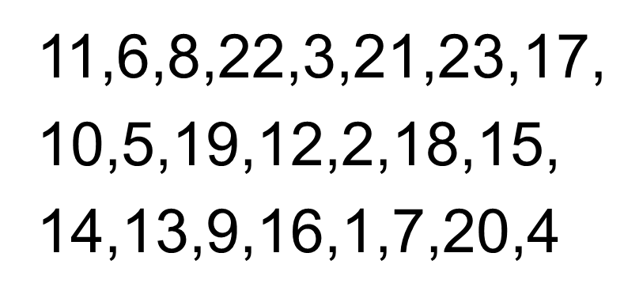
The original order . .
Notes:
The Key message(s) on this slide:
This is ‘the answer’. It is entirely unnecessary as the task was to create a credible storyline, and yet some participants will be desperate to check if they got it ‘right’. Show it only if participants insist, and even then only briefly. Use it as an opportunity to take the mickey out of those groups who try to rearrange their answer so that it is ‘right’.
Detail:
Before showing the slide, ask who wants to see the right answer. Ask who will be upset if you do not show it.
Some will care not a jot, while others are already wondering if they can find the original on the internet if you do not know it or refuse to show it.
If you have time, explore these different approaches. Experience is that teachers of subjects with ‘right answers’ (like Maths and Science) are more prone to want to see the answer than those where a variety of interpretations are possible.

Slide 26
What are the design features?
It appears to be about a cartoon, but what’s really happening here?
What are the task design features?
Could you use this task design in your own curriculum?
How might you do to adapt it to challenge the higher achievers?
Which learning behaviours were you using...even unknowingly.
How might you use the Rating Wheel?
Notes:
The Key message(s) on this slide:
This is a key slide. It debriefs the Tin Tin activity and the Rating Wheel activity.
The big messages are:
Even on a relatively simple task, effective learners use a wide blend of learning behaviours, even if they are not aware of so doing.
The task may not be what it at first appears and is applicable across the curriculum.
Remove one or two key learning behaviours and the task becomes impossible.
The Rating Wheel has many uses.
Detail:
It appears to be about a cartoon, but what’s really happening here? –
The Tin Tin task is about reassembling information that has been broken up.
What are the task design features? –
This is what we would call a manipulating task. All of the necessary information is given, the task is to manipulate/rearrange the given information.
Could you use this in your classroom –
Ask what they might break up in their classroom for their students to reassemble? (Think stanzas of a poem / any sequence of events or processes / timelines / a recipe etc)
How could you adapt it?
Consider things like: putting in information (ie cards) that does not belong; withholding some of the information and giving blanks to be completed; offering two sets that need to be separated before they can be sequenced.
Which learning behaviours were you using...unknowingly. - A question for Observers.
Draw out from their answers:
The wide range of behaviours used
How they were used with unconscious competence – nobody actually stopped and consciously decided to start using another behaviour.
When someone says Collaboration, use it as the chance to ask the supplementary ‘Did you have to collaborate?’ The answer is, of course, no. One person could have done the task with the others watching. Then ask the further question – ‘How could I have tweaked the task to force you to collaborate?’ (Ans: Give everyone some of the cards, tell but not show what’s on the cards). Points out that a small change to structure of the activity can affect which behaviours are used.
If observers struggle to identify learning behaviours, mention things like (in no particular order):
Noticing detail – by reading the words, by looking carefully at the cards;
Revising – trying out different ways of ordering the cards;
Planning – some groups take stock of the task in hand before starting, others just ‘get on with it’
Reasoning – this one must come before that one because . . .
Capitalising – using what you already know of the way cartoons are constructed to help
Making Links – spotting patterns, looking for associations . . .
Questioning – posing speculative questions about what might be happening. . .
Imagining – what might be happening . . .
Pose the question – ‘If you were to suddenly lose your ability to Notice detail, could you solve this problem?’ Repeat with losing your ability to Reason. Repeat with losing your ability to change your mind. The point here is that effective learners have a well-developed blend of all of the behaviours -take one or two away and learning becomes much more difficult. Hence we cannot just focus on a subset – you cannot learn to play bridge by starting with just the red suits. The game, played even at novice level, requires all of the cards in the pack. Effective learners can move seamlessly across all of the behaviours.
Be prepared for the ambush sometime around this point – Someone might ask ‘I was never taught about learning at school, yet I became an effective learner. So why do we need to teach these skills?’ Think - How will you answer?
How might you use the Rating Wheel? A question for everyone.
Teachers generally see the potential of using the Rating Wheel as a lens through which to look at their own classes. Ask:
Could you use it analyse a lesson that you taught yesterday?
Could you use it to predict which learning behaviours an upcoming lesson might exercise?
Translated into ‘kid speak’, could you use it to help students to become more aware of the learning behaviours they are exercising / could be exercising?
To senior/middle leaders – Could you use it as a lesson observation proforma? Could you use it to stimulate a conversation about learning with the teacher of the observed lesson? Could you use it as a means of getting a handle on which skills are regularly being exercised (or neglected) in lessons?

Slide 27

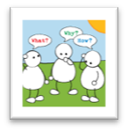
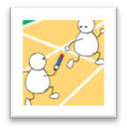
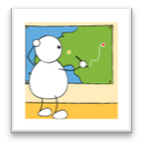
Learning: poles apart
Fragile, dependent, risk averse, weak perseverance |  |  | Absorbed, attentive, hang in there despite toughness, give it a go
|_____________|_____________|_____________|_____________| Emotional engagement
Rule bound, like only tried and tested, fragmented info, passive, uncritical |  |  | Curious, rich understandings, imaginative, logical
|_____________|_____________|_____________|_____________| Cognitive range
Isolated and dependent, lack of engagement with others. |  |  | Collaborative, listen empathise, Learn with and from others
|_____________|_____________|_____________|_____________| Social interaction
Little self awareness, robotic, can’t explain reasons for what/why they do things |  |  | Plan, revise, know themselves as learners. Like to take responsibility for own learning
|_____________|_____________|_____________|_____________| Strategic responsibility
Notes:
The Key message(s) on this slide: ​
​
‘Schooling’ often leaves many students towards the left hand side. How can we help them move towards the right ?​
​
Detail:​
​
What might happen if pupils are not supported in their learning behaviours? ​
What might happen if we spoon-feed learners ?​
​
Here are the alternatives - we want learners to be at or near the right hand side​
tough, alternative, curious, imaginative, rational, collaborative, empathetic, revisionist, and meta-cognitive​
Rather than​ fragile, risk averse, rule-bound, fragmented understanding, passive, dependent, robotic.​
If we left learners to it they would probably be like the right hand side – they certainly appear to be before they go to school !​
But schooling, too often works, against these natural, innate learning behaviours. ​
It hot houses learners through, and in so doing moves them towards the left.​
​
Important​
Left side does NOT mean low achievers. Many high achieving girls are fragile learners who ‘fall apart’ when they come up against something they cannot do. They are not used to having to struggle. They have not learned how to make mistakes profitably​
​
NB Definition - Robotic learners. - unwilling to try other ways of doing things. Keep to the teachers instructions in order to pass the exam. ​

Slide 28
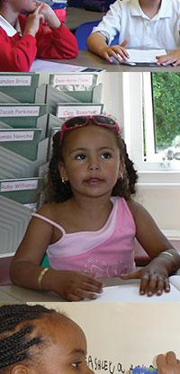
Why learning powered learners are different...
because they begin to see how to take control of their learning behaviours..
  have a learning language
  they talk about how they do it, how it feels, learning together, getting better at it
  develop self-awareness as a learner across each domain...thinking, feeling, managing, relating
  can take control of their learning...if you let them
  Consciously develop their learning behaviours...they become better learners
Notes:
The Key message(s) on this slide:
Learning Powered Learners are different
Detail:
Key points
What pupils need in order to become learning powered learners.
Here again the emphasis is on:
A language for learning
Being self aware of what they are doing as a learner
Taking control of their learning and consciously developing their capacities
The last of these means getting better at them (more skilled) and using these skills more often and across many contexts – at school, at home, in clubs, in different subjects; i.e. transferring the skills.

Slide 29
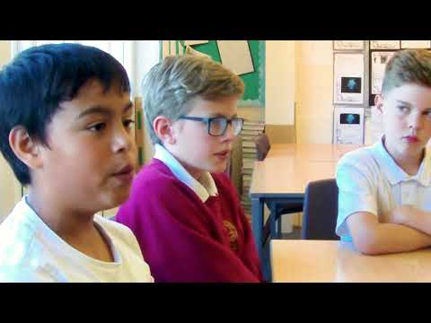
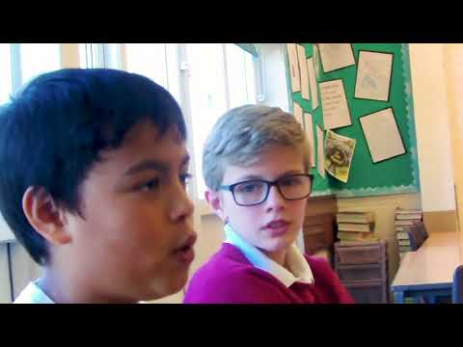
Pupils talk about their learning power
Notes:
The Key message(s) on this slide: ​
​
Give learners a language of learning so that they can understand the concept of learning​
​
Detail:​
​
Listen to these young learners. Could your students speak with similar fluency about the learning process ?​

