Slide 1
Managing. Learning Power what and why.
A guided conversation for managers of Learning Power

Slide 2
Line of argument through the slides
Our aim for young people. An overview of intent
A key ‘must do’ to make it work
Necessary changes will be extensive across school
What do we need to do early on?
Manage a dialogue about learning across school
Organise and manage of a culture of enquiry
Keep track of development of enquiries
Notes:
The threads that link these slides together:
There are changes ahead for students, teachers, leaders and whole-school systems/structures
Such change will take time and energy
There may be resistance along the way
Aim of the discussion: To consider/explore the scope of the proposed changes and how they might be introduced.
Objectives: By the end of the discussion participants will have explored:
The scope of the necessary changes
How leaders might stimulate interest in and commitment to the changes
How leaders might create a culture of experimentation
How leaders might keep a close eye on how the changes are taking root.

Slide 3
Our aim for young people
To purposefully grow our students’ learning behaviours ... perseverance, self-control, attentiveness, openness to experience, empathy, tolerance of diverse opinions, creativity, critical curiosity etc. A wealth of high value learning habits.
By developing learning friendly cultures that:
  use a learning language
  give students greater responsibility for learning
  offer classroom activities that stretch learning behaviours
  celebrate the use and growth of learning behaviours
Notes:
The Key message(s) on this slide:
Two big ideas: Firstly the aim of purposefully growing learning behaviours; Secondly that it will be achieved through a shift in classroom culture.
Detail:
Purposefully growing learning behaviours: John Hattie’s research tells us that many teachers believe that if teaching is good, then there will be a ‘ripple effect’ into learning behaviours. Furthermore, he tells us that there is absolutely no evidence that this is the case. Growing learning behaviours, he states, requires planned interventions.
Developing learning friendly cultures: these 4 aspects foreshadow section 3 on the necessary shifts in classroom culture. It flags up the need for the school developing its own language for learning, a shift of responsibility for learning towards the learner, a change to the activities undertaken in classrooms, and a shift in the things that are valued and celebrated.
Key point:
Most teachers are very happy to support the suggestion that their students need to be more perseverant, exercise greater self control, display attentiveness, to learn from experience and feedback etc etc.
Some are less inclined to accept that this is unlikely to happen unless they first change their teaching ways / classroom culture.
Put another way – if teachers won’t change, neither will students.
How much resistance of this type do you anticipate?
From where is it most likely to appear?
How might you plan to counteract it?

Slide 4
Research suggests there’s a key difference in schools that make BLP work
Stop it fizzling out by understanding BLP as:
  whole-school culture change, not an initiative
  something that will take several years to implement/sustain
  not a quick fix to raise results
  a struggle for some teachers
Notes:
The Key message(s) on this slide:
It will take time
Detail:
Either commit to Building Better Learners, wholeheartedly and with sustained focus, for the next 2 or 3 years, or walk away now. Playing with it for a while, only to have it overtaken by ‘the next good idea’ is a waste of your time and energy.
It is not a quick fix to raise results, but all the evidence is that ‘students with more elaborated conceptions of learning perform better in public examinations at age 16.’ (Watkins, Learning, Performance and Improvement). That better learners do better in examinations should not come as a surprise to us, but it will take time before the ‘elaborated conceptions of learning’ are translated into results.
A struggle for some teachers:
Habit change is never easy, and the more ingrained the habit, the harder the change may be.
A headteacher warned us recently never to underestimate how long it takes some good teachers to make the necessary adjustments. It is not because they are being difficult, nor are they necessarily resistant to change. Rather they are reflective practitioners who are evaluating the ideas and considering what this means for their own classroom practice. They are, rightly, sceptical of quick fixes and snake oil !
And it is not always to do with age and deeply ingrained habits. Some more mature teachers have memories that go back to ideas like ‘educating the whole child’, and the idea of Building Better Learners can resonate more with them than it does with younger teachers who have both learned under and taught within a system that focuses almost exclusively on attainment standards.
Whatever the reason for resistance, accept that some teachers will take longer than others, and live with it. We ask that our students take time to reflect and make sense of learning for themselves rather than simply accepting received wisdom. The same courtesy and time should be extended to teachers !
Where do you expect the greatest resistance will come from?
How might you harness them as your best critical friends rather than your biggest staffroom critics?

Slide 5
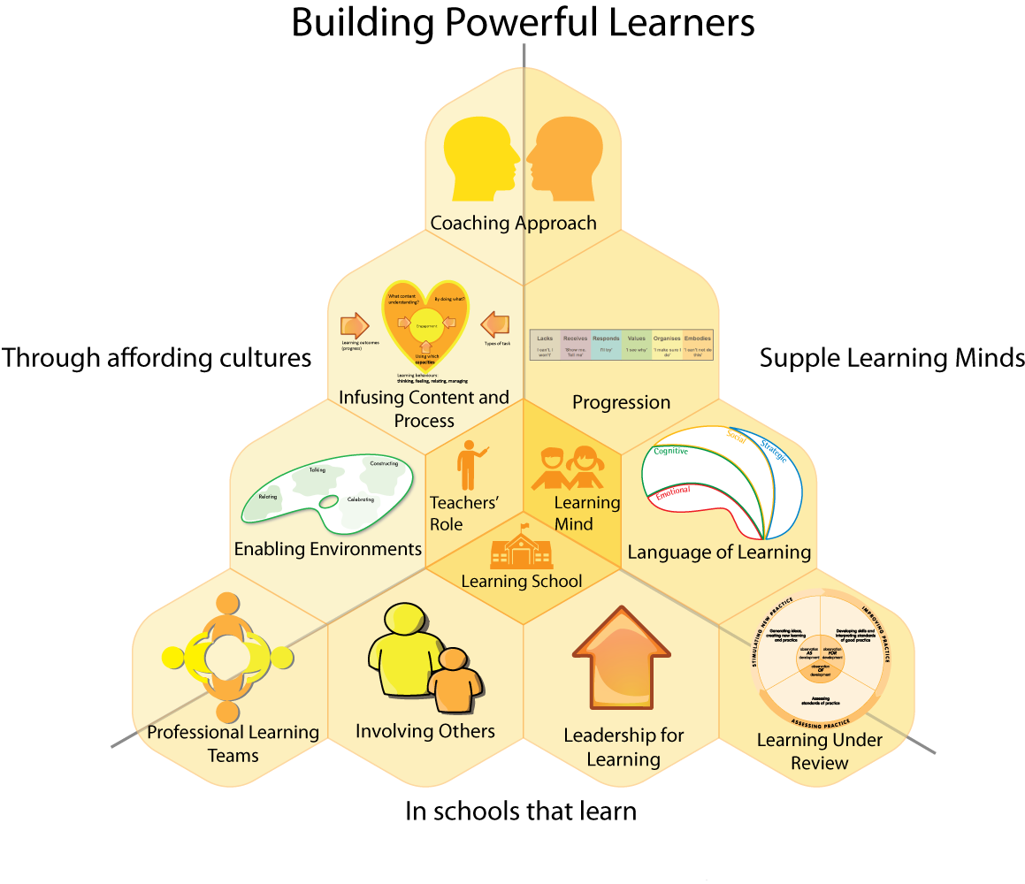
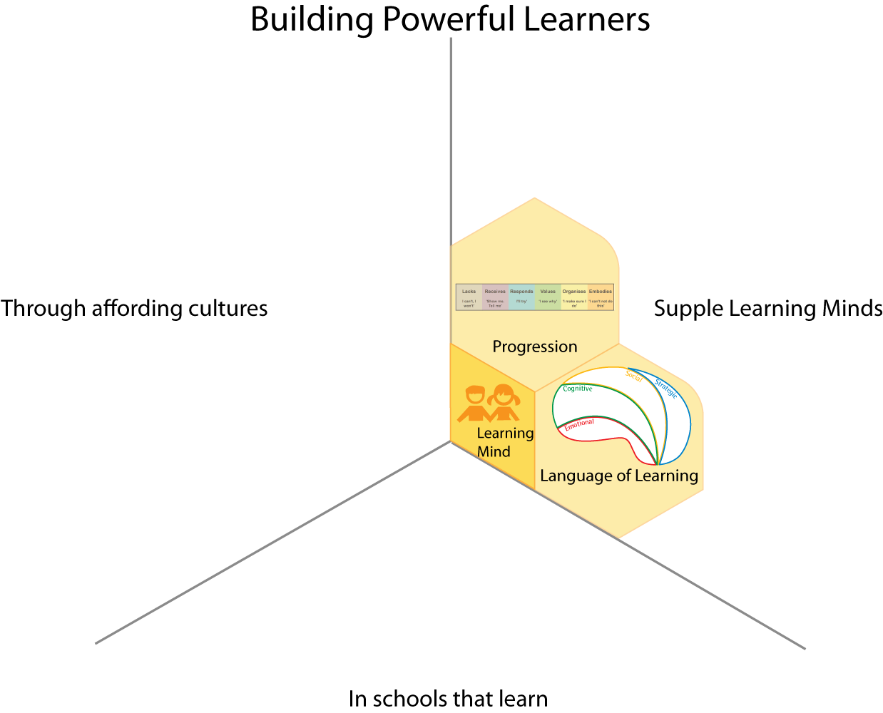
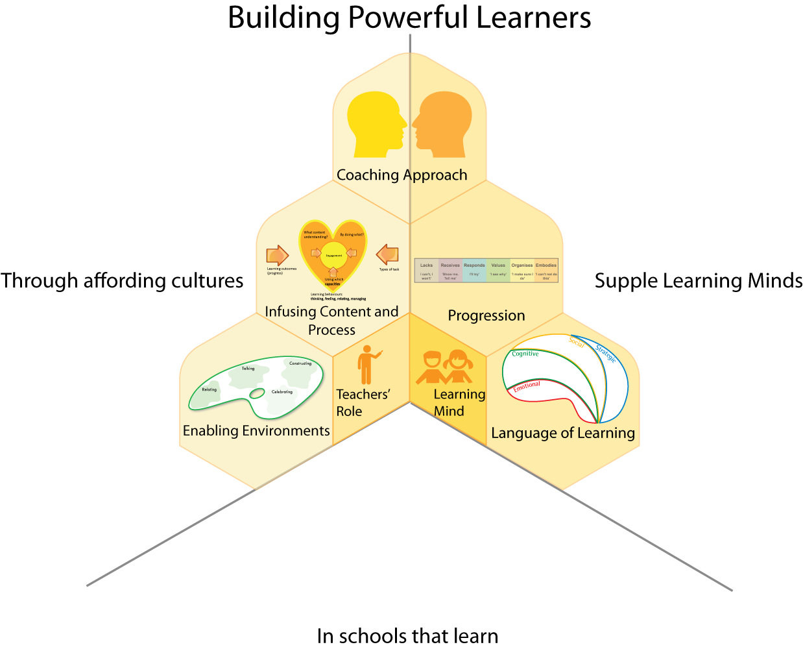
Breadth of change
Notes:
The Key message(s) on this slide:
The changes will impact on all areas of school life
Detail:
The three areas:
1 Building students supple learning minds (the learning behaviours we are seeking to develop)
2 the classroom cultures and teaching practices that will enable these behaviours to grow
3 the aspects of a learning school necessary to support the other 2 aspects.
See notes for this slide in Downloads - Notes to help understanding of slide 5 (Breadth of change)
.

Slide 6
Create a dialogue re a vision for learning. HOW?
Share Learning Power books with staff?
Make parts of this resource available to staff?
Ensure no mixed messages
Use Learning walks looking for learning NOT teaching?
Faculty/year audit of routinely used learning behaviours. Share and discuss results?
Introductory training day for all staff? (using material in this resource pack)
Notes:
The Key message(s) on this slide:
There are many change levers that need to be activated. What sort of strategies could we use to begin the school’s journey to a learning culture and by engaging staff in the exploration.
Detail:
Creating a dialogue about learning: It is a simple fact that teachers tend to pay attention to the same things to which leaders pay attention. If leaders focus on uniform, teachers conclude that uniform is important and focus likewise. If leaders focus on attainment, standards and examination results, so will teachers. It follows that if we, as leaders, want to shift the focus towards student learning, we will need to pay it lots of attention.
How might we create a dialogue about learning in the school? When/where could this dialogue take place? How will we demonstrate their sustained commitment to this dialogue?
Sharing Learning Power books with staff: Sharing Learning Power books may be a start, but only that. Some teachers will read the materials carefully, some will take a more cursory view, some will adopt the ‘it’s another initiative’ attitude, some will find the potential changes threatening and react adversely, some will say ‘yes’ and think ‘no’. Be prepared for this., and consider how you will engage/persuade the doubters.
Ensuring no mixed messages: Walk the talk ! The new, emerging vision for learning may command widespread support, but it needs to be more than a revamped vision statement that is at odds with the day to day realities of the school systems, structures and attitudes. If you focus more effort on raising results staff will be confused about which values are most important.
Learning walks to look for learning NOT teaching: Learning walks are, too often, teaching walks, or behaviour walks, or worse still, ‘management by walking about’ ! To illustrate leadership commitment to developing learning behaviours, focus learning walks exclusively on student learning. Show your interest in students as developing learners, monitor the learning behaviours that are being routinely activated in classrooms, use your observations to further stimulate the dialogue.
Faculty/year audit of routinely used learning behaviours: Ask teachers – which learning behaviours are frequently exercised in your classroom? Which ones get less frequent exposure? Ask – why those? Is it because of what you teach? Or how you teach? Or both?
Introductory training day for all staff: There are materials in this pack (see section Chalkface, Topic B) that will support you in delivering such a training day. When will such a day take place? Who will lead it? Will there be any advance reading for staff? How will you overcome the issues around support staff attending training days – this is one they cannot miss.

Slide 7
Creating a culture of enquiry. HOW?
Encourage staff to actively experiment in their classrooms
Set up Professional Learning Teams
Support the freedom to take risks and learn from mistakes
Emphasise the school is learning its way forward
Promote the idea of teachers being leaders of their own learning
Notes:
The Key message(s) on this slide:
The best way to enable staff to change is to create a culture of enquiry across the school. We ask that students ‘fail in safety’. The same should be extended to teachers.
Detail:
Experimentation is key. Trying things out, finding what works with your students, small scale action research projects supported by colleagues who are undertaking similar enquiries lie at the heart of changing teaching habits.
How will you, as leaders, ensure that teachers are supported in experimenting, making mistakes and learning from them, taking control of their own growth as reflective practitioner?
Will you have to make any alterations to existing practices/structures (like, for example, Performance Management) to ensure that teachers feel empowered to ‘fail in safety’?

Slide 8
Keep track of developments. HOW?
Regular classroom reviews in a spirit of learning support NOT judgement or appraisal
Not ‘checking up’ but reflective process across the school
Possible changes to watch out for in students:
  changes in learning behaviours,
  increased motivation
  greater interest in learning
  taking more responsibility for learning
  becoming less dependent
  showing more confidence in tackling difficulty
Notes:
The Key message(s) on this slide:
Leaders need to keep track of developments in the most sensitive, supportive way possible
Detail:
Consider how you might monitor:
changes in students’ learning behaviours,
increased motivation
greater interest in learning
taking more responsibility for learning
becoming less dependent
showing more confidence in tackling difficulty
Ask yourselves:
How would it change your usual lesson observation proformas if you set out to capture this type of evidence?
How might you engage teachers in contributing to the gathering of this information?
How might you gather learner views?
This could provide a useful baseline measure against which to evaluate future developments.

