Slide 1
Managing. Learning friendly cultures
A guided conversation for managers of Learning Power

Slide 2
Line of argument across the slides
Three types of classroom cultures. Where are we now?
The four big shifts in classroom culture to build supple learning minds. What do classrooms look like now?
Consider taking an Amble around the school to find out
And decide what to do to support the results of your Amble; how you will support staff in the spirit of BLP
So that ultimately we should see a move from the left (good teaching) to the right (Learning powered teaching) in terms of teachers’ practice (see Poles apart)
Notes:
The threads that link these slides together:
Classroom culture is of critical importance;
Building better learners is unlikely to take root in highly teacher focused classroom cultures;
Teachers need time and help to change the prevailing culture of their classroom;
Creating learning focused classrooms is about moving teaching from good to outstanding.
Aim of the discussion: To consider/explore classroom culture as it is now, and how it needs to be to enable learning to flourish.
Objectives: By the end of the discussion participants will have explored:
The ‘3 panel’ culture 1 tool, and assessed classroom culture against it;
Undertaken a Learning Amble’ around classrooms;
Reflected on the Culture 2 Tool and evaluated the extent of the necessary changes;
Considered how best to model leadership commitment to building better learners.

Slide 3
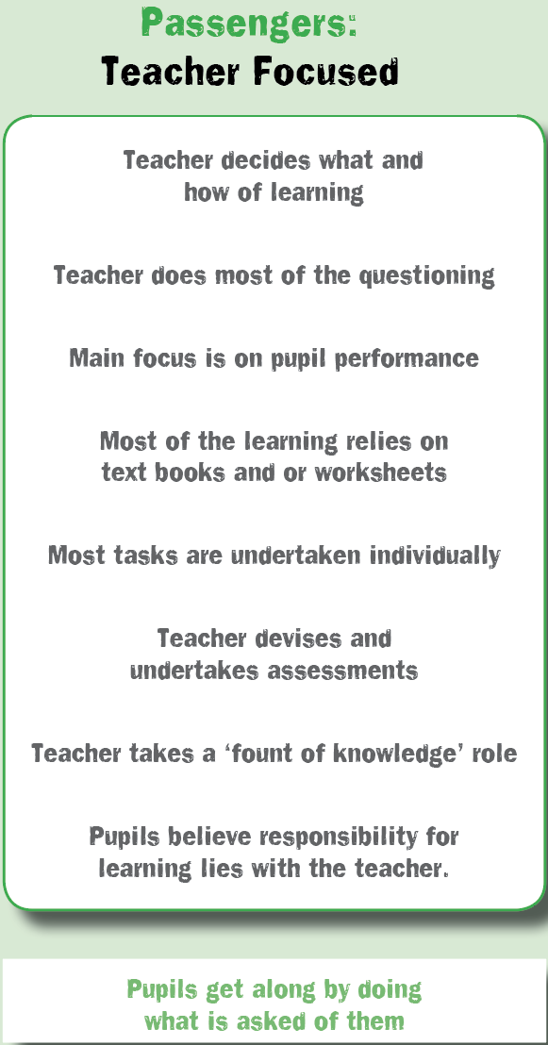
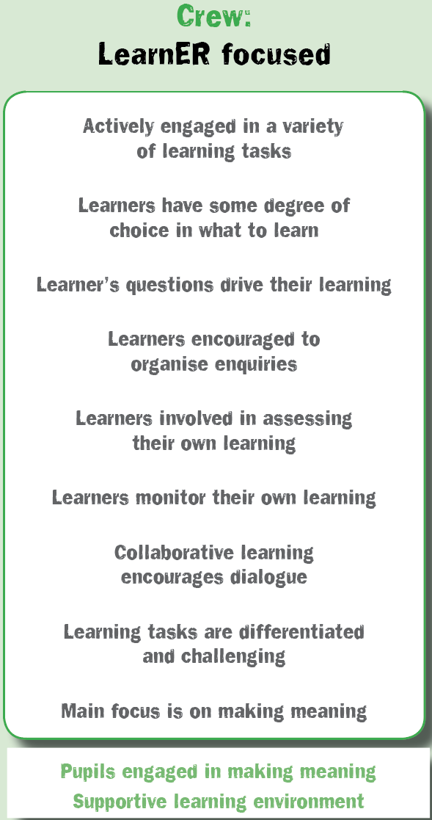
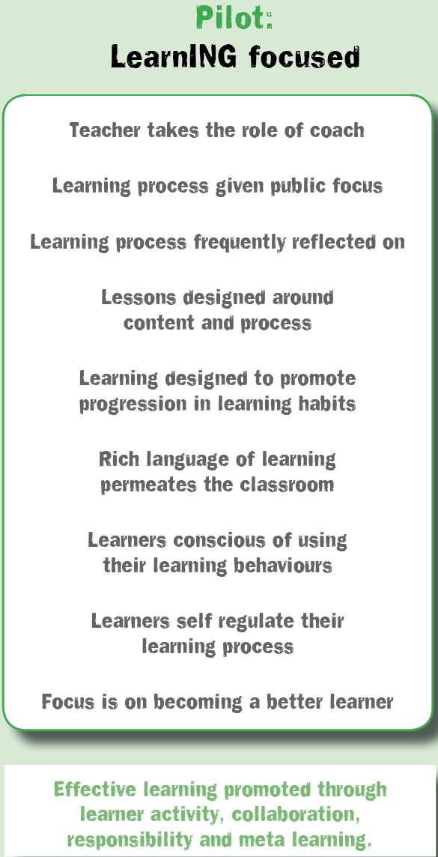
Classroom cultures
What is your’s like?
Notes:
The Key message(s) on this slide:
There are three distinct types of classroom culture – Teacher focused, Learner focused, and Learning focused.
Detail:
Here’s the shift in more detail.
[Based on research by Chris Watkins of The London Institute]
Classrooms can broadly be categorised as predominantly one of 3 types.
The teacher focused classroom is highly unlikely to be learning friendly. It is designed for the efficient transmission of curriculum content. Learners’ roles are predominantly passive, responsibility for learning resides with the teacher, dialogue is largely teacher generated.
The learner focused classroom is a step in the right direction. Learning is increasingly active; students are beginning to take more responsibility for their own learning; and students have more opportunities to talk and explore their ideas for themselves. Students are beginning to create their own understandings rather than memorizing teacher delivered information.
The learning focused classroom develops effective learning behaviours through learner activity, collaborative endeavour, devolved responsibility and high levels of meta learning.
Where are most classrooms in your school?
Watkins argues that it is impossible to achieve a learning focused classroom without first securing a goodly range of aspects in panel 2. Put another way, the teacher focused classroom cannot become learning focused without first adopting a learner focus.
This is not to say that all aspects of a teacher focused classroom are bad. Indeed, some may well still be evident on occasion in the learning focused classrooms.

Slide 4
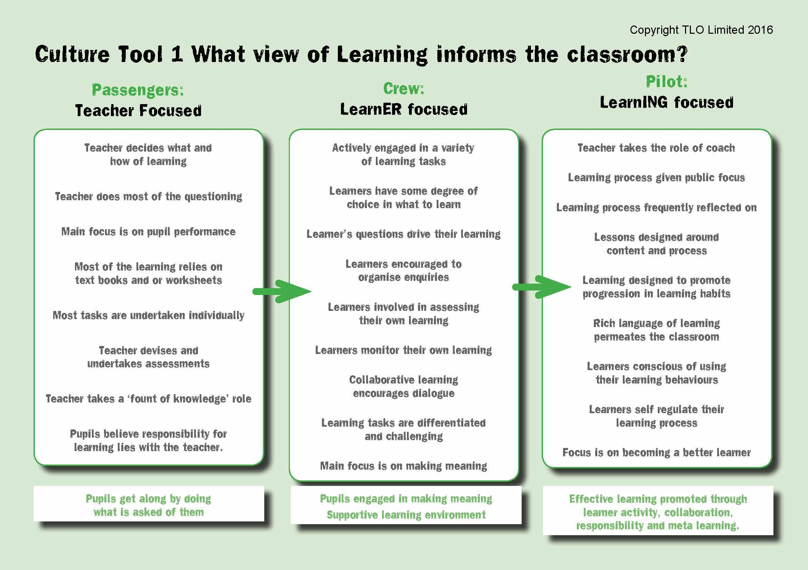
Our classroom cultures. Where are they now?
Reflect on the culture of your classrooms ….
Highlight all aspects of culture that are a regular feature in your classrooms
Where is the in-school variation?
What is this telling you?
Notes:
The Key message(s) on this slide:
Take time to think ‘where are we now?’
Detail:
In the online culture module and during the training day, teachers are asked to consider their own classroom culture. Here we are asking leaders/managers to think more widely about classrooms in general.
Which features are a regular feature in your classrooms?
What is the extent of in-school variation?
Which aspects appear where?
Are there any links between classroom culture and examination performance?
Are there any examples of existing good practice that could/should be shared?
What is this analysis telling you about the scale of the changes ahead?

Slide 5
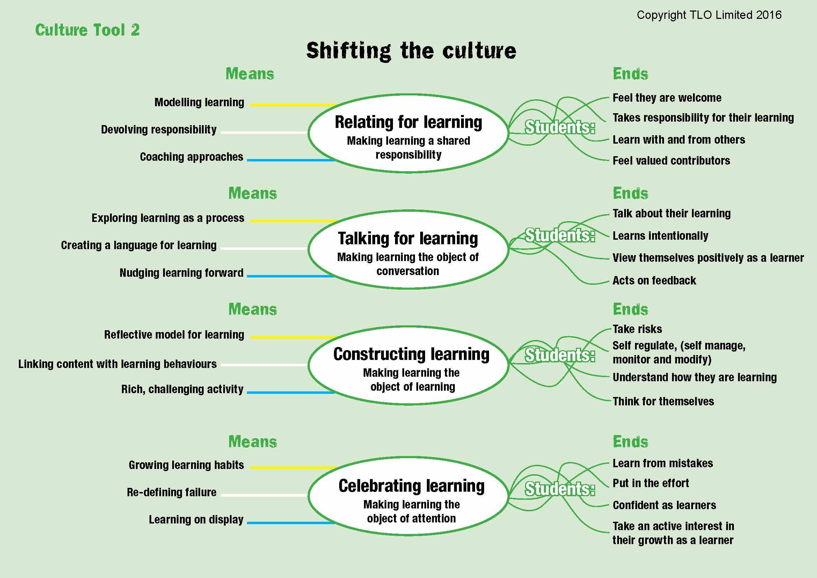
Shifts towards learning friendly cultures.
Notes:
The Key message(s) on this slide:
Creating a learning focused classroom culture is necessary to achieve desirable changes for students
Detail:
Talk through (at a deeper level) the Culture 2 tool. Look here at the outputs on the right hand side in some detail.
Which are critical?
Which may be puzzling?
Why are they there?
Are some more important than others?
What would you want to add?
Where would you put it?
Which are most in need of development?

Slide 6
Keeping track on progress in classroom culture
Try this Learning Amble tool to establish
  Where classrooms are at now
  Where they are in 6 months time
  Changes that occured in the first six months
It could be undertaken by teachers themselves
It could be undertaken in or between departments
Use more sophisticated tools after a year (see Review unit in Stepping Stones Phase I)
Notes:
The Key message(s) on this slide:
The slide introduces the Learning Amble (see the next slide) and explores how it might be used.
Detail:
Consider:
who else, beyond this group, might profitably undertake the Amble;
how you might capture and share their views;
how you might use the Amble to monitor shifts in classroom culture over time.

Slide 7
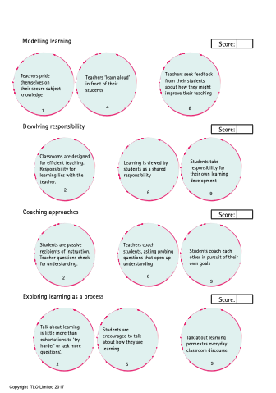
Learning Amble. Learning Friendly Culture.
Notes:
The Key message(s) on this slide:
The slide introduces the Learning Amble and stimulates a discussion around the outcomes.
Detail:
Download and print copies of the Amble (see Data Gathering Materials)
Undertake the Amble:
Depending on the size of the group, this may be split or a whole-group discussion.
For each of the 12 indicators, consider where your school is now. You do not need to match one of the example descriptors, as you might, for example, consider that you are “better than ‘2’ but not yet ‘5’”. If you finish the quiz before other groups, go back to those indicators and try to write your own descriptor.
Discuss with others what you think and why etc etc.
Reflect on the outcomes:
Do our classrooms support learners to take greater responsibility for themselves as learners?
Do our classrooms support learners to understand and discuss the process of learning?
Do our classrooms support the development of positive learning habits in a progressive and coherent manner?
Do our classrooms support the celebration of the growth of learning habits?
Are our classrooms ‘learning focused’?

Slide 8
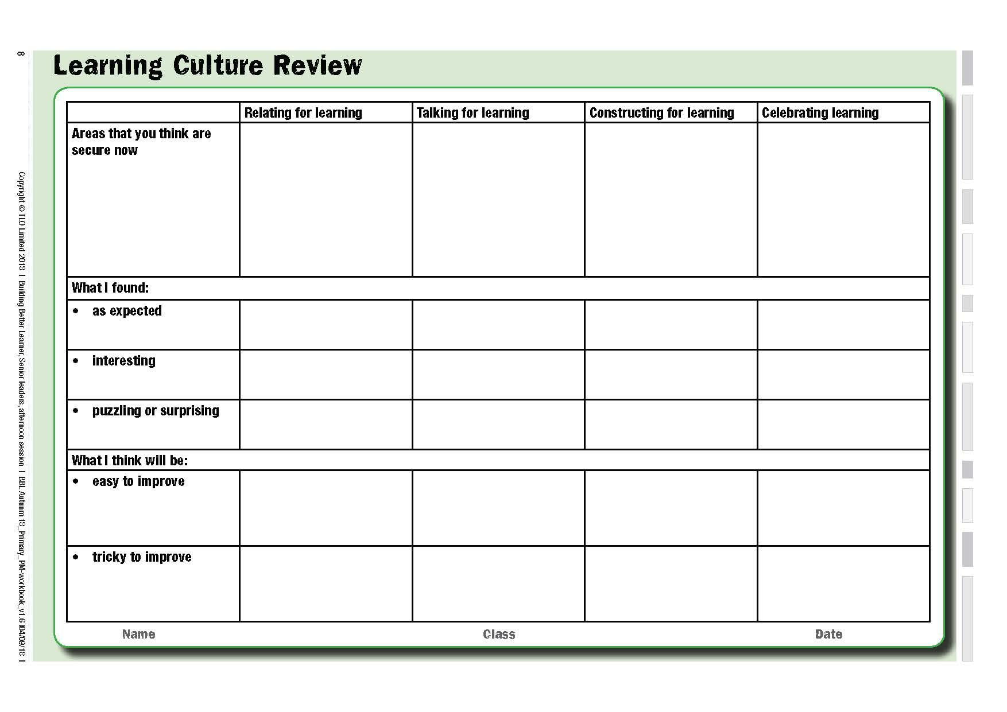
Record the outcomes of your Amble
Notes:
The Key message(s) on this slide:
Time to distil and capture key outcomes from the Amble and from your discussions around the Culture 2 Tool
Detail:
Download and print copies of the Culture Review Tool (Downloads section)
This is a key monitoring tool. It pulls together and records your discussions around Culture Tool 2 and the Amble.
To record the outcomes of the Review - Ask yourself:
What have we learned about classroom culture?
Where are our relative strengths and weaknesses?
Which aspects might be easy to shift?
Which might prove harder?
To consider a way forward - Ask yourself:
Who else might need to do the Amble and Review at this stage?
How will you collect / record / share their perceptions?
To monitor future shifts in classroom culture - Ask yourself:
When will we repeat the Amble?

Slide 9
Supporting the outcomes of the Culture Amble. How might we..
Signal that we (leadership) are devolving responsibility to teachers in the same way that teachers should be devolving responsibility to students
How will we show willing and use a learning language to support teachers Without this unifying language, new intentions can remain rhetorical or cosmetic, and not permeate the culture.
How will we design learning activities that deliberately stretch and exercise habits of mind. Without changes to pedagogy, teaching may routinely stimulate only a narrow subset of students mental faculties.
How will we use the physical environment to reinforce positive messages about exploration and growth of learning power. If the display and celebration is only of students’ ‘excellent work’, it will convey retrograde messages about teaching and learning.
Notes:
The Key message(s) on this slide:
The review is a waste of time if we do not act on it
Detail:
Encourage leaders and managers to model the changes that they are requiring teachers to make: devolving responsibility; taking risks; making mistakes (and learning from them); coaching rather than telling; ensuring that the culture of meetings is learning, not teacher, focused.
encourage teachers to use a learning language to support their students’ development as powerful learners; Without this unifying language, new intentions can remain rhetorical or cosmetic, and will not permeate the culture.
support the design of learning activities that deliberately stretch and exercise the full range of learning-oriented habits of mind. Without changes to pedagogy, teaching may routinely stimulate only a narrow subset of students’ mental faculties.
use the physical environment to reinforce positive messages about exploration and growth of learning power. If the display and celebration is only of pupils’ ‘excellent work’, it will convey retrograde messages about the commitment to building better learners.

Slide 10
Supporting the outcomes of the Culture Amble.
How could we model our commitment to...
devolving responsibility for the leadership of learning to teachers and to teams?
using the school's emerging language for learning?
constructing lessons with learning in mind?
organising displays to promote positive attitudes to learning?
Notes:
The Key message(s) on this slide:
The review is a waste of time if we do not act on it and walk the talk
Detail:
devolving responsibility for the leadership of learning to teachers and to teams – think about the levels of independence in your school. If teachers cannot function independently, nor will their students. How might you enable greater independence?
using the school's emerging language for learning? - think about the extent to which you talk 'learnish'. Do you use the language in assemblies and in meetings, and in conversation with students?
constructing lessons with learning in mind – think about staff/subject/phase meetings. Do they activate the types of learning behaviours you hope to see in classrooms? In terms of the first culture tool, to what extent are meetings 'teacher focused'?
organising display to promote positive attitudes to learning – think about the public display areas that you have responsibility for. Ask whether they demonstrate the commitment to Building Better Learners, or do they still carry some unfortunate messages from a time long past?

Slide 11




Teaching: poles apart
Subject content explained plus hints and tips for exams. |  |  |  |  |  |  |  | Learning capacities explained discussed and trained. Become a learning coach
|_____________|_____________|_____________|_____________| Relating
Busy activities. Learning content driven. Display best products. Spoon feeding. Heavy scaffolding. |  |  |  |  |  |  | Activities and environment arranged to surface and develop learning habits. Less scaffolding.
|_____________|_____________|_____________|_____________| Constructing
Mark regularly with supportive comments about subject. |  |  |  |  | Continual comment (talk and written) to nudge progression in learning power. Learning language developed.
|_____________|_____________|_____________|_____________| Talking
Secure in curriculum knowledge. Try not to show vulnerability. |  |  |  |  |  | Model being a learner too – trying things out, making mistakes, getting stuck.
|_____________|_____________|_____________|_____________| Celebrating
Notes:
The Key message(s) on this slide:
How teachers behave impacts on how students are as learners
Detail:
Another Poles apart diagram, this time looking at teaching behaviours. In the left hand column, competent teaching behaviours that focus on the efficient delivery of curriculum content, and in the right hand column the teaching behaviours of the teacher who is delivering curriculum content and, at the same time, building better learners.
Key Points
This slide suggests the change teachers need to make.
The left side depicts a perfectly good enough teacher but there is still a gap between how a good teacher works, where their emphasis lies, and the learning coach type teacher that developing learning power demands
Use this slide to orchestrate a discussion about the shift needed.
Note that the 4 dimensions are Relating, Constructing, Talking and Celebrating. These are the dimensions that are picked up in the Teachers’ Palette and the culture diagram.

