Slide 1


Introducing Learning Power to Leadership Teams

Slide 2




Your contribution
Outcomes
  Consider the learner attributes necessary for 21st century success
  Understand the philosophy and practice of BLP
  Reflect on the learning culture as it currently is
  Appreciate how learning power is built in the classroom
  Understand the strategic dimensions involved in building school wide learning power
  Feel excited about taking on the learning journey.
?
Notes:
Key points
Typical split screen i.e.
Learning outcomes= content ( learning by end of session
Learning behaviours= participant behaviours needed to achieve the objectives
Run through learning objectives i.e.
Look at what works so you can see BLP as a long term strategy
Run through learning behaviours ie Making links to own practice, questioning what LP will mean for you and your students, focus on possibility and tolerate uncertainty,imagine how things could be and reflect on key messages and their appropriateness to your context
Stress need to be positive about how BLP would work for them

Slide 3
How do we want our students to be as learners ?
Evaluated
Self evaluative
Deferential
Good at following instructions
Listen to teachers
Attentive to everyone
Imaginative
Responsible
Good at copying
Initiators
Adventurous
Correct
Creative
Solitary workers
Social learners
Active
Sit still
Do as told
Curious
Good at remembering facts
Select your top five learner attributes necessary for successful 21st century learning.

Slide 4
How do we want our students to be as learners ?
Evaluated
Self evaluative
Deferential
Good at following instructions
Listen to teachers
Attentive to everyone
Imaginative
Responsible
Good at copying
Initiators
Adventurous
Correct
Creative
Solitary workers
Social learners
Active
Sit still
Do as told
Curious
Good at remembering facts
How many were green ?

Slide 5
How do we want our students to be as learners ?
Evaluated
Self evaluative
Deferential
Good at following instructions
Listen to teachers
Attentive to everyone
Imaginative
Responsible
Good at copying
Initiators
Adventurous
Correct
Creative
Solitary workers
Social learners
Active
Sit still
Do as told
Curious
Good at remembering facts
A bit 19th century clerk ?

Slide 6
How do we want our students to be as learners ?
Evaluated
Self evaluative
Deferential
Good at following instructions
Listen to teachers
Attentive to everyone
Imaginative
Responsible
Good at copying
Initiators
Adventurous
Correct
Creative
Solitary workers
Social learners
Active
Sit still
Do as told
Curious
Good at remembering facts
More like a 21st century explorer

Slide 7
Evaluated
Self evaluative
Deferential
Good at following instructions
Listen to teachers
Attentive to everyone
Imaginative
Responsible
Good at copying
Initiators
Adventurous
Correct
Creative
Solitary workers
Social learners
Active
Sit still
Do as told
Curious
Good at remembering facts
Which are your students better at ? Being red, or being green ?
Is there anything wrong with the red ones ?
To what extent do schools rely on red for their day to day operation ?
There is a tension - We might say we want green, but we may behave red !

Slide 8

If teachers don’t change what they do, students won’t change how they are.
Notes:
Key Points
How do teachers build pupils learning power?
Key - making pupils aware of the learning tools THEY command
Developing language, designing tasks, structuring the environment.
Turning themselves into a learning coach
Background notes
The focus now changes to looking at teaching rather than learning This slide just gives a broad rundown on the change in role/job in hand.
This slide concentrates on the role of the teacher who is charged with creating a learning environment where children understand their learning capacities and are enabled to stretch them. (Remember this includes emotional, social, cognitive and strategic capacities.)
The teacher becomes a learning power coach: orchestrating the language, the activities including assessment, and the set-up of the classroom to ensure children have continuing opportunities to develop the learning habits that underpin all the subject disciplines.

Slide 9
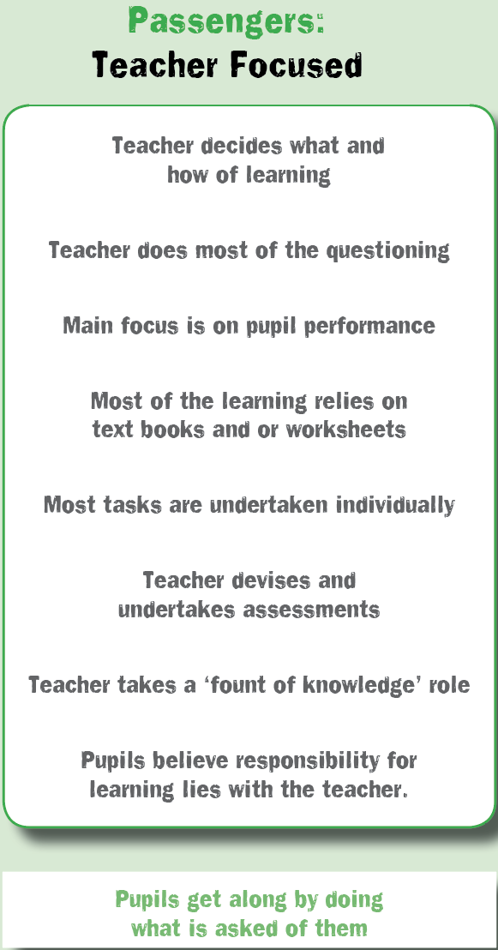
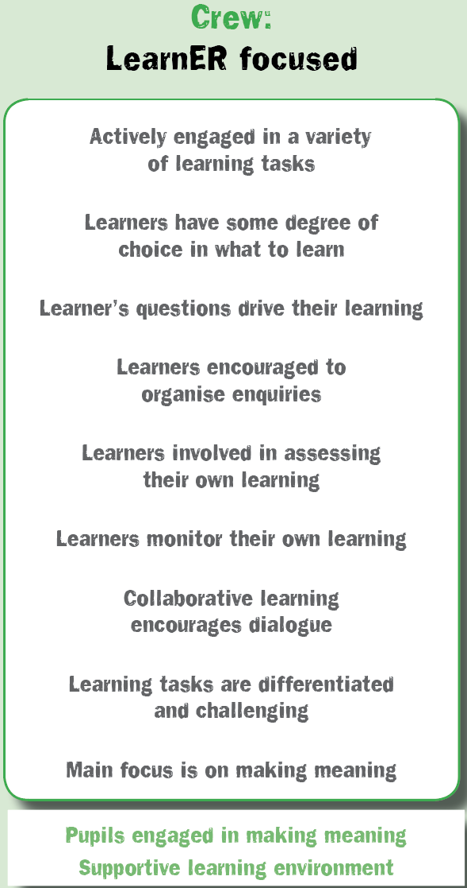
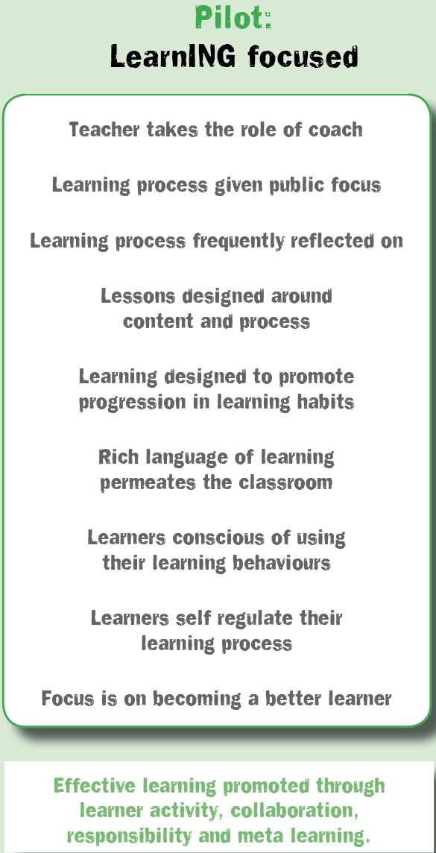
Classroom cultures
What is yours like?
Notes:
11.15
Animate this slide one panel at a time

Slide 10
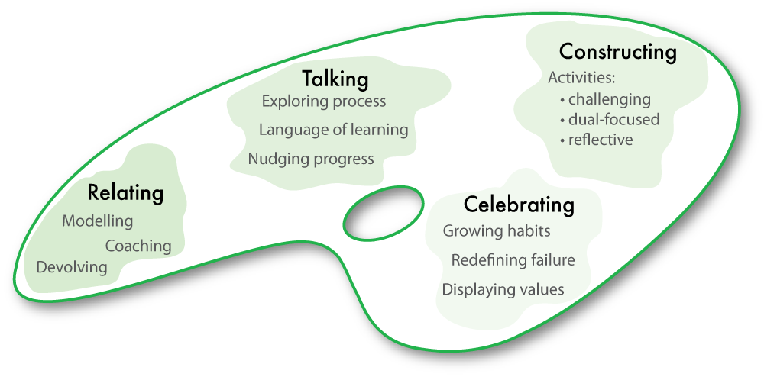
The teaching framework to make it work
Notes:
The culture 2 tool translated into a NEW palette.

Slide 11
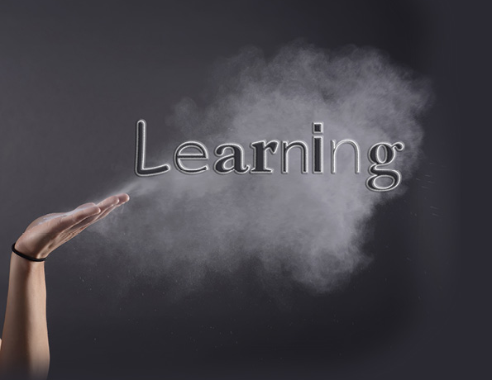
Building Learning Power
Making Learning Visible
to both teachers and pupils
Notes:
The purpose of BLP is about making learning visible to you the teacher and more importantly to students

Slide 12




How do we learn?
What’s happening here?
What learning skills are you using?
Notes:
Key points
Form groups of 4 or 5
One person to take charge of the set of cards
Only use the cards on top of the packet
Watch the screen for instructions
Two aspects of the exercise
What’s happening in this picture? (Content)
What learning skills are you using to arrive at your conclusion?
Give each group a set of cards640 × 511 - pixabay.com
Stress the rules of the exercise
not using the tiles in the packet
only using the cards in response to the instructions on the screen
Background notes
The purpose of this activity here is to have participants thinking about learning by doing it. [Other activities can be used for the same purpose if desired]
Expect the activities itself to take about 15 mins.
Some people get irritated if the following instructions are too slow appearing!
The main learning habit used in this activity is revising - rethinking ideas in the light of new/different information. however, numerous other learning behaviours are used in this activity.

Slide 13



What do we do when we learn ?
Groups of 4-5
You have two tasks:
  Sort the cartoon into a credible story line?
  Watch learning skills do you deploy to solve this problem ?
Copyright TLO Limited 2014 | FCD1-Pri
13
Copyright TLO Limited 2013 | FCD1-Pri
Notes:
Groups of 4 – 5
Give out the Tin tin cards
Participants to sort these to give a credible story.
Observe the process
Allow about 10 mins to solve the puzzle

Slide 14
What do we do when we learn ?
The original order
11,6,8,22,3,21,23,17,
10,5,19,12,2,18,15,
14,13,9,16,1,7,20,4
Copyright TLO Limited 2014 | FCD1-Pri
14
Copyright TLO Limited 2013 | FCD1-Pri
Notes:
Only offer this after the discussion and if participants ask for it.

Slide 15
Reflection
What were you doing to solve this puzzle?
What learning behaviours were you using?
?
Copyright TLO Limited 2014 | FCD1-Pri
15
Copyright TLO Limited 2013 | FCD1-Pri
Notes:
Post activity discussion.
How were we behaving as learners. Allow 10 mins for this conversation
Sort their responses in four ways as EMOTIONAL, COGNITIVE, SOCIAL and STRATEGIC behaviours.
Do not reveal how you are sorting these random responses as you write in four corners of the flip chart.
Prompt further thinking if the feedback dwindles.
Invite them to notice how you have been sorting their observations. Enable them to see that these are the four fundamental area that are being developed when deep learning is taking place in the classroom and around the school. Draw attention to the fact that these four psychological domains apply in all contexts for people of all ages.

Slide 16
What do learning powered learners do?
Notes:
So our first big question is all about how do LP learners are different. What do they do differently?

Slide 17

BLP is about helping students to understand how they learn.
Managing the process
Feelings about learning
Relating to others
Thinking in different ways
Notes:
Learning is our brain at work. Making it work better at learning its a good idea to understand a bit about how it works.
To understand that learning is most affected by how we feel, and how we feel controls how we attend.
To learn well we need to;
be emotionally engaged
think in different ways,
relate to others, with and from whom we can learn
be able to manage the process of our learning.
It all goes on in our brain. The problem is we cant see it happening.
Performance is simply about seeing some of what may have happened.
Learning Power is about being aware of learning as it is happening, and adapting to make it better!

Slide 18
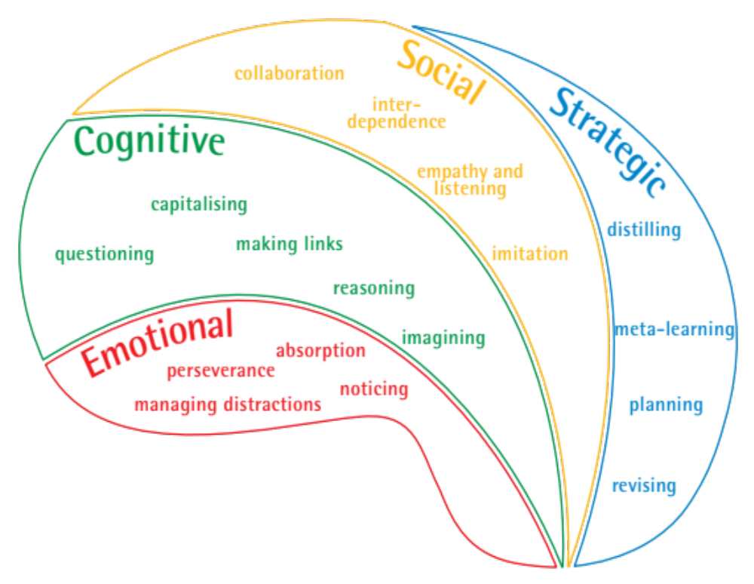
The Learning Power Framework
Covers the domains of learning
Emotional
Cognitive
Social
Strategic
Notes:
Key points
These slides build up the key capacities that make up each domain of learning
The beginnings of a language of learning
Each capacity develops or atrophies over time
Background notes
This is what it takes to be a good learner
International research suggests key capacities for better learning
BLP is about building these capacities into HABITS
These capacities give us a start on a language for learning
Resilience: attentional engagement — emotional aspect — feeling
Resourcefulness: range of tools and skills — cognitive aspect - thinking
Reciprocity: learning with and from others — social aspect – relating
Reflectiveness: good manager of learning — strategic awareness — managing
Vigotsky quote — ‘You pick up your mind from people you hang around with’ (Link to imitation)
How do we optimally build these capacities?
Hence BLP is an all-embracing framework, based on the psychology of learning. The Rs are clustering devices for the capacities. The capacities are what successful learners do. The point of BLP is to develop capacities into HABITS.
NB This slide picture is available as a poster

Slide 19
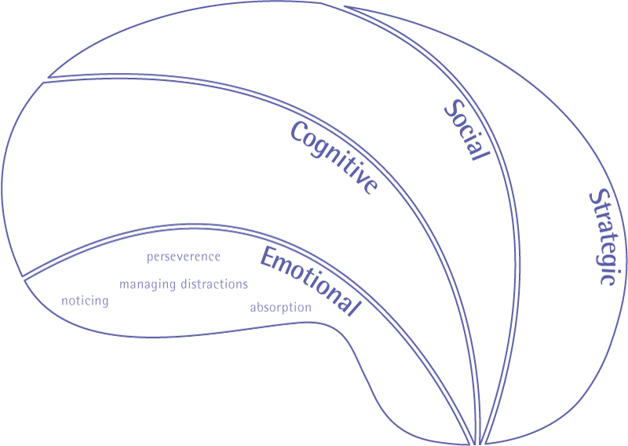




The
BIG one
Become absorbed
  Being rapt and attentive
Overcome distraction
  Creating your own best learning environment
Notice attentively
  Perceiving detail, subtlety, nuances and patterns
Persevere:
  Keep going despite difficulty; tolerate the feelings of learning
Emotional engagement
Notes:
Use this slide to open discussion about how children are emotionally engaged in learning. There are four capacities that contribute to having a resilient disposition. The capacities are what lies within the secret garden of learning. Building Learning Power is about making these capacities transparent / public / overt to pupils. Giving them a language about learning, drawing attention to when they are using these capacities, designing activities to stretch and develop these capacities.
Being ready and willing are the dispositional qualities i.e. there is a tendency to act in these ways. The ‘able to’ relates to the skill. Having the skill isn’t enough: skills are not always used.
Emotional learning habits
Are they emotionally engaged learners?
Do they stick with challenges?
Are they able to keep focus and interest?
Do they lock onto tasks and notice details?
Do they keep going under their own steam and with others?
Do they exercise initiative and take personal responsibility?

Slide 20



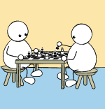

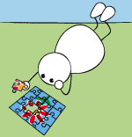
The one we concentrate on…
Curious:
  question, dig deep for answers
Make links:
  relationships between things
Imagine:
  look at things in different ways, playing with ideas
Reason:
  construct logical arguments
Capitalise:
  on learning resources to help
Cognitive range
Notes:
Use this slide to unpack the disposition of being resourceful; of naturally using a wide range of cognitive approaches. There are five capacities which make up the cognitive range. These capacities need to be nurtured, stretched, grown, and made visible so that pupils use them consciously and can seek to improve them.
Cognitive learning habits
Are they using their capacity to think in a variety of ways?
Are they curious and willing to ask questions of themselves and others (including teachers)?
Are they able to capitalise on internal and external resources autonomously?
Do they make links between diverse experiences in/between/outside lessons?
Are they able to reason things through logically and systematically?
Do they use their imagination to consider possibilities?

Slide 21

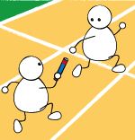

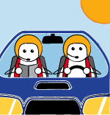

The one we think just happens…
Collaborate:
  Know how to learn with others
Interdependent:
  Balances learning alone and with others
Empathise and Listen:
  Get inside others’ minds
Imitate:
  Pick up others’ thinking and ideas
Social interaction
Notes:
Use this slide to unpack the disposition of being reciprocal, or being interpersonally involved as a learner. There are four capacities that make up this socially based disposition.
Again, the capacities, over time, should be introduced, made public, talked about, form the basis of learning activities, stretched, developed into habits.
Social learning habits
Are they able to work effectively with others?
Do they know when it’s best to work alone or with others?
Are they able to draw the best out of other people?
Are they able to use a range of roles in collaborative group work?
Do they listen to others and understand how they are thinking?
Are they able to pick up habits from other people and imitate preferred ways of doing things?

Slide 22
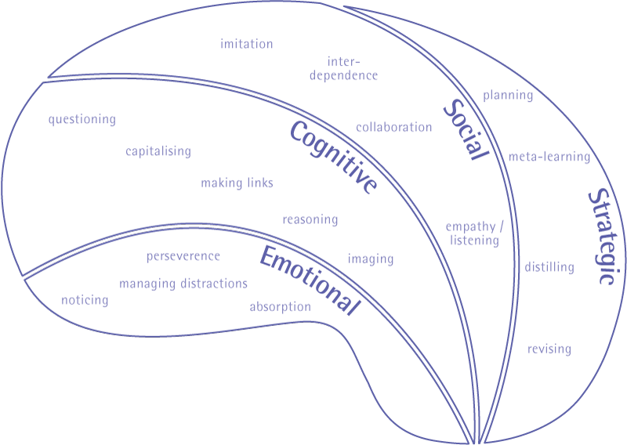



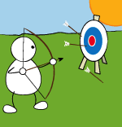
The one we tend to forget about altogether…
Plan:
  Work learning out in advance
Revise / Refine:
  Monitor and adapt along the way
Distil:
  Draw out the lessons from experience
Learn about how they learn:
  Know themselves as a learner
Strategic responsibility
Notes:
Use this slide to unpack the disposition of being reflective, or taking strategic responsibility for learning.
The capacities that make up a reflective learner are a willingness and ability to plan learning, revise plans, to monitor how things are going, to distil out what went well in learning for use in learning elsewhere, to understanding yourself as a learner – to become a meta-learner.
Stress that staff do not need to concern themselves, at this stage, with remembering all the capacities. The on-line course for year 1 deals with 3...perseverance, collaboration and questioning at a deep level..
Strategic learning habits
Are they reflective learners?
Do they plan what they have to do and make sound decisions?
Do they adapt, change and revise their work as they proceed?
Are they able to pull out the main learning points from what they have done?
Do they understand themselves as learners and use this knowledge to support how they learn?

Slide 23
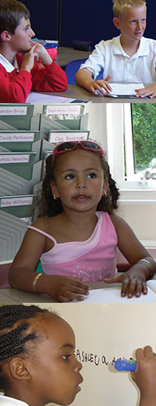
Learning powered learners are different
Because they
  Have a learning language
  Develop self-awareness as a learner across each domain of learning
  Have the tools to take control of their learning
  Consciously develop their learning behaviours...they become better learners
Notes:
Key points
What pupils need in order to become learning powered learners.
Here again the emphasis is on:
A language for learning
Being self aware of what they are doing as a learner
Taking control of their learning and consciously developing their capacities
The last of these means getting better at them (more skilled) and using these skills more often and across many contexts – at school, at home, in clubs, in different subjects; i.e. transferring the skills.

Slide 24
In the classroom
How can we build learning powered learners in the classroom?

Slide 25
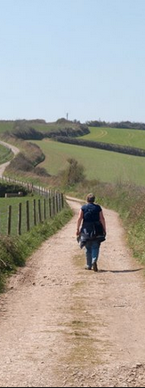
The learning power journey for secondary schools
Year 3:
Absorb into whole curriculum
perfecting, extending
Year 2:
Extend range - polish teaching
11 further learning behaviours
Swift, extensive, infused into lessons
Year 1:
Develop a learning friendly culture
Focus is on perseverance
Deep, solid, gradual
Notes:
The headlines of the learning journey
Year 1 just 3 key behaviours dealt with but to a deep level, giving gradual solid change
Year 2 adding 9 other behaviours which can be integrated more swiftly due to the solid understanding achieved in year 1
Year 3 is about perfecting the approaches right across the curriculum

Slide 26
Blended learning programmes
Staged blended programmes that chunk and order this complex innovation into do-able bite sized sessions, modules and programmes to implement over time. The blended learning programmes are a careful blend of:
Online learning sessions … that faithfully disseminate the researched content;
Professional Learning Team sessions … actioned by the school to provide sustained, meaningful support for teachers;
Trying things out in the classroom … because ‘learning by doing’ is integral to the development of expertise which can only be developed if teachers have ample opportunity for practice, reflection, and adjustment.
This trio of learning opportunities work together to help teachers replace long-standing habituated practices with more effective ones.

Slide 27



The learning process
Individual learning
Online units
Monthly
Read, think prepare
Team session
Tight, focused agenda
Monthly meetings
Share, discuss, plan
Developing practice
Planned gradual changes
Monitor impact
Share with coach
Notes:
Now to the blended learning programme.
Talk through the learning process diagram
New ideas and suggestions are fed to teachers working at their own pace each month. these are absorbed and thought about
Teachers then meet as groups to discuss the ideas firm up understanding and plan how to use them
In later session they bring accounts of their classroom experiments to the group. These are probed and extended by the group
After the team session teachers put their plans into action and monitor the effects.
possibly discussing with a coach if coaching is part of the school’s CPD support system.

Slide 28

Nutshells Phase 1: Introducing Key Learning Behaviours
Nutshells Phase 1
  nine online modules
  each expected to take about a half term to work through.
Sessions introduce staff to:
  Classroom culture
    Devolving responsibility
    Active engagement
    Dialogue and collaboration
  4 aspects of perseverance
Modular on-line programme organises a consistent school wide approach to developing pupils’ learning behaviours

Slide 29
Nutshells Phase 2: Introducing Other Learning Behaviours
Nutshells Phase 2
  11 online modules
  each expected to take about a half term to work through.
Sessions introduce staff to:
  11 further learning behaviours:
    Noticing; Questioning; Making links; Imagining; Reasoning; Capitalising; Collaboration; Listening; Planning; Revising; Meta learning.
  A reviewing progress module
Modular on-line programme organises a consistent school wide approach to developing pupils’ learning behaviours

Slide 30
Why do it ?
Because Hattie’s research says..
“Dispositions to learning should be key performance indicators of the outcomes of schooling. Many teachers believe that, if achievement is enhanced, there is a ripple effect to these dispositions. However, such a belief is not defensible. Such dispositions need planned interventions.”
Notes:
And if you thought it would just happen think again

Slide 31

And because it is the key to raising standards
Research by the EEF shows that developing ‘Meta Cognition and Self Regulation’ and ‘Quality Feedback’ are the two biggest factors in raising standards (and are lowest in cost terms)
Notes:
Putting BLP in the context of a wider movement of world class learning
This and next few slides from ideas in Redesigning Schooling, an SSAT booklet written by Guy

Slide 32
The big picture
How can we strategically build learning powered learners across the school?

Slide 33
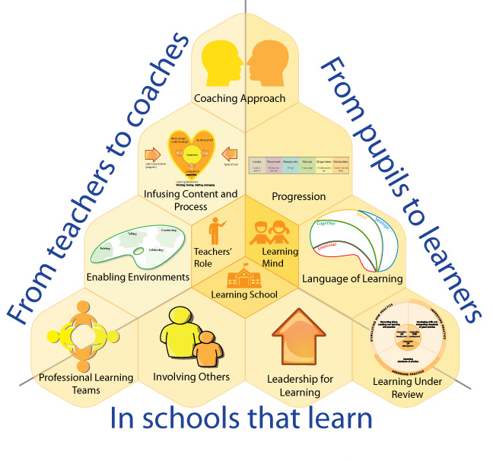
The big picture

Slide 34
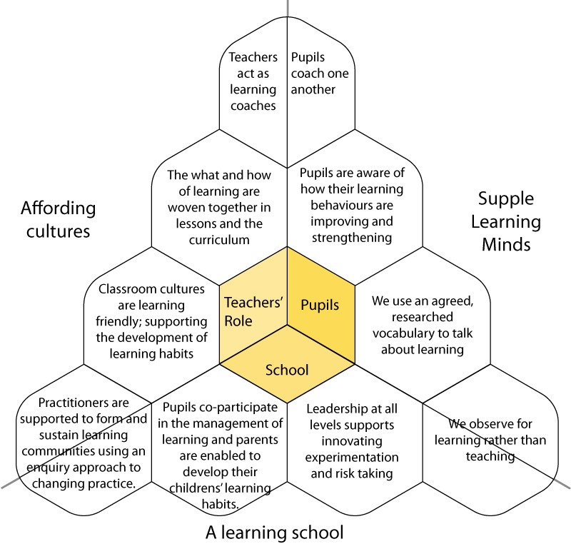
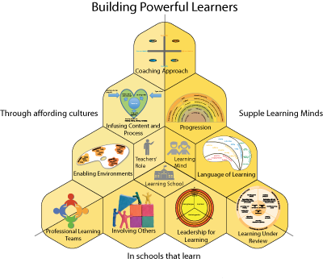
Where are we now?
Learning in a learning school
Notes:
Activity. Group to look at the distillation of the core model and colour in the hexagons to match what level of development they think they are at. See resource book

