Slide 1
To what extent are our learners engaged, motivated and ready to learn?
Notes:
The Key message(s) on this slide: ​
​
​
Detail:​

Slide 2
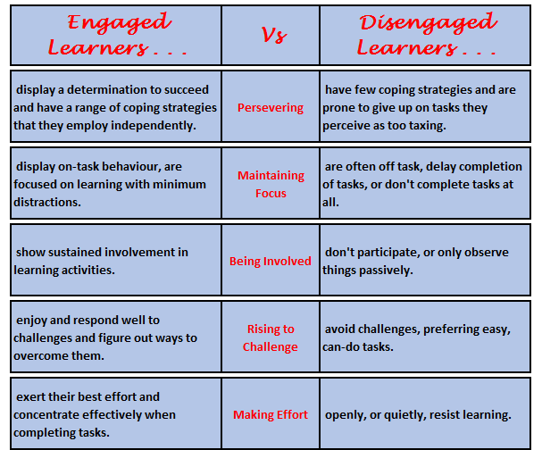
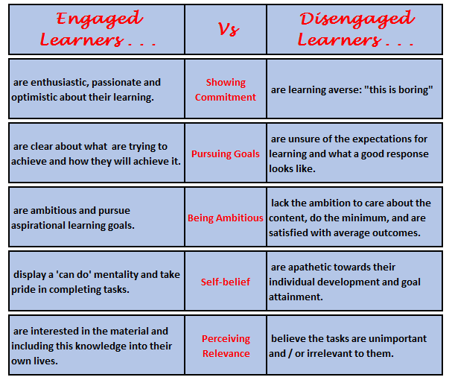
10 aspects of learner engagement . . . .

Slide 3
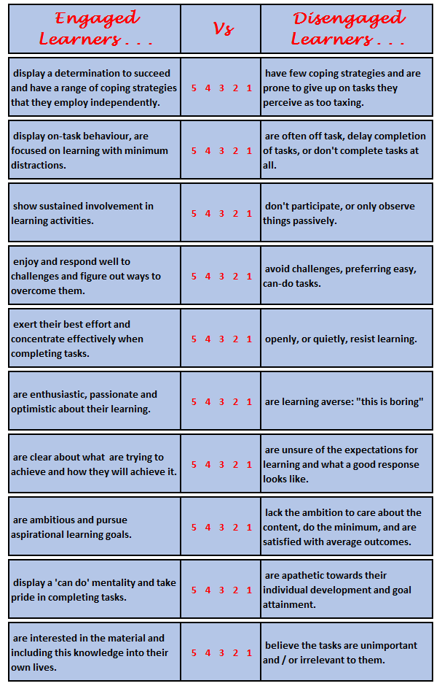
Table based discussion . .
How engaged are the majority of your learners?
[For the moment, forget about the ‘outliers’, the exceptional ones. Focus on the majority.]
For each of the 10 descriptors, agree and circle the number that best describes the majority of your learners.

Slide 4
Table based discussion . .
Be on the lookout for any interesting similarities or differences between year groups / subjects.
On which of these 10 aspects are learners closest to the left?
Closest to the right?

Slide 5
On a fresh sheet . .
Turn your focus to your higher attaining learners – what score would best describe them?
On a third sheet, repeat for your lower attaining learners – what score would best describe them?
Can you discern any links between levels of engagement and attainment?

Slide 6
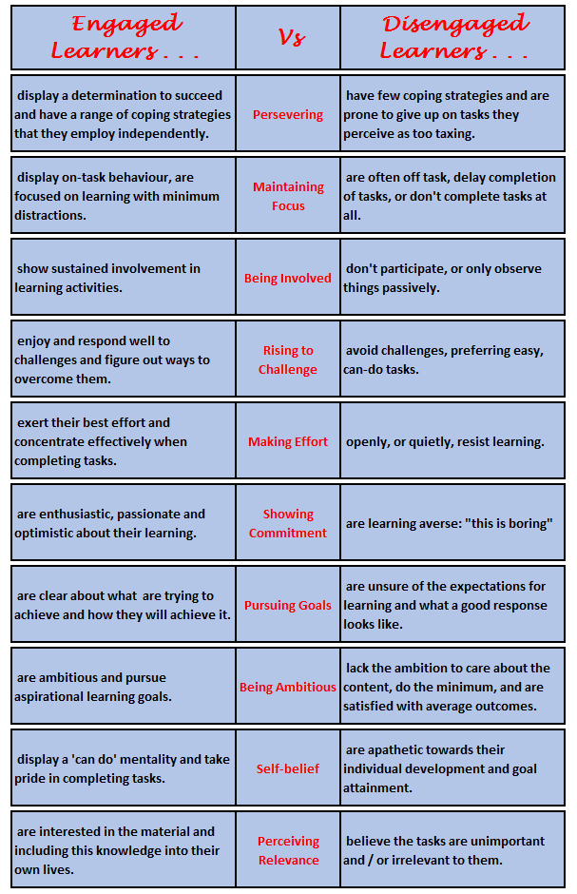
Distil your discussions
What have you learned about your students in terms of their levels of engagement?
What questions do you have about this?
What do you think we should do about this?

Slide 7

Introducing the online module ‘Re-energising your learners’ resilience’

Slide 8
4 key aspects of understanding resilience: unsticking learning; managing distractions; rising to the challenge; achieving goals.

