Slide 1

Introducing Classroom Cultures
Copyright TLO Limited 2020

Slide 2
What we are trying to achieve in this session
Outcomes
Become aware of features of our classrooms in relation to building students’ learning power
Consider our school’s vision for learning in relation to the learning power approach
Learning behaviours you will need to contribute!
Making Links
To your current practice
Reflect
On what happens now
Imagine
How developing learning power would work in your classroom?
Persevere
Relish a challenge
Notes:
This presentation is about features of learning friendly classrooms, how they work, and how they relate to the schools vision for learning.

Slide 3
Outcome 1
Become aware of the cultural features of our classrooms in relation to building students’ learning power
How learning friendly are our classrooms?

Slide 4
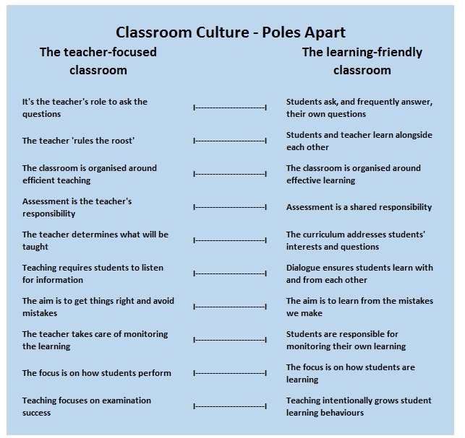
What do we believe about teaching?
Poles apart diagram with 10 aspects of classroom culture -
left hand side a highly teacher-focused culture
right a more learning-friendly classroom culture.
‘Estimate' where our classroom cultures are now.
Notes:
A short table based discussion – guestimate where our classroom culture is currently in relation to the teacher focused classroom and the learning focused classroom.

Slide 5
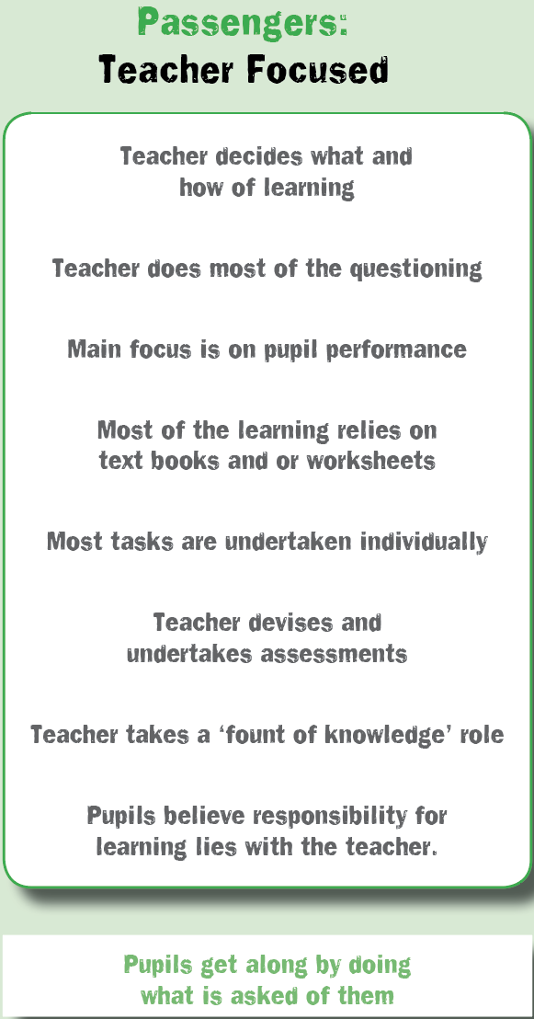
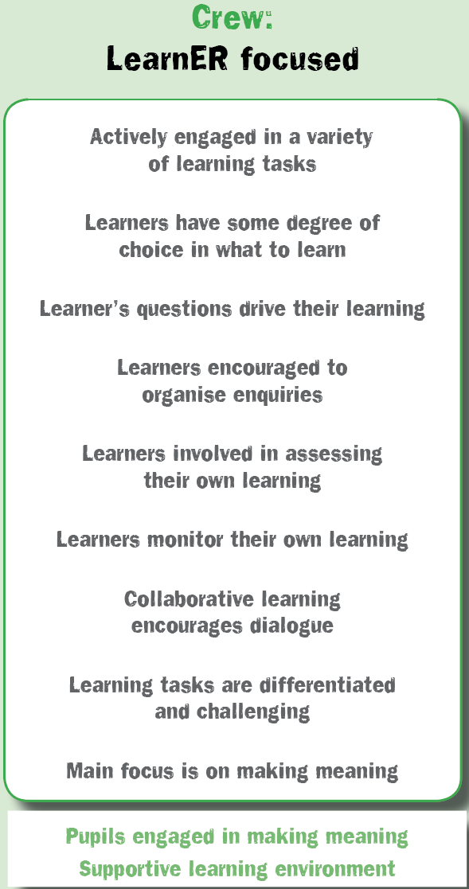
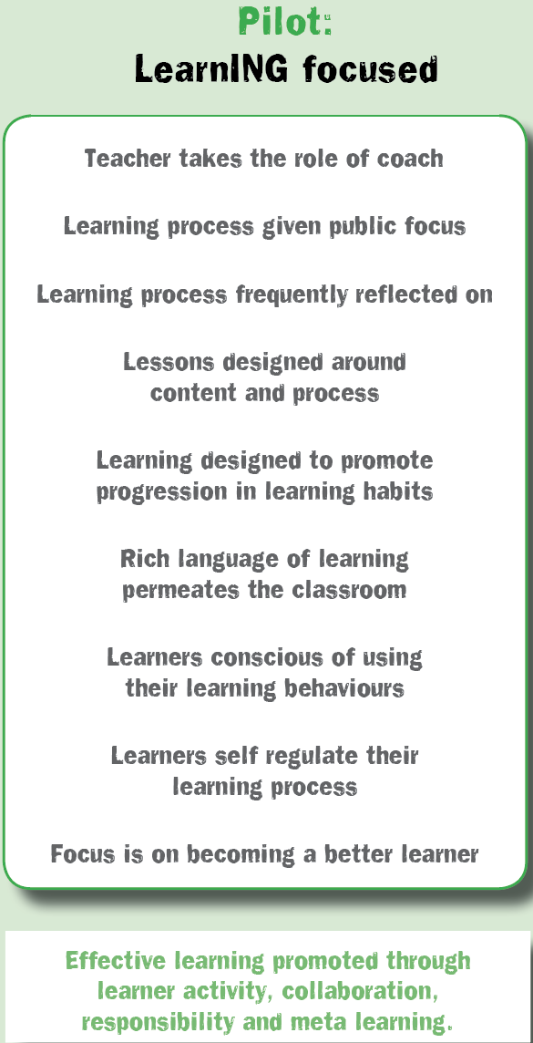
Classroom cultures
What is yours like?
Copyright TLO Limited 2019
Notes:
This model, the Culture Tool 1, is rooted in the work of Chris Watkins of the London Institute.
He argues that it is not possible for a classroom to become learning focused unless there are a good number of learner focused features already in place. In other words, classroom culture cannot jump from ‘panel 1’ to ‘panel 3’ without first developing ‘panel 2’ characteristics. The key differences, he argues, between panels 1 and 2 are that in panel 2 learners are more active participators, learning becomes an increasingly shared responsibility, and collaborative learning is in greater evidence.
Experience tells us that classroom culture frequently becomes more like panel 1 as examinations loom into view. Early years practitioners frequently describe a learning focused culture to us, but worryingly this seems to evaporate in the face of ‘schooling’..
The journey teachers will take in the future is to move cautiously from teacher focused to learning focused.

Slide 6

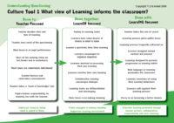
Just checking...where we are now
Highlight all aspects of culture that are a regular feature in your classroom.
Chat to your neighbour
What is this telling you?
Similarities / differences
Surprises
Delights
Shortfalls
Notes:
Firstly a self reflection activity - where is your classroom culture now?
Invite staff to...
​​Tick/highlight all aspects that they consider to be a regular feature in their classroom.
Try to avoid suggesting that teacher focused is always bad and learning focused is always good. There are some aspects of ‘teacher focused’ that will be present in all classrooms, to a greater or lesser extent, no matter how learner/learning focused?
Secondly a pairs or small group activity. Invite staff to…
Share their first considerations and look for similarities and possibilities.
The point here is to give teachers a glimpse of what learning friendly cultures consist of.
The following slides show first tiny steps in how this can be achieved.

Slide 7
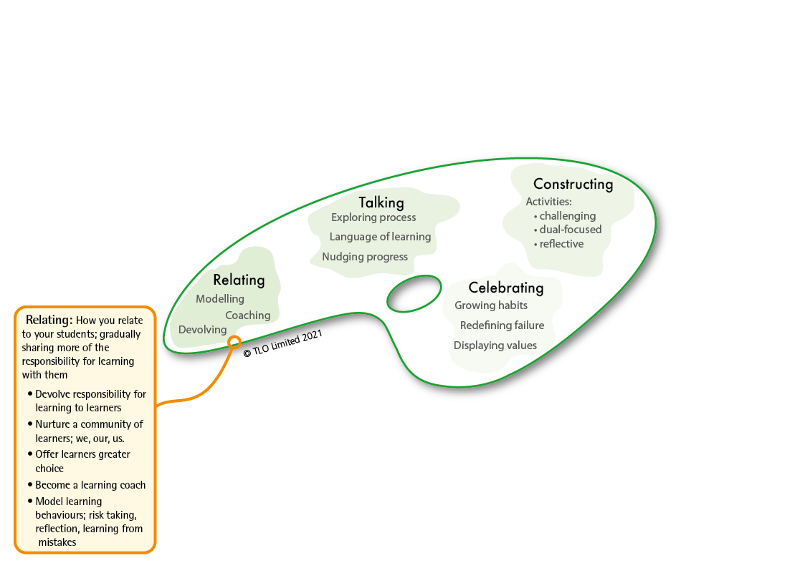
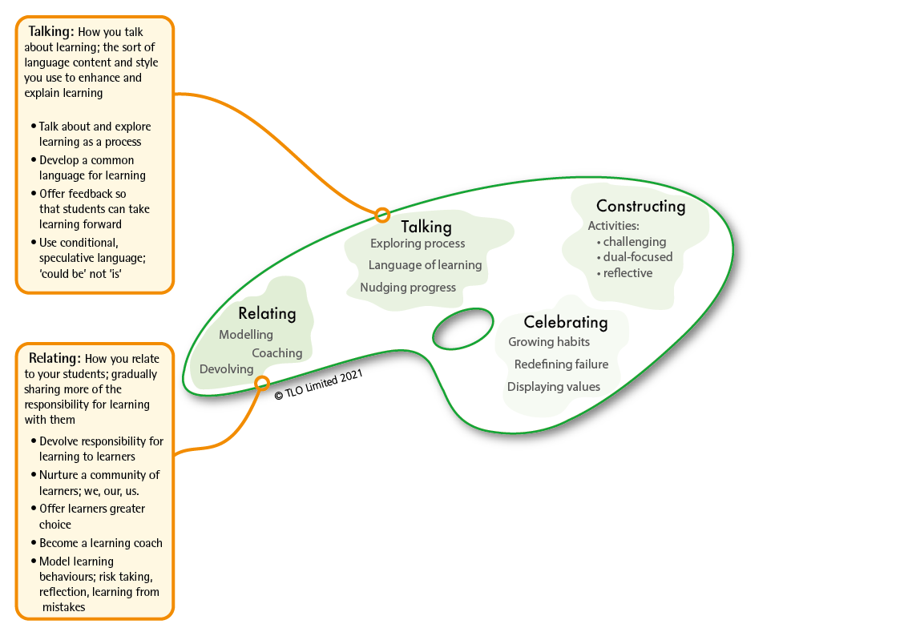
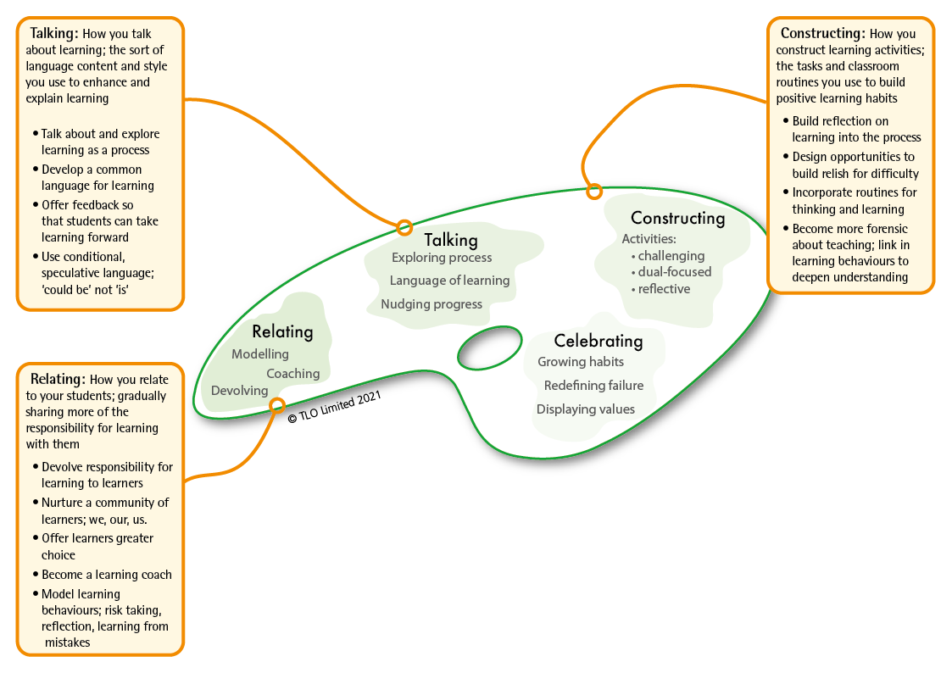
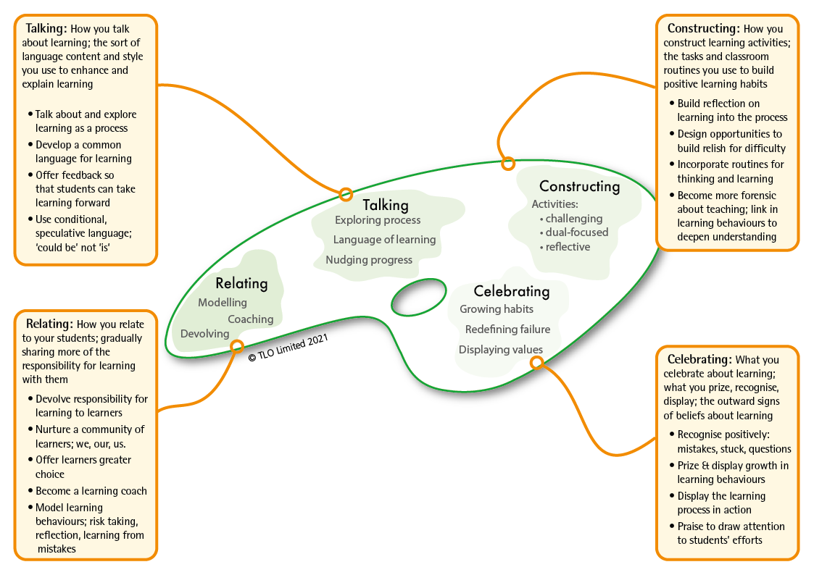
The teaching framework that makes it all work
BLP’s second model: the teachers’ palette.
Based on research by Chris Watkins
Notes:
The 2nd model of Building Learning Power...The Teachers’ Palette
This framework gives a systematic introduction to the principles behind the teaching for building powerful learners: the framework teachers need to have at the back of their minds, as they;
explain the approach to pupils,
plan their activities,
comment on pupils performance and
demonstrate learning power in their own lives.
Putting LP into action is not a seven day wonder, a quick fix, or a miracle cure for all the ills and difficulties in education. It is potentially a long journey that starts with small steps and is capable of fundamentally shifting the way teachers think, the way they teach and the whole ethos of the school.

Slide 8
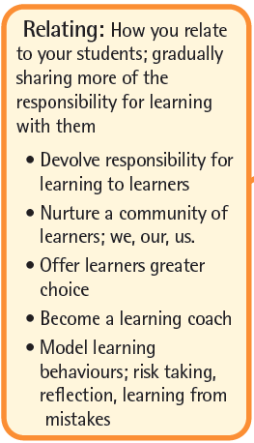
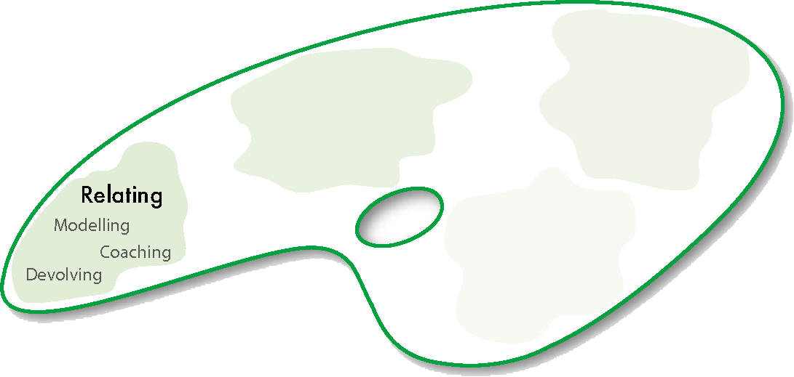
About relating for learning: what you can give away
Notes:
RELATING​ for learning involves;
devolving responsibility – shifting the emphasis towards learners taking increasing responsibility for their own development​
coaching approaches – moving away from ‘teacher telling’ mode whenever possible​
modelling learning – walking the talk, being a learner yourself.

Slide 9
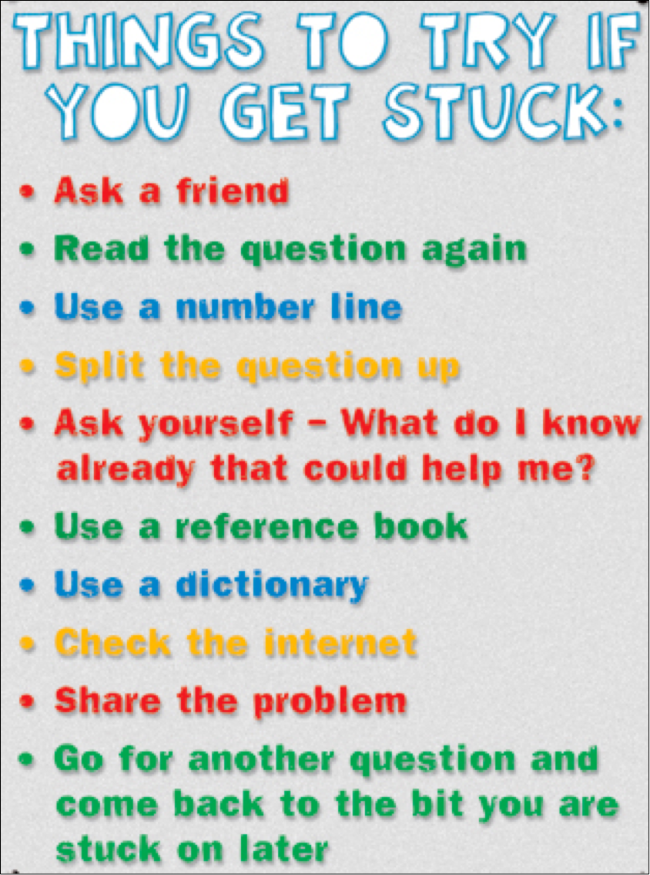
Things to give away...for example
Devolve responsibility for getting unstuck. Offer lots of ideas for how.
Explore what is meant by ‘effort’; discuss ways to apply it.
Connect effort and improvement; the sort of effort being used that is causing their improvement.
Notes:
So-called stuck prompts come in various shapes and sizes;
essentially they’re simply homemade lists of what students can try when they get stuck with their learning:
‘Read the question again’,
‘Split the question into smaller bits’,
‘Try sounding the word out letter by letter’,
‘Ask your neighbour’ — that kind of thing.
If teachers were simply to photocopy the list from a L2L manual and stick it on the wall it wouldn't work.
In a learning powered classroom, the ideas are generated by the students themselves, and are the subject of continual debate and refinement.

Slide 10
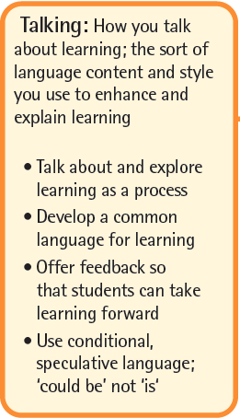

About talking for learning: what you can say
Notes:
TALKING​ about learning
Exploring learning as a process – finding time to talk about learning and how it works​
Developing a language for learning – teacher talk uses the school’s learning language.
Nudging learning forward – catching students employing positive learning behaviours and commenting on them, orally and in writing​
[DEVELOPING A LANGUAGE FOR LEARNING IS KEY TO UNDERSTANDING LEARNING AS A PROCESS. IT UNDERPINS METACOGNITIVE ACTIVITY]

Slide 11

Things to say...for example, talk to nudge getting unstuck
Can you explain why you are stuck?
What happened when you got stuck before? You’ve come through the confused / stuck feeling. What helped you?
It’s when you get stuck that you really start to learn.
That’s an interesting mistake.
What do you know? What do you need to know? How might you bridge the gap?
Give it a go and see what happens.
Notes:
How might we catch learners actually learning..
alert them to it,
remind them about it, and
suggest how they might get better at it?
We can talk in ways that nudge students to do more for themselves and encourage positive learning strategies. For example, the apparently simple question ‘Can you explain why you are stuck?’
It seeks to move them from ‘I’m stuck’ to ‘I’m stuck because’
If we can nudge students to identify the source of their stuckness, often a way forward becomes apparent.
I am stuck because I don’t know what xxx means – follow up with “so how might you find out?”
I am stuck because I do not know what to do next? – so what might you do next?
I am stuck because I do not understand yyy – so who might be able to help you?
I am stuck because I can’t zzzz – so how could you find out how to zzzz?

Slide 12
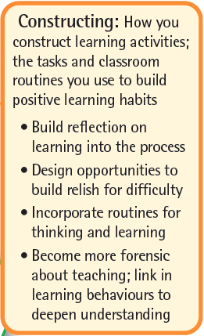

About constructing learning: what you can do every day
Notes:
CONSTRUCTING​ learning
Using a reflective model for learning – reflection on content and reflection on learning behaviours is routinely built into lessons​
Linking content with learning behaviours – lessons are designed intentionally to deliver content and to exercise learning behaviours. Students are made aware of both​
Rich, challenging activities – increasingly open-ended activities are designed to engage, to stretch and to challenge
NOTE THAT CONSTRUCTING LEARNING WILL BE THE FOCUS OF UNIT 3 AND IS NOT DEVELOPED IN UNIT 2 ​

Slide 13

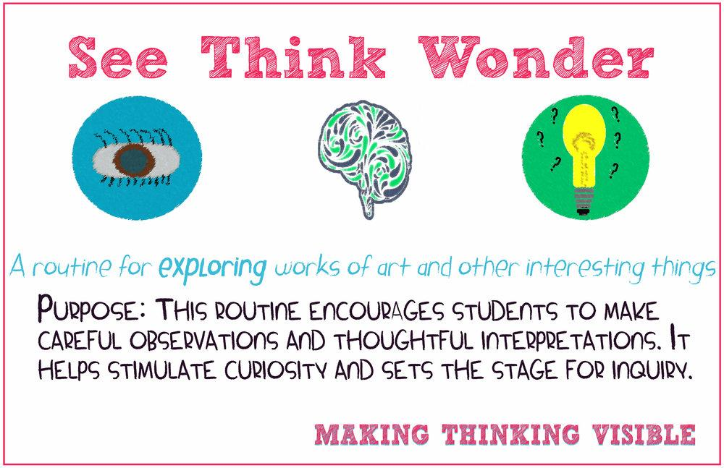
Things to do every day...for example
Build reflection into the learning process
Incorporate routines for thinking and learning
Notes:
Make reflecting part of everyday lessons
Classroom observation confirms that reflection is done either infrequently, or poorly.
At its worst, it gets lost in the rush to finish the lesson.
Slightly better, but still poor, the teacher does the reflection FOR students – this amounts to little more than the teacher repeating the intended, content-related, learning outcomes and checking for student understanding.
Reflection needs to be done BY students, not FOR them, and reflection should focus on both what has been learned and how it has been learned.
Visible thinking routines - A visible thinking routine is a set of questions or a brief sequence of steps used to scaffold and support student thinking and to nudge specific learning behaviours.
They are used frequently, hence the word routine. The intention is to build them into learning habits.
The example given here is the routine See/Think/Wonder.
What do you see? (encourages attentive noticing)
What do you think about that? (requires a blend of imagining and reasoning)
What does it make you wonder? (stimulates curiosity)
Use it to open up a conversation about any object, image etc.
Change it to Read/Think/Wonder to interrogate text.

Slide 14
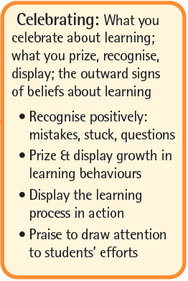
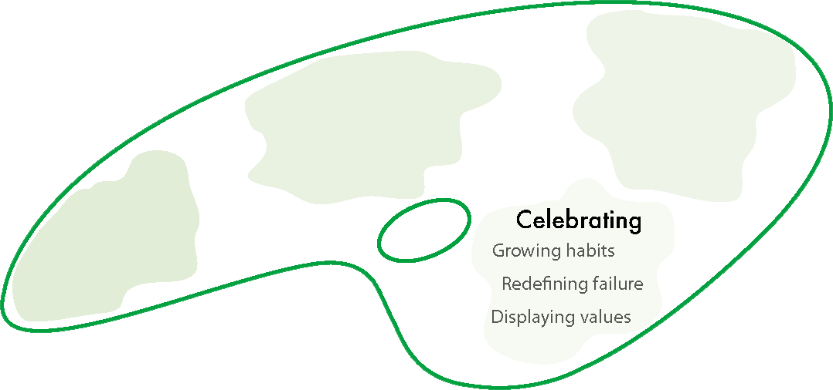
About celebrating learning: what you display
Notes:
CELEBRATING​ learning and its growth
Growing learning habits – finding ways to track, record and celebrate learning behaviour growth,​
Redefining failure – turning the lens around: mistakes become learning opportunities; difficulty is when learning happens; asking questions shows curiosity, not a lack of intelligence. ​
Putting learning on display – the process of learning (as opposed to the finished outcomes of learning) are on display. Annotated work in progress, first attempts, revisions, failed lines of enquiry, leading, of course, to the finished article.​

Slide 15


Things to display...for example
Bring the learning process out of the shadows
Celebrate the growth of learning behaviours publicly
Re-define failure
Notes:
Bring the process of learning out of the shadows – make the process of learning visible in displays. Display the learning strategies that were used. Give space on walls to the how as well as the what of learning.
Celebrate the growth of learning behaviours – be on the lookout for learners employing effective learning behaviours and offer public praise. Show your interest in their growth as a learner (rather than a knower).
Redefine failure – prize hard work and effort over effortless expertise; value interesting questions over correct answers; treat mistakes as learning opportunities rather than a failure; expect students to find it difficult and challenge them if they are succeeding too easily; expect students to refine and improve on their first attempts . . . .

Slide 16
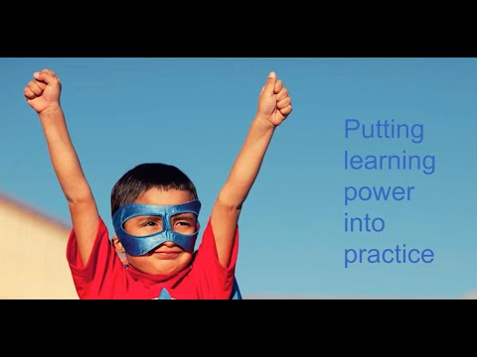
Notes:
How it all hangs together when it’s working
A 3 minute clip exploring Classroom Culture.

Slide 17
Outcome 2 Consider our school’s vision for learning in relation to classroom culture
Do we agree with the outcomes?

Slide 18
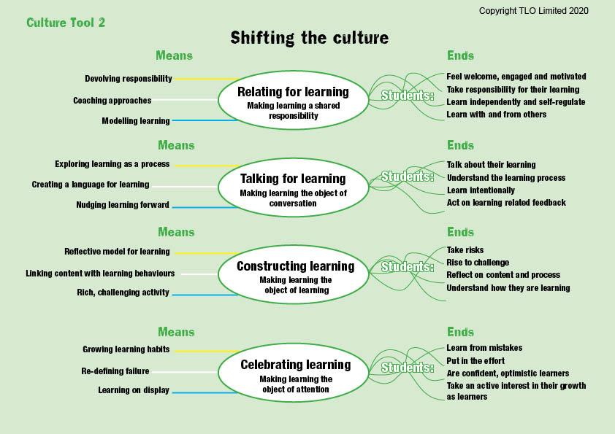
A learning focused culture
Notes:
Putting detail into the palette ideas​
​ In using the palette’s ideas what outcomes are we aiming to achieve?
Start with the end in mind.
Teachers change the means in order to achieve the desired outcomes for learners​
Which of these outcomes would NOT be valid?
​
​
Talk through the outputs/ends for learners...which of these would you not want?​
Which of these are NOT important in the modern world?​
How do these play out against the school’s values and beliefs/ Vision statements
​

Slide 19
Just checking...
Discuss together;
What you understand by each of the ‘Ends’ statements
Do we want our students to be like this? Why?
Do they become more like this as they pass through our school? How do we know?
How do these ends chime with our school’s values/vision?
Notes:
A discussion activity:
What do we understand by each of the ‘Ends’ statements?
Do we want our students to be like this?
To what extent are our students already like this?
Do they become more like it as they pass through our school? If yes, why does this happen - planned intervention or by chance? If no, what might need to be done differently?

Slide 20
A learning focused culture
Notes:
The inputs...the teachers’ job
You are the means... working for the ends
How might we do this? Going now to look at a range of ways we could make a start on this shift.

Slide 21
Notes:
Let’s take a closer look at the whole model bit by bit . . .
The image builds, click by click.
For guidance on how to talk to it, download the presenter notes for slide 21 in the Additional Resources section.

Slide 22

A teacher’s job becomes one of…
Introducing learning behaviours
making pupils aware of the tools they command as learners
Developing a language for learning
Infusing learning behaviours into lessons
Becoming a learning power coach
Celebrating the use and growth of learning behaviours
Notes:
The changing role of teachers
​How do teachers build pupils learning power?​
Key - making pupils aware of the learning tools THEY command​
Developing language, designing tasks, structuring the environment.​
Turning themselves into a learning coach ​
​
Background notes​
This slide gives a broad rundown on the change in role/job in hand.​
It concentrates on the role of the teacher who is charged with creating a learning environment where children understand their learning behaviours and are enabled to stretch them. (Remember this includes emotional, social, cognitive and strategic behaviours.) ​
The teacher becomes a learning power coach: orchestrating the language, the activities including assessment, and the set-up of the classroom to ensure children have continuing opportunities to develop the learning habits that underpin all the subject disciplines.​

Slide 23

And in case you thought it just happens.....
“Dispositions to learning should be key performance indicators of the outcomes of schooling.
Many teachers believe that, if achievement is enhanced, there is a ripple effect to these dispositions. However, such a belief is not defensible. Such dispositions need planned interventions.”
It won’t happen by itself!
John Hattie
Notes:
And just in case we thought we might not need to change….
There is evidence that EVEN high quality teaching alone does nothing in terms of improving learning dispositions,
This is a key slide. There are many teachers who believe that because their teaching is effective in enabling their students to do well in examinations, then they must also be effective in building better learners, that somehow examination success implies that learning behaviours must be improving.
It is a seductive line of reasoning, often used as an excuse for not engaging with building powerful learners.
Hattie indicates that research does not support this. Just because achievement is high, learning behaviours are not necessarily improving. Learning behaviours improve because teachers intervene in order to improve them – they will not necessarily improve if left to chance.

Slide 24
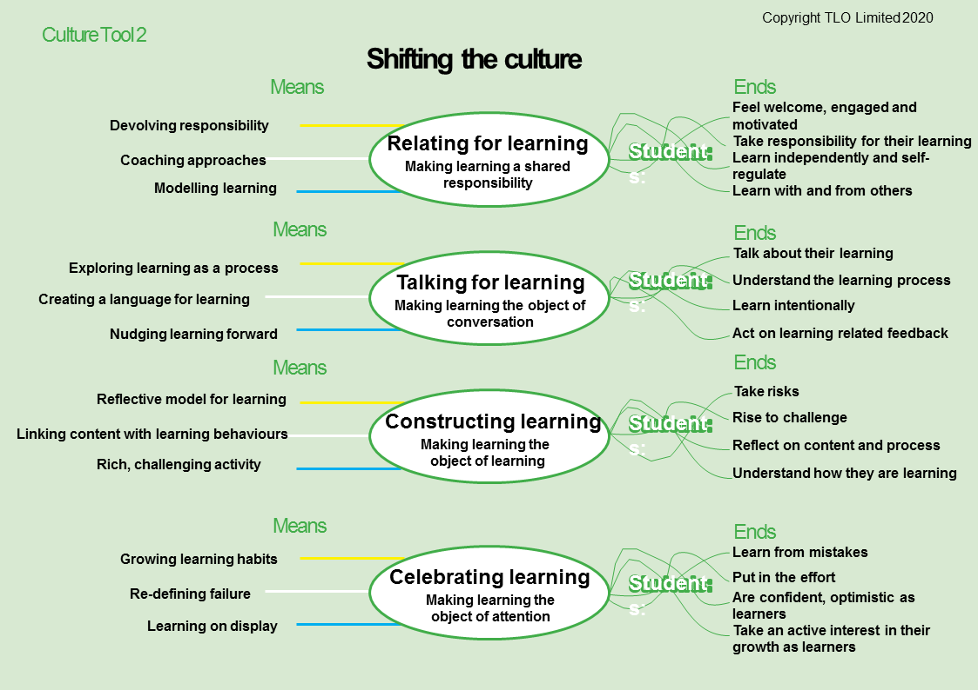
A moment to reflect . .
How is this connected to what you already know about classroom culture?
How has it extended your thinking?
What questions do you now have?

