Slide 1

Introducing Unit 3 - Constructing Learning
Copyright TLO Limited 2020
Notes:
This brief ppt explains the contents of Unit 3 and shows how Unit 3 links with and follows on from Unit 2

Slide 2
What we are trying to achieve in this session
Outcomes
To understand the contents of Unit 3 and how it links with Unit 2.
To understand the anticipated timings for tackling Unit 3 and when the Team Meetings are scheduled.
Learning behaviours you will need to contribute!
Making Links
To your current planning practices
Reflect
On what happens now
Imagine
How planning for learning might affect curriculum planning
Capitalise
Prepare to capitalise on the resources / activities available

Slide 3
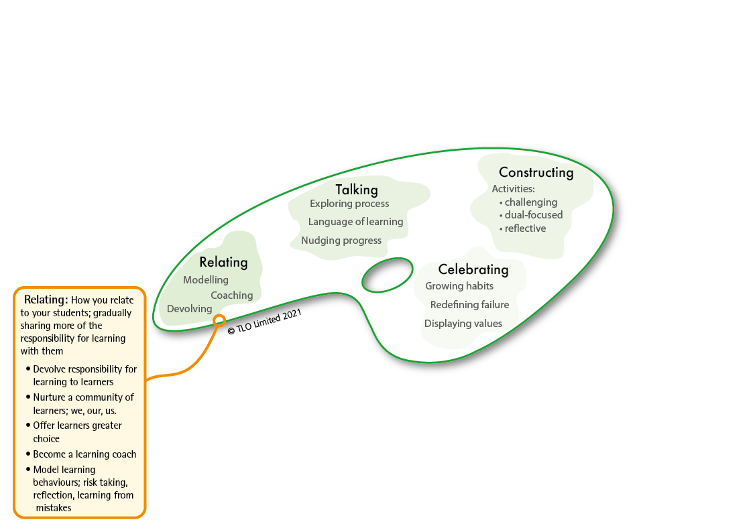
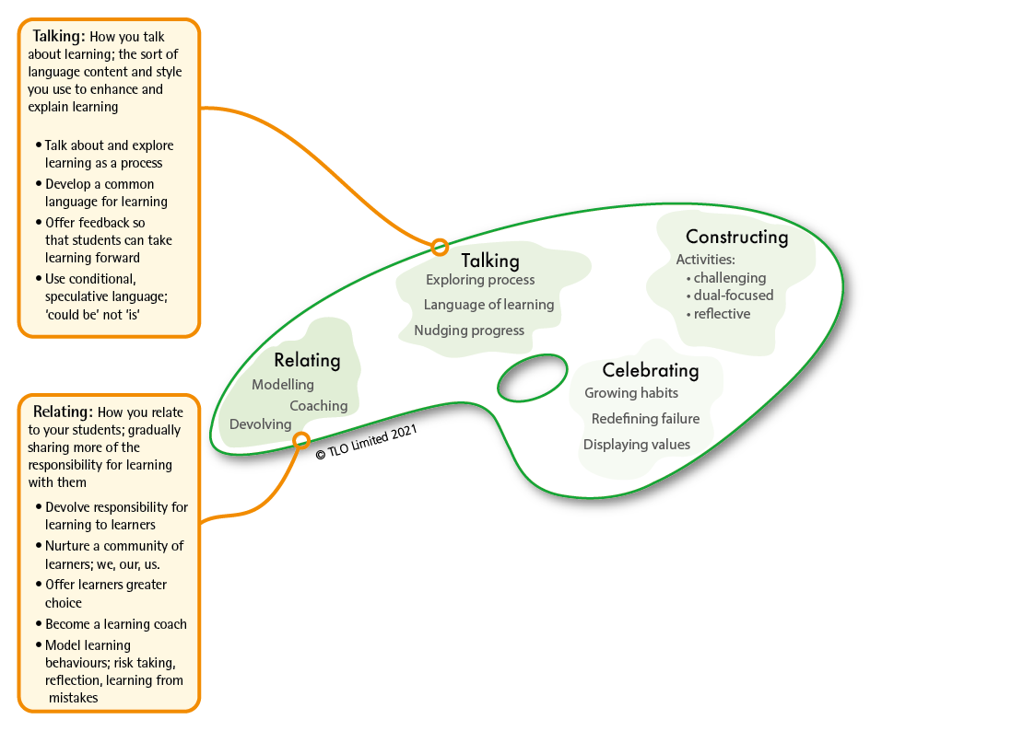
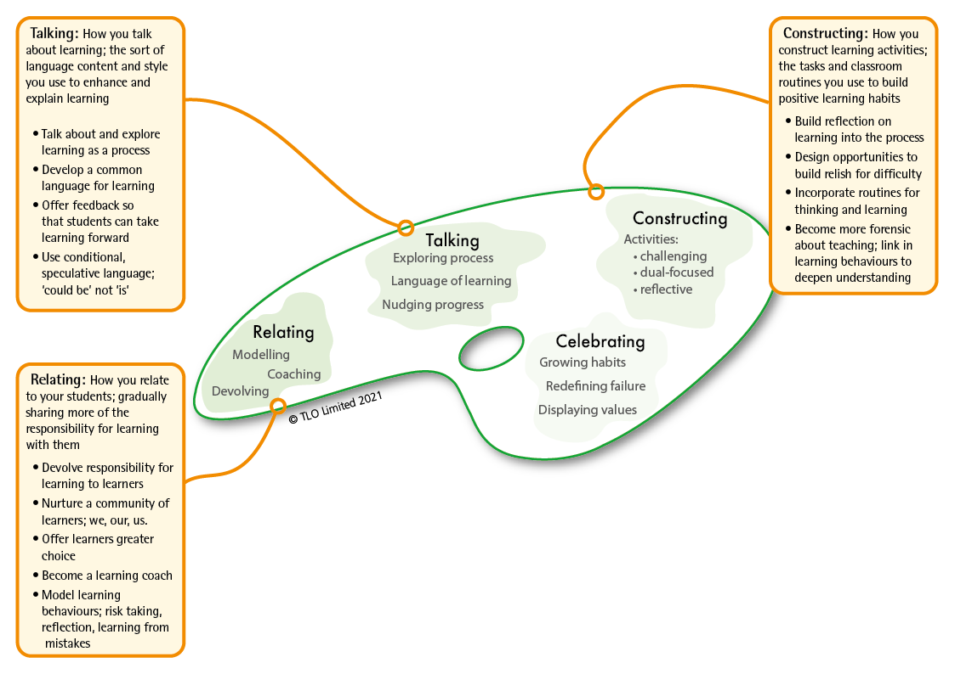
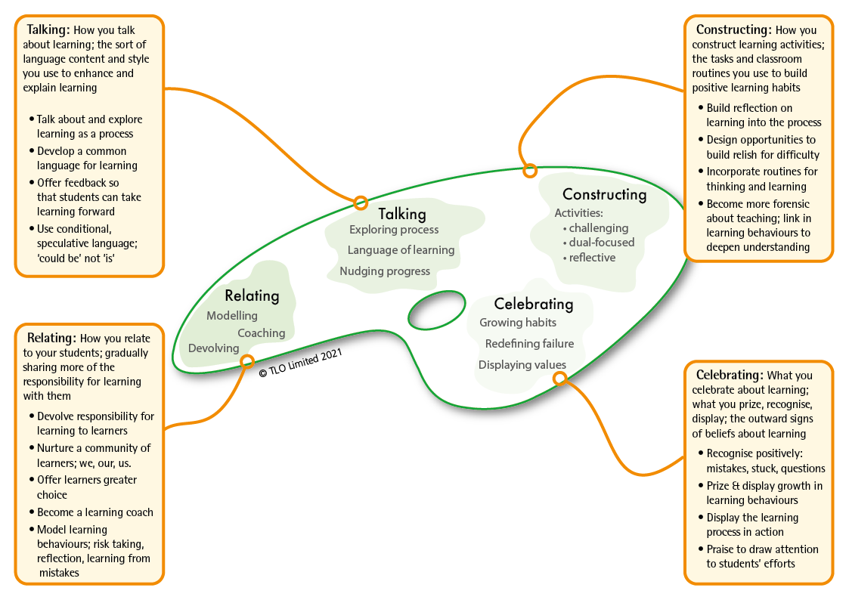
Unit 2 had a focus on 3 aspects of classroom culture
BLP’s second model: the teachers’ palette.
Based on research by Chris Watkins
Notes:
The 2nd model of Building Learning Power...The Teachers’ Palette
This framework outlines 4 aspects of classroom culture.
Unit 2 had a focus on 3 of these:
Click #1 – Relating – how we: devolve responsibility to learners; coach more and tell less; model ourselves as learners.
Click #2 – Talking – how we: develop a language for learning; talk about the learning process; offer feedback about learning behaviours
Click #3 – Celebrating – how we: display the learning process in action; re-define failure / mistakes / effort; celebrate the growth of learning behaviours.
Unit 2 was about readying our classroom culture for learning, making classrooms places where positive learning behaviours can grow and flourish.
All of those things we have been exploring, the positive changes we have been making, the ideas that seem to be working best and can be applied across the school, should continue - these are the foundations for Unit 3.

Slide 4
Unit 3 considers the 4th aspect – how we construct lessons with learning in mind
BLP’s second model: the teachers’ palette.
Based on research by Chris Watkins
Notes:
Unit 3 has a focus on the 4th aspect of classroom culture – how teachers create schemes of work, construct lessons and design activities that build positive learning habits.
It has a focus on how teachers:
plan to weave learning behaviours and curriculum content together
incorporate routines for thinking and learning
design activities that promote perseverance, curiosity, collaboration, monitoring
build in opportunities for reflection on learning
Like Unit 2, there are 4 sections . .
Sections 3a, 3b and 3c explore issues around planning lessons with learning in mind
Section 3d is a treasure trove of teaching ideas that can be built in to lesson planning.

Slide 5
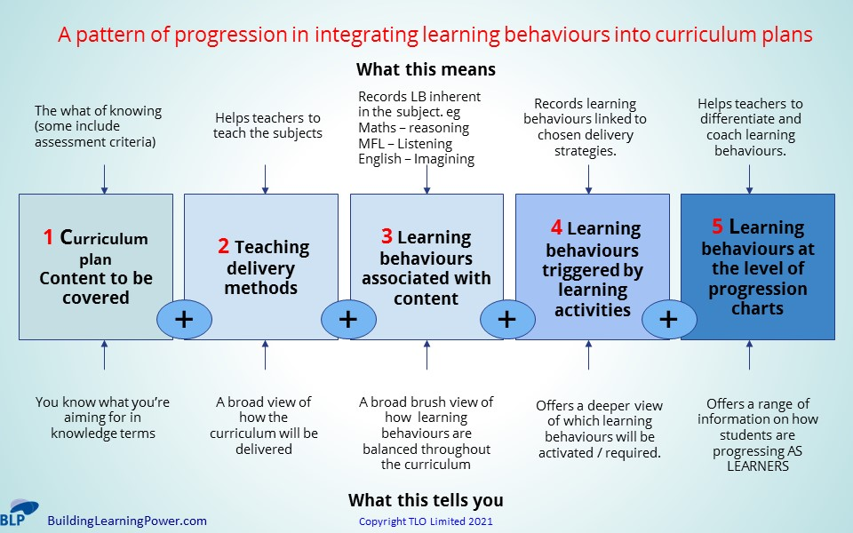
Section 3a - Absorbing learning habits into the whole curriculum
Explores a progression trajectory for integrating learning behaviours into curriculum planning
Notes:
Considers 5 ‘levels’ of planning:
Content only planning – little more than a list of what will be covered and when
Content plus delivery methods – what will be covered, when and how
Content, delivery and learning behaviours – a step change, identifying and planning for the broad brush learning behaviours necessary to access the curriculum content
Content, delivery, learning and activities – a recognition that the planned activities also activate learning behaviours in addition to the ones necessary for content acquisition
Content, delivery, learning and activities – building fine grain learning behaviours drawn from progression trajectories into curriculum planning
Section 3a may lead to long-term changes in how we plan learning

Slide 6
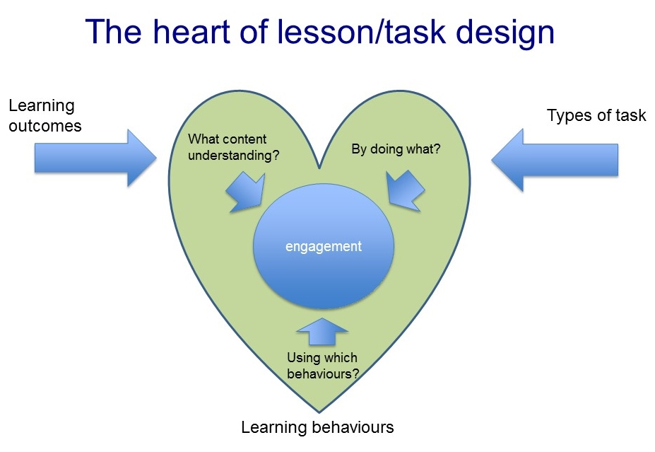
Section 3b - Absorbing learning habits into units of work and lessons
Explores how teachers build learning behaviours into:
Units of work
Individual lessons
Notes:
Builds on Section 3a
Explores linking content, learning behaviours and tasks/activities
Considers the issues around building learning behaviours into medium term planning and individual lesson planning.

Slide 7
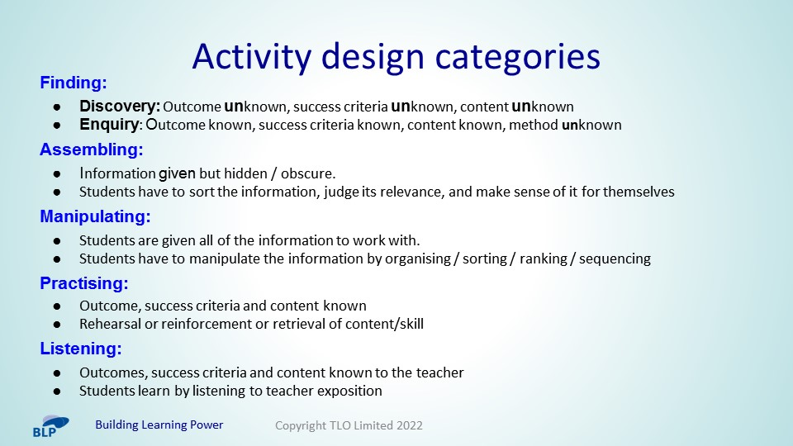
Section 3c - Absorbing learning-rich activities into lessons
Explores different types of activities and how they activate positive learning behaviours.
Notes:
It identifies 5 activity design categories and offers examples of each
Challenges us to consider the types of activities that we currently build into lessons

Slide 8
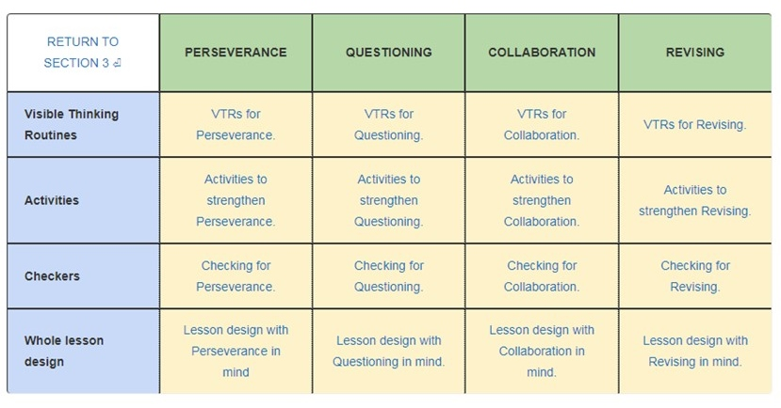
Section 3d - Absorbing the foundational four learning behaviours into lessons
Notes:
Is a treasure trove of teaching ideas to explore and build into lessons . .
For each of the 4 foundation learning behaviours, you have . .
Click #1 - 6 or so Visible Thinking Routines
Click #2 – 10 activities to build into lessons
Click #3 – 10 ways of Monitoring the learning behaviours
Click #4 – a fully planned lesson for each learning behaviour to illustrate how you might design lessons with learning in mind.

Slide 9

Anticipated Timings . .
Expect to spend around three months on Unit 3
During the first month you will explore sections 3a, 3b and 3c, and have a team meeting at the end of the month to explore the issues raised
During months two and three, you will be working on section 3d – identifying teaching ideas that you can weave into your own lessons
And there will be a second team meeting between months 2 and 3

