Slide 1

Introducing Unit 4 – Broadening the Range
Copyright TLO Limited 2020
Notes:
This brief ppt explains the contents of Unit 4 and shows how it links with previous units

Slide 2
What we are trying to achieve in this session
Outcomes
To understand the contents of Unit 4 and how it links with previous units.
To consider the order in which teachers might tackle the content of Unit 4.
To understand the anticipated timings for the Unit.
Learning behaviours you will need to contribute!
Making Links
To your students’ learning behaviours
Reflect
On what happens now and what we have been doing
Plan
The order you intend to tackle the materials
Notes:
This very short presentation is designed to help teachers to understand the contents of Unit 4 and to consider which new behaviours they might introduce to their students.

Slide 3
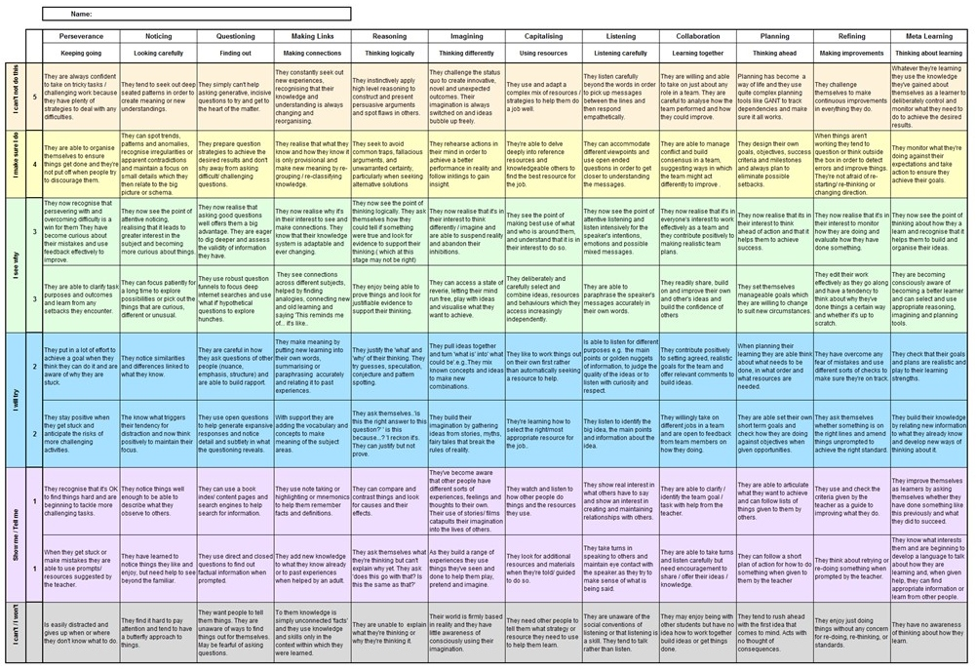

In Unit 1 . . . .
Notes:
Unit 1 summary
Click #1 – Unit 1 looked at the 2 key models of Learning Power – the Supple Learning Mind and the Teachers’ Palette (The warp and Weft of learning)
Although classroom culture is introduced here, the main focus in Unit 1 was on the Supple Learning Mind, how the 12 learning behaviours grow, and . . .
Click #2 – creating Learning Profiles for our students.

Slide 4
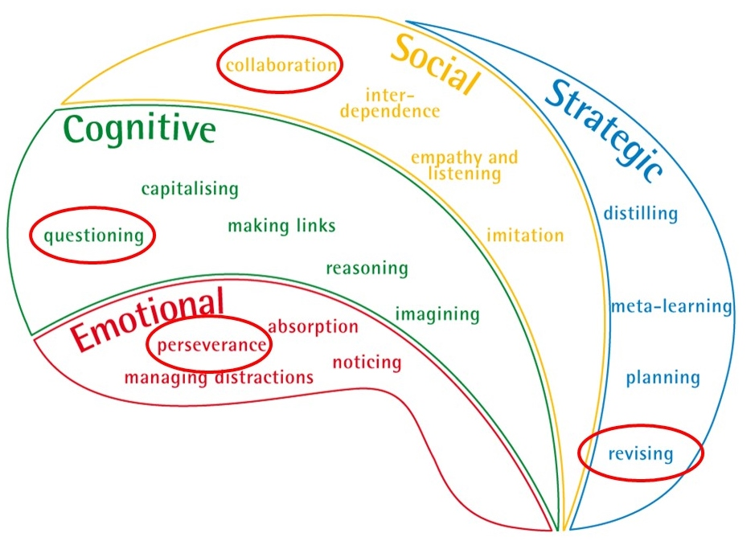
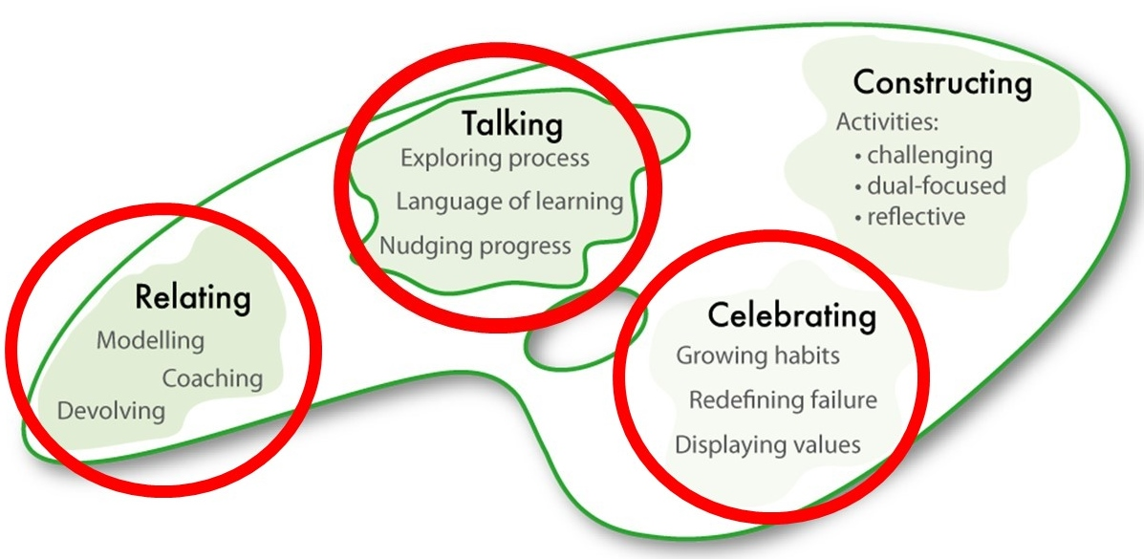
In Unit 2 . . . .
Notes:
Unit 2 Summary
Click #1 – Unit 2 explored 3 aspects of classroom culture (Relating, Talking and Celebrating) . . .
Click #2 – through the lens of the 4 foundational learning behaviours (Perseverance, Questioning, Collaborating, Revising)

Slide 5
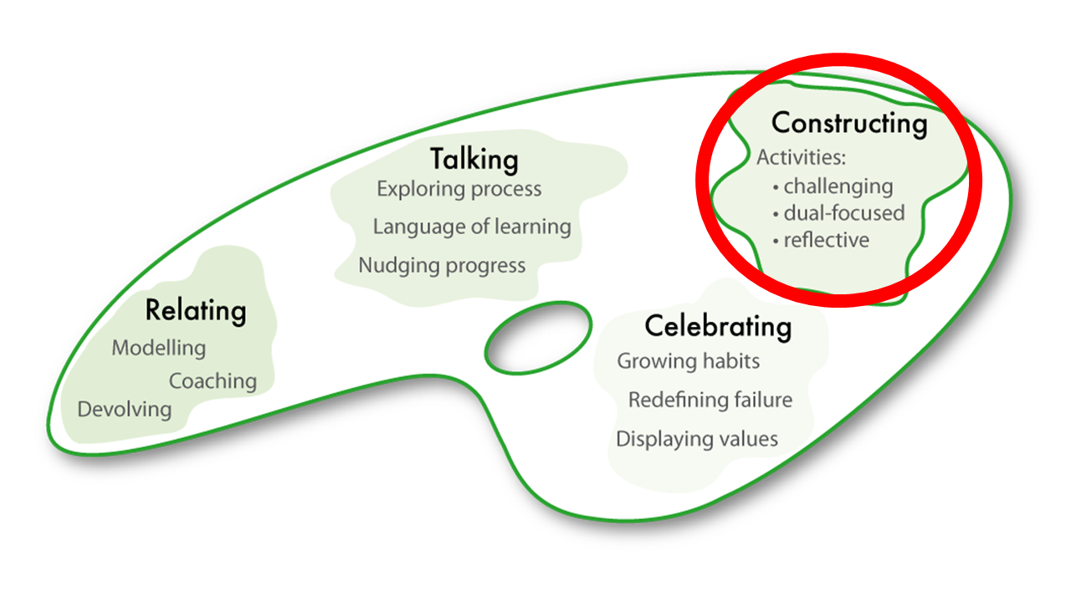
In Unit 3 . . .
Notes:
Unit 3 summary
Click #1 – explored the 4th aspect of classroom culture, how we construct lessons with learning in mind
Click #2 – again through the lens of the 4 key behaviours.
The last 6 months or so have had a dual focus on Classroom Culture through the lens of the big 4 behaviours.

Slide 6
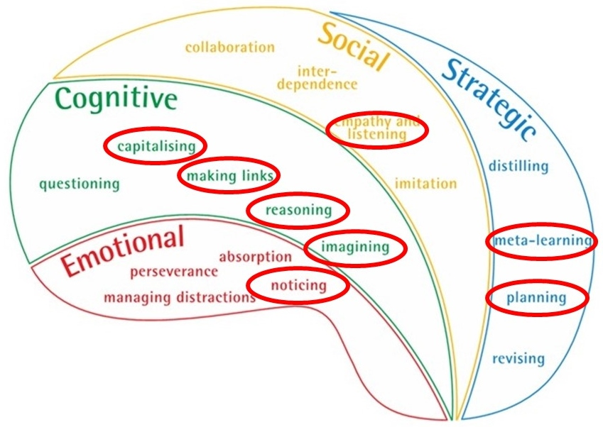
In Unit 4 . . . .
Notes:
Unit 4 offers an introduction to the 8 learning behaviours that were considered in Learning Profiles, but have taken a back seat to the big 4 over the past few months.
Each of the 8 sections are ‘Toes in the Water’ sections – brief introductions to each of the 8, sufficient to get you going, but insufficient to dive in deeply (the deep dive is what Phase 2 is all about).
Consider just one of the 8 – in this case, Noticing . . .
Next slide

Slide 7
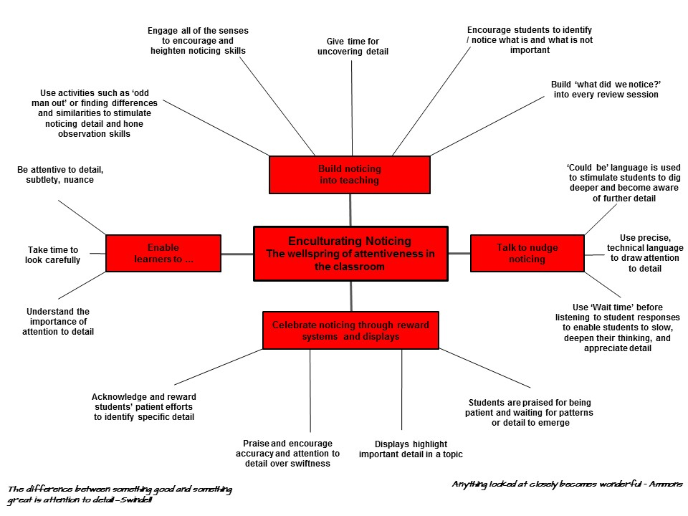
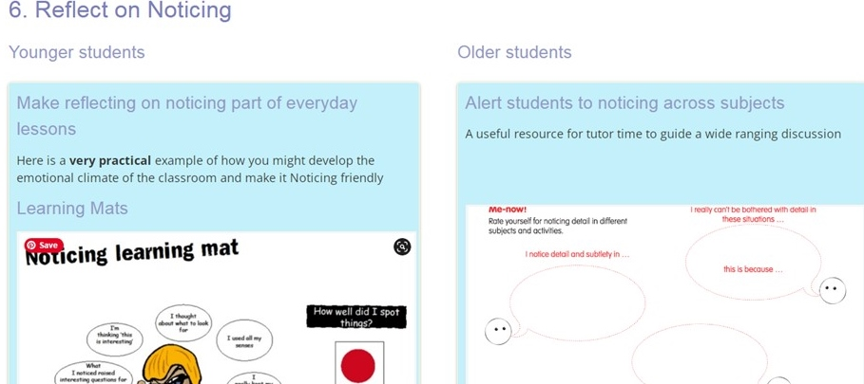
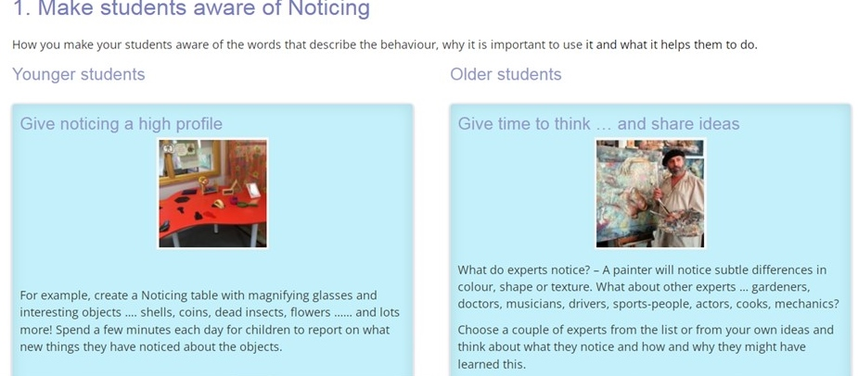
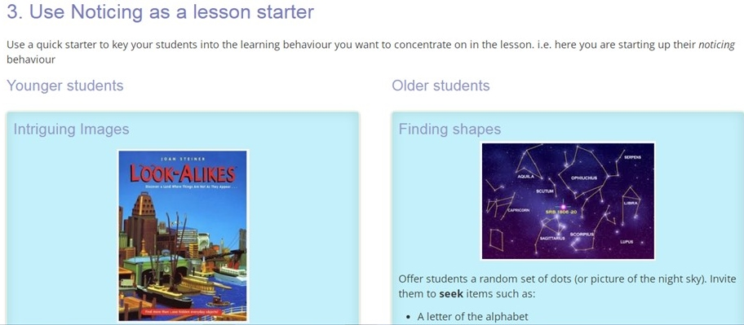
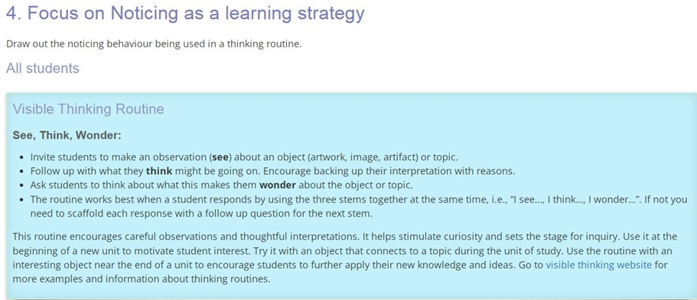
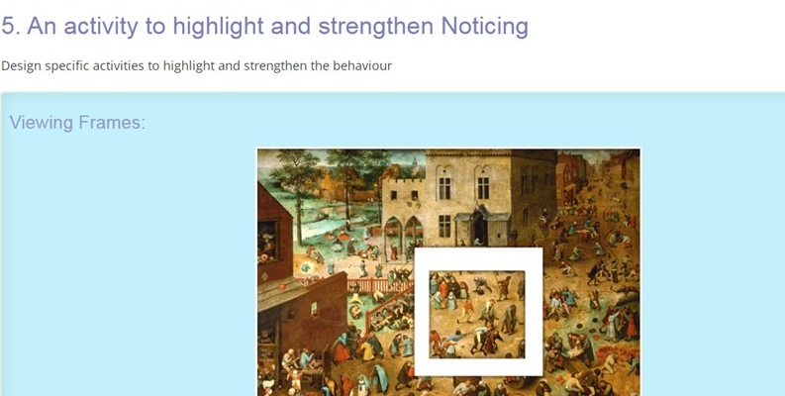
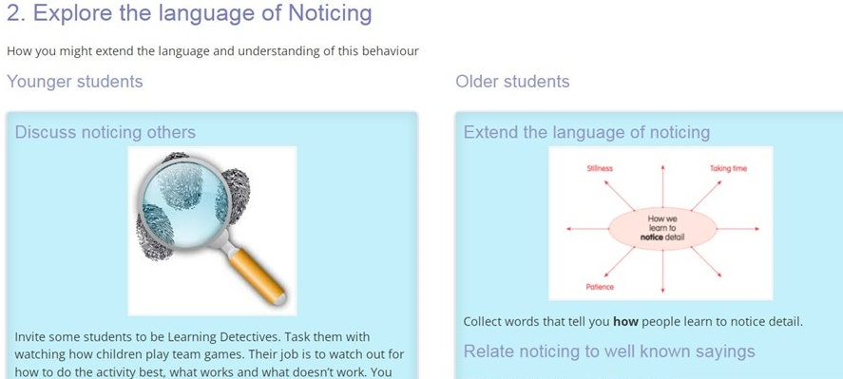
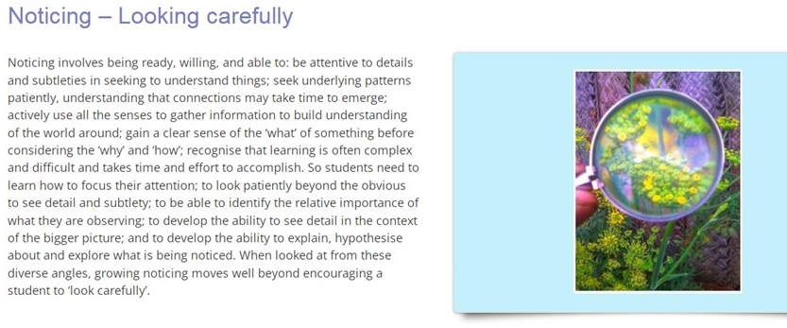
Notes:
Click #1 – each starts with a brief description / reminder of the behaviour
Click #2 – offers hints about the types of classroom cultures that nurture the behaviour
There are . . .
Click #3 – Ideas to make students aware of the behaviour (some for younger students, some for older)
Click #4 – Ways to talk about the behaviour
Click #5 – lesson starter ideas
Click #6 – a visible thinking routine
Click #7 – an activity to develop Noticing
Click #8 – ways of reflecting on Noticing

Slide 8
What do we do?
There is no intention that you tackle all 8 of these behaviours over the next 2 months – if you manage to explore a couple of them, that would be great.
The aim is to begin to ‘Broaden the Range’ of behaviours in your classroom in advance of moving on to a deeper exploration of these behaviours in Phase 2 of the programme.
So – how do we decide which of the 8 to focus on . . . .
Notes:
Talk through the LHS

Slide 9
Where do we start?
There are a number of possibilities . .
Look back at your students’ learning profiles and decide
Focus on behaviours that interest you / fit well with your upcoming curriculum content
Share them out so that all of them get explored in at least one classroom
Decide together and all focus on the same 2
Notes:
Mention the possibilities

Slide 10
Where do we start?
Table discussion
How do we want to tackle Unit 4?
Notes:
Initiate a discussion to explore how teachers wish to proceed
Intend to close the discussion having agreed a course of action that all are happy with

