Slide 1

Introducing Unit 1 - ‘Understanding Learning and Cultures’
Copyright TLO Limited 2020

Slide 2
Running this session.
This PowerPoint is an introduction to Unit 1 of Playing the Learning Power Game.
If you have already shared the ppt ‘Introducing Playing the Learning Power Game’ you may choose to omit slides 6 - 9 and slides 12 -15 of this slide deck and use slides 5 and 11 to remind teachers of what they have already seen.
If you have not used the ppt ‘Introducing Playing the Learning Power Game’, we suggest that you use the slide deck as it is.
Depending on how expansive your commentary is, the full ppt might take an hour to go through if you build in a few reflection/discussion points.

Slide 3
What we are trying to achieve in this session
Outcomes
To understand the contents of Unit 1 and what we all need to do
To understand the anticipated timings for tackling Unit 1 and when the Team Meeting is scheduled.
Learning behaviours you will need to contribute!
Making Links
To what you already know about learning
Reflect
On your own classroom culture
Notice
Your students’ learning behaviours
Capitalise
Prepare to take advantage of
resources / activities available

Slide 4
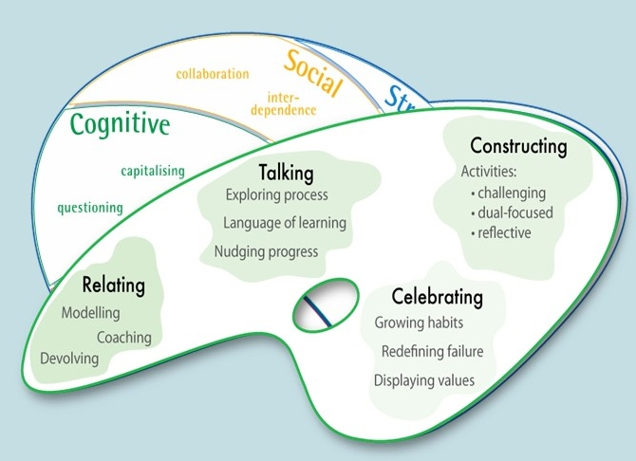
Notes:
Unit 1 begins with a deep exploration of the 2 key models of Learning Power: The Supple Learning Mind and the Teachers’ Palette.
Both are considered at the beginning of Unit 1, but thereafter the focus of Unit 1 is on The Supple Mind. [Units 2 and 3 focus more on the Palette, and Unit 4 goes back to expanding understanding of the Supple Mind.]

Slide 5
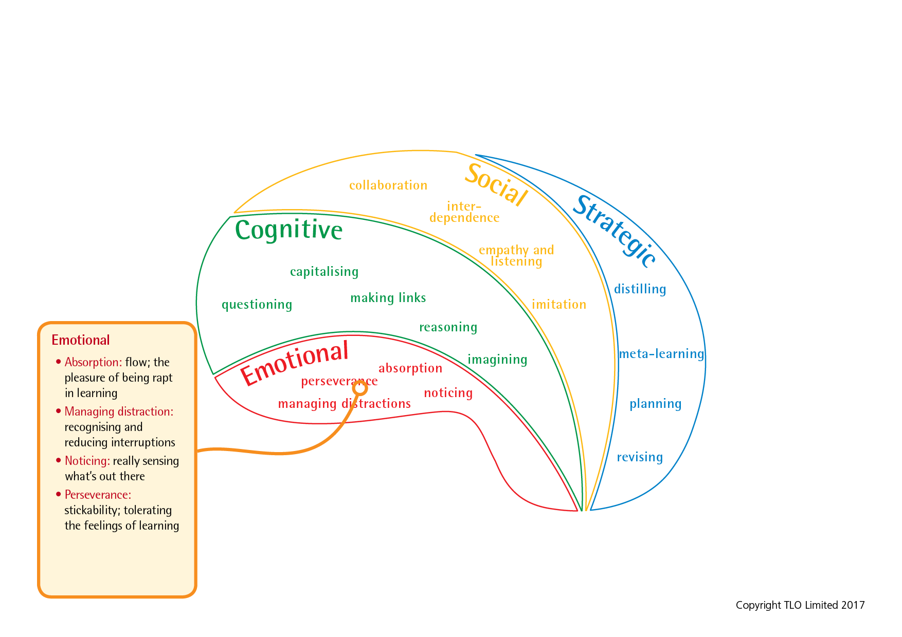
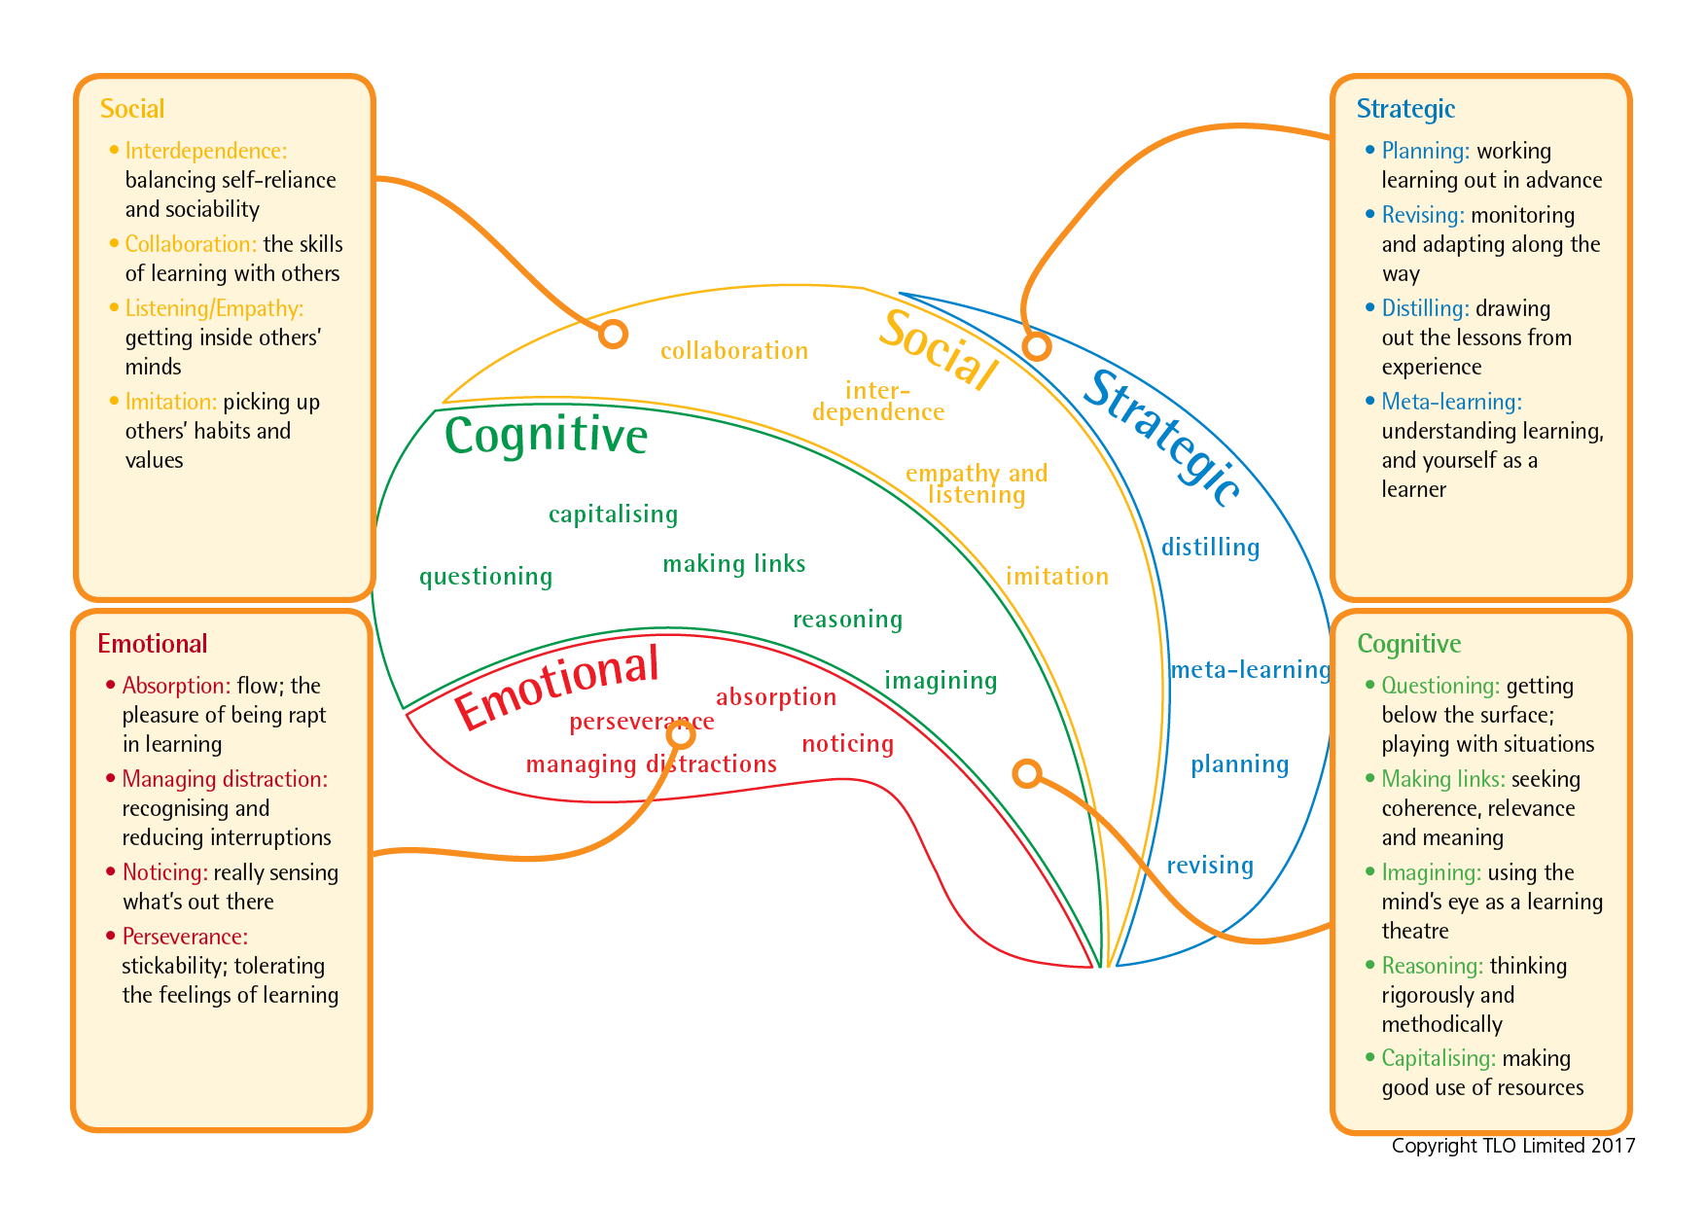
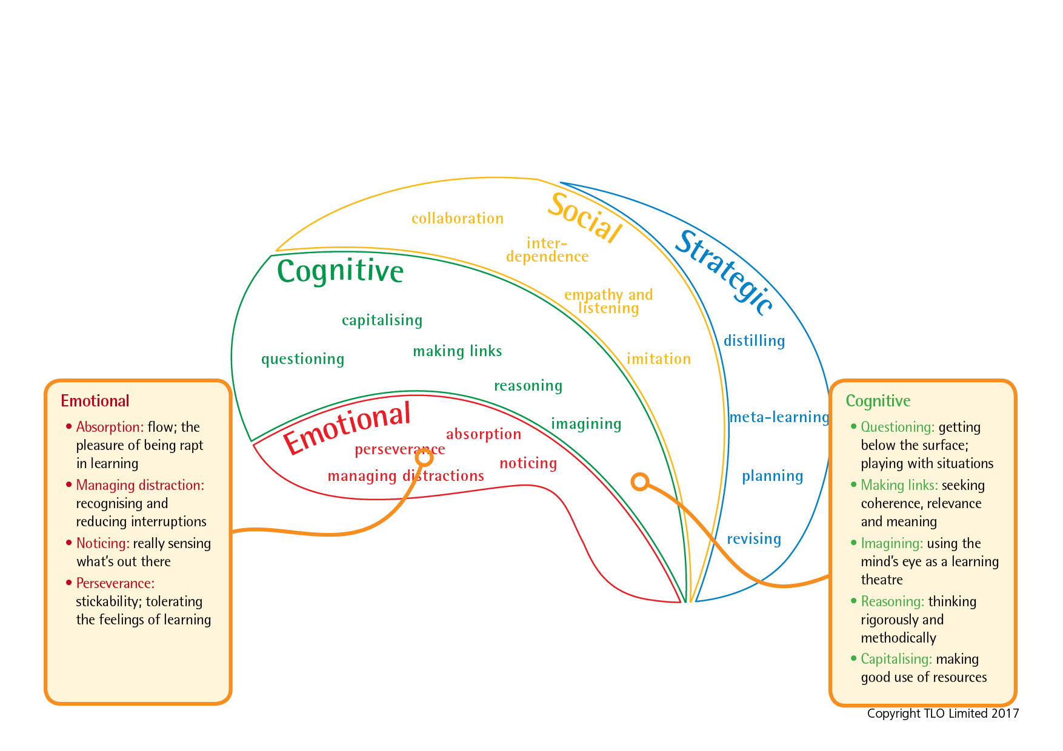
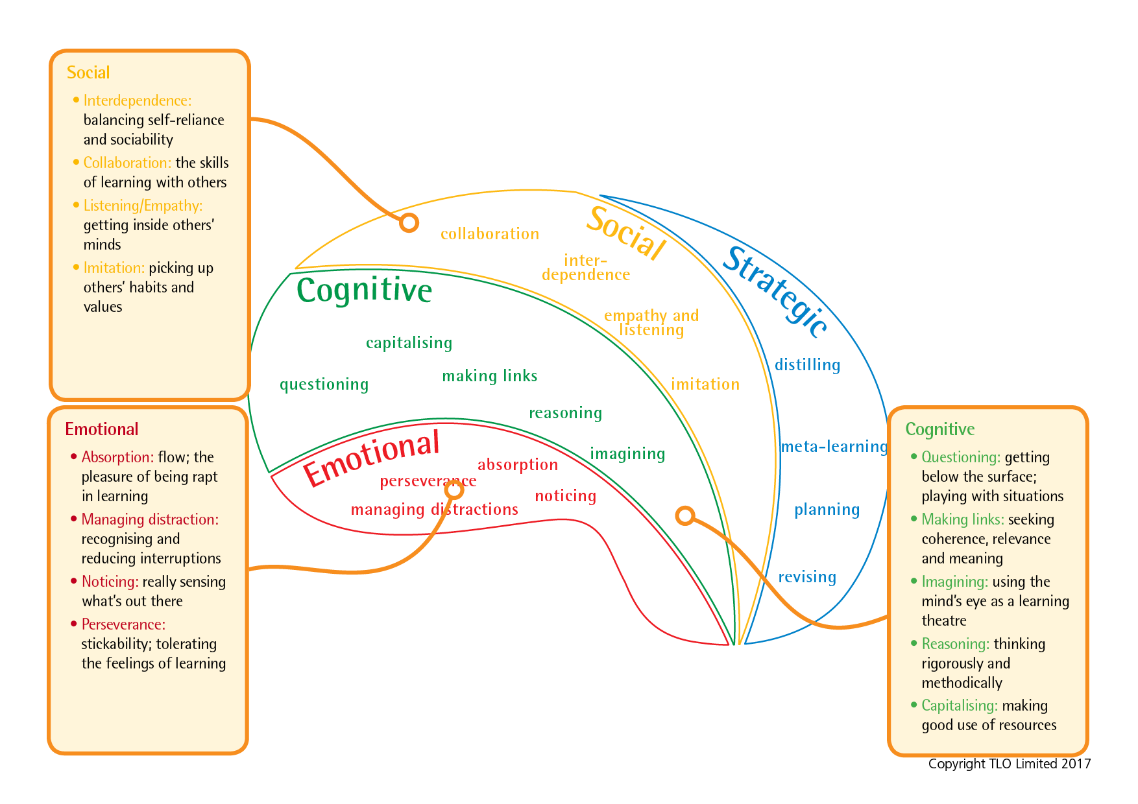
The Supple Learning Mind framework
Notes:
How the supple learning mind is made up.
It came from research into learning undertaken at Bristol University about 20 years ago.
Brief overview
The supple learning mind framework captures the key psychological characteristics that are judged to be of the highest value in helping students to learn...how to be tenacious and resourceful, imaginative and logical, self disciplined and self aware, collaborative and inquisitive as learners. They shape how we learn

Slide 6
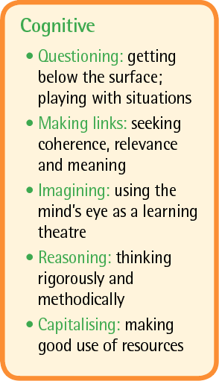
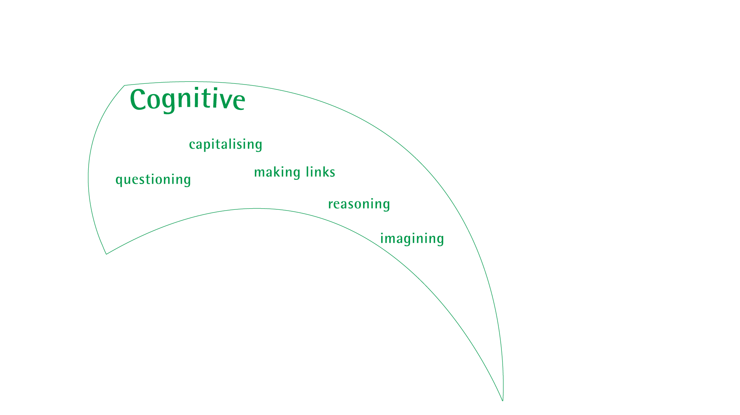
Cognitive processes: the workhorse of learning
Notes:
We’ll build up the supple learning mind that we want to help students to develop, starting with
the cognitive group; the workhorse of learning, the behaviours we tend to think of first.
While these behaviours are all crucial in making learning stick they are not the be all and end all of learning. There’s far more to learning than cognition.

Slide 7
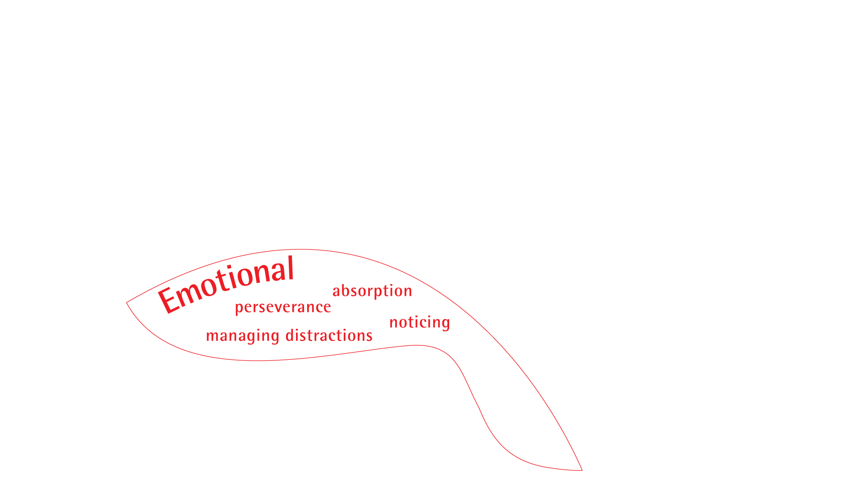
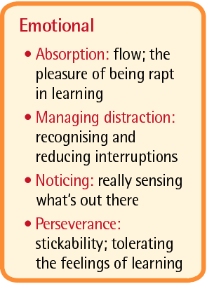
Emotional processes: the bedrock of learning.
Notes:
The bedrock of our learning habits are our feelings.
Without perseverance little learning will take place.
Without knowing how to manage distractions little learning will stick.
Without determination in noticing much will be missed

Slide 8
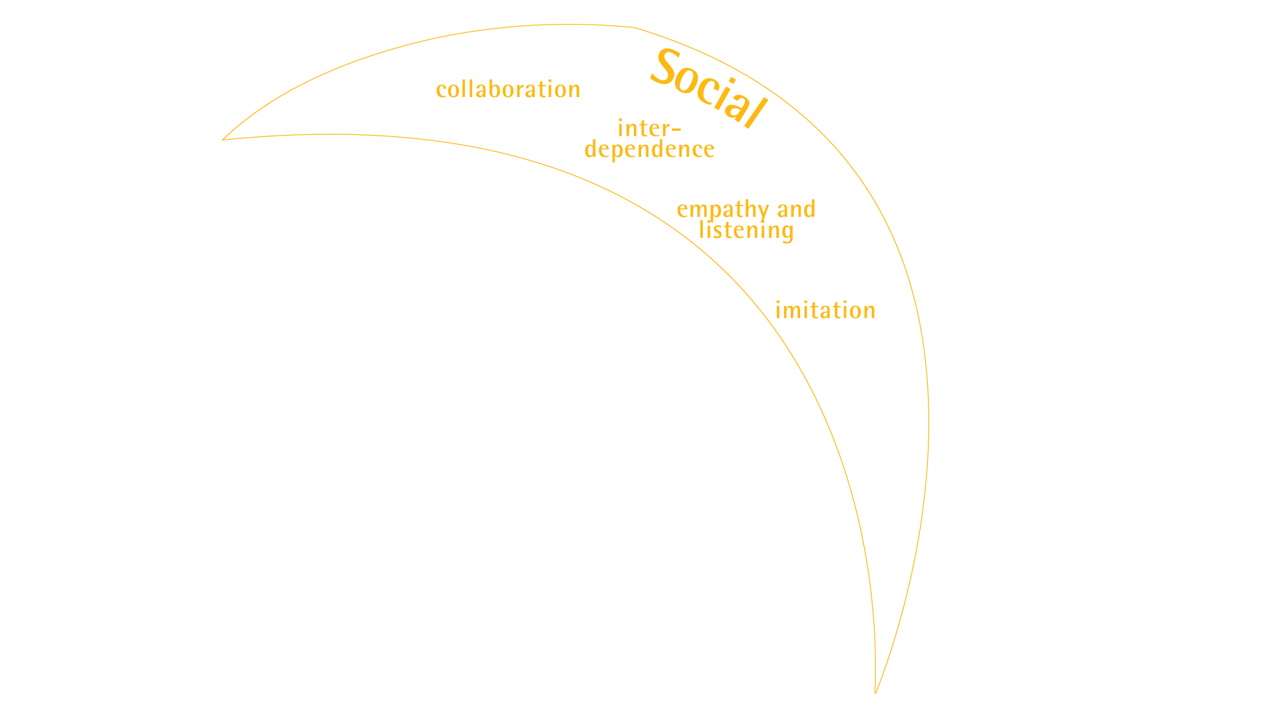
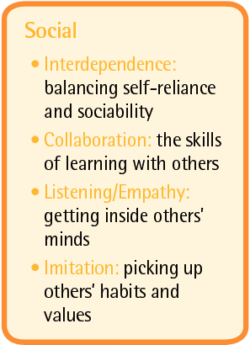
Social processes: the relationships of learning
Notes:
With the ever increasing connectivity in our world our ability to interact, learn and build knowledge with others becomes ever more essential.

Slide 9
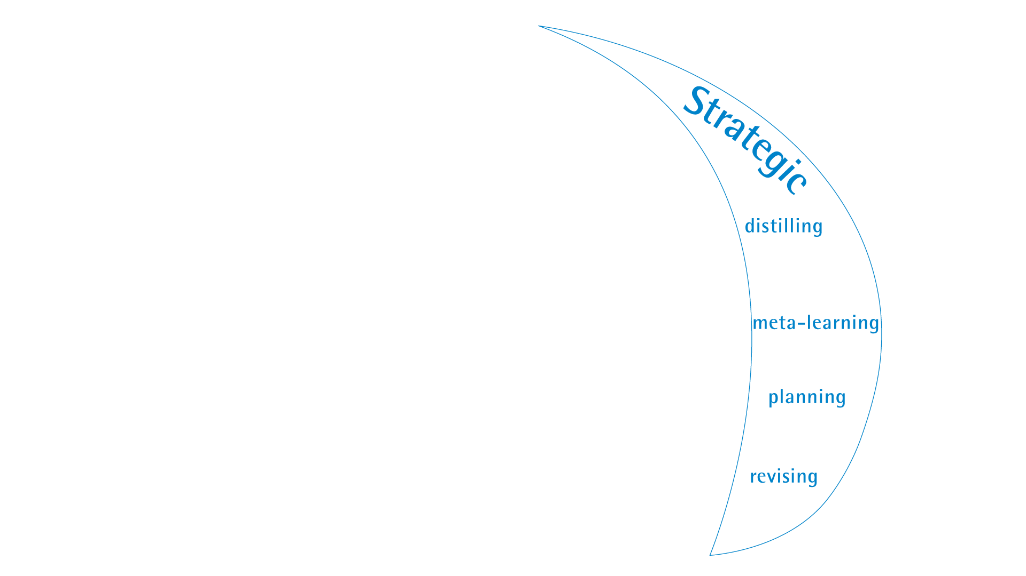
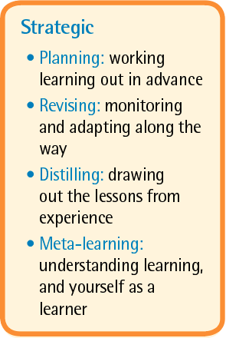
Strategic processes: the management of learning
Notes:
And last but not least... the strategic aspects of learning... which have been shown, relatively recently in the world of education, to be so essential in making any learning stick.(i.e. metacognition and self regulation)

Slide 10
The Supple Learning Mind framework
Notes:
Underlying this approach is a recognition that learning how to learn involves more than skills, it involves students’ attitudes, values, interests and beliefs as well. It’s about helping students to help themselves to be disposed to persist, to question and be curious, to collaborate harmoniously and to be open to new ideas.

Slide 11
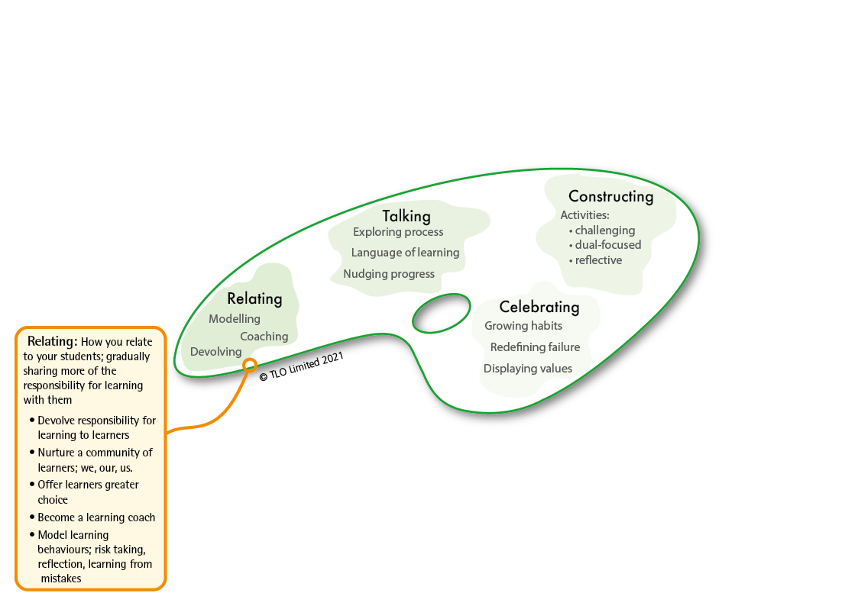
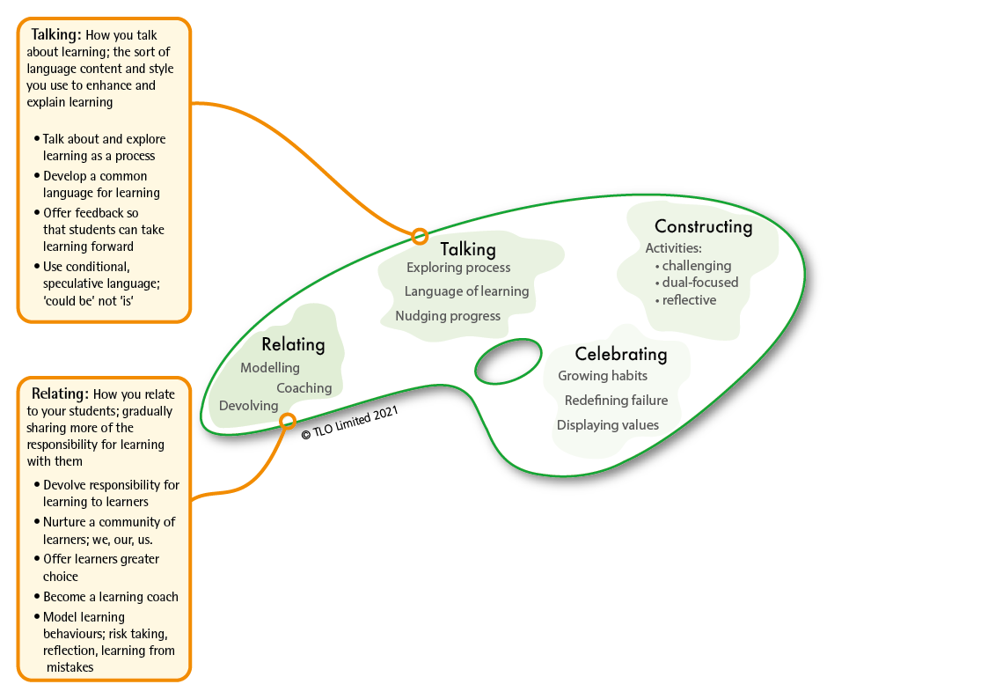
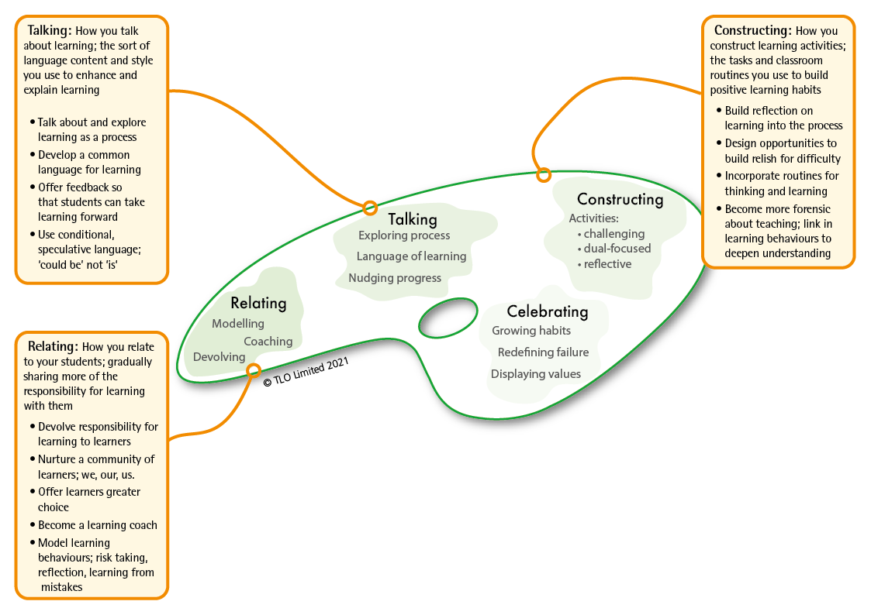
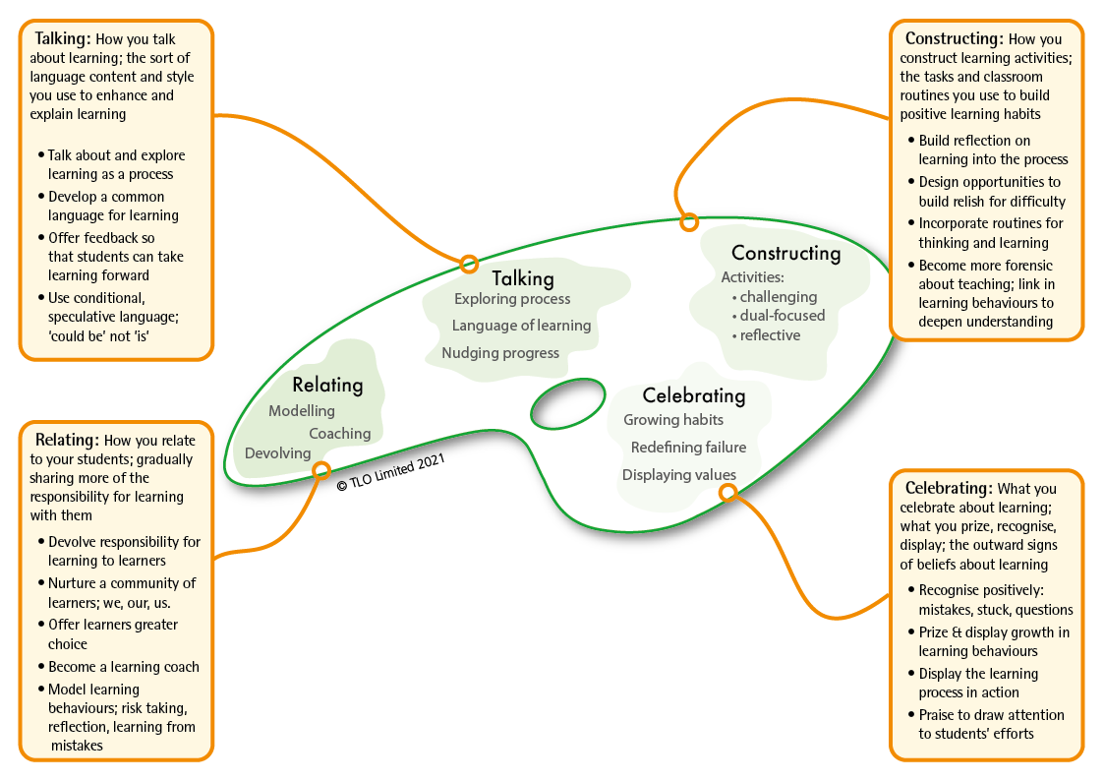
The teaching framework that makes it all work
BLP’s second model: the teachers’ palette.
Based on research by Chris Watkins
Notes:
The 2nd model of Building Learning Power...The Teachers’ Palette
This framework gives a systematic introduction to the principles behind the teaching for building powerful learners: the framework teachers need to have at the back of their minds, as they;
explain the approach to pupils,
plan their activities,
comment on pupils performance and
demonstrate learning power in their own lives.
Putting LP into action is not a seven day wonder, a quick fix, or a miracle cure for all the ills and difficulties in education. It is potentially a long journey that starts with small steps and is capable of fundamentally shifting the way teachers think, the way they teach and the whole ethos of the school.

Slide 12
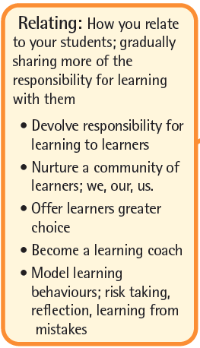
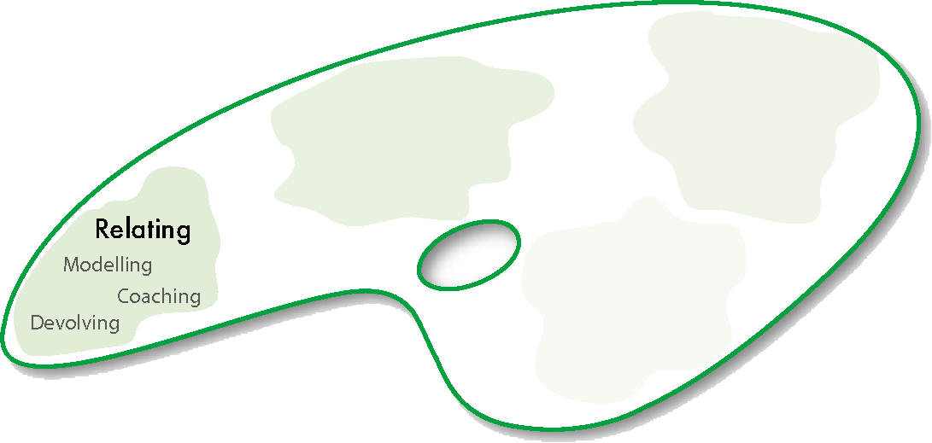
About relating for learning: what you can give away
Notes:
RELATING​ for learning involves;
devolving responsibility – shifting the emphasis towards learners taking increasing responsibility for their own development​
coaching approaches – moving away from ‘teacher telling’ mode whenever possible​
modelling learning – walking the talk, being a learner yourself.

Slide 13
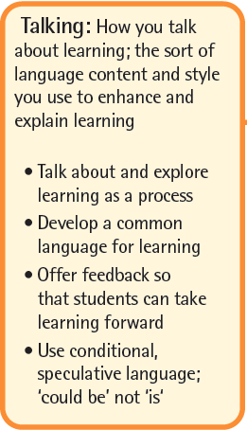

About talking for learning: what you can say
Notes:
TALKING​ about learning
Exploring learning as a process – finding time to talk about learning and how it works​
Developing a language for learning – teacher talk uses the school’s learning language.
Nudging learning forward – catching students employing positive learning behaviours and commenting on them, orally and in writing​
[DEVELOPING A LANGUAGE FOR LEARNING IS KEY TO UNDERSTANDING LEARNING AS A PROCESS. IT UNDERPINS METACOGNITIVE ACTIVITY]

Slide 14
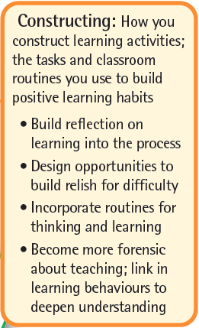

About constructing learning: what you can do every day
Notes:
CONSTRUCTING​ learning
Using a reflective model for learning – reflection on content and reflection on learning behaviours is routinely built into lessons​
Linking content with learning behaviours – lessons are designed intentionally to deliver content and to exercise learning behaviours. Students are made aware of both​
Rich, challenging activities – increasingly open-ended activities are designed to engage, to stretch and to challenge
NOTE THAT CONSTRUCTING LEARNING WILL BE THE FOCUS OF UNIT 3 AND IS NOT DEVELOPED IN UNIT 2 ​

Slide 15
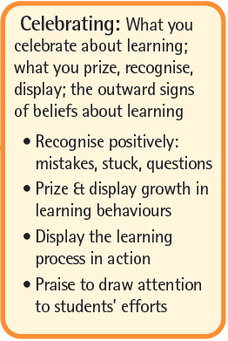
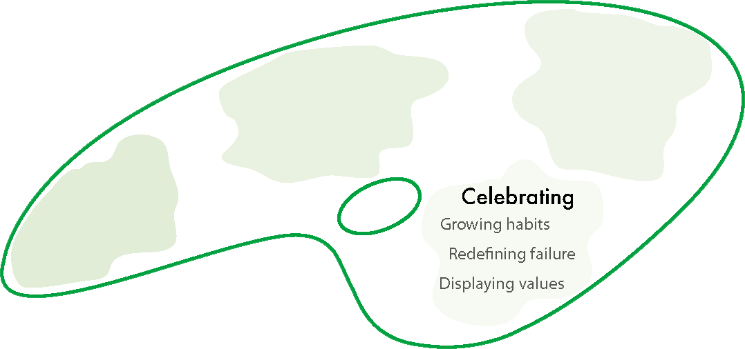
About celebrating learning: what you display
Notes:
CELEBRATING​ learning and its growth
Growing learning habits – finding ways to track, record and celebrate learning behaviour growth,​
Redefining failure – turning the lens around: mistakes become learning opportunities; difficulty is when learning happens; asking questions shows curiosity, not a lack of intelligence. ​
Putting learning on display – the process of learning (as opposed to the finished outcomes of learning) are on display. Annotated work in progress, first attempts, revisions, failed lines of enquiry, leading, of course, to the finished article.​

Slide 16
Section 1a – The warp and weft of learning
introduces you to the foundational ideas of learning power; the basic ‘must knows’
Notes:
Both The Supple Mind and the Teachers’ palette are considered in section 1a., but the focus of the remainder of Unit 1 is on The Supple Mind.
[Units 2 and 3 focus more on the Palette, and Unit 4 goes back to expanding understanding of the Supple Mind.]
This section introduces and explores the 2 models that underpin Learning Power:
The Supple Learning Mind – the key learning behaviours that were and are judged to be of the highest value in helping students to learn and thrive in a complex world;
The Teachers’ Palette – the ways that teachers: shift responsibility for learning towards students; talk about the process of learning; plan lessons that consciously develop positive learning behaviours; celebrate the growth of learning.

Slide 17

Section 1b – Why learning habits matter
is designed to give you confidence that the approach is valid with a long history of research and development
Notes:
‘Why learning habits matter’ explores the background, heritage and research behind learning to learn and why it is so important for 21st Century learners.

Slide 18
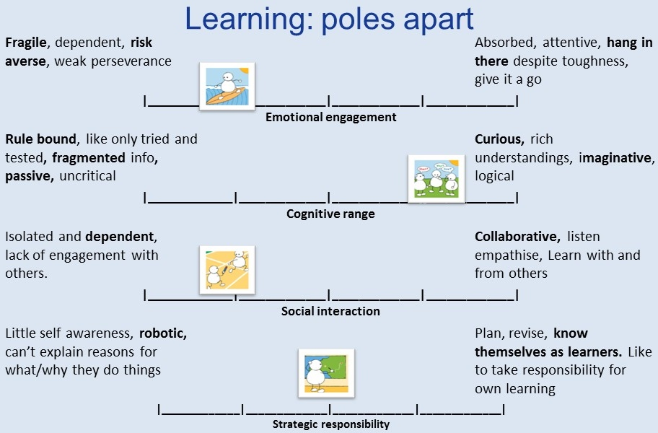
Section 1c – Uncover the mysteries of learning behaviours and how they grow
helps you become aware of how learning behaviours grow and develop. It’s an eye-opening read about the complex nature of each of the twelve habits..
Notes:
‘Uncover the mysteries of learning behaviours’ explores 12 important learning behaviours and introduces you to how these behaviours might grow. It is the first step in moving from Learning Power to Building Learning Power.

Slide 19
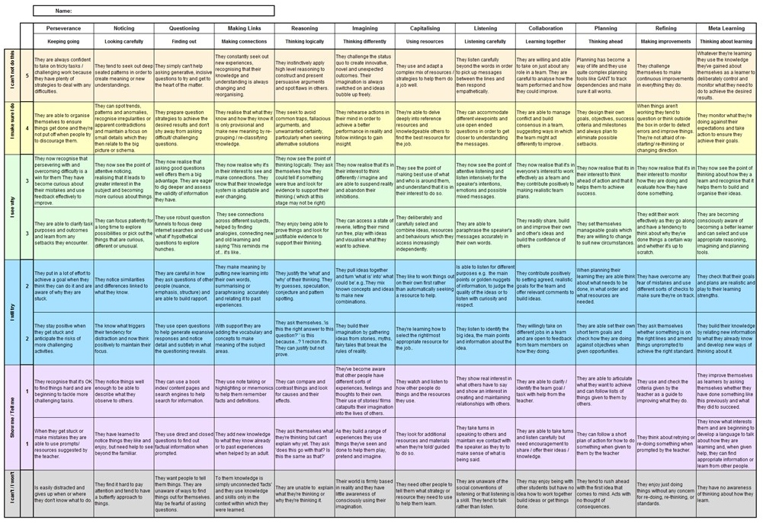
Section 1d – Up close and personal with learning
begins your voyage of discovery. It’s about taking what you have learned about the learning habits and thinking about how these ideas apply to yourself and then a couple of your students.
Notes:
‘Up close and personal with learning’ pulls together the growth trajectories introduced in the previous section into one progression chart covering all 12 learning behaviours and invites you to look at your own learning behaviours through this lens, and subsequently to consider a couple of the students in your class.

Slide 20
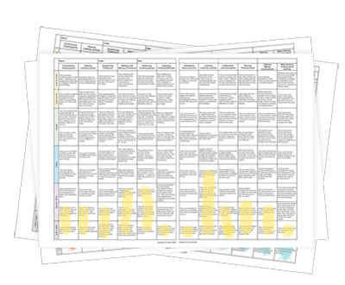
Section 1e – Finding learning characteristics
sets you up with intriguing, new and valuable information about your students and helps you discover different aspects of your students as learners
Notes:
‘Finding learning characteristics’ invites you to turn your attention to your class and to build learning profiles for each of them individually.

Slide 21

Anticipated Timings . .
Expect to spend two months on Unit 1.
During the first month you will explore sections 1a, 1b and 1c, and in section 1d you will begin to create your own learning profile and the profiles of a couple of the children in your class.
During the second month you should be working on creating learning profiles for the children in your class, beginning to look for patterns, comparing and contrasting different groups of learners in your class.
At the end of month 2 there will be a team meeting when we pool our students’ profiles and discuss what we have discovered about our students’ learning habits. It will be fascinating!

