Slide 1
To what extent are our students skilled learners?
Notes:
The Key message(s) on this slide: ​
​
​
Detail:​

Slide 2
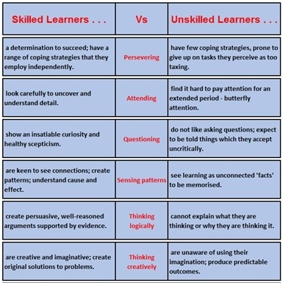
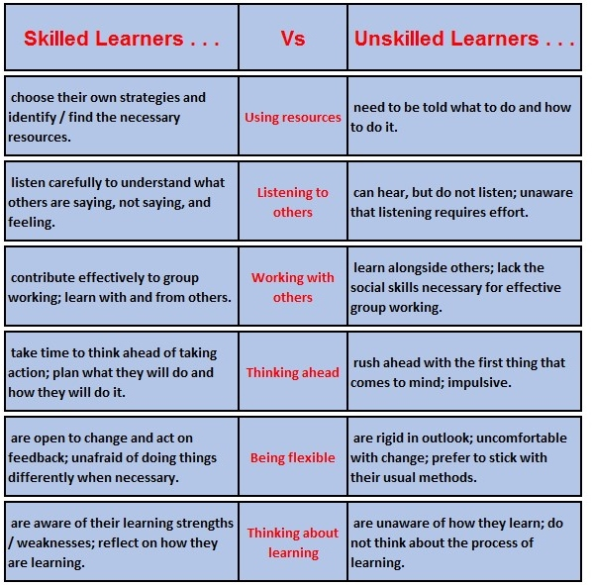
12 aspects of learning skills . . . .

Slide 3
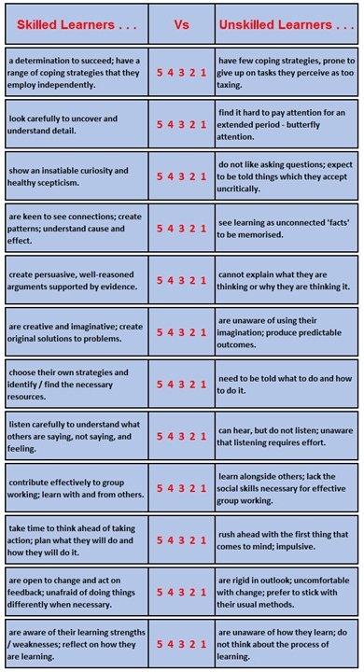
Table based discussion . .
How skilled are the majority of your learners?
[For the moment, forget about the ‘outliers’, the exceptional ones. Focus on the majority.]
For each of the 12 descriptors, agree and circle the number that best describes the majority of your learners.

Slide 4
Table based discussion . .
Be on the lookout for any interesting similarities or differences between year groups / subjects.
On which of these 12 aspects are learners closest to the left?
Closest to the right?

Slide 5
On a fresh sheet . .
Turn your focus to your higher attaining learners – what score would best describe them?
On a third sheet, repeat for your lower attaining learners – what score would best describe them?
Can you discern any links between levels of learning skill and attainment?

Slide 6
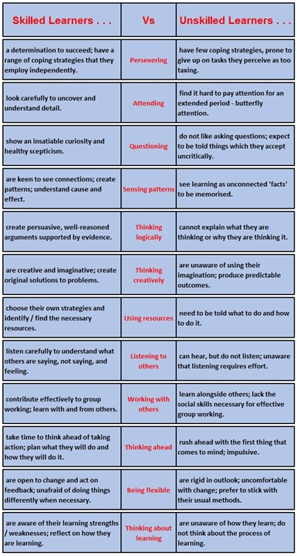
Distil your discussions
What have you learned about your students in terms of their learning behaviours?
What questions do you have about this?
What do you think we should do about this?

