Slide 1
Lesson Overview: Subject/phase – KS2/3
  Content
  To activate all of the senses to stimulate the imagination in advance of a creative writing activity
  Using VTRs
  What’s happening here? What makes you say that?
  What else might explain . .
  I used to think. Now I think.
  Learning behaviours –Imagining using all of the senses with patient noticing – in particular:
  Speculating on possibilities;
  Engaging the visual imagination;
  Engaging the aural imagination;
  Visualising from another perspective;
  Creating an imaginary storyline
Here is a dual focused introduction….a content objective alongside the learning behaviours the task will activate in pupils.
Notes:
Rough cut planning.
At this point, before you have thought hard about the outcomes and flow of the lesson, you are jotting down what the lesson will achieve....roughly what you want students to achieve and the learning behaviours they will need to use.

Slide 2
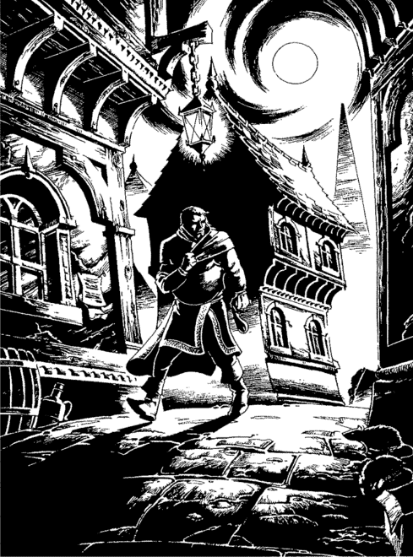



Episode 1 - What do you notice ?
Teacher talk
I want you to be nosey – what do you notice?
What did your partner notice?
Whose partner noticed something really interesting?
Who is already making up a story about what is happening here?
Good guy or bad guy?
Going towards something, or away from something?
Screen image
Teacher Action
Invite students to look at the image in silence, to notice something about it and to tell their neighbour what they have noticed.
Collect interesting things that have been noticed.
Ask who is already beginning to build a story around the image.
Use ‘what makes you say that?’ to encourage explanation.
Use ‘what else might explain that?’ to open up other possibilities.
Student Action
20 secs to study the image as an individual
1 minute to exchange what has been noticed with a partner
2 minutes sharing what has been noticed with the whole class..
Process encourages students to be patient in noticing detail, to share their thoughts with a partner, and to listen to what others have noticed.
Notes:
The ‘process encourages’ banner is critical – it is where the teacher identifies the precise learning
Behaviours needed for success in this particular learning episode
Once completed, it is possible to decide how the teacher will commentate so as to nudge, prompt support those behaviours (the teacher talk cloud)
2

Slide 3
Episode 2 - Turn up the colours
Teacher talk
Who can see any colours?
What can you see in colour?
Does anyone see xxx in a different colour?
Give me a bit more on that . . . .
Is it a dark red ? . . .
How would you describe the colour?.
Screen image
Teacher Action
Invite students to look at the image in silence, to ‘turn up the colours’ and see the image in colour.
Ask ‘who can see any colours?’
Explore which things can be seen in colour.
Student Action
20 secs to study the image ‘in colour’.
5 minutes to discuss as a whole class who can see colours, what they can see in colour, and what the colours are.
.
Process encourages students to engage their (visual) imaginations and to describe what they can ‘see’
Notes:
The ‘process encourages’ banner is critical – it is where the teacher identifies the precise learning
Behaviours needed for success in this particular learning episode
Once completed, it is possible to decide how the teacher will commentate so as to nudge, prompt support those behaviours (the teacher talk cloud)
3

Slide 4
Episode 3 - Turn up the sounds
Teacher talk
Who can hear sounds but could not see colours ?
How long is the sound ?
Was it broken or continuous?
Volume? Pitch?
What can you compare it to?
Screen image
Teacher Action
Invite students to look at the image in silence, to ‘turn up the sounds’ and listen to the image.
Ask ‘who can hear anything?’
Explore what can be heard.
Student Action
20 secs to ‘listen’ to the image.
5 minutes to discuss as a whole class who can hear sounds, and to describe what they can hear.
Process encourages students to engage their (aural) imaginations and to describe what they can ‘hear’.
Notes:
The ‘process encourages’ banner is critical – it is where the teacher identifies the precise learning
Behaviours needed for success in this particular learning episode
Once completed, it is possible to decide how the teacher will commentate so as to nudge, prompt support those behaviours (the teacher talk cloud)
4

Slide 5
Episode 4 - Jump into the picture
Teacher talk
Who would like to tell us where they chose to stand?
Where did you stand?
Did anyone else stand there?
Why there?
What can you see/ hear/ smell?
How do you feel?
What is the colour of / sound of / smell of. . . .
Screen image
Teacher Action
Invite students to look at the image in silence while they ‘jump into the image and stand somewhere’.
As they look in silence, ask quietly at 5 second intervals: ‘what can you see?’; ‘what can you hear?’; ‘What can you smell?’; ’ How do you feel?’
Ask ‘who would like to tell us where they chose to stand?’
Explore where they stood, why there, how they are feeling.
Student Action
30 secs to study the image as an individual.
Class discussion about where they chose to stand, why, what they could see, hear and smell, and how they feel.
Process encourages students to imagine themselves in a different situation and to describe their emotions as they do so..
Notes:
The ‘process encourages’ banner is critical – it is where the teacher identifies the precise learning
Behaviours needed for success in this particular learning episode
Once completed, it is possible to decide how the teacher will commentate so as to nudge, prompt support those behaviours (the teacher talk cloud)
5

Slide 6
Episode 5 - What is going on here ?
Teacher talk
Is he a goodie or a baddie ?
Is he walking towards something, or away from something.
What has he got in his left hand ?
Why the look over the shoulder ?
What's on the paper on the wall of the building to the left ?
Who has heard an interesting story?
Screen image
Teacher Action
Invite students to look for one minute at the image.
What is going on here ? What is the / your story ?
Nudge their thoughts with the teacher talk as they think
1 minute to tell their story to their neighbour.
Finally conduct another whole class discussion – who has heard a really interesting explanation for what is going on here?.
Student Action
1 minute silence to build an interesting, credible story line.
1 minute to exchange their story with a partner.
5 minutes sharing ‘stories’ with the whole class.
Process encourages students to distil their thoughts and to describe a plausible story line for what is happening in the image, drawing on their own imaginations and the imaginations of others.
Notes:
The ‘process encourages’ banner is critical – it is where the teacher identifies the precise learning
Behaviours needed for success in this particular learning episode
Once completed, it is possible to decide how the teacher will commentate so as to nudge, prompt support those behaviours (the teacher talk cloud)
6

