Slide 1
Lesson Overview: Subject/phase – KS2/3
  Content
  To employ and then reflect on a wide range of learning behaviours that are used to solve a Mystery Accident.
  Using VTRs
  Think Puzzle Explore
  What’s happening here? What makes you say that?
  What else might explain . .
  I used to think. Now I think.
  Headlines
  Think Pair Share
  Learning behaviours – The lesson intentionally encourages a very wide range of learning behaviours, sometimes by the tasks (ie writing a headline – Distilling) or how the learning is organised (ie pairs to fours – Collaboration).
Here is a dual focused introduction….a content objective alongside the learning behaviours the task will activate in pupils.
Notes:
Rough cut planning.
At this point, before you have thought hard about the outcomes and flow of the lesson, you are jotting down what the lesson will achieve....roughly what you want students to achieve and the learning behaviours they will need to use.

Slide 2

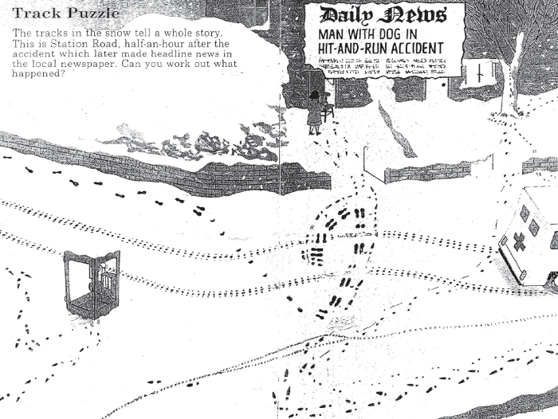
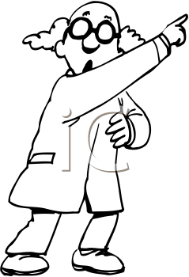

Episode 1 How might we set about solving the Mystery Accident?
Teacher talk
What do you think you already know about this scene?
What is puzzling you?
How might you tackle this problem?
What can you be sure of?
What don’t you get?
How might you start?
What would you do next?
Screen image
Teacher Action
Issue a copy of the picture to each student.
Explain - there has been a hit and run accident. The challenge is to find out what has happened by looking at the tracks in the snow.
Organise students to work in pairs
Ask What do you Think you know about this? What is puzzling you?
Collect their ‘puzzles’ and display for later reference.
Move to 4’s - ‘How do you plan to Explore the problem?
Student Action
Pairs 1 minute to discuss what they know about a snow scene like this.
Pairs 2 minutes to identify things they do not yet understand.
Fours 2 minutes to take stock and consider how they might tackle the problem
.
.
Process encourages students to make links to what they already know, consider and contribute what they do not yet understand, and to begin to decide on a strategy for solving the mystery.
Notes:
See the notes online relating to these Episodes for detail on how you might conduct the conversations.
2

Slide 3
Episode 2 How many people and animals are involved?
Teacher talk
What can we be sure of?
It could be a cat . . . . .
What is the maximum possible number of characters?
.Some people might say...
On the other hand...
Screen image
Teacher Action
Challenge 4’s to list the people and animals involved.
Orchestrate whole class discussion to agree a list of characters.
Use ‘Could be’ language to encourage speculation.
Agree what is known for certain, and where there is room for doubt.
.
Student Action
In 4’s – 1 minute to list the people and animals involved.
Whole class – 1 minute to discuss and agree a list of the people involved
.
Process encourages students to notice detail and use their reasoning and speculation skills in order to arrive at a list of characters involved
Notes:
See the notes online relating to these Episodes for detail on how you might conduct the conversations.
3

Slide 4
Episode 3 Where does the story begin?
Teacher talk
What happens before the hit and run accident?
Who is the first person to arrive?
What can the man and dog see as they first enter the scene?
What makes you say that?
What is the evidence for . . .
How do you know that for sure?
Screen image
Teacher Action
Ask the question – ‘Where does the story begin?’
Lead whole class discussion to agree where the action begins.
Use Think/Pair/Share to explore ‘What can the man and dog see as they first enter the scene?’
Student Action
2 minutes to contribute to a whole class
discussion relating to where the action begins.
2 minutes to T/P/S what the man can (and cannot) see.
.
Process encourages students to use their reasoning skills to decide where the action begins and imagining skills to visualise what can and cannot be seen at this point.
Notes:
See the notes online relating to these Episodes for detail on how you might conduct the conversations.
4

Slide 5
Episode 4 Can you tell the story, from beginning to end?
Teacher talk
How long will you need?
Who thinks they can explain what happened?
What do you see that makes you say that?
Might be . . . .
Do you need to re-think your story in light of . . .
(How) can we agree what happened?
Screen image
Teacher Action
Organise pairs or fours to ‘Build your explanation of how the events unfold”.
Ask them to estimate how long they will need for this.
Listen to emerging ideas and offer hints only when necessary.
Organise whole class discussion to share ideas and arrive at a class consensus.
Student Action
Pairs 1 Minute to discuss and agree how long they will need (X minutes)
Pairs/Fours X Minutes to discuss and agree a storyline.
Whole class 5 minutes to contribute ideas to a whole class discussion seeking to agree a story line.
.
Process encourages students to use a range of learning behaviours to think ahead of taking action, to notice detail to collect and link evidence to sequence the events into a plausible story line, to contribute to building an agreed narrative, and to revise their ideas as they listen to the ideas of others.
Notes:
See the notes online relating to these Episodes for detail on how you might conduct the conversations.
5

Slide 6
Episode 5 Imagine you are a reporter . . . .
Teacher talk
What would you like to ask . .
Which are your best three questions?
What are you hoping to find out?
Are your questions closed or open?
Which questions got the most interesting, unexpected responses?
Screen image
Teacher Action
Announce - You are a reporter having to write a piece about the accident.
Organise pairs to plan three questions they wish to ask xxxx character
.
Swap the three questions with another pair, who have to answer as if they were that character..
Reverse the Q&As
Whole class discussion – who received an answer that they were not expecting?
Student Action
2 minutes to plan three questions
2 minutes to answer the three questions framed by another pair
1 minute to review the answered questions and identify any surprises.
.
Process encourages students to plan and distil the questions they would like to ask from the perspective of a reporter, to answer the questions of another pair using their empathy skills, and to consider which questions best elicited the required / useful / surprising information.
Notes:
See the notes online relating to these Episodes for detail on how you might conduct the conversations.
6

Slide 7
Episode 6. Can you write the Headline and First Paragraph of your newspaper report?
Teacher talk
What are the key ideas?
How will you grab the attention of the reader?
What makes this a successful report?
What do these successful reports have in common?
Screen image
Teacher Action
Orchestrate pairs to create 1st paragraph and headline of the newspaper article.
Move to 4’s to share.
Organise whole class discussion around the most successful attempts and what they shared in common.
Student Action
Pairs 5? minutes to write the Headline and first paragraph of the newspaper report.
4’s to share headline/report
Nominate a report that should be heard by the whole class
.
Share examples
.
Discuss why it was rated as successful.
Process encourages students to use their imagination to distil their ideas into a report, to evaluate the quality of others’ efforts, and to make links to establish the common features of the best reports.
Notes:
See the notes online relating to these Episodes for detail on how you might conduct the conversations.
7

Slide 8
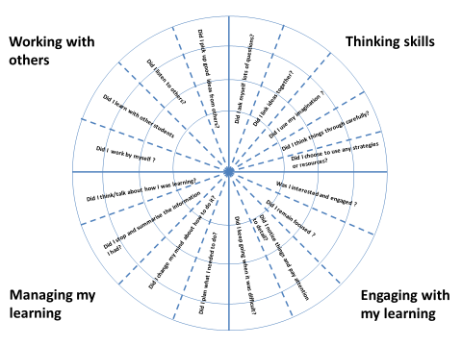
Episode 7 Which learning behaviours did you use in solving this mystery?
Teacher talk
At which point in the lesson did you . . . .?
Which did you do most/least of?
Which was most productive in solving the problem?
What would an ordinary day at school look like in terms of the wheel?
Which do you think you are particularly good/weak at?
Screen image
Teacher Action
Explain wheel and how to colour in.
Give each pupil a copy of the Rating Wheel
Organise pairs to compare and contrast, and adjust if required.
Encourage further reflection on learning behaviours used in other lessons
Encourage individual reflection on learning strengths and relative weaknesses.
Student Action
5 minutes quiet, individual reflection on the extent to which each of the learning behaviours were exercised during the lesson.
In pairs, share with partner and explain colouring in.
Individuals change their colouring in light of partner’s views if necessary.
Group reflection – what is learning usually like?
Individual reflection time – which learning behaviours are my personal strengths and weaknesses?
.
Process encourages students to engage in thinking about and talking about the learning behaviours that they have been using in solving the Mystery, in general in lessons, and to reflect on their personal strengths and weaknesses.
Notes:
See the notes online relating to these Episodes for detail on how you might conduct the conversations.
8

