Slide 1
Lesson Overview: Subject/phase – KS2/3
Content
To practise using the See Think Wonder visible thinking routine, applying it to images related to the Fire of London
Using VTRs
See Think Wonder
What’s happening here? What makes you say that?
What else might explain . .
I used to think. Now I think.
Learning behaviours – Noticing as a springboard into Reasoning, Imagining and Questioning – in particular:
Attention to detail;
Describing what has been Noticed;
Explaining what has been Noticed;
Raising Questions about what has been Noticed.
Here is a dual focused introduction….a content objective alongside the learning behaviours the task will activate in pupils.
Notes:
Rough cut planning.
At this point, before you have thought hard about the outcomes and flow of the lesson, you are jotting down what the lesson will achieve....roughly what you want students to achieve and the learning behaviours they will need to use.

Slide 2

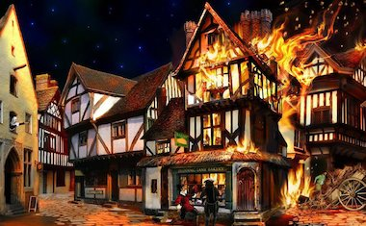
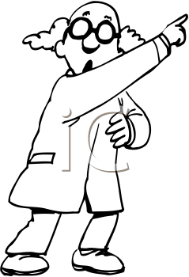

Which bit of the painting shows . . . . . ?
Teacher talk
Tell me what you can see
Put the viewing frame over . . .
Why did you choose that?
Which alternatives did you consider?
Screen image
Teacher Action
Give out viewing frames and copy of the image.
Challenge individuals to put their frame over the part of the image typifying certain aspects.
Orchestrate table based and then whole class conversations about who chose which part of the image.
Probe the extent to which students have noticed detail beyond that to which they have been alerted.
Student Action
Use viewing frames to support noticing detail and saying what they see.
Share ideas with others and with the whole class..
Consider how the viewing frame has helped them to notice detail beyond that is required of them
.
Process encourages students to look carefully and to describe what they can see to others and the whole class
Notes:
See the notes online relating to these 3 Episodes for detail on how you might conduct the conversations.
2

Slide 3
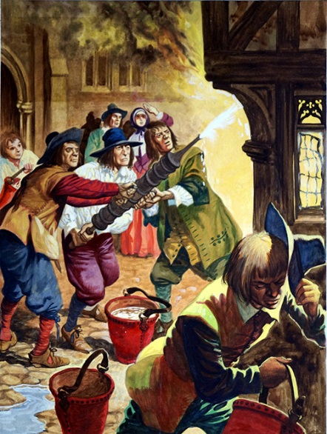
What do you think about . . . ?
Teacher talk
What are you noticing?
What do you think about it?
What makes you say that?
What else might explain . . .
If it’s not that, then . . .
Screen image
Teacher Action
Explain that students need to make two part responses – what they see and what they think about it.
Model the routine See/Think using the first highlighted image.
Invite pairs to do See/Think on highlight 2 Lead whole class discussion using See and Think only..
Repeat for highlights 3/4/5.
Repeat for the whole image.
Student Action
1 minute in pairs to do See/Think using highlight 2.
I minute contributing to whole class discussion.
Repeat for highlights 3/4/5 and the whole image.
Process encourages students to Notice detail and offer explanations about what they have Noticed using a blend of hypothesis and speculation
Notes:
The powerpoint slide showing the highlights referred to in the lesson notes follows this slide.
3

Slide 4
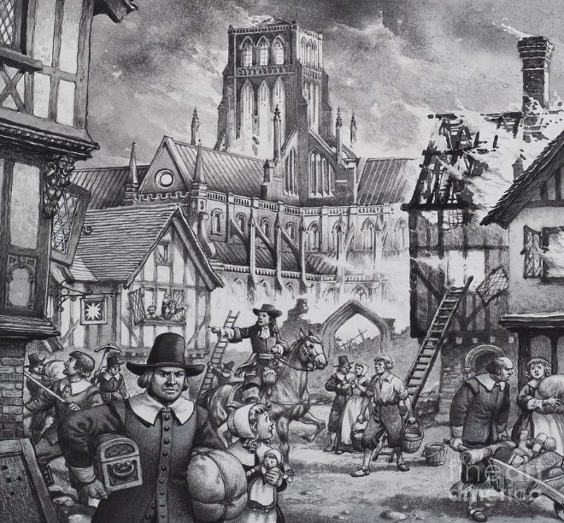
What can you See, what does it make you Think, what does it make you Wonder ?
Teacher talk
What are you noticing?
Where do you think he is going?
What is he doing?
What would you like to ask him?
What is still puzzling you?
Screen image
Teacher Action
.
Explain that student responses need to be three part – See, Think and Wonder.
Model the routine See/Think/Wonder using the first highlighted image.
Invite pairs to do See/Think/Wonder on highlight 2.
Lead whole class discussion using See, Think and Wonder..
Repeat for highlights 3/4/5.
Repeat for the whole image.
Student Action
1 minute in pairs to do See/Think/Wonder using highlight 2.
I minute contributing to whole class discussion.
Repeat for highlights 3/4/5 and the whole image.
Process encourages students to attend to detail, to say what they think about what they can see and to raise questions about what they have noticed.
Notes:
The powerpoint slides illustrating two ways of structuring the S/T/W routine follow this slide.
4

Slide 6

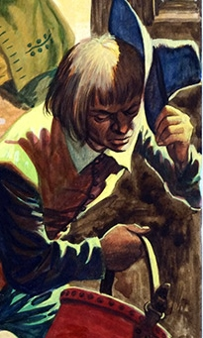
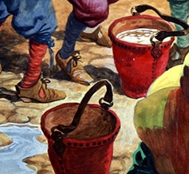




Slide 7
