Slide 1
Lesson Overview: Subject/phase – KS2/3
  Content
  To re-think what is happening in the picture as different aspects come into view as a prelude to a module of work on Terrorism.
  Using VTRs
  What’s happening here? What makes you say that?
  See, think, wonder
  I used to think. Now I think.
  Learning behaviours – Revising with reasoning, imagining and linking – in particular:
  Speculating on possibilities
  Considering changing perspectives
  Noticing with Empathy
  Making inks with prior knowledge
  Distilling and asking questions to deepen understanding.
Here is a dual focused introduction….a content objective alongside the learning behaviours the task will activate in pupils.
Notes:
Rough cut planning.
At this point, before you have thought hard about the outcomes and flow of the lesson, you are jotting down what the lesson will achieve....roughly what you want students to achieve and the learning behaviours they will need to use.

Slide 2

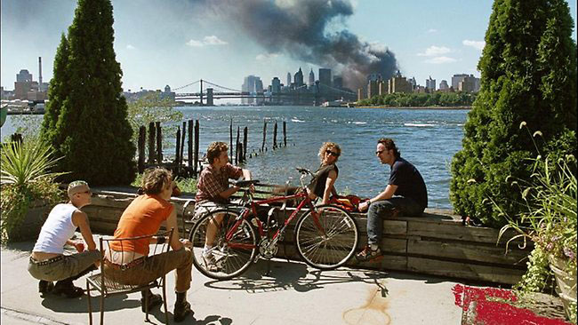


How this layout works
Teacher talk
How you will nudge the learning along through talk in each episode of the lesson.
It is the teacher talk that is the key to learning. The level and content of your nudges will the linked to the;
Learning behaviours to be used
The level (row) you are concentrating on
The content that is being brought to life in the task
WHW
Screen image
Teacher Action
The actions you as a teacher will undertake in each episode of the lesson...the role you will play
Student Action
The actions the students will undertake in each episode of the lesson
The actual behaviours you are calling up/activating in students in each episode to enable them to understand content by practising
Notes:
How it all works.
This slide shows how this format for planning works. It helps to decide things in this order
1 the screen image...what am I going to show the students? Info, pictures. Instructions etc
2 Teacher action...what am I going to do in each episode?
3 Student action...what will the students be doing
4 What sort of learning will be happening? The ‘process encourages’ banner is critical – it is where the teacher identifies the precise learning
behaviours needed for success in this particular learning episode
Once completed, it is possible to decide how the teacher will commentate so as to nudge, prompt support those behaviours (the teacher talk cloud)
5 Teacher talk...what will I say to encourage, support , challenge students to make sense of things.
2

Slide 3
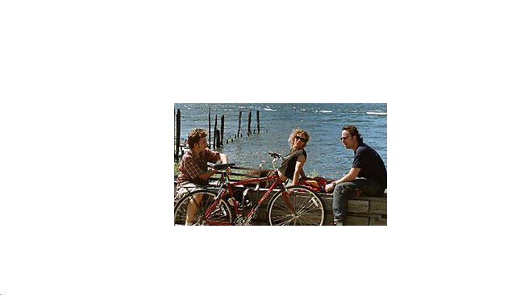
Episode 1 What’s going on here ?
Teacher talk
What are you noticing? What is happening here? When is this happening? What decade are we in? Where are we? What is the weather like? What makes you think/say that?
Screen image
What’s going on here ?
Teacher Action
Use Think Pair Share
to encourage students to explore the (partial) image and glean as much as they can from this view.
Probe pairs and groups to speculate on what might be happening.
Use ‘what makes you say that’ to provoke explanation.
Student Action
1 minute to view image in silence, noting significant detail
2 minutes to pair with a talk partner to discuss
4 minutes in a group of 4 to agree answers to the teacher talk questions and to explain their thinking.
Process encourages students to notice detail, speculate on possibilities and to explain their ideas to each other.
Notes:
3

Slide 4

Episode 2 What does this add to your thinking?
What does this add to your thinking?
Teacher talk
To what extent does this confirm your first thoughts?
What more is this telling us?
Does this change what you were first thinking?
Any new / further ideas?
Screen image
Teacher Action
Reveal next part of the image
Asks groups to discuss whether this confirms or changes their initial impressions.
Student Action
In 4’s, students discuss how this confirms what they first thought, and
how this new information is forcing any slight change of view.
Process encourages students to change(revise) their outlook in light of new information.
Notes:
The ‘process encourages’ banner is critical – it is where the teacher identifies the precise learning
Behaviours needed for success in this particular learning episode
Once completed, it is possible to decide how the teacher will commentate so as to nudge, prompt support those behaviours (the teacher talk cloud)
4

Slide 5

Episode 3 What could be going on here?
Teacher talk
What’s going on here?
Is the weather changing?
Is the weather getting worse, or getting better?
What else could explain this?
Screen image
What could be going on here?
Teacher Action
Reveal third part of the image
Use ‘could be’ language to draw out a range of possible explanations.
Encourage peculation rather than explanation.
Student Action
discuss possible alternative explanations for the cloud formation.
Process encourages students to speculate (and listen ) about a range of possibilities
Notes:
The ‘process encourages’ banner is critical – it is where the teacher identifies the precise learning
Behaviours needed for success in this particular learning episode
Once completed, it is possible to decide how the teacher will commentate so as to nudge, prompt support those behaviours (the teacher talk cloud)
5

Slide 6

Episode 4 What’s going on here?
What’s going on here?
Teacher talk
(How) Are these people related?
How might they be feeling? Relaxed? Happy?
Are they related to the first image we saw?
What might they be looking at?
What makes you say that?
Screen image
Teacher Action
reveal the fourth part of the image.
shift the focus from looking at the scenery to considering the feelings / motives of people in the image..
Student Action
2 minutes to consider in 4’s who these two people are
Speculate on how they are feeling.
Process encourages students to use their noticing and empathy skills to speculate on the relationships
Notes:
The ‘process encourages’ banner is critical – it is where the teacher identifies the precise learning
Behaviours needed for success in this particular learning episode
Once completed, it is possible to decide how the teacher will commentate so as to nudge, prompt support those behaviours (the teacher talk cloud)
6

Slide 7
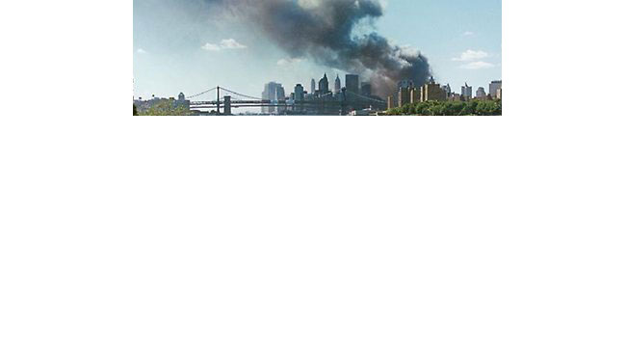
Episode 5 How does this change your thinking?
How does this change your thinking?
Teacher talk
How does this change your thinking?
What misled you initially?
What did you used to think?
What do you now think?
What made the penny drop?
Screen image
Teacher Action
Reveal the fifth part of the image (the bit that reveals the burning twin towers.)
Nudge students to make the links for themselves, or offer supportive hints if necessary.
Use ‘I used to think, . . . but now I think’ to help students to capture their change of outlook.
Student Action
2 minutes to discuss how this image adds to what they already know, and how it changes their first impressions.
In 4’s, 2 minutes to write a response to:
We used to think . . . .
But now we think . . . .
Process encourages students to make links to what they already know in order to understand what is going on in the image, and challenges them to refine their initial thinking in light of this..
Notes:
The ‘process encourages’ banner is critical – it is where the teacher identifies the precise learning
Behaviours needed for success in this particular learning episode
Once completed, it is possible to decide how the teacher will commentate so as to nudge, prompt support those behaviours (the teacher talk cloud)
7

Slide 8
Episode 6 What do you see, what do you think, what do you wonder?
Teacher talk
Now that you can see the whole image:
What are you noticing?
What are you thinking?
What questions would you like to ask the people in the image?
How do you think they would answer?
Screen image
Teacher Action
Reveal full image
Use See/ Think /Wonder help students to explore it.
Scaffold student responses step by step, or use the see/think/wonder strategy if students are already aware of it.
Organise class to agree best S/T/W’s.
Groups to speculate on the answer to these best 3 ‘wonders’
Student Action
2 minutes to decide on their best see/think/wonder
share with the other 4’s.
Whole class agree the best 3 S/T/W’s.
4’s to discuss possible answers to the ‘wonders’.
Process encourages students to distil their thinking, to reflect on how additional information frequently forces a change of perspective, or gives rise to a further range of questions.
Notes:
The ‘process encourages’ banner is critical – it is where the teacher identifies the precise learning
Behaviours needed for success in this particular learning episode
Once completed, it is possible to decide how the teacher will commentate so as to nudge, prompt support those behaviours (the teacher talk cloud)
8

