Slide 1
Lesson Overview: Subject/phase – KS2/3
  Content
  To select the most useful items to enable a group to survive in a desert.
  Learning behaviours – Collaboration with reasoning and linking – in particular:
  Agreeing goals
  Building ideas
  Dealing with disagreement
  Reflecting on contribution
  Evaluating group action
Here is a dual focused introduction….a content objective alongside the learning behaviours the task will activate in students.
Notes:
Rough cut planning.
At this point, before you have thought hard about the outcomes and flow of the lesson, you are jotting down what the lesson will achieve....roughly what you want pupils to achieve and th learning behaviours they will need to use.

Slide 2

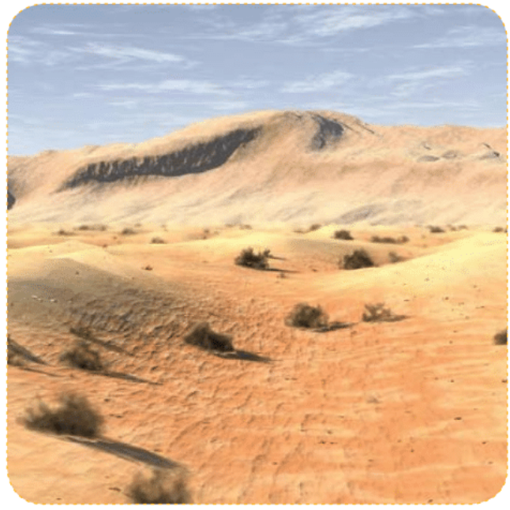
7
Episodes. Different learning functions in the lesson
Teacher talk
How you will nudge the learning along through talk in each episode of the lesson.
It is the teacher talk that is the key to learning. The level and content of your nudges will the linked to the;
Learning behaviours to be used
The level (row) you are concentrating on
The content that is being brought to
life in the task
Teacher Action
The actions you as a teacher will undertake in each episode of the lesson...the role you will play
Student Action
The actions the students will undertake in each episode of the lesson
The actual behaviours you are calling up/activating in students in each episode to enable them to understand content by practising
Notes:
How it all works.

Slide 3
7
Episode 1. Setting up the learning challenge
Teacher talk
Our group rules apply in this lesson
Take turns
Share your own ideas and listen to each other
Respect each other’s views and opinions
What are you noticing ?
Has everyone understood it ?
Perhaps you might need to read it again
to be sure you have not missed anything
Screen image
Your challenge is to …
Make sure that your group survives in the desert. You managed to grab twelve items when escaping from the minibus.
Rank the items according to their importance to your survival (you have 30 mins)
1 = Most important
12 = least important
Teacher Action
Set up groups of 5-6 students. Ask for volunteer observers.
Give groups the learning challenge (R1)
Allow groups time to read and digest
[While group is reading the challenge, brief the observers] R9
Pose the question – What is the first thing you will need to do?
Student Action
Groups of 5 plus one observer
5 minutes to read and discuss the learning challenge
2 minutes to consider what is the first thing that needs to be done
Call up/activate students’ learning capacity to notice detail and to share ideas and listen carefully

Slide 4
8
Episode 2. Possible survival strategies.
Screen image
How are you going to survive?
What are the possibilities?
Can you come up with three possibilities?
Teacher talk
Challenge
What might you do?
What else?
Are there any other possibilities?
Team work
Have you all had a turn
That’s a good idea
What might happen if …
Teacher Action
Conduct class discussion to bring out the fact that the items cannot be ranked until the group have decided what they will be doing in order to survive
Issue the challenge to find at least 3 possible strategies for survival.
Student Action
Class discussion
3mins - Contribute to class discussion to identify the first steps in the process
Group discussion
5 minutes to generate possible strategies
Call up/activate students’ capacity to share their views, listening and reasoning in order to build on others’ ideas / relevant comments.

Slide 5
5
Episode 3. What should we do?
Teacher talk
How will you decide on your strategy ?
What decision-making process is best here ?
What could you do if you disagree ?
Are you willing to change your views?
Are you all convinced that is the best course of action ?
What might go wrong ?
Will this ensure your survival ?
Screen image
Decide on your survival strategy
Teacher Action
Nudge groups to decide on how they intend reaching agreement, and what they will do if they cannot agree.
Nudge groups to think carefully about their preferred strategy, suggesting possible pitfalls to encourage them to rethink / refine their strategy.
Student Action
Groups
5 minutes to discuss and agree which strategy for survival they will adopt
Call up/activate setting an agreed goal. Using reasoning. Dealing with controversy

Slide 6
12
Episode 4. What do we need [most]?
Screen image
Which of the items
will you need?
How will you use them?
Can you rank their importance?
Teacher Talk
Which items will you need ?
How will you use them ?
Why is this item important?
What might happen if you used x. item?
Have you overlooked anything ?
Are you still convinced that this is your best
chance of survival ?
Can you now rank the items from 1-12?
Teacher Action
Nudge groups to begin the ranking activity – which items will be most useful ?
How will they be used ?
Student Action
Groups
10 minutes to decide which items will be necessary for their chosen strategy and to detail how they will use them.
2 minutes to complete the 1-12 ranking
Groups must have a ranked list by the end of this episode.
Call up/activate Prioritising action and foreseeing obstacles.(planning) Making good decisions to reach the goal. Revising their ideas.

Slide 7
3
Episode 5. How did I do?
Teacher talk
None required
Screen image
Think about
how well you contributed to the group decisions
Teacher Action
Give out resource 3 – Post-decision Questionnaire.
Intervene to support individuals as necessary
Student Action
Individually
3 minutes for individuals to complete the post-decision questionnaire.
Call up/activate students’ capacity to reflect on their individual contribution/feelings

Slide 8
6
Episode 6. How well did we do as a team?
Screen image
How well did we perform as a team?
What did the observers see?
Teacher talk
What helped the group to be successful ?
What hindered you ?
How might you deal with this next time ?
Which behaviours are essential for successful group working ?
How did you overcome disagreement?
Did you look for enough reasons for
your decisions?
Teacher Action
Set up the episode
Intervene to support observers as necessary.
Nudge groups to consider how they might behave differently next time they work as a team.
Student Action
Groups
3 minutes for observers to feed back to the group the collaboration behaviours that they recorded during the activity
3 minutes discussion – how could we have been more effective as a group ?
Call up/activate students’ ability to accept feedback on team performance and draw warranted conclusions, to reflect on their performance as a group

Slide 9
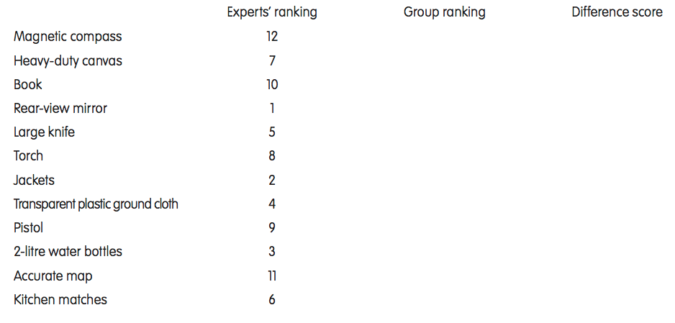
6
Episode 7. What the experts say
Screen image
What do the survival experts say?
Teacher talk
Do you agree with the experts ?
How close were you?
What would have helped you get closer?
What is the most important aspect of the expert solution ?
Did you think of something that you missed ?
Might their ‘answer’ not work ?
What have you learned about working
together as a team?
Teacher Action
Resource – The answer sheet
Offer the survival experts’ solution to the Stranded challenge.
Student Action
Groups
3 minutes for groups to compare and contrast their solution with the expert version.
3 minutes to consider what they could have done differently.
Call up/activate students’ learning capacity to reassess their ideas and re- draw warranted conclusions if necessary.
Notes:
9

