Slide 1
Lesson Overview: Using the Ted Talk ‘How to get better at the things you care about’ to listen for different purposes
Content
The teacher has identified some content that is to be acquired, and that students will need to listen to carefully to understand it.
Here the content is offered through a Ted Talk, but it could simply be some teacher exposition – anything that requires attentive listening.
Learning behaviours – The lesson intentionally encourages listening for different purposes, and also nudges learners to:
Make links to prior knowledge;
Distil key points;
Paraphrase/summarise;
Frame questions.
Notes:
Here is a dual focused introduction….but not one that we complete just yet. You have already identified the content, you intend to use Jigsaw Listening to help students to access spoken information, but the remainder will be filled in after the individual Episodes are planned.

Slide 2

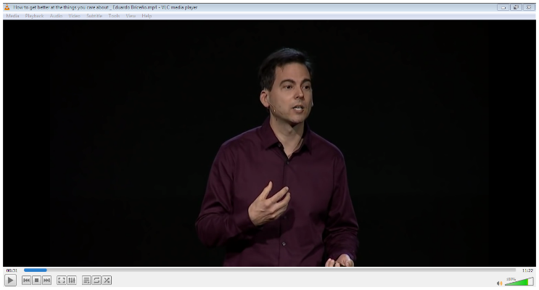
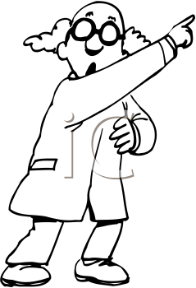

Episode 1: Listening to engage with the message
Ask yourself
Does this sound interesting?
What is immediately striking a chord with me?
Might I be able to apply these ideas in my own life, professional or otherwise?
Do I want to know more?
Screen image
Organising this episode
Ted Talk: 0.00 to 2.06 mins
Listen to the first 2 minutes only.
What you do
Listen to the first 2 minutes of the talk with the following in mind –
do I find this subject matter of interest?
does the premise sound plausible?
do I want to know more?
You listen to the introduction to gauge your interest, the relevance and to engage with the ideas being presented
Notes:
2

Slide 3
Episode 2: Listening to the ideas as presented
Ask yourself . .
What did I already know?
What didn’t I know before?
What’s new?
How does it link to current understanding?
Similarities and differences
What’s the big idea?
What is important?
Screen image
Organising this episode
Listen to Ted Talk: 2.06 to 5.33 mins
What you do
Listen to the next 3.5 mins minutes of the talk with the following in mind –
What new ideas are there?
What do these ideas link to in what I know
What didn’t I know before?
You listen to identify new information, make links to what you already know, and distil the key messages
Notes:
3

Slide 4
Episode 3: Listening to summarise the key ideas
Ask yourself
What would I tell someone else about this section?
how does it link to what I already know?
How would I say that in my own words?
Can I summarise this?
What is the main point?
Screen image
Organising this episode
Listen again to the Ted Talk: 2.06 to 5.33 mins
What you do
Listen again to the 3.5 mins minutes of the talk with the following in mind –
If I had to explain this section to a colleague, what would I say?
You listen to notice and distil the key points, and summarise them in your own words
Notes:
4

Slide 5
Episode 4: Listening to ask questions and seek clarification
Ask yourself . .
What’s new?
What are the big ideas?
What do I want to know more about?
What is bugging me? .
Screen image
Organising this episode
Listen to the Ted Talk: 5.33 mins to the end.
What you do
Listen to the remainder of the Ted Talk, and practise what you have done thus far in terms of listening for new information/facts and listening for the main points/ key ideas.
Additionally listen with the intention of framing questions that you would like to ask Eduardo, should you have the opportunity.
You listen in order to garner information, to distil key ideas and to identify what you still need to find out
Notes:
5

Slide 6
Episode 5: Listening to consider the beliefs of the speaker and for the implications of what he is saying
Ask yourself . .
So what?
Does this make sense to me?
What’s the big idea?
What does Eduardo believe?
Why is he saying this?
What are the implications for the way I organise my classroom?
What are the implications for the way I practise the craft of teaching?.
Screen image
Organising this episode
Listen again to the whole Ted Talk from start to finish.
i
What you do
Listen to the talk from start to finish..
Feel free to pause it or re-wind if you find it helpful.
Focus this time on listening for 2 new things:
What are Eduardo’s motivations, values and beliefs?
What are the implications for my professional practice?
You listen for key messages, for the intentions and beliefs of the speaker, and for the implications of what you hearing
Notes:
6

