Slide 2

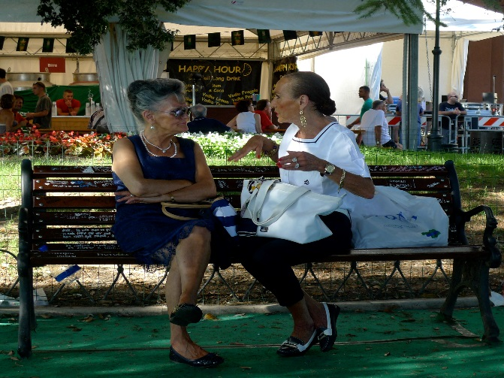


What time of day is this ?
Teacher talk
What makes you say that ?
Can you give me a bit more on why you think . . .
Convince me
How can you be sure
What do we know for certain about the time of day ?
Screen image
Teacher Action
Use Think Pair Share to encourage students to explore the image with a view to deciding what time it is.
Use ‘What makes you say that?’ to encourage students to offer explanations rather than opinions.
Conduct class discussion to explore hypotheses.
Conduct class discussion about how the question cannot be answered for certain.
Student Action
1 minute in silence to consider the evidence
1 minute to explain to a partner what they are thinking and why.
5 minutes whole class discussion.
2 minutes to debate whether there is sufficient evidence to answer the question ?
Process encourages students to hypothesise, with very little evidence on which to base the hypothesis, to explain their thinking to others, and to understand that the evidence is insufficient to answer the question. .
Notes:
The ‘process encourages’ banner is critical – it is where the teacher identifies the precise learning
Behaviours needed for success in this particular learning episode
Once completed, it is possible to decide how the teacher will commentate so as to nudge, prompt support those behaviours (the teacher talk cloud)
2

Slide 3
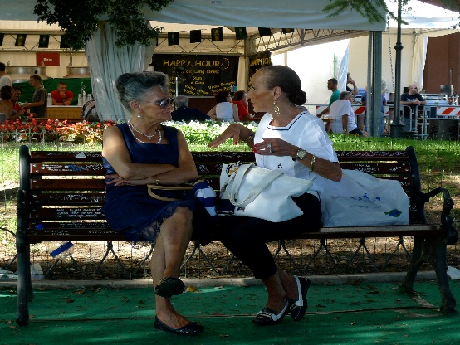
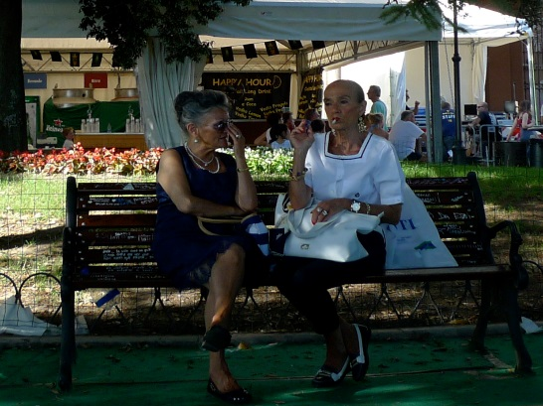
Spot the differences and similarities
Teacher talk
What are you noticing?
What is still the same?
What are the differences?
Anyone else spot that?
Which differences are most important?
Least important? On what grounds?
Screen image
Teacher Action
Again use Think Pair Share to encourage students to identify differences and similarities.
Ask pairs to share the differences they have noticed.
Ask if anyone has a difference that nobody else has noticed?
Record / gallery differences / similarities arising from the discussion.
Student Action
1 minute to study the 2 images.
2 minutes to share similarities and differences with a partner.
2 minutes class discussion to collate the outcomes.
Process encourages students to be patient to notice similarities, differences and obscure differences, to share their ideas with others, and finally to contribute their ideas to a class list of similarities and differences.
Notes:
The ‘process encourages’ banner is critical – it is where the teacher identifies the precise learning
Behaviours needed for success in this particular learning episode
Once completed, it is possible to decide how the teacher will commentate so as to nudge, prompt support those behaviours (the teacher talk cloud)
3

Slide 4
Which photo was taken first ?
Teacher talk
What is and is not important?
What is your evidence for . . ?
Is it possible to decide this?
What do we know – for certain How is that different from what we think we know?
Screen image
Teacher Action
Organise table based discussion – which similarities and differences are most important/relevant here?
Lead whole class debate on which image came first.
Lead whole class discussion on whether there is sufficient evidence to make a definitive decision, leading in to a discussion about what we really do know.
Student Action
1 minute to discuss on tables which differences are most important.
2 minutes to debate which image comes first.
2 minutes to decide on whether there is sufficient evidence to answer the question
1 minute to reflect on what we do KNOW about the 2 images.
Process encourages students to rank the evidence in order of importance, to debate with others, to present their reasoning in order to convince, and finally to reflect on whether the evidence is sufficient to draw warranted conclusions.
Notes:
The ‘process encourages’ banner is critical – it is where the teacher identifies the precise learning
Behaviours needed for success in this particular learning episode
Once completed, it is possible to decide how the teacher will commentate so as to nudge, prompt support those behaviours (the teacher talk cloud)
4

Slide 5
What time elapsed between the two images
Teacher talk
What is most important here?
Does changing the question change the importance?
What is your point? What is the evidence for that? What does that tell us? (PEE)
How might we resolve this?
Screen image
Teacher Action
Organise table based discussions on:
a) relative importance of the evidence;
b) the elapsed time
Lead whole class discussion to weigh the evidence and counter evidence.
Student Action
1 minute on tables to consider whether the important similarities and differences in Episode 3 are still the important ones now that the question has changed.
3 minutes to discuss and decide on the time elapsed.
2 minutes to debate and hopefully come to a class consensus. Or not !
Process encourages students to identify key evidence and counter evidence; to present their logical arguments others; to consider the arguments of others in reaching a consensus.
Notes:
The ‘process encourages’ banner is critical – it is where the teacher identifies the precise learning
Behaviours needed for success in this particular learning episode
Once completed, it is possible to decide how the teacher will commentate so as to nudge, prompt support those behaviours (the teacher talk cloud)
5

Slide 6
Within what time window were these two images taken ?
Teacher talk
What lead you to think that?
Which bits of evidence did you find most compelling?
Who thinks differently?
Can we come to a consensus on this?
Do we buy this?
What is our best guess?
Screen image
Teacher Action
Organise 4’s to discuss and agree, with evidence, their proposed ‘time window’.
Organise 8’s to debate and agree.
Lead whole class discussion to explore the arguments and counter arguments.
Student Action
2 minutes for each table to agree their preferred time window, based on all of the evidence.
2 minutes for 4’s to become 8’s with a view to agreeing their collective answer.
1 minute to explore differences and counter arguments.
Process encourages students to reach consensus through reasoned argument; to present their reasoning; to reconsider their line of thinking in light of others’ arguments.
Notes:
The ‘process encourages’ banner is critical – it is where the teacher identifies the precise learning
Behaviours needed for success in this particular learning episode
Once completed, it is possible to decide how the teacher will commentate so as to nudge, prompt support those behaviours (the teacher talk cloud)
6

Slide 7

What have we learned about Reasoning ?
Teacher talk
What do we know now that we did not know before?
What is the single most important thing we have learned about Reasoning today?
Imagine a world without Reasoning . . .
Screen image
Teacher Action
Organise pair reflection time on what has been learned about reasoning.
Enable students to collate post its in a gallery
Help students to distil their learning about Reasoning.
Produce a display to distil what has been learned about Reasoning..
Student Action
2 minutes in pairs to reflect on and share what has been learned about reasoning.
1 minute to write on 2 post its two things that they have learned about reasoning.
1 minute to gallery their post its and consider what others have learned.
Process encourages students to reflect on and share what has been learned about the process of Reasoning.
Notes:
The ‘process encourages’ banner is critical – it is where the teacher identifies the precise learning
Behaviours needed for success in this particular learning episode
Once completed, it is possible to decide how the teacher will commentate so as to nudge, prompt support those behaviours (the teacher talk cloud)
7

