Slide 1

Introducing ‘Playing the Learning Power Game’
Copyright TLO Limited 2020

Slide 2
Running this session.
This PowerPoint is an introduction to Playing the Learning Power Game.
If using the slides with teachers, use the slide deck as it is.
If using the slides for an introduction for governors (for example), you could remove some of the detail by hiding slides 5 to 8, slide 12, and slides 14 to 17.
Adjust it depending on the level of detail you need.
Slide 18 is a key slide – initially you will use it to describe the blended learning programme, how teachers will undertake a cycle of online learning, team meetings and classroom enquiries. Later, after you have, as leaders, considered all of the ‘Leadership Questions’ in this section and made decisions about the structure the team meetings, workload issues, projected timings for the programme etc, you will personalise the comments to reflect how you as a school are planning to implement the programme.

Slide 3
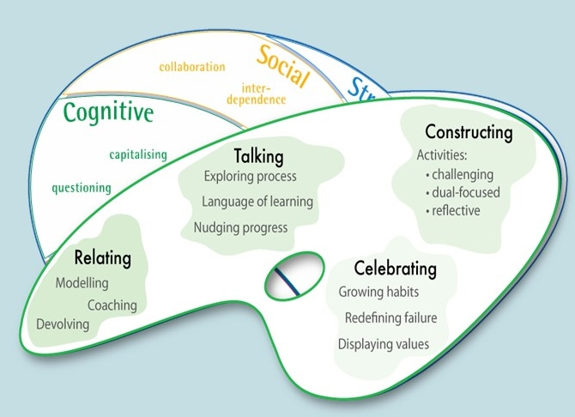
Notes:
The programme ‘Playing the Learning Power Game’ is based on the 3 key models of Learning Power:
The Supple Learning Mind that identifies important learning behaviours and the associated model of progression . . .
The Teachers’ Palette of that describes the aspects of a learning-friendly classroom culture.
Let’s explore each of these models in turn . . .

Slide 4
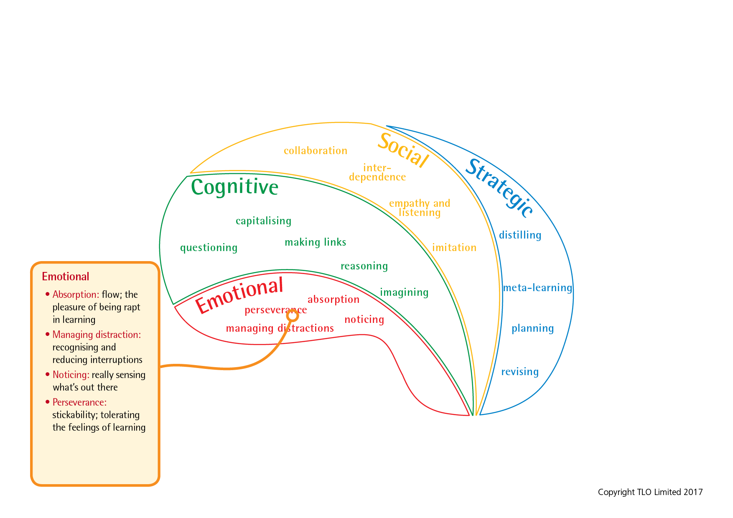
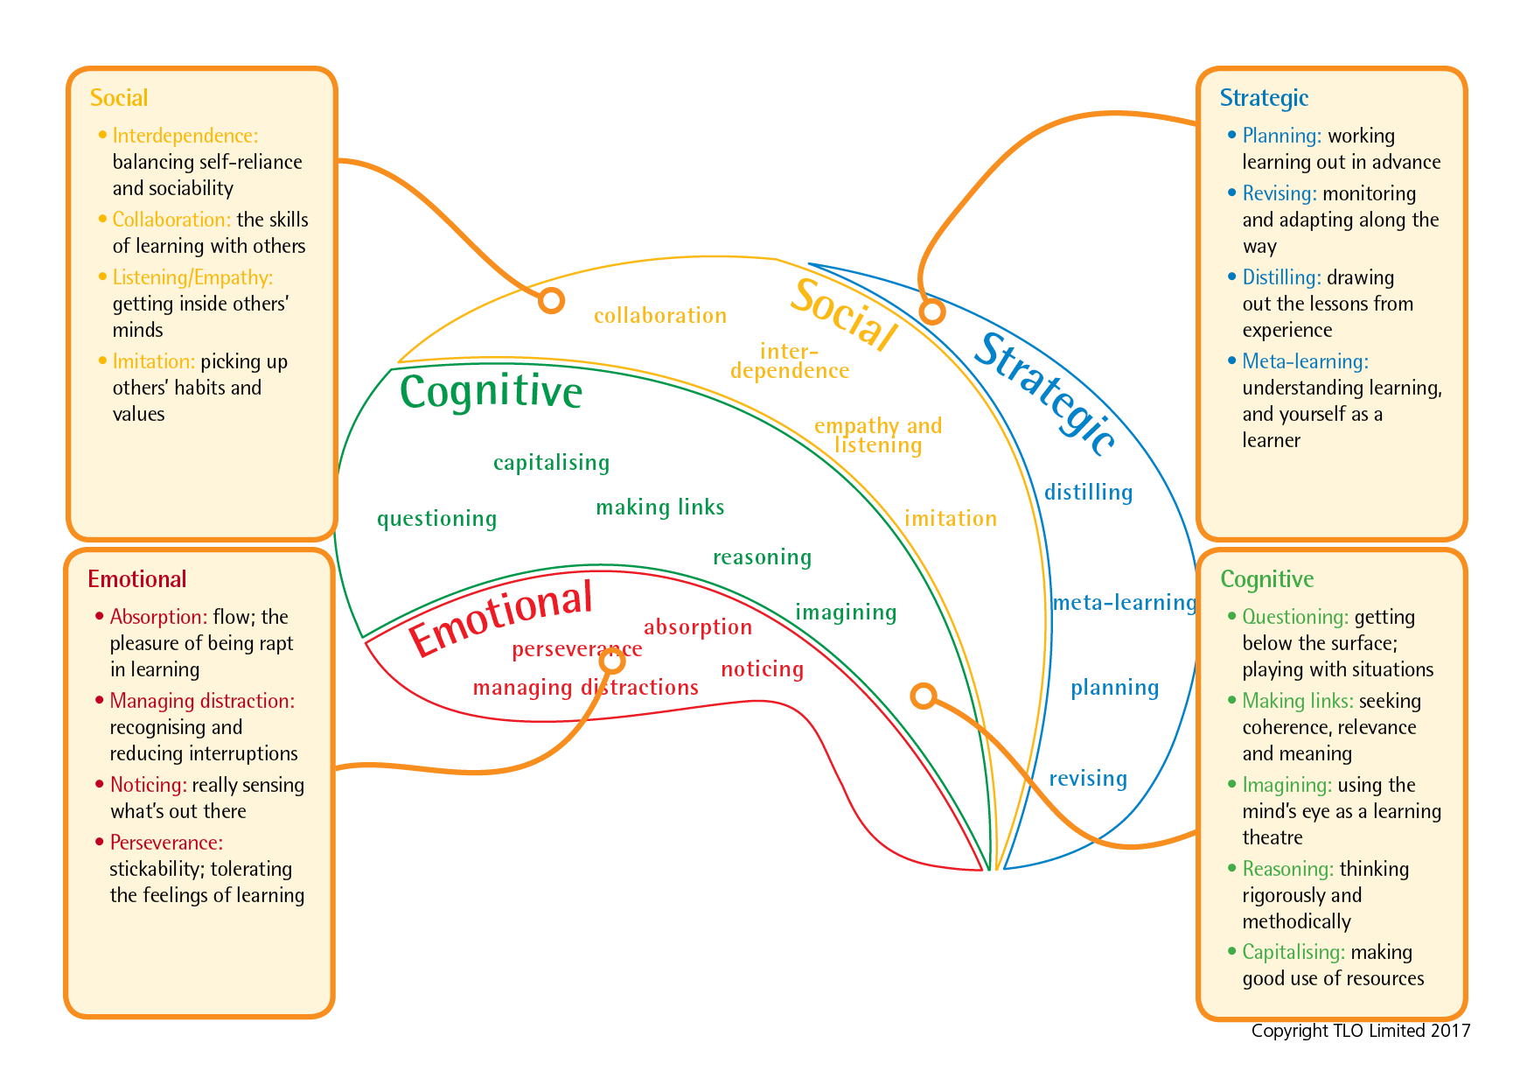
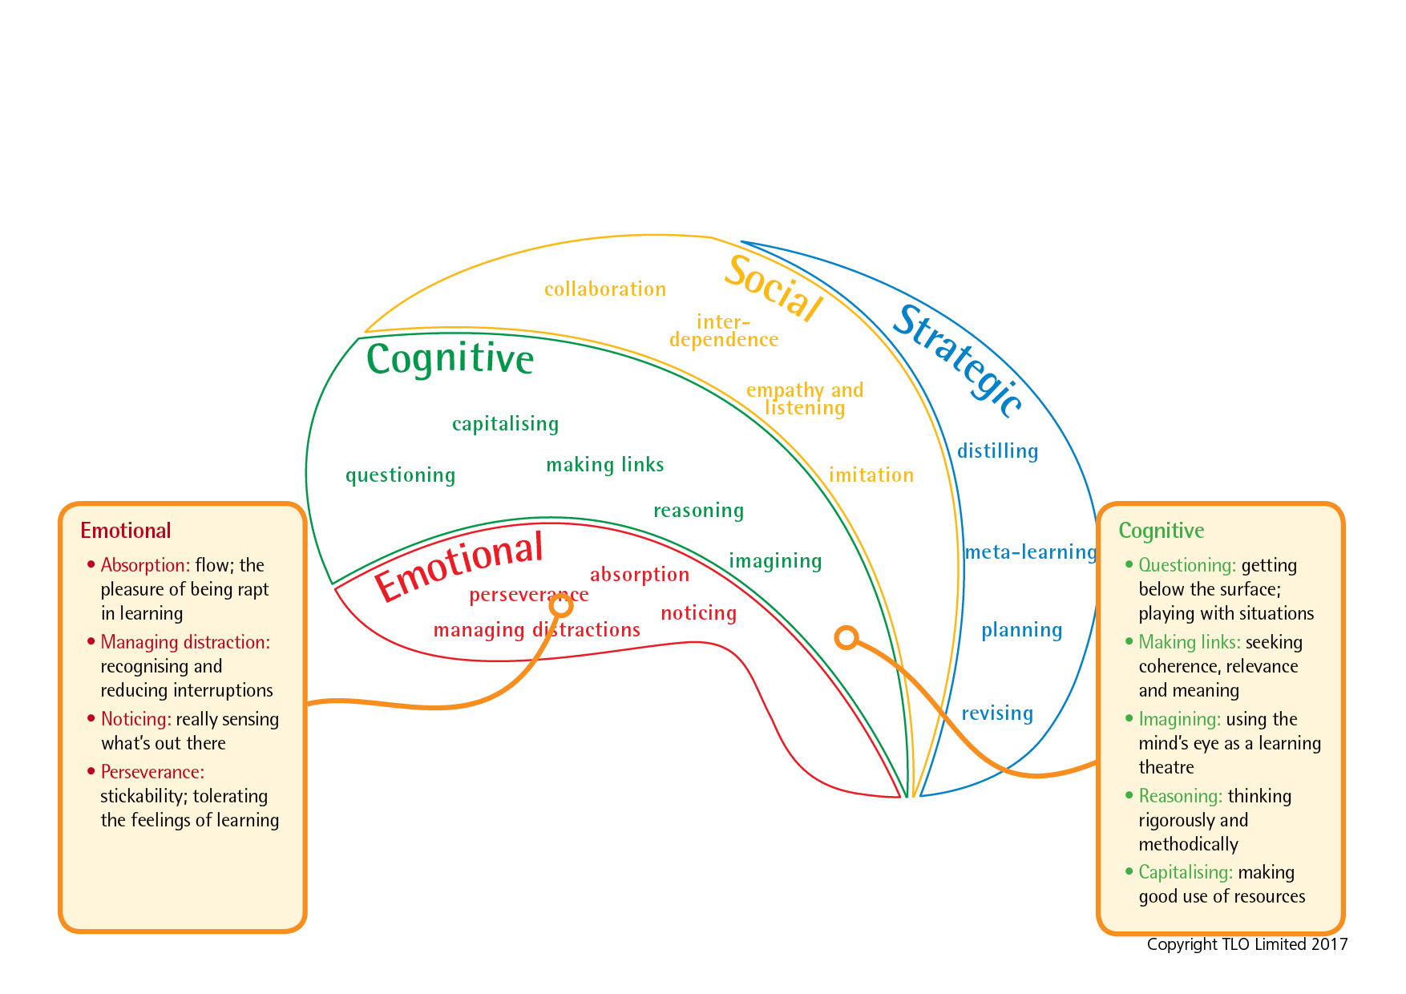
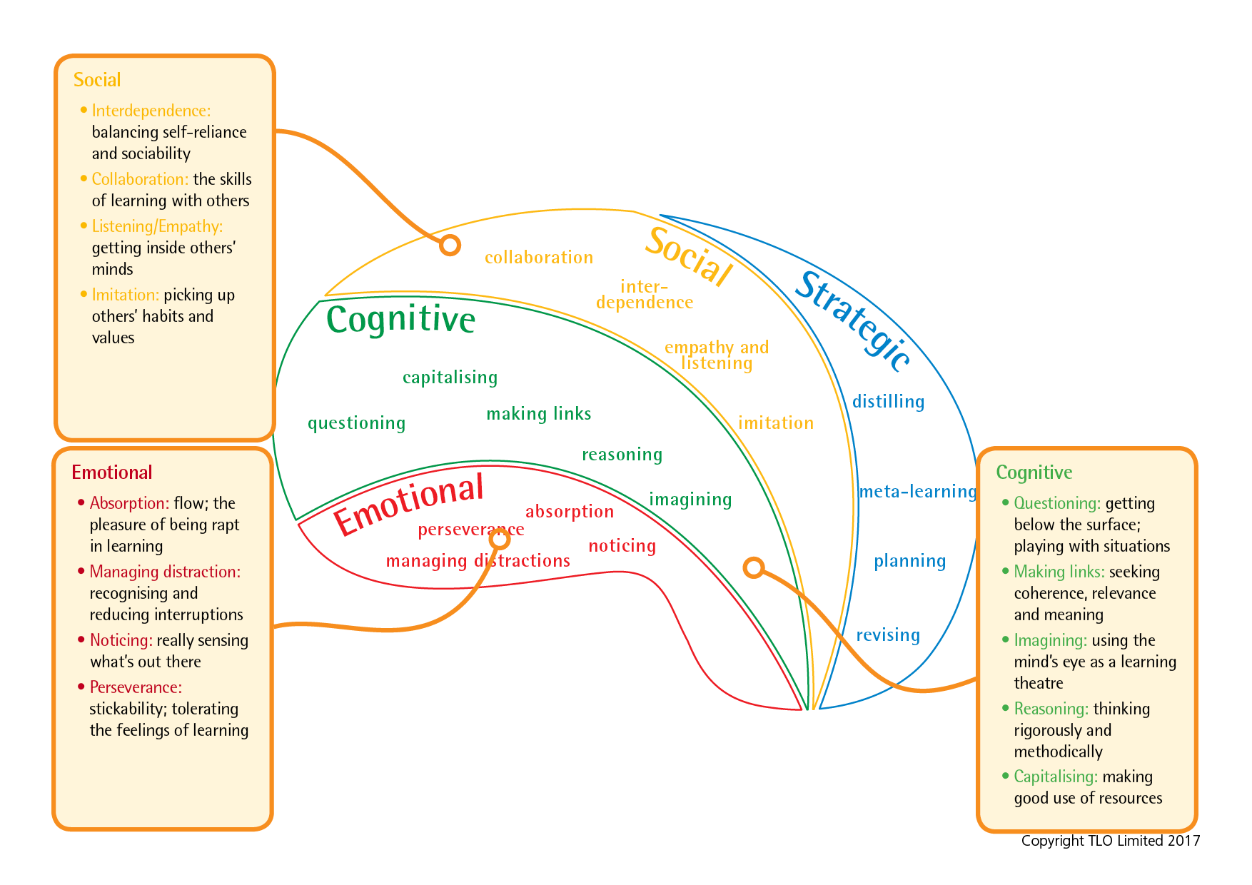
The Supple Learning Mind framework
Notes:
How the supple learning mind is made up.It came from research into learning undertaken at Bristol University about 20 years ago.
Brief overview
The supple learning mind framework captures the key psychological characteristics that are judged to be of the highest value in helping students to learn...how to be tenacious and resourceful, imaginative and logical, self disciplined and self aware, collaborative and inquisitive as learners. They shape how we learn

Slide 5
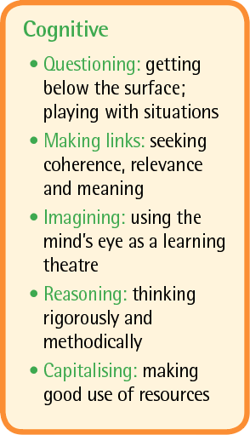
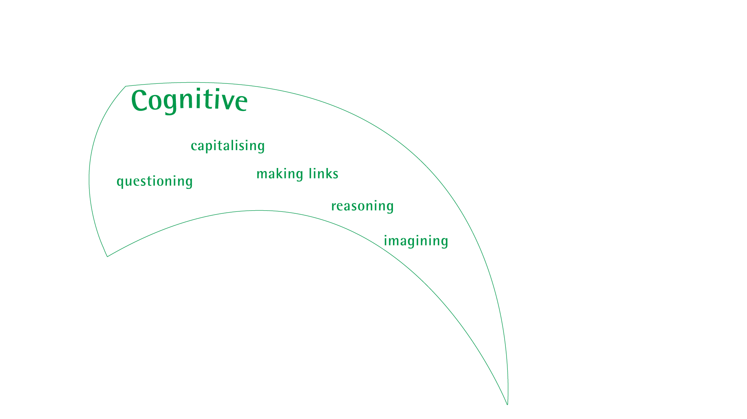
Cognitive processes: the workhorse of learning
Notes:
We’ll build up the supple learning mind that we want to help students to develop, starting with
the cognitive group; the workhorse of learning, the behaviours we tend to think of first.
While these behaviours are all crucial in making learning stick they are not the be all and end all of learning. There’s far more to learning than cognition.

Slide 6
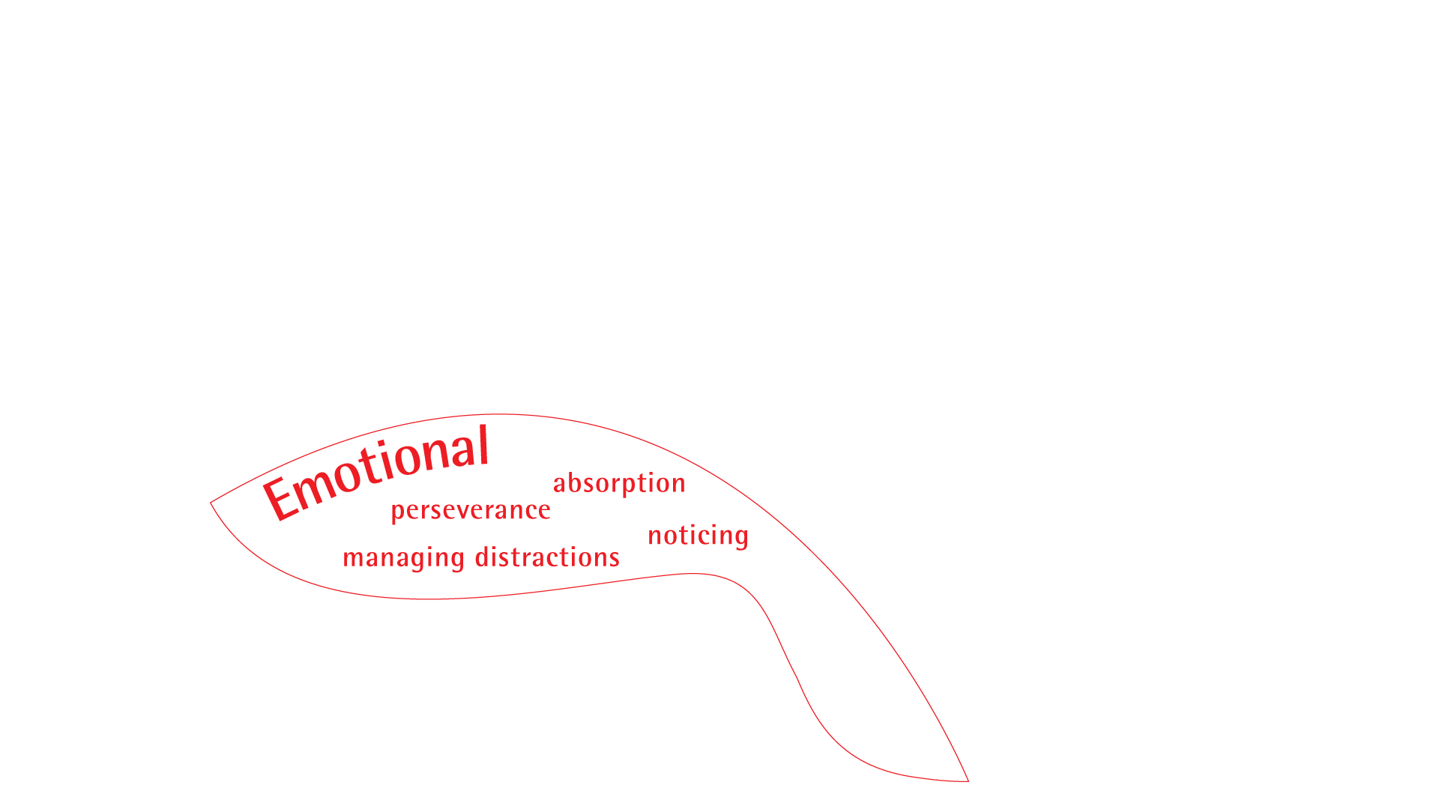
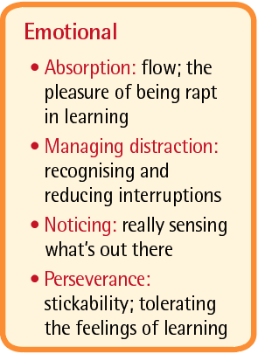
Emotional processes: the bedrock of learning.
Notes:
The bedrock of our learning habits are our feelings.
Without perseverance little learning will take place.
Without knowing how to manage distractions little learning will stick.
Without determination in noticing much will be missed
How we feel Impacts on how we attend

Slide 7
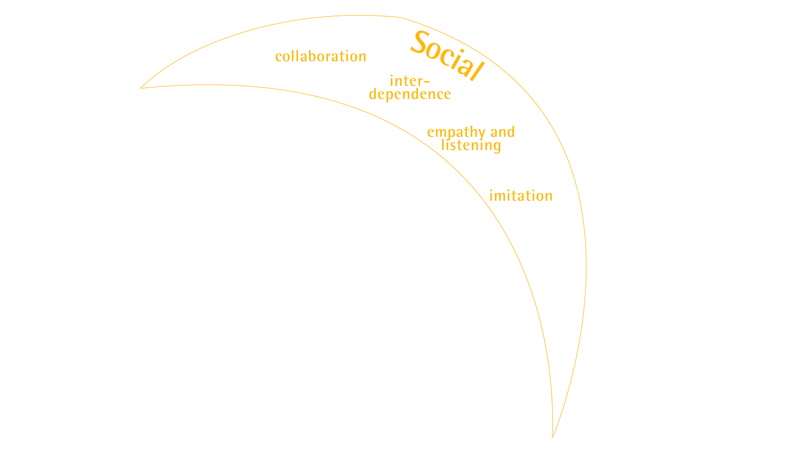
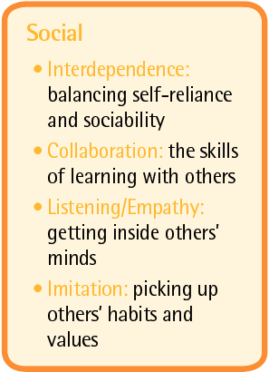
Social processes: the relationships of learning
Notes:
With the ever increasing connectivity in our world our ability to interact, learn and build knowledge with others becomes ever more essential.

Slide 8
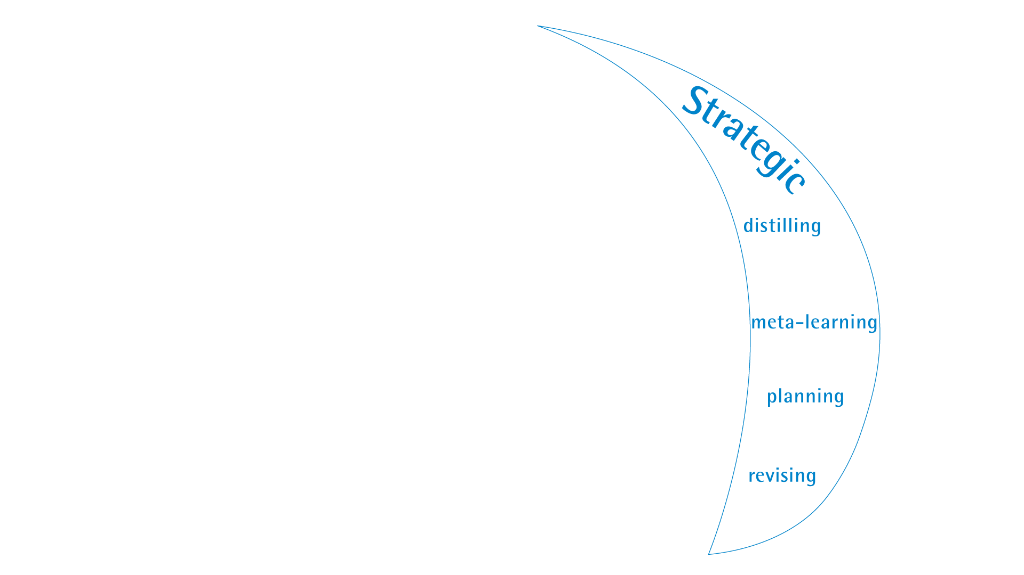
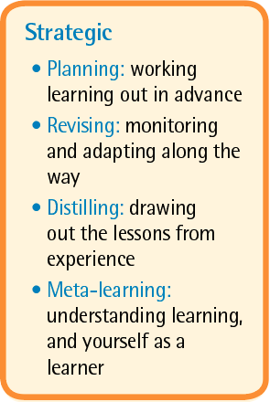
Strategic processes: the management of learning
Notes:
And last but not least... the strategic aspects of learning... which have been shown, relatively recently in the world of education, to be so essential in making any learning stick. (i.e. metacognition and self regulation)

Slide 9
The Supple Learning Mind framework
Notes:
Underlying this approach is a recognition that learning how to learn involves more than skills, it involves students’ attitudes, values, interests and beliefs as well. It’s about helping students to help themselves to be disposed to persist, to question and be curious, to collaborate harmoniously and to be open to new ideas.

Slide 10
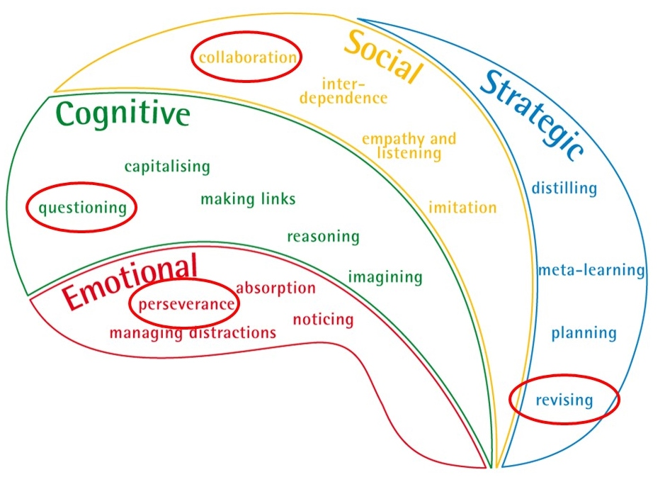
Notes:
It is impossible to tackle all 17 behaviours at the outset – to try would exhaust teachers and confuse learners.
Hence the programme identifies 4 key learning behaviours to make a start on, and feeds a further 8 in towards the end of the programme
The foundational 4 are Perseverance, Questioning, Collaboration and Revising.
[Why these 4 ?
Perseverance - because it is the main thing that teachers tell us would most help their students to become less dependent and needy
Questioning - because motivation and engagement are rooted in curiosity
Collaboration - because learning with and from others lies at the heart of the learning-friendly classroom
Revising - because without a willingness to do / see things differently, students repeat their existing patterns of behaviour ]

Slide 11


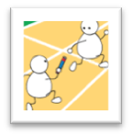
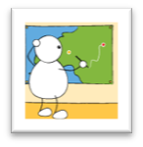
Learning: poles apart
Fragile, dependent, risk averse, weak perseverance |  |  | Absorbed, attentive, hang in there despite toughness, give it a go
|_____________|_____________|_____________|_____________| Emotional engagement
Rule bound, like only tried and tested, fragmented info, passive, uncritical |  |  | Curious, rich understandings, imaginative, logical
|_____________|_____________|_____________|_____________| Cognitive range
Isolated and dependent, lack of engagement with others. |  |  | Collaborative, listen empathise, Learn with and from others
|_____________|_____________|_____________|_____________| Social interaction
Little self awareness, robotic, can’t explain reasons for what/why they do things |  |  | Plan, revise, know themselves as learners. Like to take responsibility for own learning
|_____________|_____________|_____________|_____________| Strategic responsibility
Notes:
But the point of Learning Power is not to know about it, but to get better at it – it is the Building bit of Building Learning Power.
It is (relatively) easy to describe learners lacking effective learning behaviours [on the LHS of the image] and equally to describe accomplished learners with a full range of effective learning behaviours [on the RHS].
But the problem is that few learners lie at these extremes in all circumstances. Most are somewhere in between, neither completely lacking or completely accomplished.
In ‘Playing the Learning Power Game’ we explore what lies inbetween these 2 extremes, the skills and dispositions that can be progressively cultivated to help learners become increasingly accomplished.
And of course the point of Learning Power is to help learners to grow themselves into fully rounded learners. To move them from being fragile, risk averse, dependent and with little self awareness to being a fully fledged learner over their life at school.
Detail:​
​
What might happen if pupils are not supported in their learning behaviours? ​
What might happen if we spoon-feed learners ?​
​
Here are the alternatives - we want learners to be at or near the right hand side​
tough, alternative, curious, imaginative, rational, collaborative, empathetic, revisionist, and meta-cognitive​
Rather than​ fragile, risk averse, rule-bound, fragmented understanding, passive, dependent, robotic.​
If we left learners to it they would probably be like the right hand side – they certainly appear to be before they go to school !​
But schooling, too often works, against these natural, innate learning behaviours. ​
It hot houses learners through, and in so doing moves them towards the left.​
​
Important​
Left side does NOT mean low achievers. Many high achieving girls are fragile learners who ‘fall apart’ when they come up against something they cannot do. They are not used to having to struggle. They have not learned how to make mistakes profitably​
​
NB Definition - Robotic learners. - unwilling to try other ways of doing things. Keep to the teachers instructions in order to pass the exam. ​

Slide 12
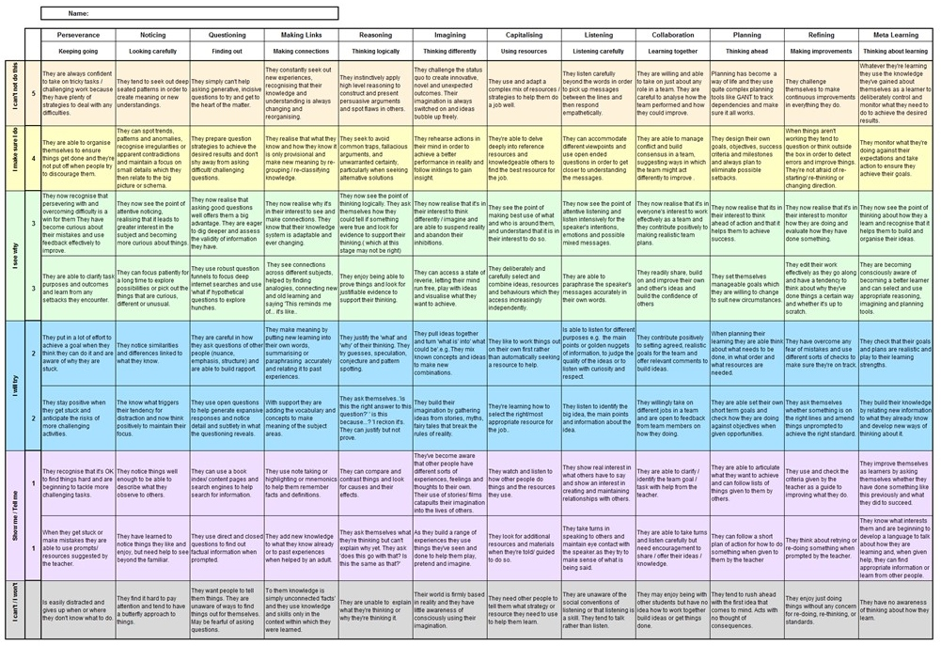
Section 1d – Up close and personal with learning
begins your voyage of discovery. It’s about taking what you have learned about the learning habits and thinking about how these ideas apply to yourself and then a couple of your students.
Notes:
In Playing the Learning Power Game we introduce the growth trajectories for the 12 key learning behaviours
And invite teachers to use these trajectories to:
Understand their students as learners (rather than performers);
And to create learning profiles for individual students.
It is these learning profiles that help teachers to target the interventions they make.

Slide 13
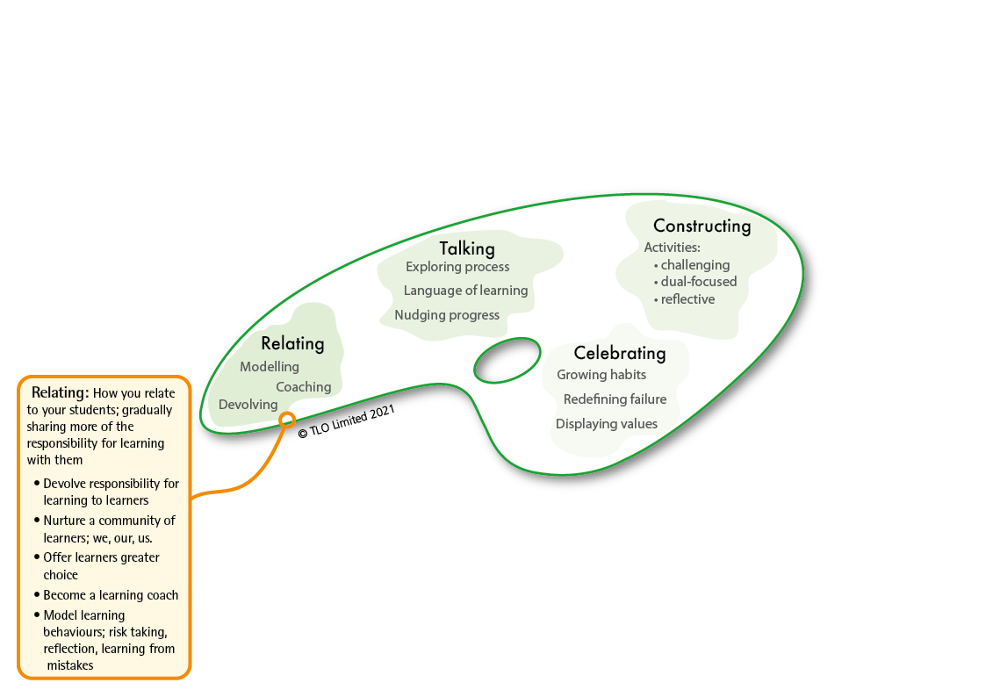
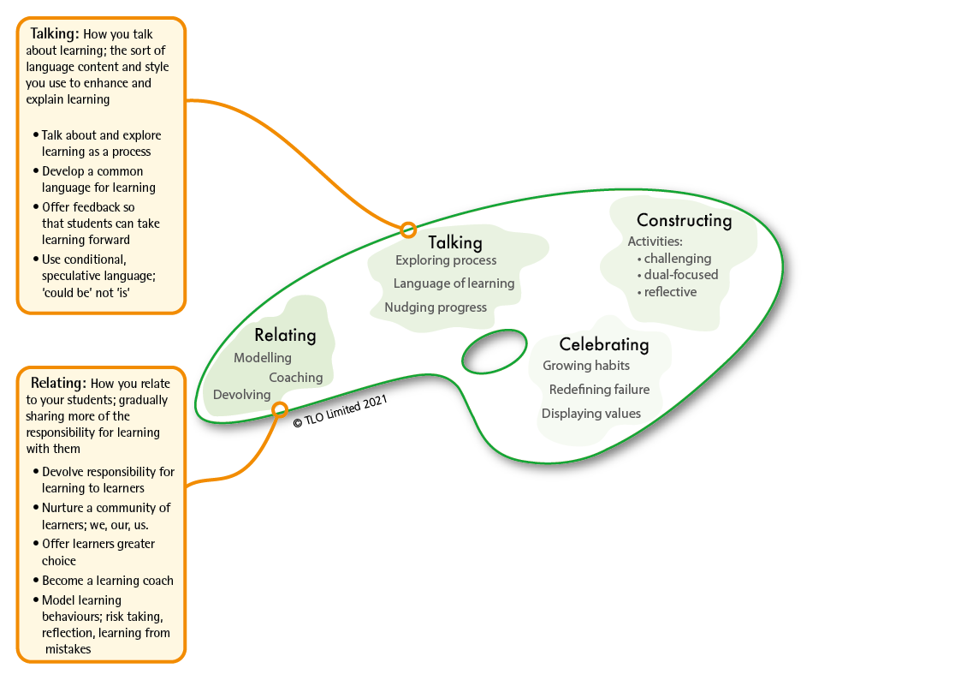
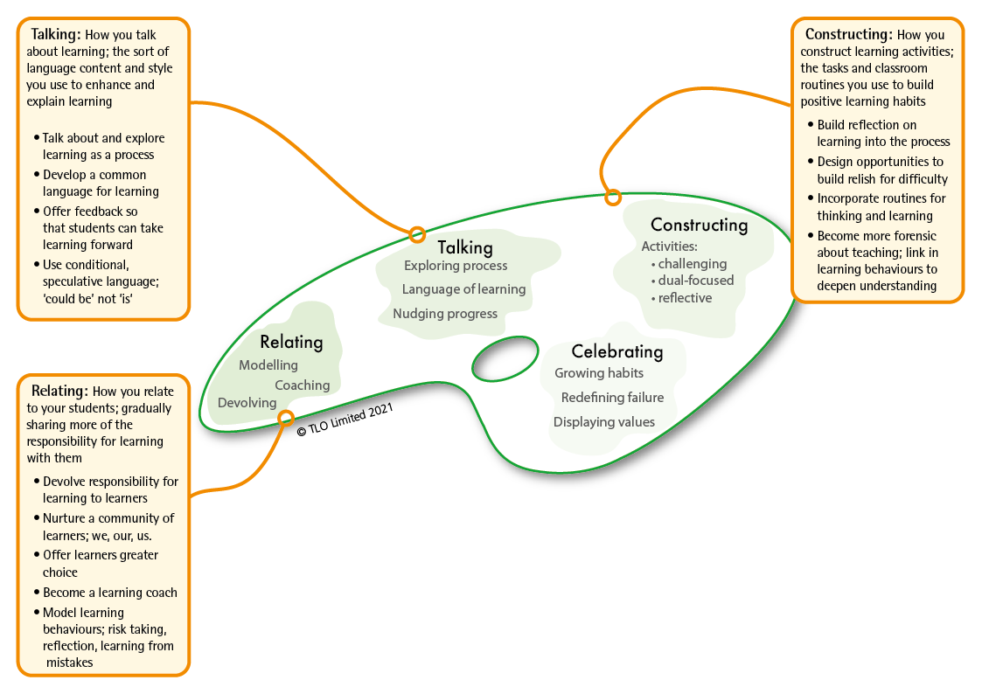
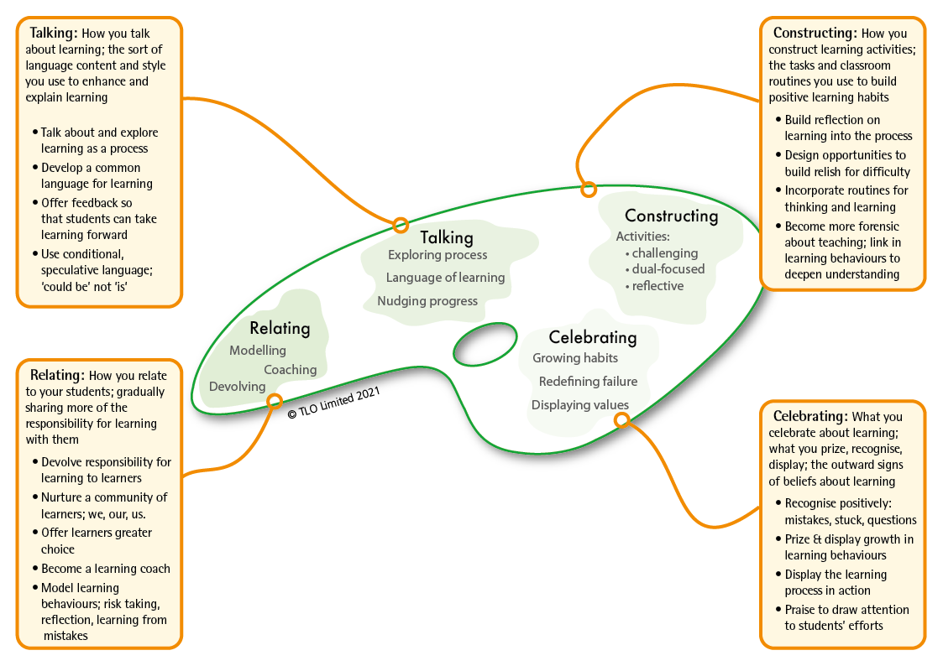
The teaching framework that makes it all work
BLP’s second model: the teachers’ palette.
Based on research by Chris Watkins
Notes:
The 2nd model of Building Learning Power...The Teachers’ Palette
This framework gives a systematic introduction to the principles behind the teaching for building powerful learners: the framework teachers need to have at the back of their minds, as they;
explain the approach to pupils,
plan their activities,
comment on pupils performance and
demonstrate learning power in their own lives.
Putting LP into action is not a seven day wonder, a quick fix, or a miracle cure for all the ills and difficulties in education. It is potentially a long journey that starts with small steps and is capable of fundamentally shifting the way teachers think, the way they teach and the whole ethos of the school.

Slide 14
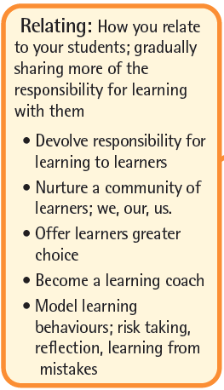
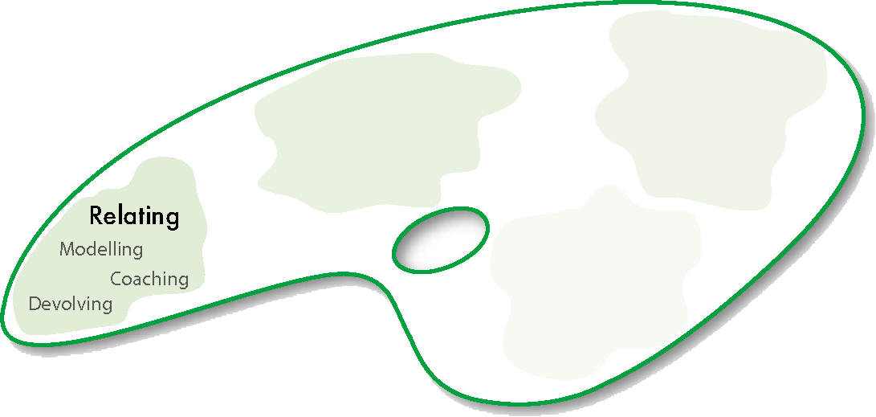
About relating for learning: what you can give away
Notes:
RELATING​ for learning involves;
devolving responsibility – shifting the emphasis towards learners taking increasing responsibility for their own development​
coaching approaches – moving away from ‘teacher telling’ mode whenever possible​
modelling learning – walking the talk, being a learner yourself.

Slide 15
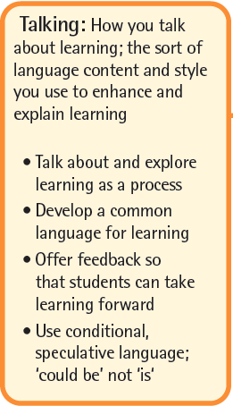

About talking for learning: what you can say
Notes:
TALKING​ about learning
Exploring learning as a process – finding time to talk about learning and how it works​
Developing a language for learning – teacher talk uses the school’s learning language.
Nudging learning forward – catching students employing positive learning behaviours and commenting on them, orally and in writing​
[DEVELOPING A LANGUAGE FOR LEARNING IS KEY TO UNDERSTANDING LEARNING AS A PROCESS. IT UNDERPINS METACOGNITIVE ACTIVITY]

Slide 16
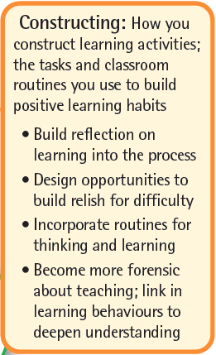

About constructing learning: what you can do every day
Notes:
CONSTRUCTING​ learning
Using a reflective model for learning – reflection on content and reflection on learning behaviours is routinely built into lessons​
Linking content with learning behaviours – lessons are designed intentionally to deliver content and to exercise learning behaviours. Students are made aware of both​
Rich, challenging activities – increasingly open-ended activities are designed to engage, to stretch and to challenge
NOTE THAT CONSTRUCTING LEARNING WILL BE THE FOCUS OF UNIT 3 AND IS NOT DEVELOPED IN UNIT 2 ​

Slide 17
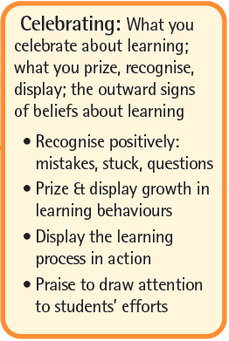
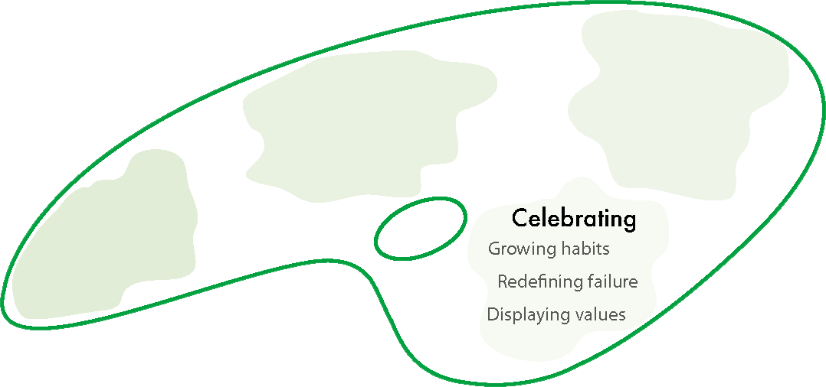
About celebrating learning: what you display
Notes:
CELEBRATING​ learning and its growth
Growing learning habits – finding ways to track, record and celebrate learning behaviour growth,​
Redefining failure – turning the lens around: mistakes become learning opportunities; difficulty is when learning happens; asking questions shows curiosity, not a lack of intelligence. ​
Putting learning on display – the process of learning (as opposed to the finished outcomes of learning) are on display. Annotated work in progress, first attempts, revisions, failed lines of enquiry, leading, of course, to the finished article.​

Slide 18
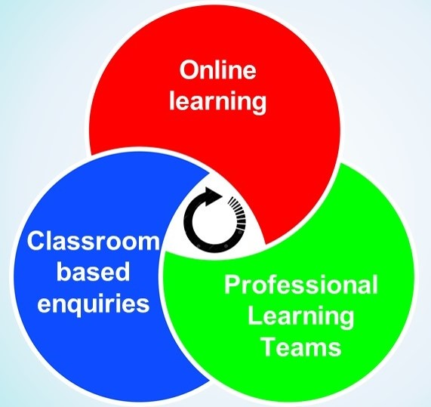
A blended learning programme with . . . 3 components: Online learning; Learning team meetings; Classroom enquiries . . . In a regular cycle of activity.
Notes:
1. The first aspect of the blended programme is the online course Playing the Learning Power game. This provides the content for introducing the Learning Power approach into classrooms. The online course is grouped into digestible pieces (sections) to help teachers take them on board.
2. The second aspect of the blended programme couples the online content with the PD approach of Professional Learning Team sessions. These offer the best way of supporting and delivering changes in teachers' classroom practice.
3. The third aspect of the blended programme incorporates a learning enquiry element into discovering how teachers, by changing their practice, are beginning to impact on the development of their students as learners.
All three components of the blended learning programme are infused with a coaching approach to learning.
There are 7 Professional Learning Team meetings built into the programme to ensure a regular cycle of activity

Slide 19
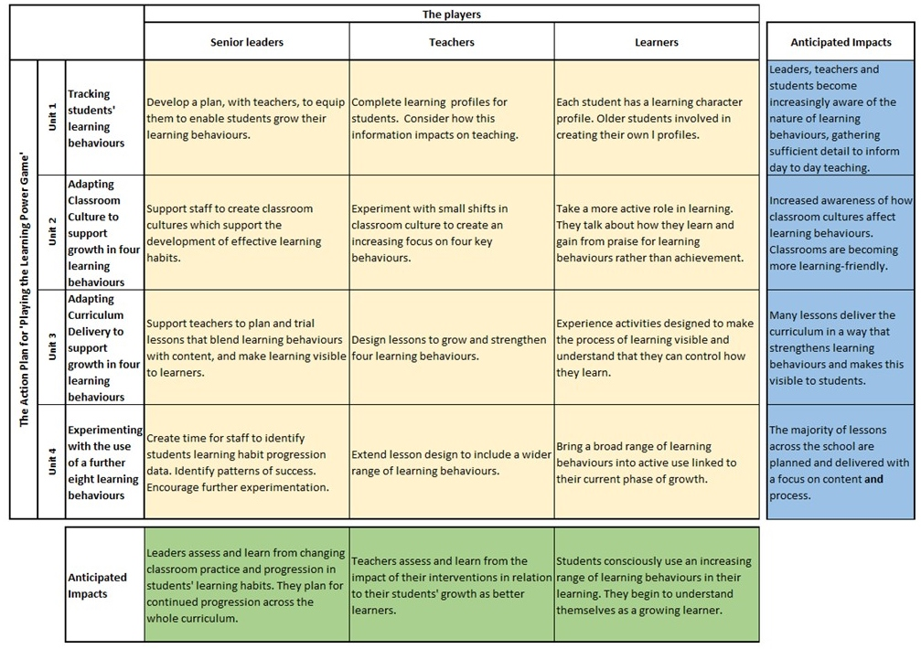
A blended learning programme with a big ambition.
Notes:
The players…leaders, staff, students
The game – 4 units (from top to bottom)…
Collecting students’ learning behaviours. Unit 1
Adapting classroom cultures using 4 key learning behaviours. Unit2
Adapting curriculum delivery using 4 key learning behaviours. Unit 3
Expanding the use of learning behaviours. Unit 4

Slide 20
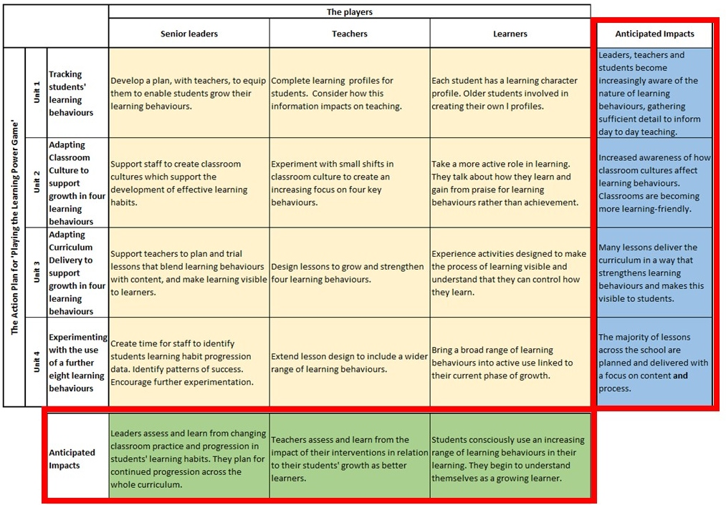
Notes:
Green…the outcomes for each group of players....what to look for by the end of this phase 1 of the whole programme
Blue….the outcomes of the combined activities for each of the 4 units. The accumulated outcomes of each unit of the programme

